Slide 1
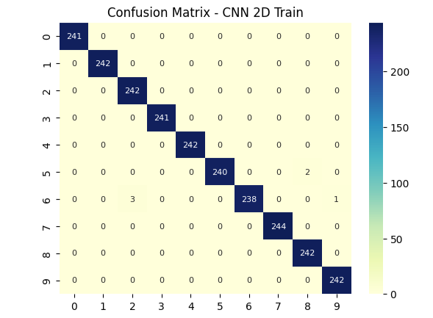
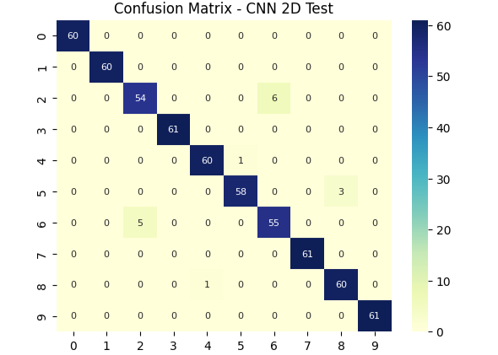
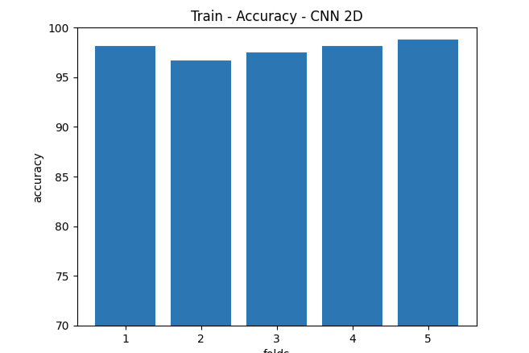
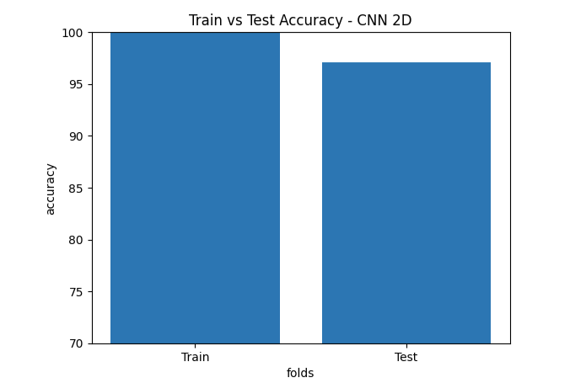
Experiment 1: No Overlap
interval_length = 1600(no overlap)
Shape of Input Data = (3026, 1600)
Shape of Label Y_CNN = (3026, 10)
Shape of Label Y = (3026, 1)
CNN model - (3026, 40, 40, 1)
CNN 2D train accuracy = 100.0
CNN 2D validation accuracy = 97.85123944282532
CNN 2D test accuracy = 97.0957100391388

Slide 2
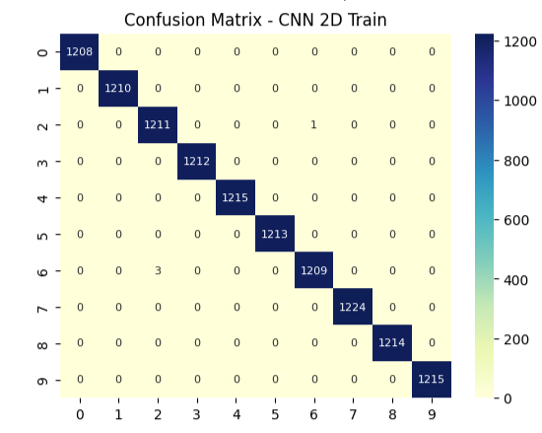
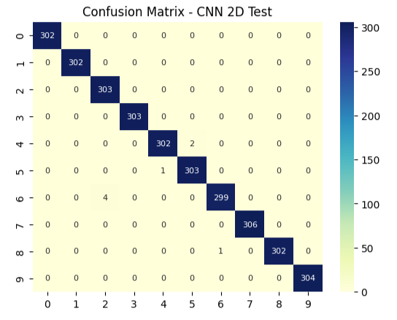
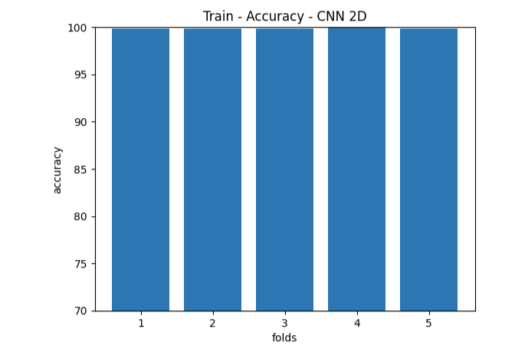
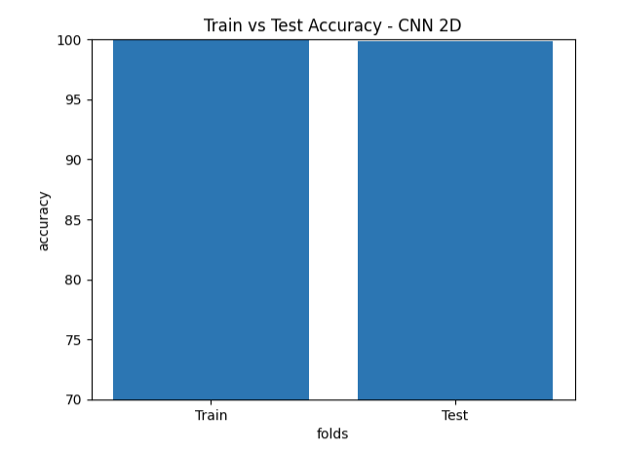
Experiment 2: Overlap
interval_length = 320
Shape of Input Data = (15169, 1600)
Shape of Label Y_CNN = (15169, 10)
Shape of Label Y = (15169, 1)
CNN model -(15169, 40, 40, 1)
CNN 2D train accuracy = 100.0
CNN 2D validation accuracy = 99.85990881919861
CNN 2D test accuracy = 99.81542587280273

Slide 3
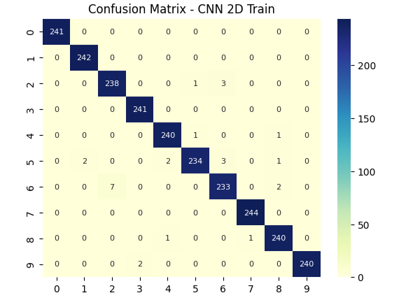
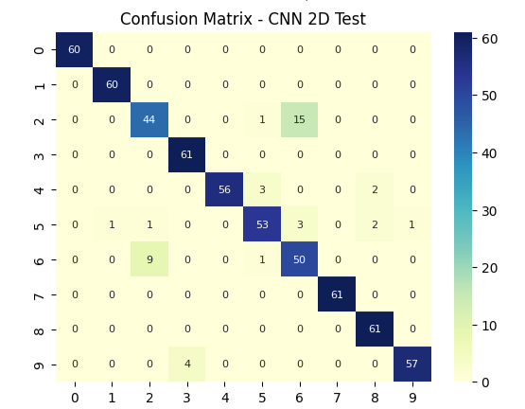
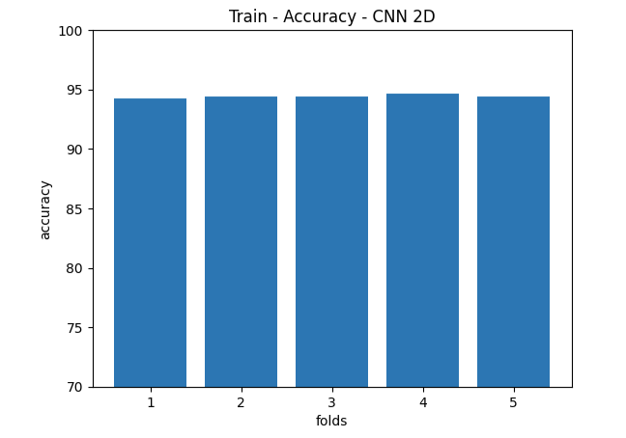
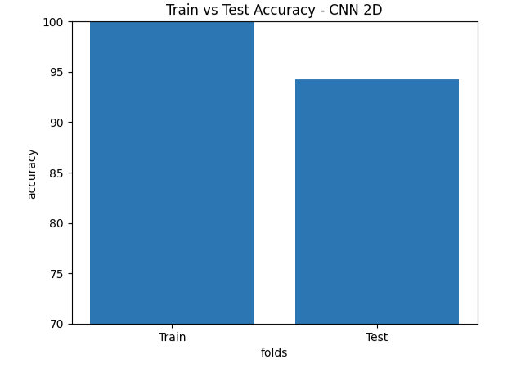
Experiment 3: Change in window size 36x36 for interval_len=1600
(no overlap)
(3026, 36, 36, 1)
Shape of Input Data = (3026, 1296)
Shape of Label Y_CNN = (3026, 10)
Shape of Label Y = (3026, 1)
CNN 2D train accuracy = 99.96900796890259
CNN 2D validation accuracy = 94.42148804664612
CNN 2D test accuracy = 94.25742626190186

Slide 4
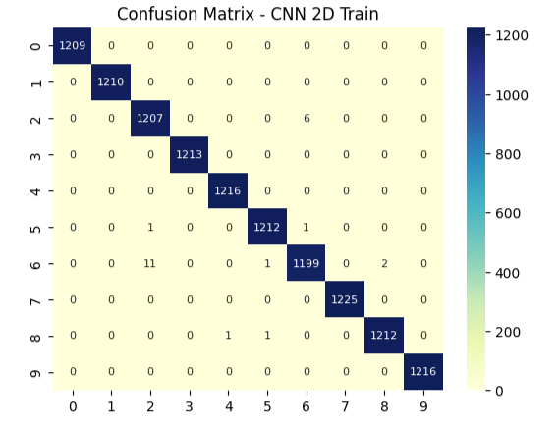
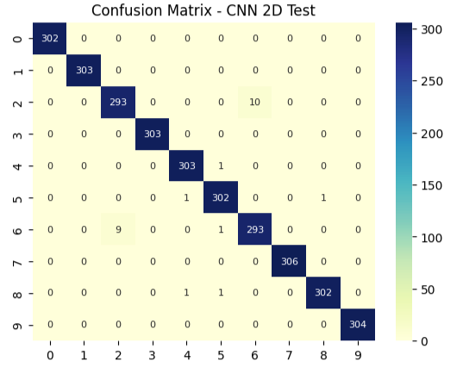
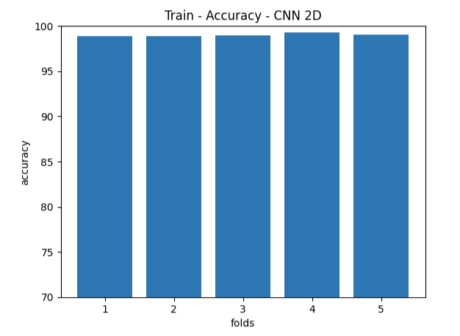
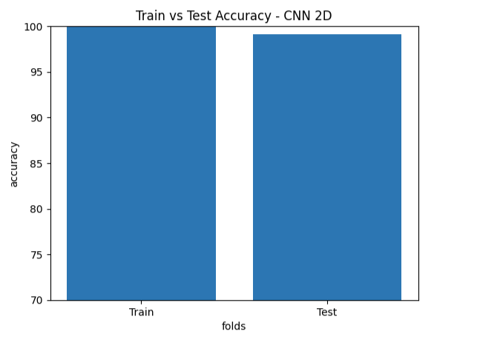
Experiment 4: Change in window size 36x36 for interval_len=320
(overlap)
(15179, 36, 36, 1)
Shape of Input Data = (15179, 1296)
Shape of Label Y_CNN = (15179, 10)
Shape of Label Y = (15179, 1)
CNN 2D train accuracy = 100.0
CNN 2D validation accuracy = 98.98709654808044
CNN 2D test accuracy = 99.07773494720459

Slide 5
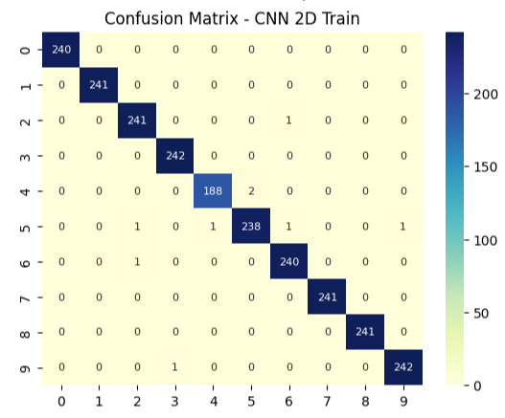
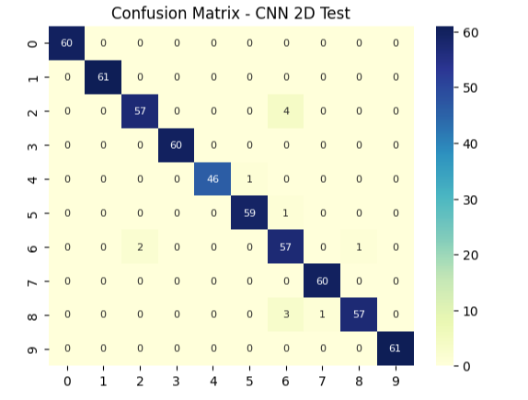
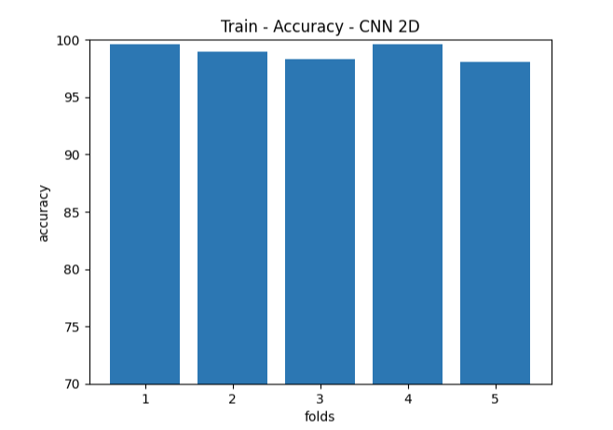
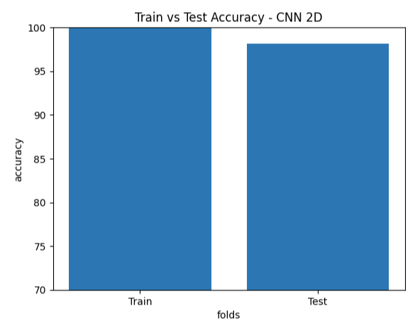
Experiment 5: Dataset with 1hp load
(window size 40x40)
Interval_len= 1600(no-overlap)
(2954, 40, 40, 1)
Shape of Input Data = (2954, 1600)
Shape of Label Y_CNN = (2954, 10)
Shape of Label Y = (2954, 1)
CNN 2D train accuracy = 99.98942375183105
CNN 2D validation accuracy = 98.89964818954468
CNN 2D test accuracy = 98.10490727424622

Slide 6
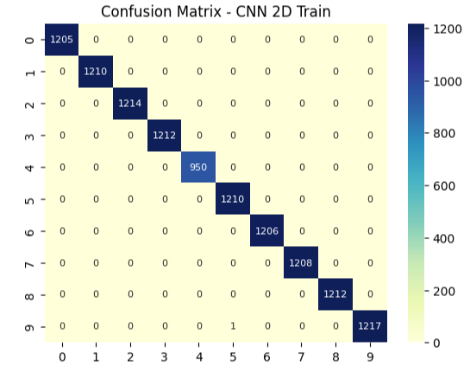
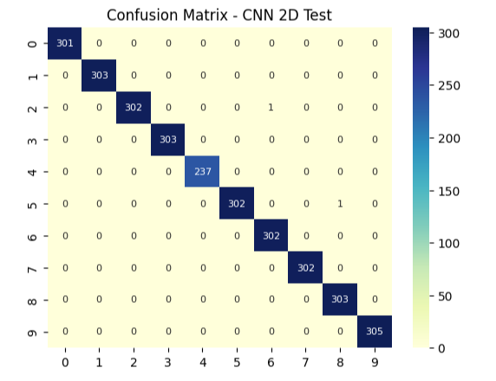
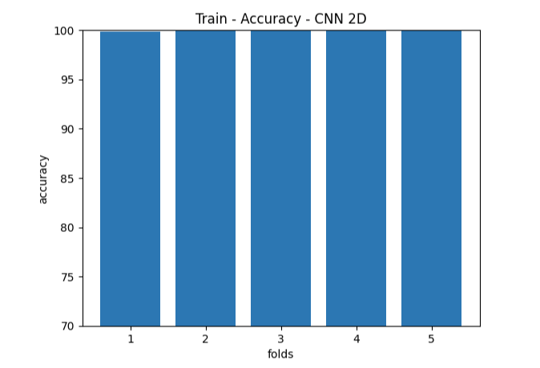
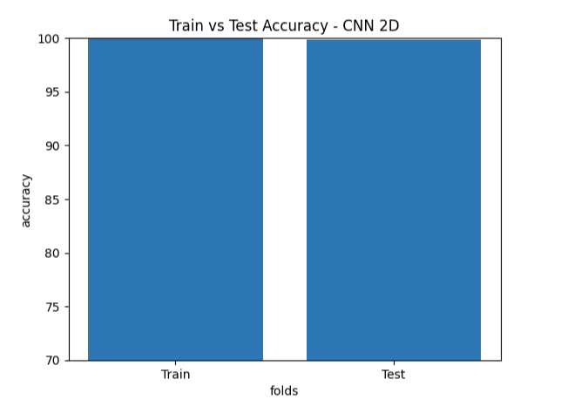
Experiment 5: Dataset with 1hp load
(window size 40x40)
interval_len=320(overlap)
2D-image-shape- (14807, 40, 40, 1)
Shape of Input Data = (14807, 1600)
Shape of Label Y_CNN = (14807, 10)
Shape of Label Y = (14807, 1)
CNN 2D train accuracy = 99.9957799911499
CNN 2D validation accuracy = 99.93246078491211
CNN 2D test accuracy = 99.88521337509155

Slide 7

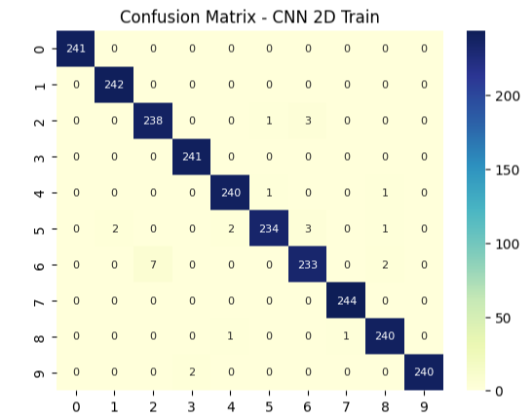
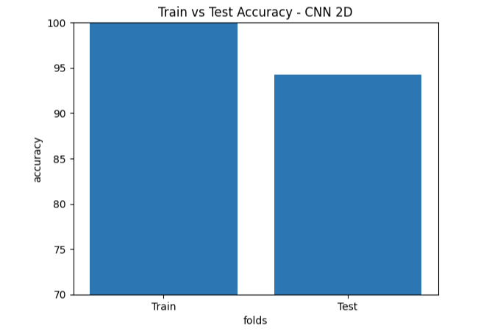
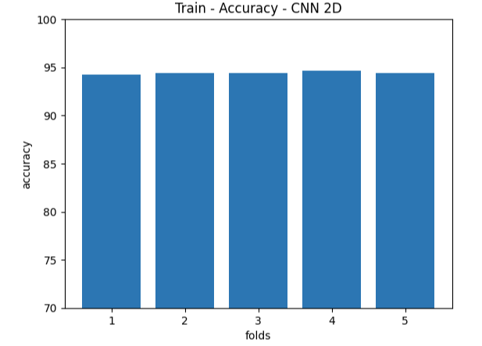
Experiment 6: Dataset with 1hp load
(window size – 36x36)
Interval_len= 1600(no overlap)
Shape of Input Data = (2954, 1296)
Shape of Label Y_CNN = (2954, 10)
Shape of Label Y = (2954, 1)
2D-image-shape-(2954, 36, 36, 1)
CNN 2D train accuracy = 99.97883558273315
CNN 2D validation accuracy = 96.99528813362122
CNN 2D test accuracy = 95.43147206306458

Slide 8
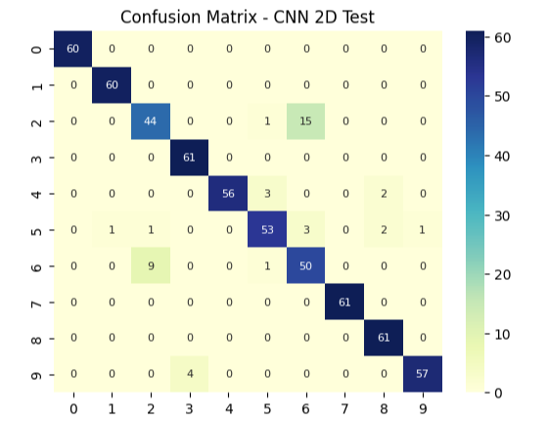
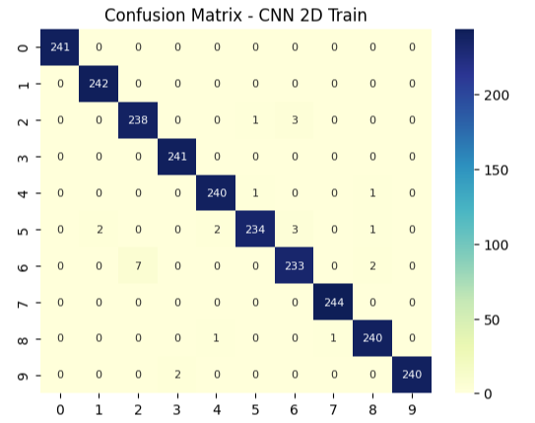
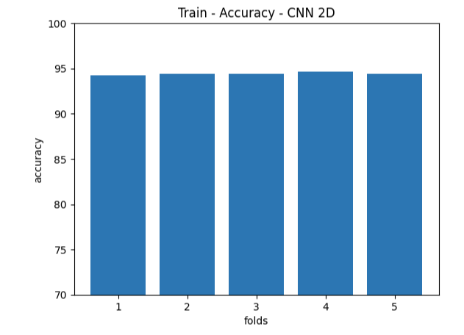
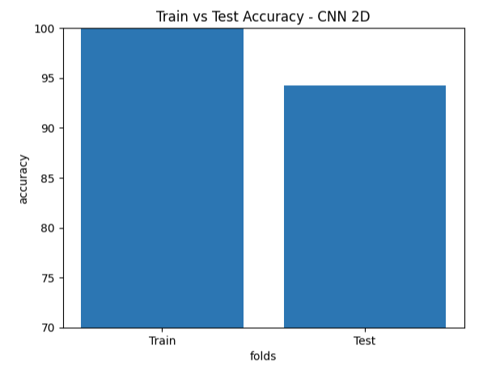
Experiment 6: Dataset with 1hp load
(window size – 36x36)
interval_len=320(overlap)
Shape of Input Data = (14817, 1296)
Shape of Label Y_CNN = (14817, 10)
Shape of Label Y = (14817, 1)
2D-image-shape- (14817, 36, 36, 1)
CNN 2D train accuracy = 99.96900796890259
CNN 2D validation accuracy = 94.42148804664612
CNN 2D test accuracy = 94.25742626190186

Slide 9
SUMMARY
Overlap: Increases dataset size and generally improves validation/test accuracy. (at the cost of test leakage)
Window Size: 40x40 consistently outperforms 36x36.
1hp Load: Slightly lower performance in no-overlap cases but excels with overlap and 40x40 window size (99.89% test accuracy).

Slide 10
Experiment 6: hp=1 load case, CNN model change for better performance - no overlap

