Slide 1
Employee Data Analysis using Excel
STUDENT NAME: GAYATHRI. V
REGISTER NO: 312209558
DEPARTMENT: B.COM GENERAL
COLLEGE: ANNA ADARSH COLLEGE FOR WOMEN

Slide 2

PROJECT TITLE
Employee Performance Analysis using Excel

Slide 3


AGENDA
Problem Statement
Project Overview
End Users
Our Solution and Proposition
Dataset Description
Modelling Approach
Results and Discussion
Conclusion
3/21/2024 Annual Review

Slide 4

PROBLEM STATEMENT
To write a problem statement on employee performance, you need to identify the specific area of performance that is problematic, such as low productivity, high absenteeism, or poor quality of work. Objective: Improve the effectiveness of the employee performance evaluation system within Company to enhance overall productivity, employee satisfaction, and alignment with organizational goals. Background: The current employee performance evaluation system is perceived as subjective and inconsistent. This has led to concerns about fairness, accuracy, and its impact on employee motivation and development. Identification and strengths and weekness: It helps in identifying which employees are performing well and which ones need improvements . Performance Metrics:It allows the organization to track key performance indicators (KPIS)such as task completion,sales treagets,and other measurable objectives. Informed Decision-making:Management can make informed decision about promotions,rewards,or additional training based on performance data Resource Allocation: It helps in optimizing the allocation of resources by identifying where more support or training may be needed. Employee Development : It assists in creating personalized development plans for employees, helping them grow in their roles.

Slide 5

PROJECT OVERVIEW
Analyzing the performance of the employee by considering the various factor like agenda,
performance, achievements, etc.The employee performance analysis project aims to assess and enhance productivity by evaluating key performance metrics and competencies. It will
involve collecting data through surveys, evaluations, and performance indicators over a
defined period. The analysis will identify strengths, areas for improvement, and alignment
with organizational goals. Key stakeholders include employees, managers, and HR
personnel. The project will culminate in actionable insights and recommendations to support professional development and performance improvements.this project overview helps to
identify the trends and pattends of different categories of employees like high,
medium,low,etc. The employee performance analysis using excel project aims to evaluvate
and improve employee productivity within an organization by leveraging excels data analysis and visualization capabilities.the project involves collecting relevant performance data such
as attendance,task completion rates, and sales figures,and organizing this information into a structured excel workbook.Using various excel functions and tools,the data will be analyzed
to identify trends,strengths,and areas needing an improvement

Slide 6
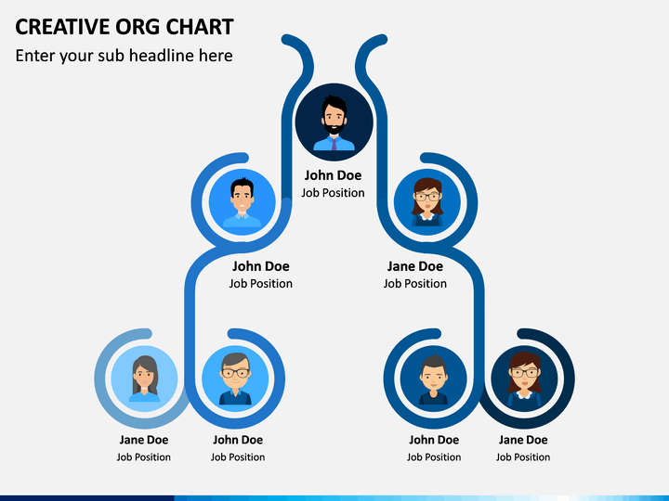

WHO ARE THE END USERS?
Management: They will gain insights into employee productivity and performance trends, helping them make informed decisions about promotions, rewards, and resource allocation.​​ • HR Department: HR professionals can use the analysis to identify training needs, develop personalized development plans, and ensure fair and data-driven performance evaluations.​​ • Employees: Employees will benefit from clear feedback on their performance, leading to opportunities for growth, recognition, and career advancement.​​ • Team Leaders: They can use the analysis to understand team dynamics, identify top performers, and address any performance issues within their teams.​​ • The Organization as a Whole: By optimizing employee performance and productivity, the organization can achieve better overall efficiency, reduce costs, and improve employee satisfaction and rete

Slide 7


OUR SOLUTION AND ITS VALUE PROPOSITION
Conditional formatting - missingFilter - remove Formula - performance Pivot - summary Graph- data visualization

Slide 8

Dataset Description
Employee=tony stark 26- features 9-features Emp ID number-3435 NAME-TEXT-Calibri Business Unit-STKI Job Function- Engineer Gender-Male Employee rating number-5 Performance Score-Fully Meets

Slide 9

THE "WOW" IN OUR SOLUTION
Performance level =IFS(Z11>=5,"very high",Z11>=4,"high",Z11>=3,"medium",TRUE,"low")
3/21/2024 Annual Review
9

Slide 10
MODELLING
Data Collection and Entry: •Sheet in: This sheet contains detailed employee information, including Employee ID, names, start dates, job titles, supervisors, email addresses, business units, and performance-related data. This is the primary data source for my analysis.​ 2. Data Preparation: •Sheet in: •I have gathered comprehensive employee data, possibly from various sources, and compiled it into this sheet.​ •The data includes demographic information, job details, and performance metrics like "Performance Score" and "Employee Rating."​ •This sheet also has a "Performance level" column, though some values appear to be missing.​ 3. Aggregation of Performance Data: •Sheet Sheet1: •This sheet appears to summarize performance data by Business Unit.​ •The table is organized to show the count of employees in each performance level (high, low, medium, very high) across different Business Units (e.g., BPC, CCDR).​ •I used Excel functions like COUNTIF or PivotTables to aggregate this data. •The sheet also includes a "Grand Total" column, which summarizes the total count of employees across performance levels for each Business Unit.​
10

Slide 11
MODELLING
4. Visualization: •Although not explicitly shown in the provided data, it’s common to create charts or graphs in Excel to visualize performance distributions. •I have used the data in Sheet1 to create bar charts or pie charts illustrating the distribution of performance levels across different Business Units. 5. Additional Data Analysis (Sheet2): •Sheet Sheet2: •Contains ID-marks pair, possibly related to some other aspect of performance or another dataset. •It might be used for supplementary analysis, though it’s unclear how it ties into the main performance analysis. 6. Final Analysis and Reporting: •I would likely compile these analyses into a coherent report, possibly adding explanations, visualizations, and insights directly into the Excel file or exporting the data into a presentation format. •Key insights could include identifying top-performing Business Units, areas

Slide 12
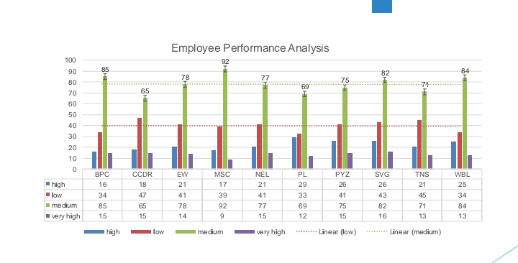
RESULTS
12

Slide 13
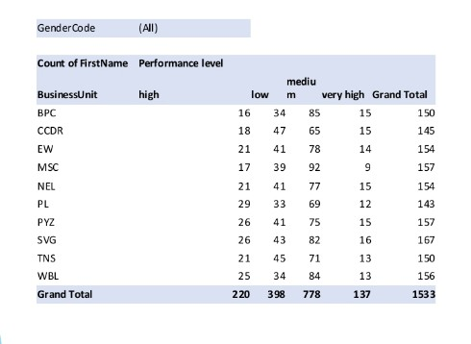
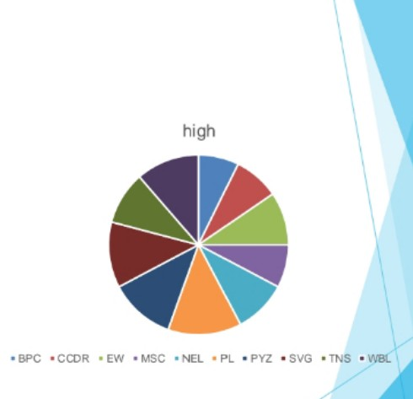
RESULTS

Slide 14
conclusion
The Employee Performance Analysis reveals varied performance levels across different Business Units, with a significant number of employees falling into the "medium" and "low" categories, particularly in units like BPC and CCDR. There are also strong performers in the "very high" category, suggesting potential for leadership development. However, some data gaps, such as missing "Performance level" entries, need addressing for more accurate insights. Overall, the analysis suggests a need for targeted training and development in lower-performing units, recognition programs for high performers, and improved data accuracy for future assessments.

