Slide 1
DIGITAL PORTFOLIO
STUDENT NAME : GAYATHRI .S
REGISTER NO AND NMID:E5EE7CB616B2B5EBAEE4C013B
DEPARTMENT : Bsc.(AI)
COLLEGE:OM SHANTI ARTS AND SCIENCE COLLEGE/MADRAS UNIVERSITY

Slide 2
PROJECT TITLE
This digital portfolio showcases my skills, experience, and accomplishments in Artificial intelligence. The portfolio highlights my expertise in python , java and demonstrates my ability to success.

Slide 3
AGENDA
Problem statement
Project overview
End users
Tools and Technologies
Portfolio design and layout
Features and functionality
Results and screenshots
Conclusion
Github link

Slide 4
PROBLEM STATEMENT
In today’s increasingly digital world, individuals and professionals across various fields face challenges in effectively showcasing their skills, experiences, and achievements to potential employers, clients, or collaborators. Traditional resumes and paper-based portfolios are often static, limited in content types (e.g., text only), and lack interactivity.

Slide 5
PROJECT OVERVIEW
In the modern digital era, maintaining a strong online presence is essential for students, professionals, and creatives alike. A digital portfolio serves as a personalized platform to showcase an individual’s skills, achievements, work samples, and professional background in a visually appealing and easily accessible format.

Slide 6
WHO ARE THE END USERS ?
The end users of a digital portfolio vary based on the purpose of the portfolio and the profession of its creator.

Slide 7
TOOLS AND TECHNIQUES
Creating a professional and functional digital portfolio involves the use of various development tools, design platforms, and techniques. These ensure the final product is visually appealing, responsive, and user-friendly.

Slide 8
PORTFOLIO DESIGN AND LAYOUT
A well-structured and visually appealing design and layout is essential for creating a professional digital portfolio. It helps deliver content in a clear, organized, and engaging manner, ensuring a great user experience and effective communication of the creator's skills and work.

Slide 9
FEATURES AND FUNCTIONALITY
A well-designed digital portfolio must be visually appealing, easy to navigate, and packed with features that effectively showcase the user's skills, work, and personality.

Slide 10
RESULTS AND SCREENSHOT
The digital portfolio project was successfully completed with the following outcomes:
1. Fully Responsive Website Works seamlessly on desktop, tablet, and mobile devices . Optimized for various screen sizes using media queries or frameworks like Bootstrap/Tailwind CSS.
2. Modern and Clean UI Design User-friendly navigation . Aesthetic color scheme and typography aligned with personal branding.
3. Functional Components Implemented Dynamic project gallery with filters or categories .Contact form with email functionality (using services like Formspree or EmailJS).Resume download button . Integrated external links to GitHub, LinkedIn, and other platforms.
4. Performance and Optimization Fast load times due to image compression and clean code . Basic SEO tags added for better discoverability.
5. Deployment Successfully deployed online using GitHub Pages / Netlify / Vercel.

Slide 11
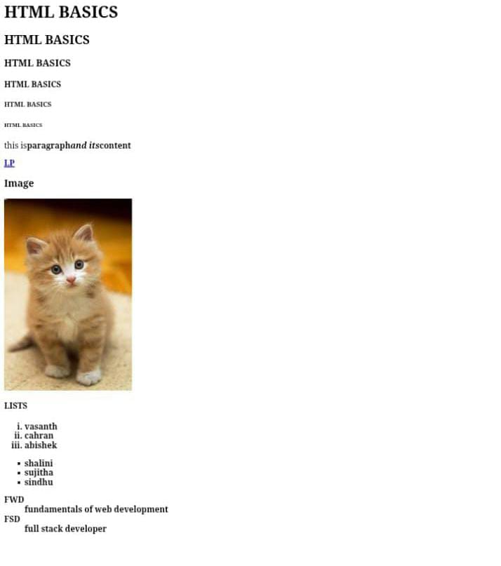
simple html page:

Slide 12
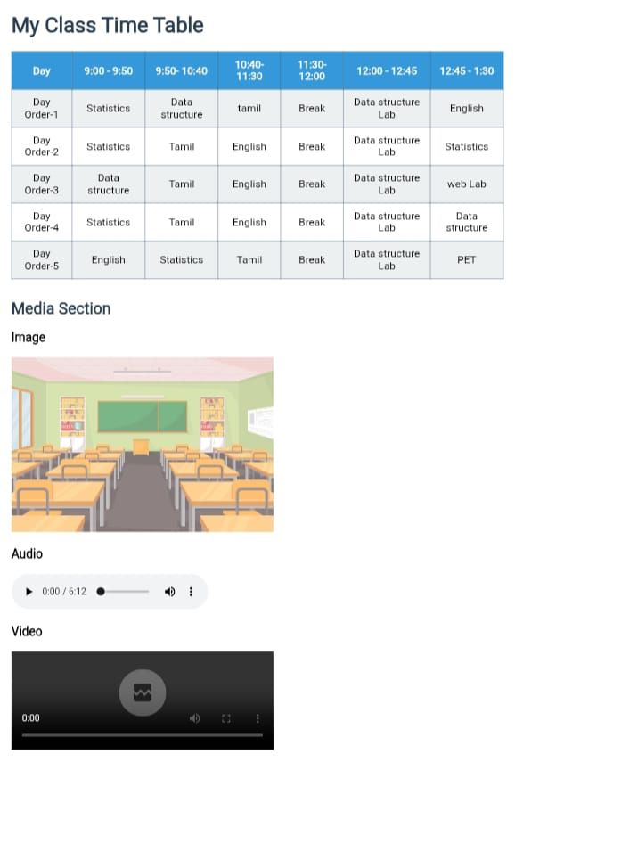
My class timetable and media using html:

Slide 13
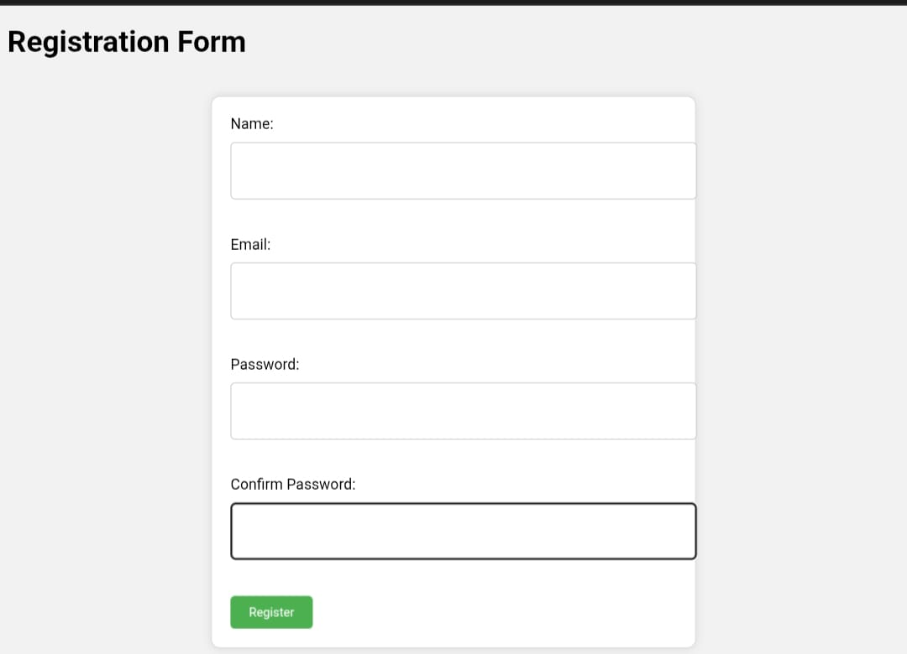
Registration form and css type

Slide 14
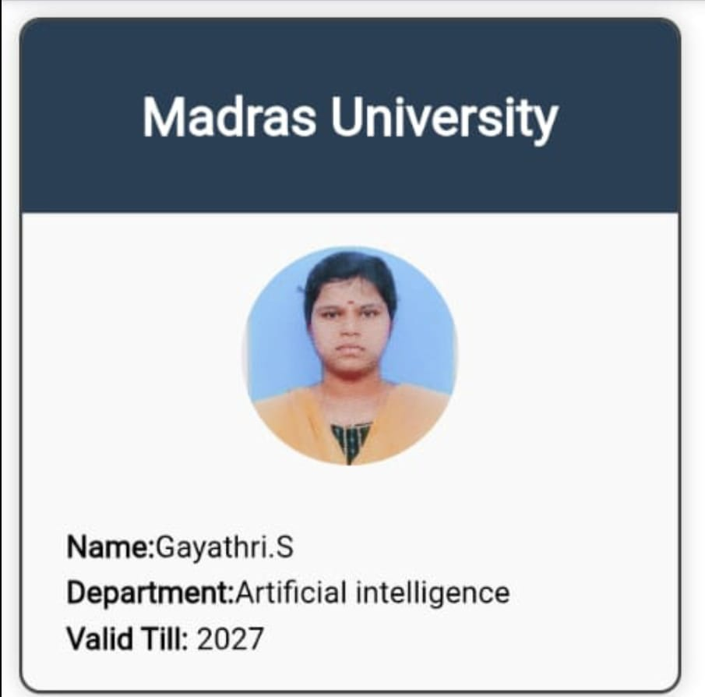
Id card:

Slide 15
CONCLUSION
This digital portfolio serves as a comprehensive representation of my work and experience in Artificial intelligence. I am confident that it will provide a clear understanding of my skills and expertise, and I look forward to the opportunity to discuss my qualifications further.

