Slide 1
How indoor readings reach an application
Four components carry one reading from the room to the screen.
LoRaWAN radio
IP backhaul
Integration
AM300
UG65
Network server
Cloud / app
Measures indoor
conditions
Receives radio
messages
Sessions and
message routing
Uses the sensor
readings
Exact model determines
which parameters it measures.
Forwards sensor messages
through its IP connection.
Controls joining and routes
uplinks to an integration.
Decodes, stores or displays
data, depending on platform.
Model check
AM304L, AM305L, AM307, AM308/AM308L and AM319 can measure different parameters. Confirm the unit label and matching guide.
AM300 SENSOR + UG65 GATEWAY
01
Notes:
Follow one reading from the room sensor to the screen. These are logical roles. A gateway is a radio-to-IP bridge and is not automatically a dashboard or network server. AM300 models and firmware can differ, so identify the full model before choosing units and decoder. The sensor sends compact LoRaWAN uplinks at configured intervals or for events. The UG65 listens on configured channels. Multiple gateways may hear the same uplink. Milesight advertises up to 2,000 devices, 8-channel communication and up to 2 km urban coverage for UG65. These are maximum product figures, not guarantees for a particular site. Confirm regional hardware, firmware and manuals.
Source: user-provided AM300 Sensor and UG65 Gateway outline, slides 1, 2, 4 and 5. Supplied references: https://www.milesight.com/iot/product/lorawan-sensor/am300 and https://www.milesight.com/iot/product/lorawan-gateway/ug65.

Slide 2
Frontend dashboard and system flow
Presents current readings, historical charts and alerts to users.
AM304L sensor
UG65 gateway
Network server
Dashboard responsibilities
Measures indoor conditions
Receives radio messages
Device authentication
Message processing
Current environmental readings
Historical measurement charts
Sensor and connection status
Threshold exceedances
Alert history for staff
LoRaWAN over LoRa
IP packet forwarding
HTTP/HTTPS API requests
MQTT or HTTP
Frontend
Database
Backend app
Readings, charts
and alerts
Sensor readings
and alert history
Validation, rules
and alerts
Store and retrieve
Possible technologies
Sensor data and alert responses
HTML, CSS, JavaScript
or React
AM300 SENSOR + UG65 GATEWAY
02
Notes:
The frontend displays current environmental readings and historical measurements in charts. It shows sensor and connection status, highlights readings that exceed configured thresholds, and provides alert history and relevant information for staff. Possible technologies include HTML, CSS, JavaScript or React. The architecture is a logical design supplied by the user. AM304L sends LoRaWAN over LoRa radio to UG65. The gateway uses IP networking and packet forwarding to the LoRaWAN network server. The server integrates with the backend through MQTT or HTTP, depending on configuration. The backend stores and retrieves database records. The frontend sends HTTP/HTTPS API requests to the backend, and the backend responds with sensor data and alerts. The dashboard does not directly query the database in this diagram.
Source: user-provided section 3.6 and Mermaid flowchart.

Slide 3
Protocols and decoding
LoRaWAN carries the sensor message. MQTT and APIs can deliver it downstream.
LoRaWAN
Platform-specific routes
AM300
UG65
MQTT publisher
Binary payload
Radio to IP
Publishes to a broker
IP forwarding
MQTT broker
App subscribes
Network server
REST API / webhook
Routes uplinks
Cloud service or app/API client
Payload decoding
A decoder for the exact model converts sensor bytes into readings.
The platform may then provide JSON. Raw data may be hex or Base64.
AM300 SENSOR + UG65 GATEWAY
03
Notes:
Diagram shows alternative downstream integrations, not a guaranteed feature path for every gateway or platform. UG65 forwards over an IP connection using its configured mode. Ask which component runs the decoder and which publishes to MQTT or exposes an API. MQTT uses a broker. An API is a software interface, often over HTTP. Neither is the AM300-to-UG65 radio link. JSON is a data format, not a protocol. The sensor uses model-specific compact binary payloads. A platform can offer decoded JSON after decoding, while other messages may contain raw hex or Base64. Milesight documents REST APIs and webhooks for its Development Platform. Confirm any direct UG65 API/MQTT feature against the exact gateway manual and firmware. Optional building-system connections can use BACnet or Modbus when configured.
Source: user-provided outline, slides 3 and 6. Supplied references: https://www.milesight.com/iot/resources/download-center/ and https://github.com/Milesight-IoT/SensorDecoders.

Slide 4
Backend application
Processes sensor data and manages the rules that create alerts.
INPUT
Sensor data from the network server
Receive and decode
Validate
Apply rules
Store and serve
Receive messages.
Decode payloads
when necessary.
Check readings
and timestamps.
Evaluate configured
thresholds and
generate alerts.
Store readings and
alerts. Provide data
through an API.
OUTPUT
Validated readings, stored records and alert information
The frontend requests data through the backend API.
AM300 SENSOR + UG65 GATEWAY
04
Notes:
Purpose: process and manage sensor data. Receive data from the network server. Decode the application payload if necessary. Validate readings and timestamps. Apply configured threshold rules. Generate alerts when defined conditions are met. Store readings and alert information in the database. Provide data to the frontend through an API. Input: sensor data from the network server. Output: validated readings, stored records and alert information.
Source: user-provided section 3.4.

Slide 5
Database
Stores sensor readings and alert information for historical analysis.
POSSIBLE RECORD CONTENT
Information group | Fields to store
Identity and location | Device ID, room or sensor location
Measurement | Type, value and unit
Time | Timestamp
Device health | Device status
Alerts | Alert status and alert history
Technology options
PostgreSQL
or InfluxDB
Choose according to project requirements.
The backend stores and retrieves these records.
AM300 SENSOR + UG65 GATEWAY
05
Notes:
Purpose: retain sensor data for historical analysis. Possible fields include device ID, room or sensor location, measurement type, value and unit, timestamp, device status, alert status and alert history. PostgreSQL and InfluxDB are possible technologies, not a finalized selection. Choose according to the project requirements. The backend stores and retrieves the data.
Source: user-provided section 3.5 and Mermaid architecture.

Slide 6
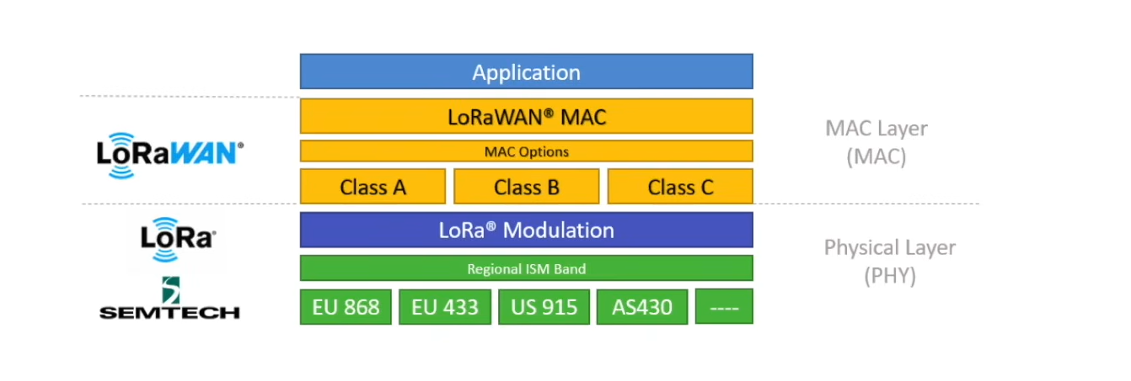

Slide 7
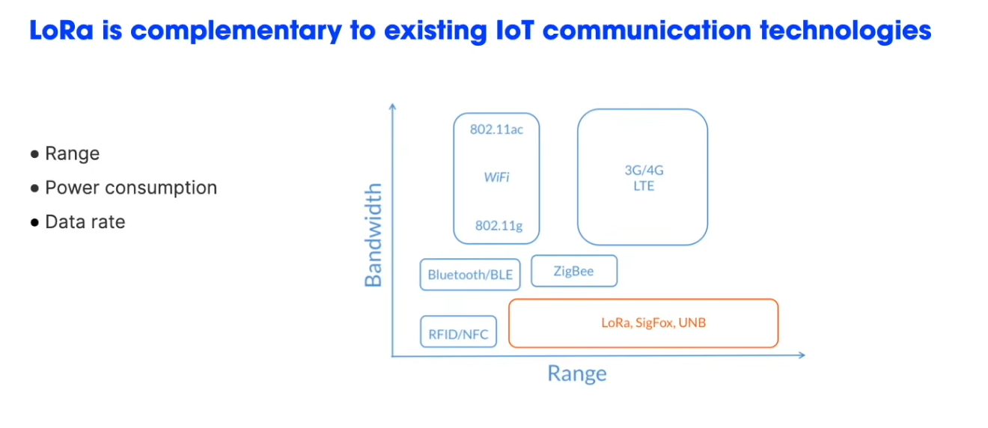

Slide 8
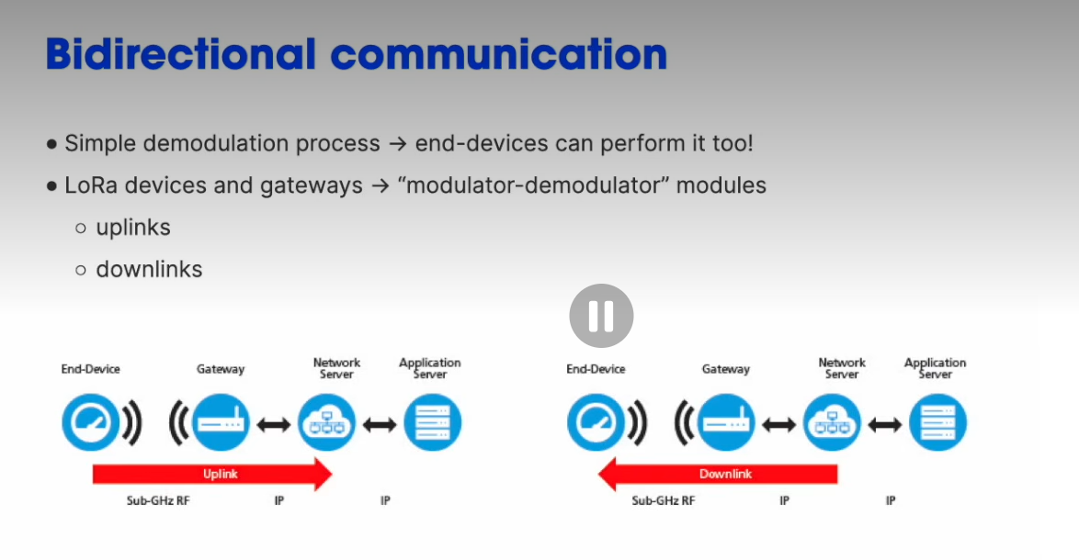

Slide 9
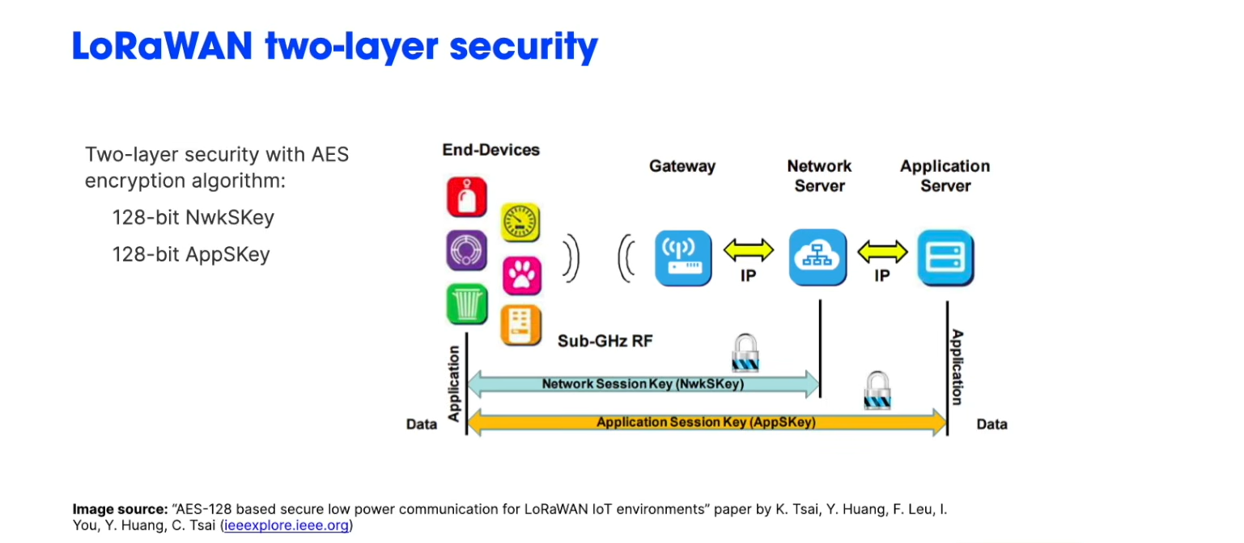

Slide 10
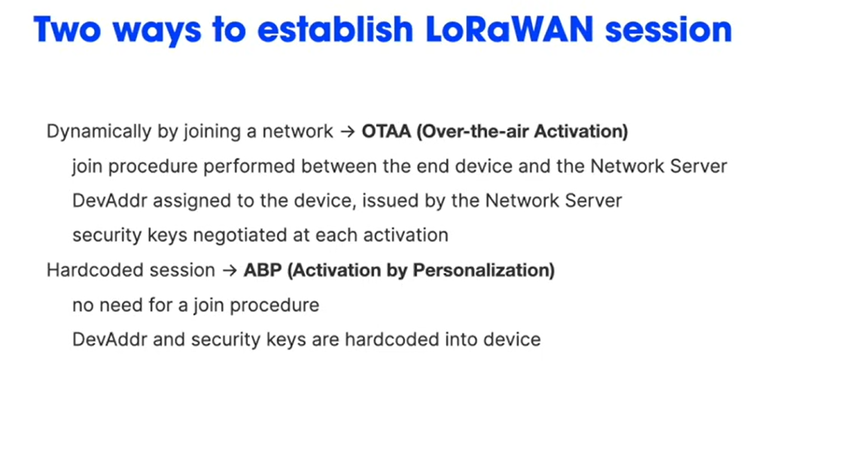

Slide 11
