Slide 1
GROCery STORE

Slide 2
OUTLINE
Introduction
Use case Diagram
Er Diagram
Tables

Slide 3
INTRODUCTION
On average, every human generated at least 1.7 MB of data per second in 2020.
Less data -More data. (unstructured data)
Rdbms. -DB (structured data)

Slide 4
ASSUMPTIONS
User details are fixed.
Main criteria: Customer--> Items-->Courier.
Consideration upto Transaction-flow.

Slide 5
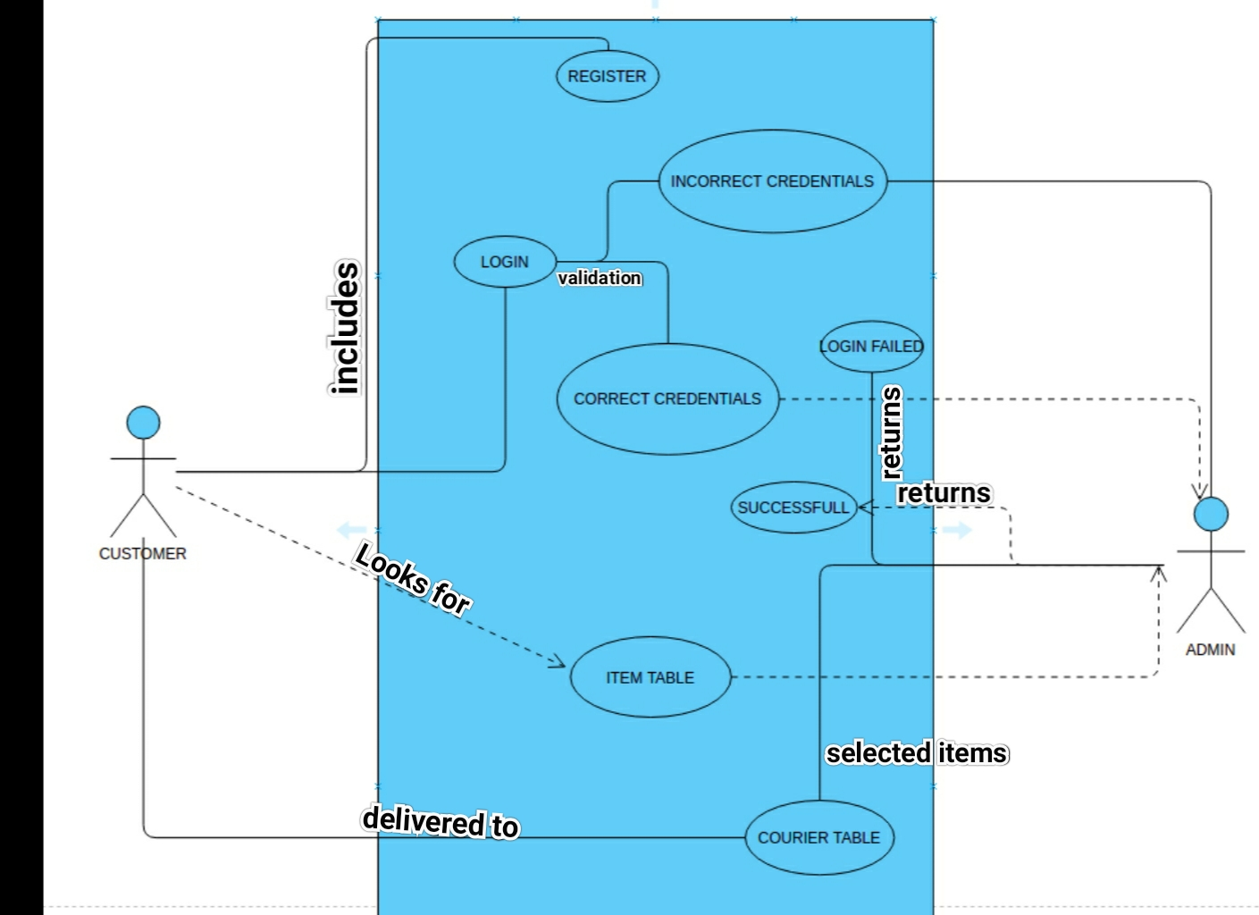

Slide 6
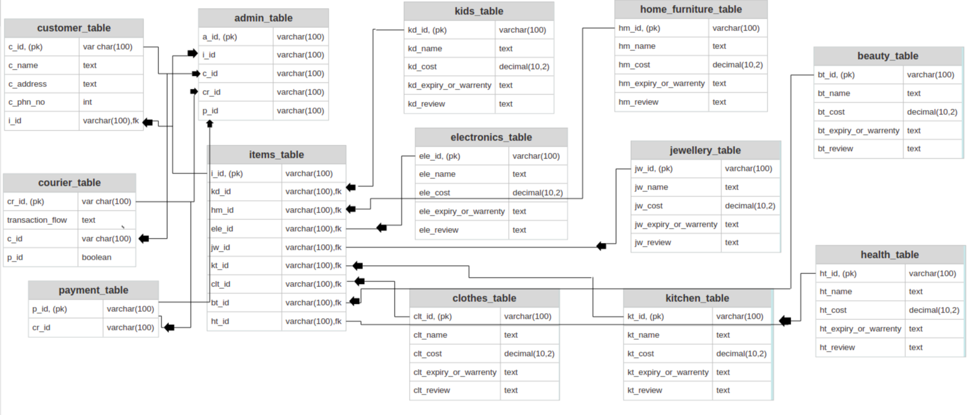

Slide 7
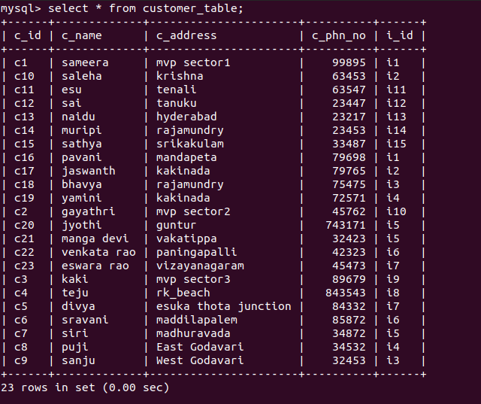
TABLES

Slide 8
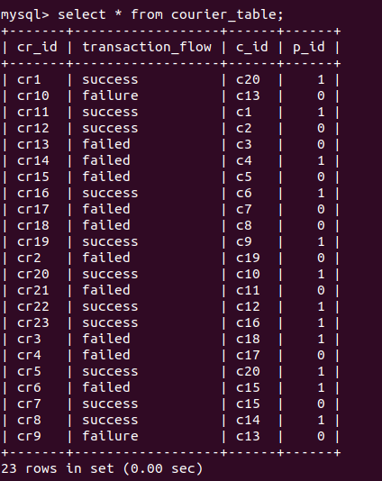

Slide 9
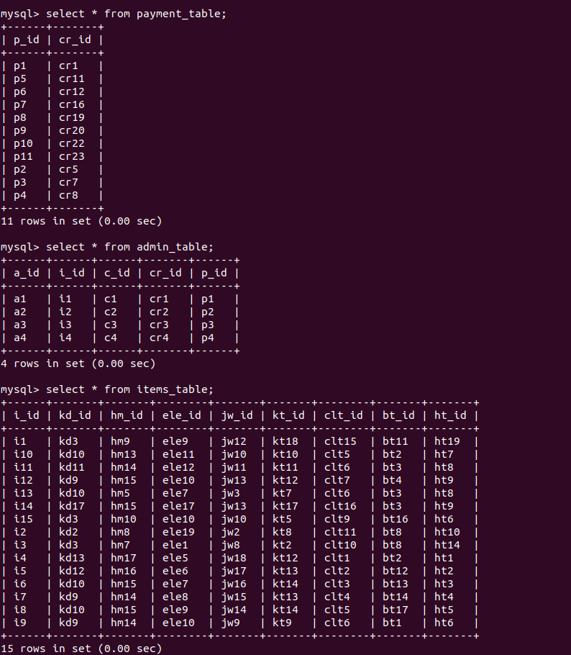

Slide 10
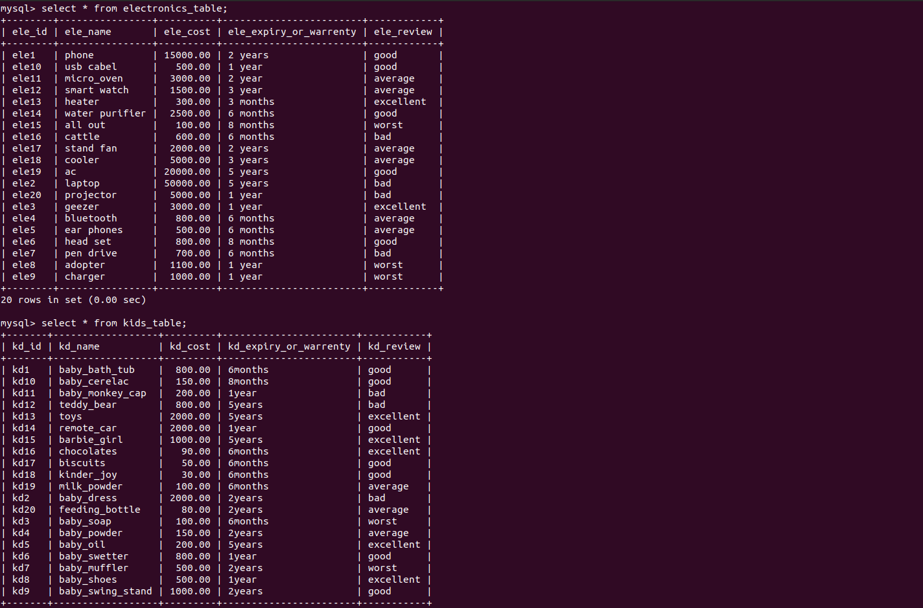

Slide 11
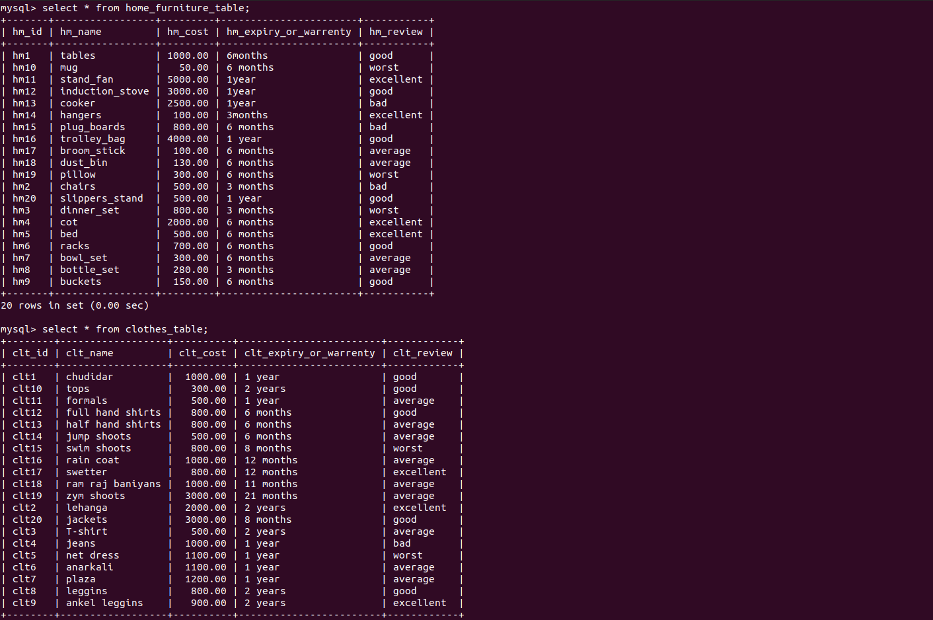

Slide 12
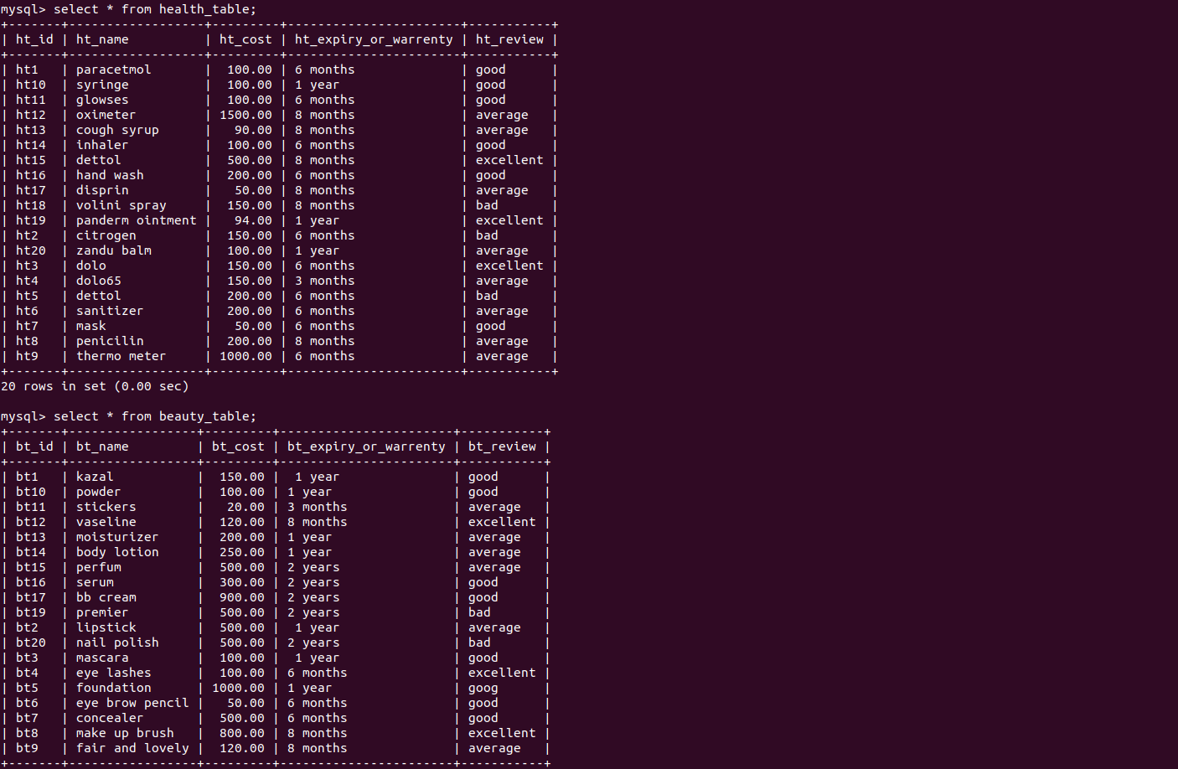

Slide 13
THANK YOU

