Slide 1



Slide 2
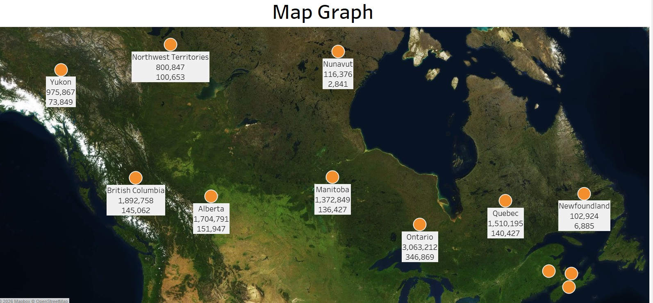
INSIGHTS
Ontario leads all regions with the highest total value of 3,063,212, while Newfoundland and Nunavut represent the lowest-performing territories.

Slide 3
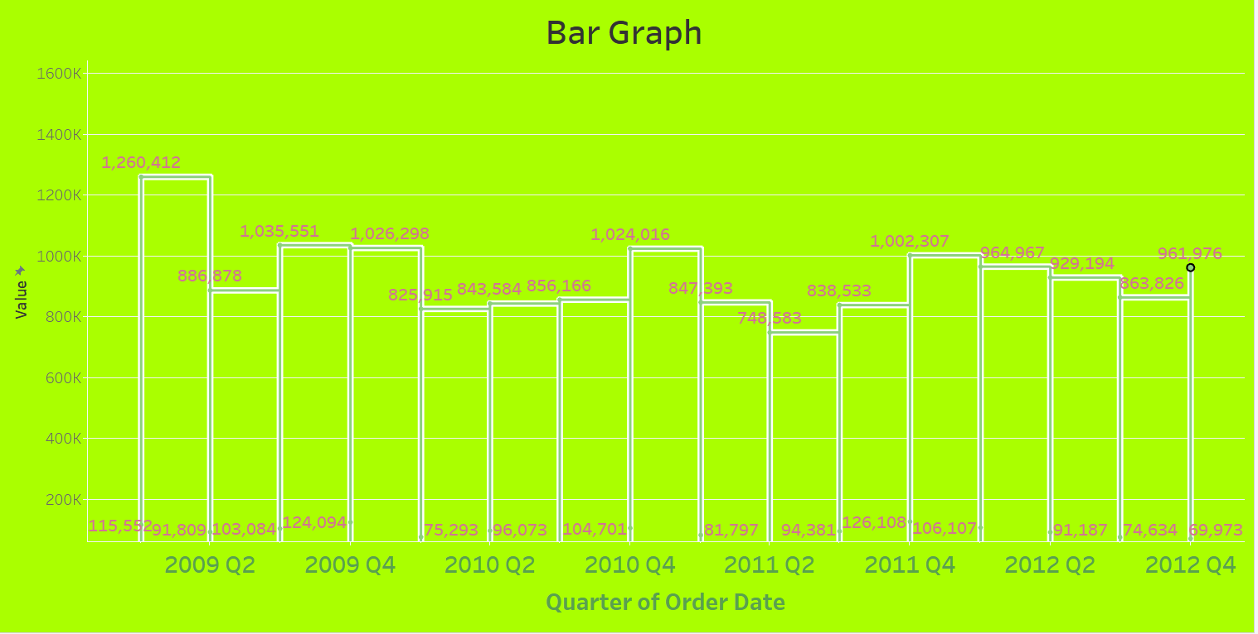
INSIGHTS
Total value reached its peak in 2009 Q1 at 1,260,412 and generally stabilized between 800K and 1,000K through 2012.

Slide 4
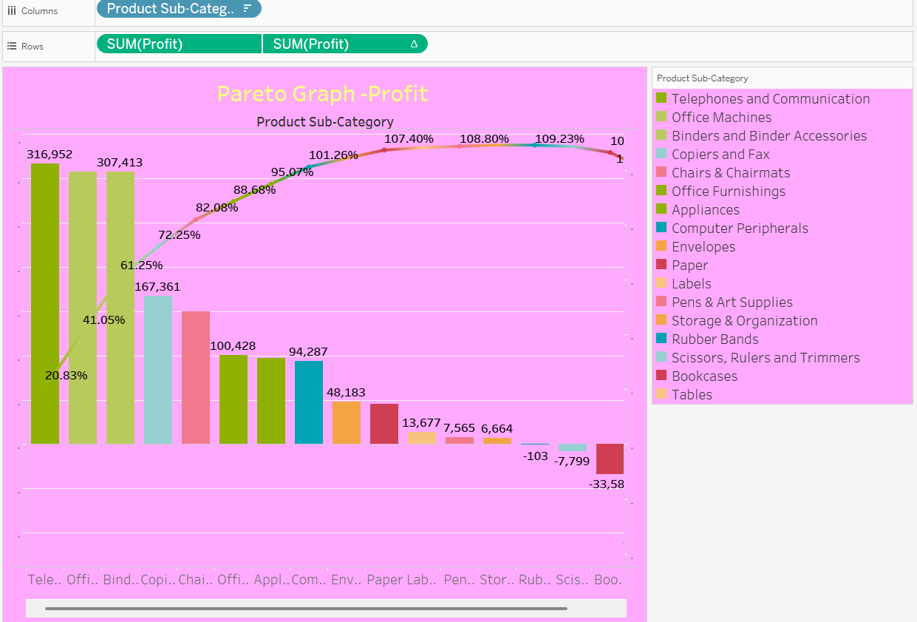
INSIGHTS
Sales: The top five product sub-categories contribute to approximately 66.48% of total sales, with Office Machines leading as the highest revenue generator at 2,168,697.

Slide 5
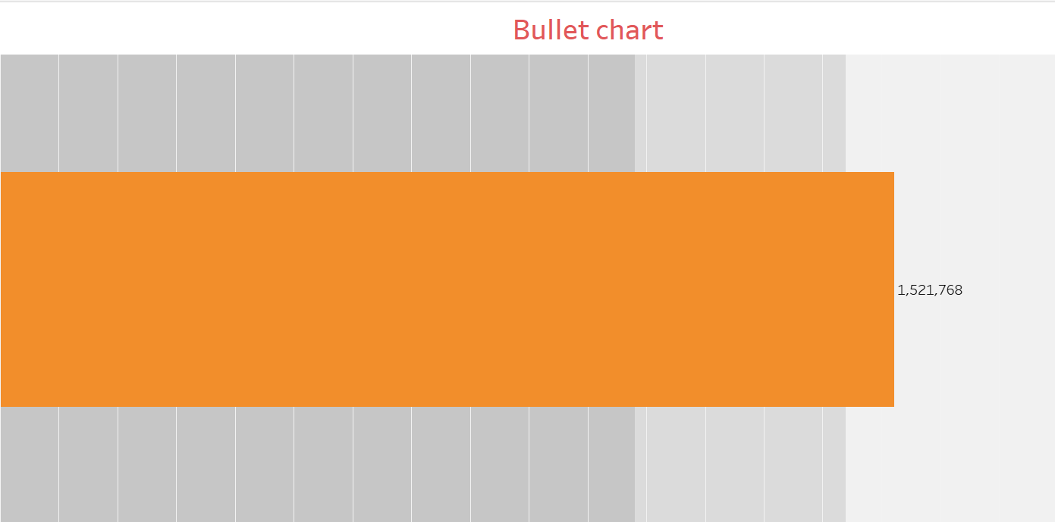
INSIGHTS
Bullet Chart: Total performance reached 1,521,768, successfully exceeding the target benchmark indicated by the final qualitative range.

Slide 6
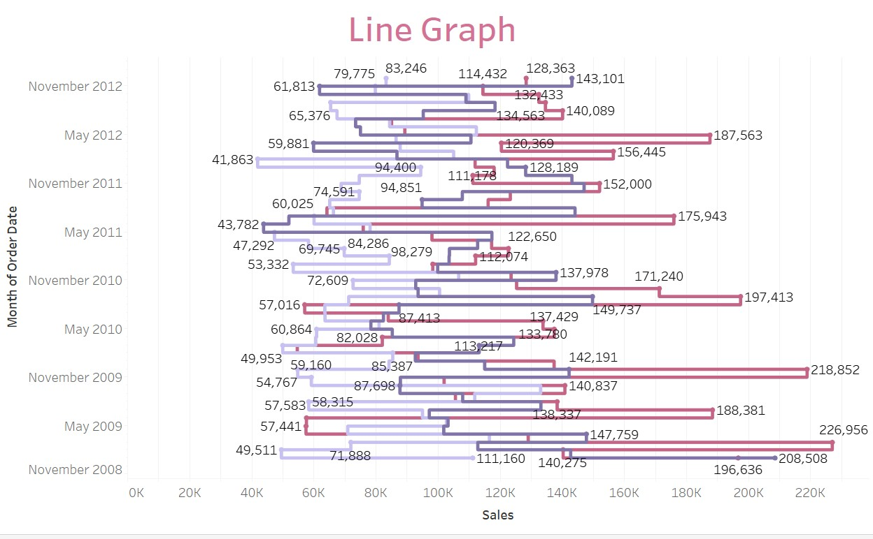
INSIGHTS
Line Graph: Monthly sales exhibit high volatility with a significant historical peak of 226,956 occurring in early 2009, followed by a general trend of stabilizing into narrower fluctuations by late 2012.

Slide 7
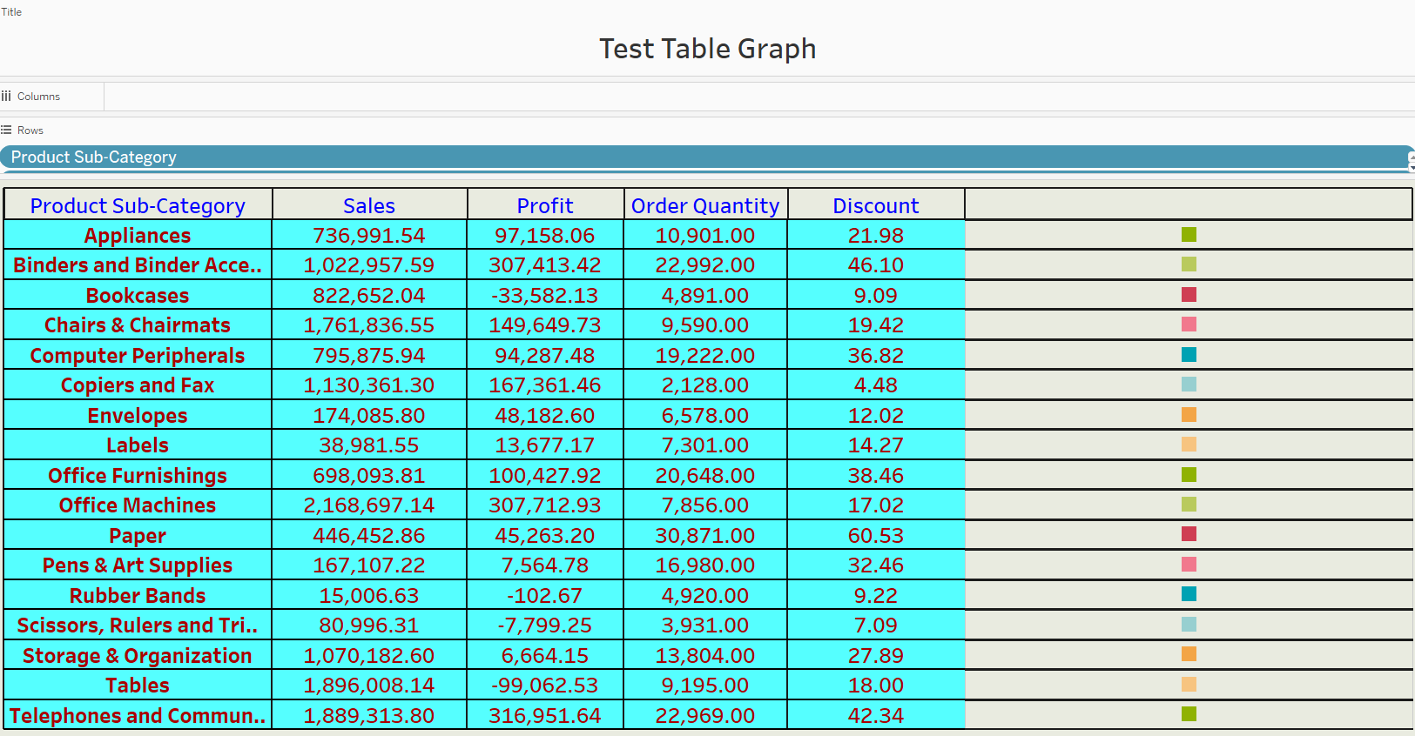

Slide 8
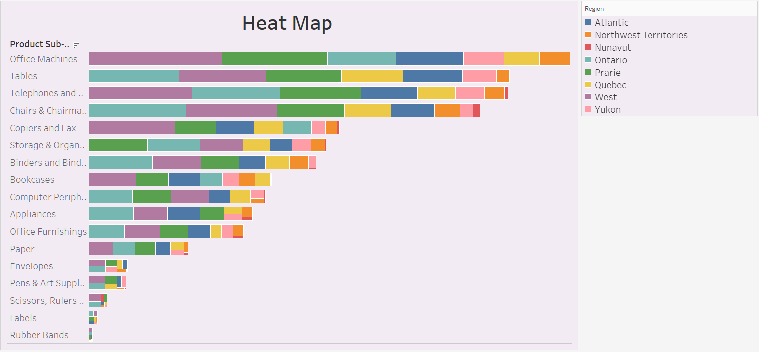
INSIGHTS
Office Machines are the top-selling sub-category across nearly all regions, with the Ontario and West regions consistently driving the largest volume of sales across most product lines.

Slide 9
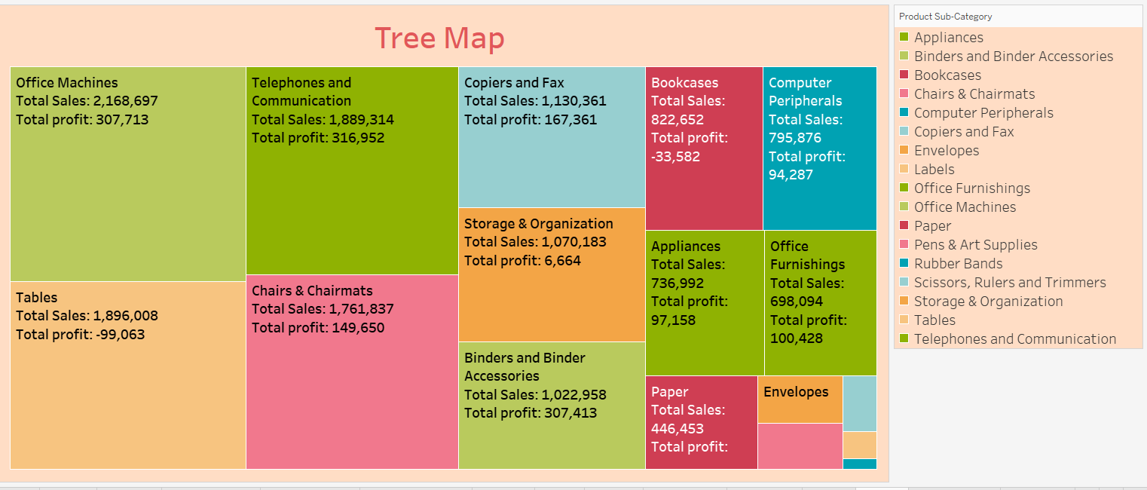
INSIGHTS
Tree Map: Office Machines drive the highest revenue and substantial profit, whereas Tables and Bookcases show significant total sales but operate at a net loss.

Slide 10
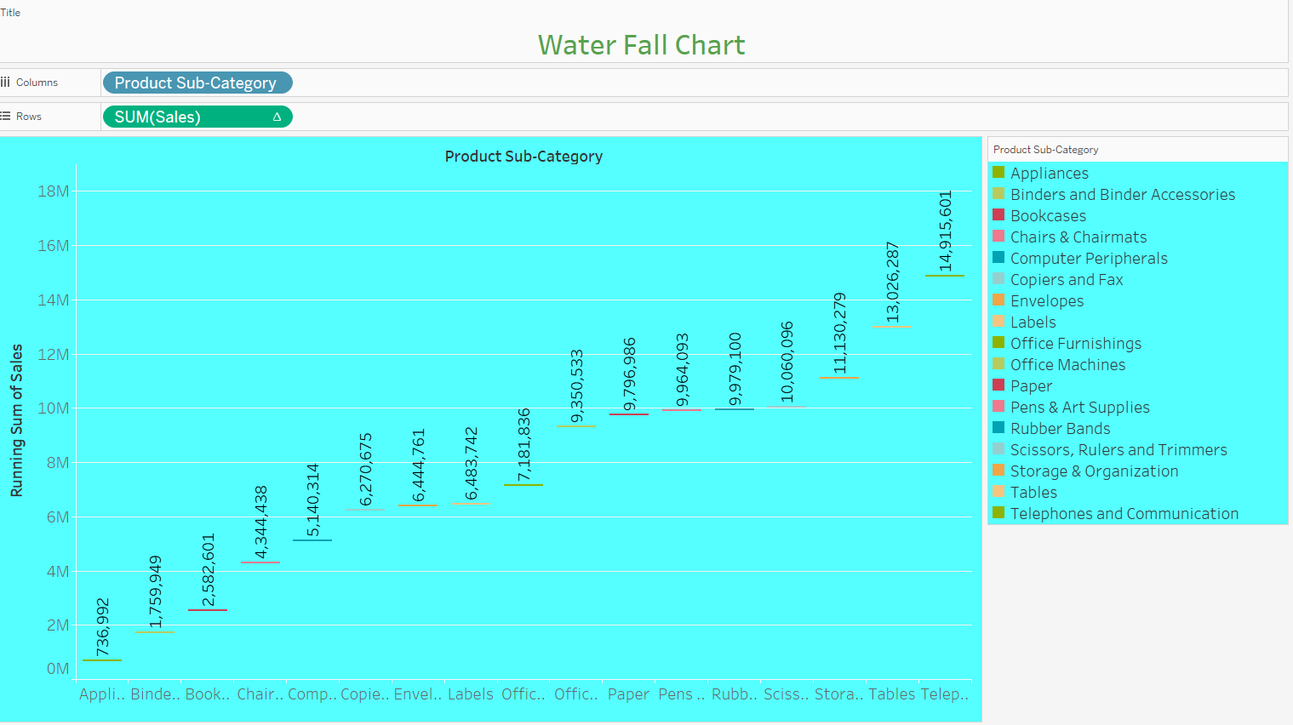
INSIGHTS
The cumulative running sum of sales across all sub-categories concludes at a total of 14,915,601, with Telephones and Communication providing the final significant upward contribution.

Slide 11
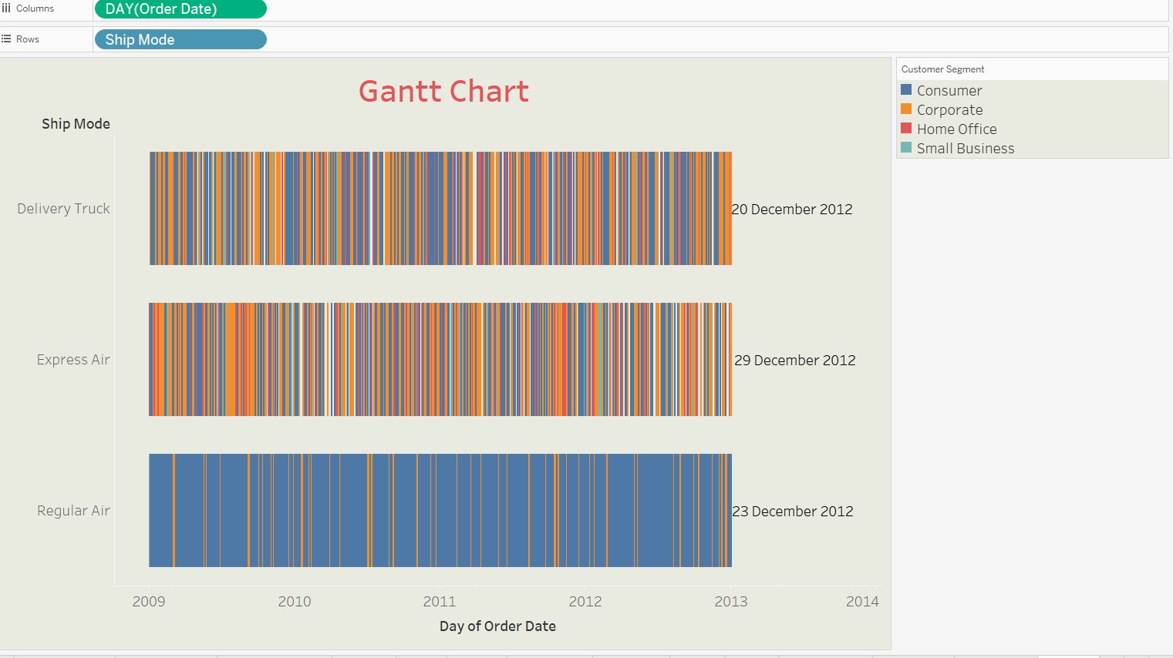
INSIGHTS
Regular Air serves as the most frequently utilized shipping mode across the four-year period, while Express Air shows a final recorded delivery date of December 29, 2012.

Slide 12
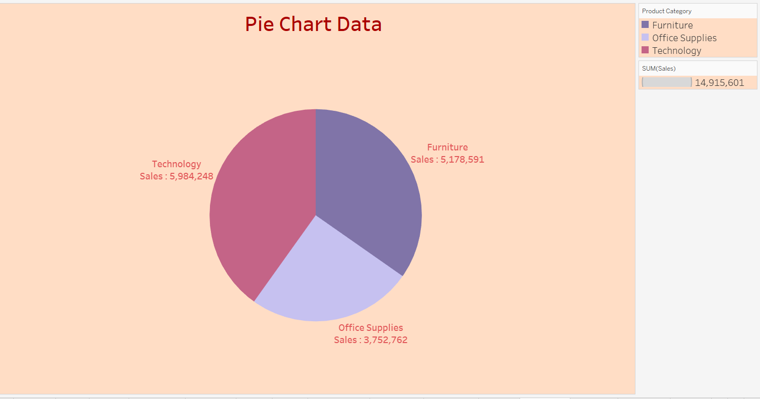
INSIGHTS
Technology is the leading product category with 5,984,248 in sales, followed by Furniture and Office Supplies to reach a total combined sales value of 14,915,601.

Slide 13
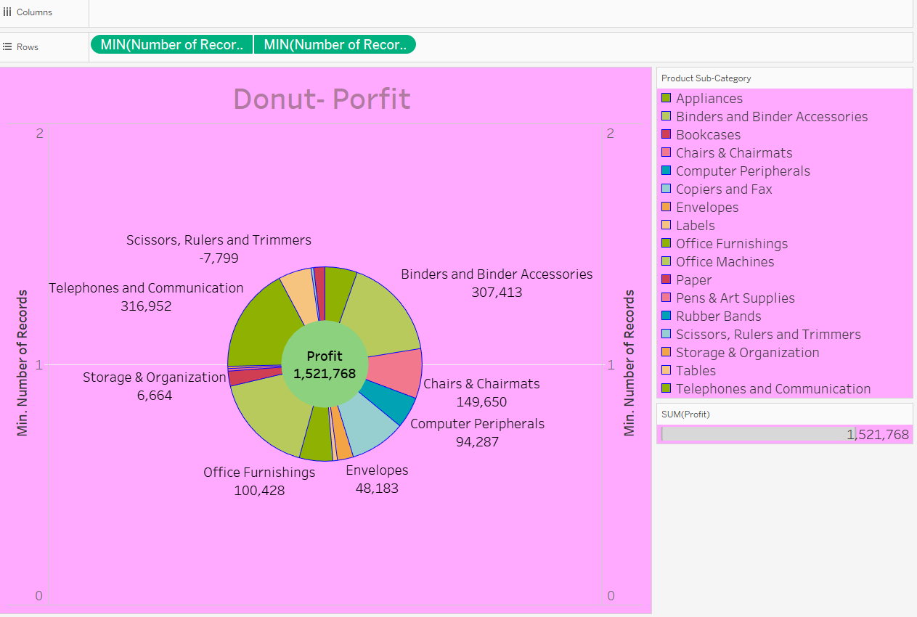
INSIGHTS
Telephones and Binders are the primary profit drivers, contributing over 600K collectively toward the total organizational profit of 1,521,768.

Slide 14
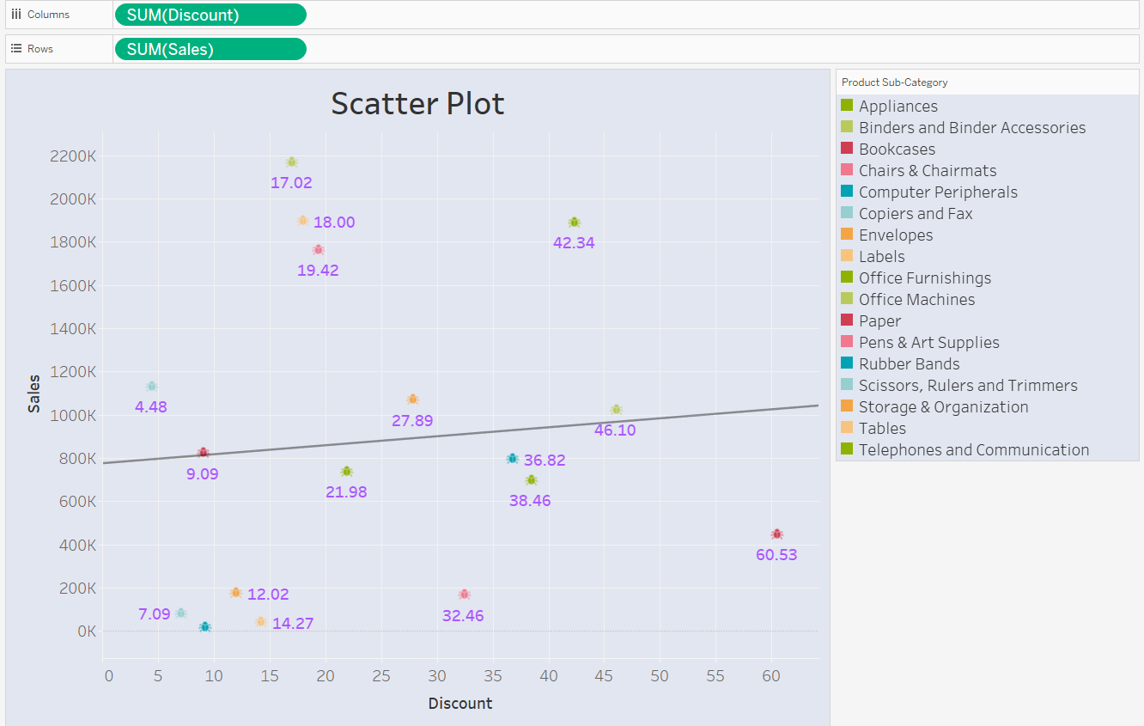
INSIGHTS
There is a weak positive correlation between discount levels and sales volume, with high-revenue items like Office Machines and Tables maintaining peak sales even at relatively low discount rates.

Slide 15
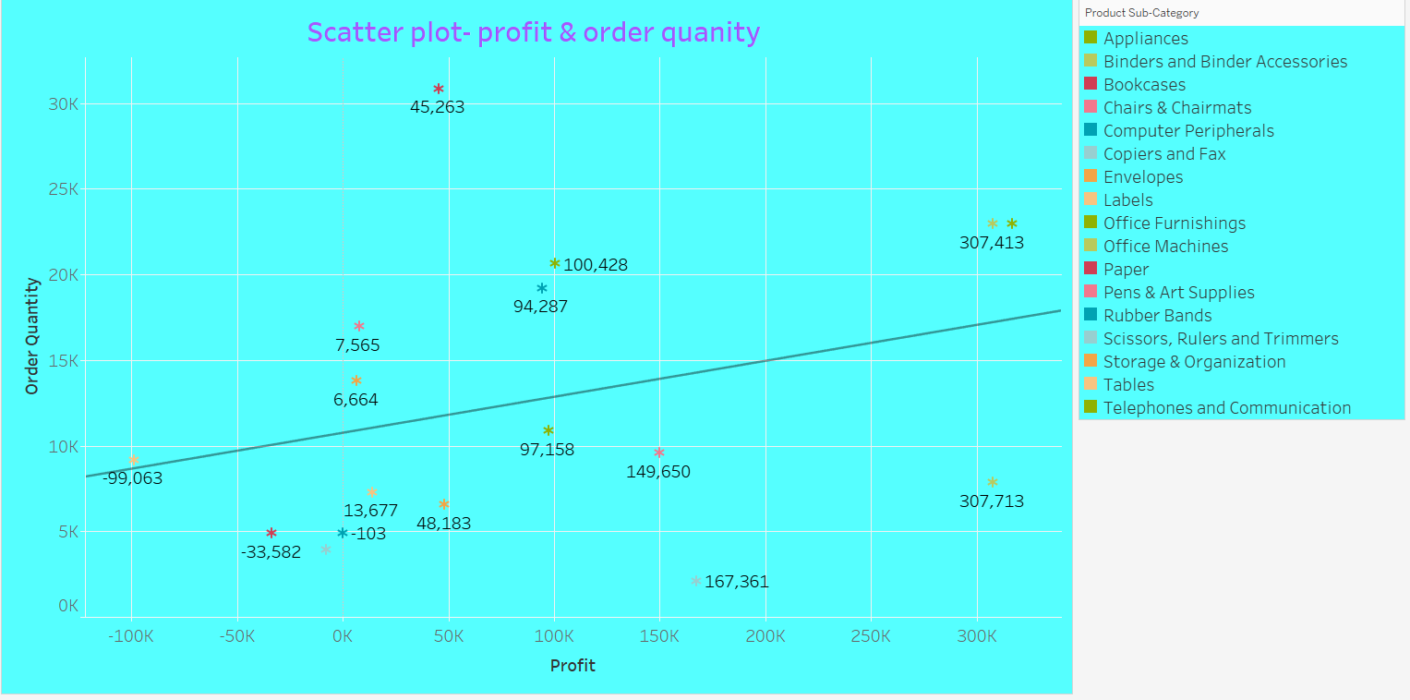
INSIGHTS
There is a positive correlation between order quantity and profit, with high-volume sub-categories like Binders and Office Machines generating the highest individual profits exceeding 300K.

Slide 16
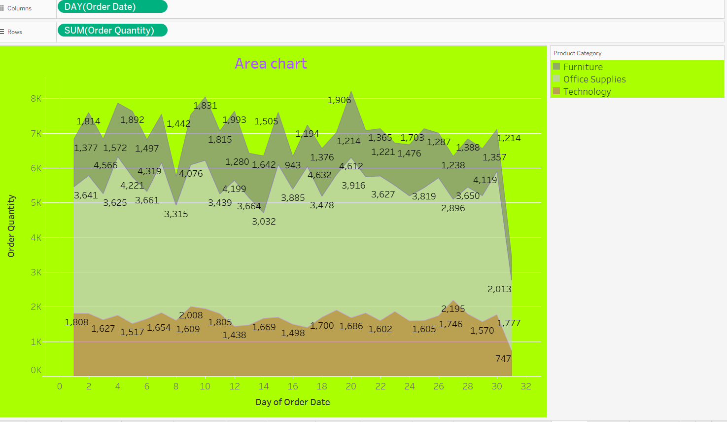
INSIGHTS
Office Supplies consistently drive the highest daily order quantities, peaking at 4,612 units on Day 20, while Furniture and Technology maintain lower, more stable volume trends throughout the month.

Slide 17
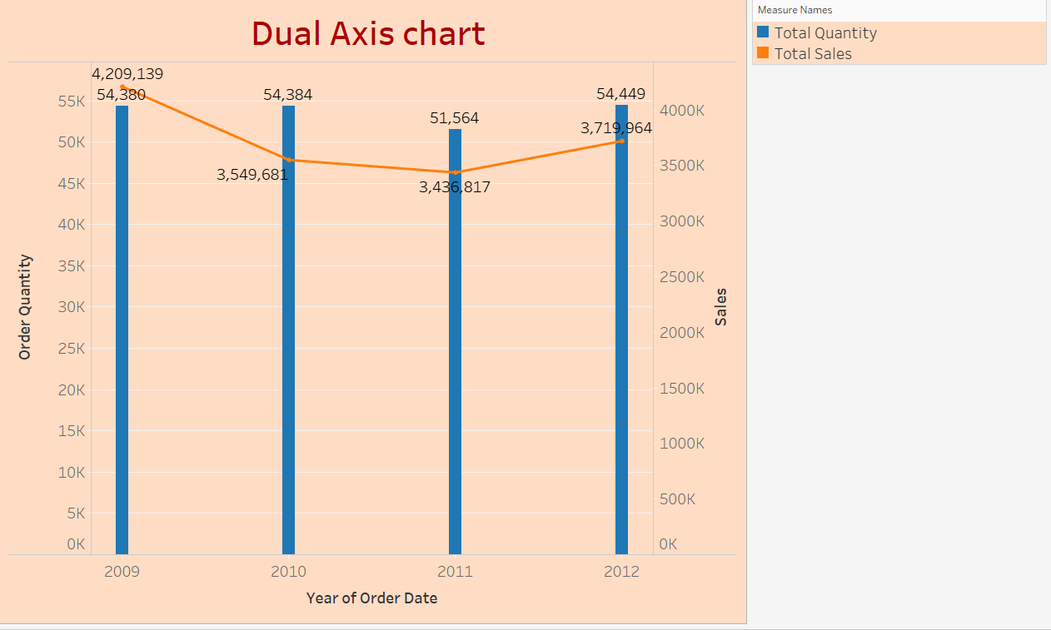
INSIGHTS
Yearly sales reached a high of over 4.2M in 2009, and while sales fluctuated in subsequent years, the total order quantity remained remarkably stable, peaking at 54,449 units in 2012.

Slide 18
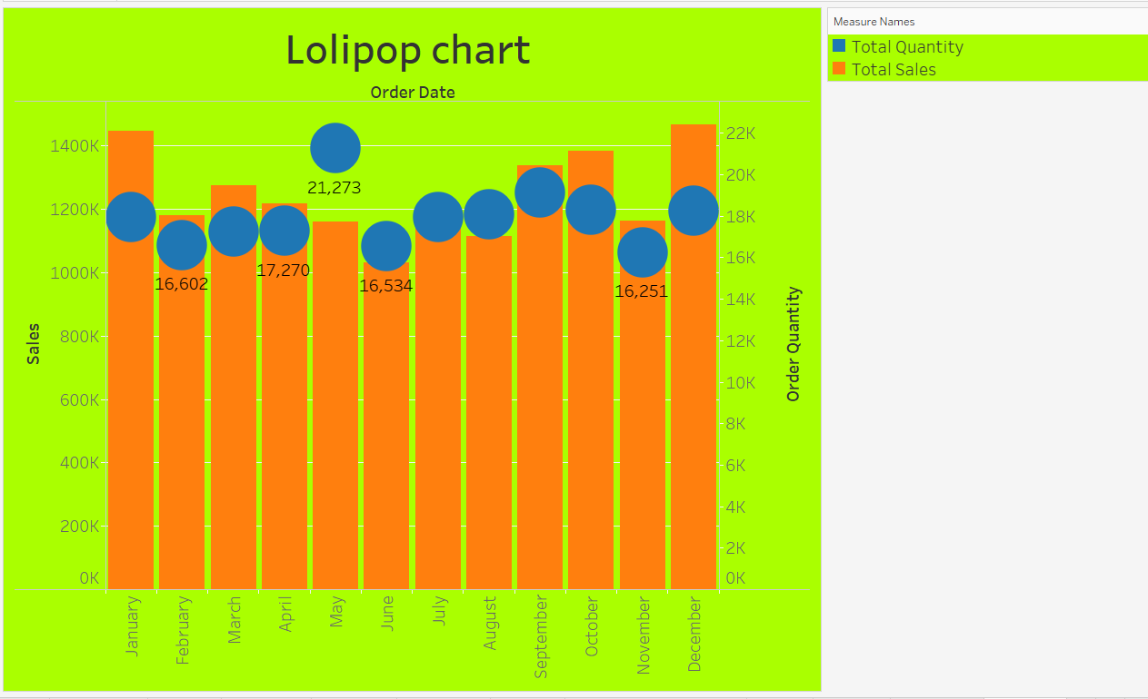
INSIGHTS
Monthly sales peaked in December at approximately 1.48M, while the highest order quantity occurred in May with 21,273 units.

Slide 19
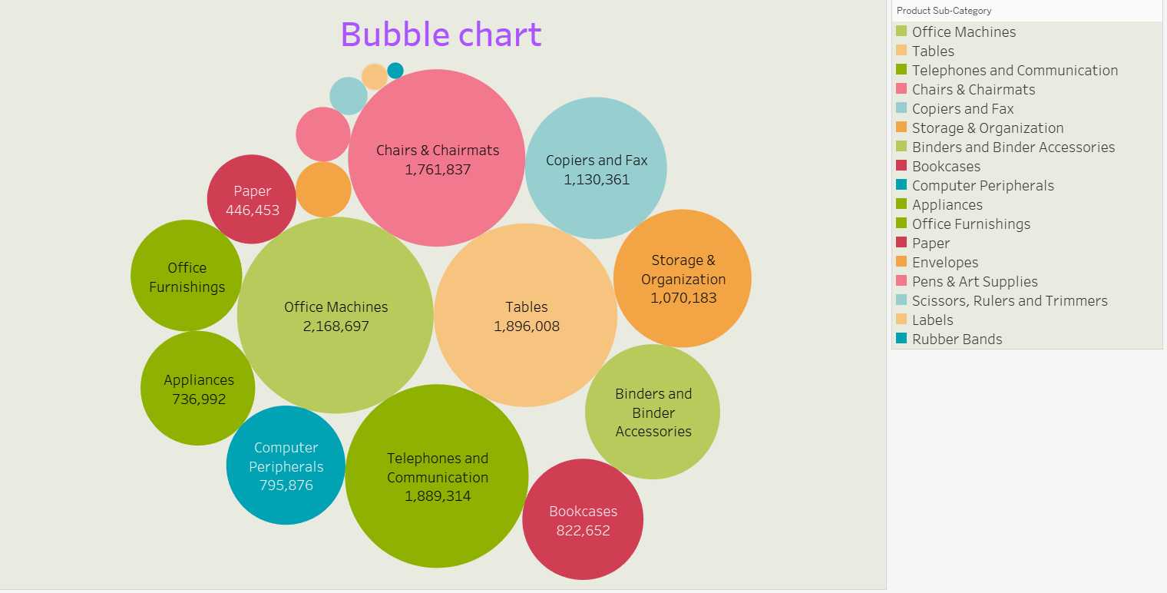
INSIGHTS
Office Machines represent the largest revenue share at 2,168,697, while high-volume categories like Tables and Telephones also command significant presence within the product mix.

Slide 20
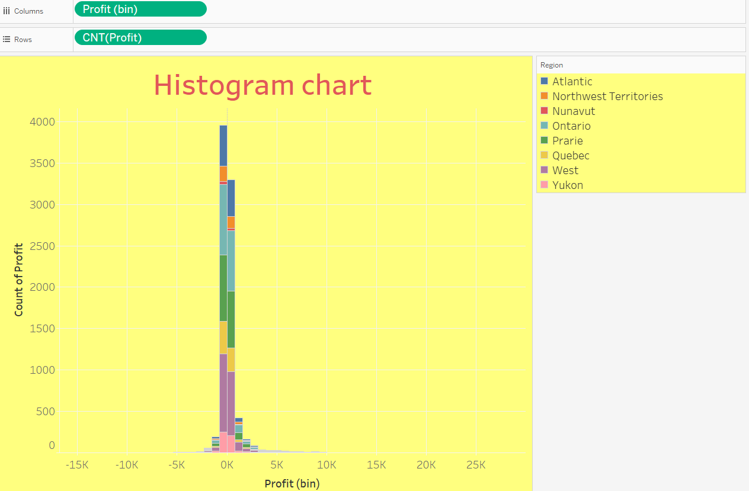
INSIGHTS
he vast majority of orders across all regions fall within a narrow profit bin near zero, with a significant concentration of low-profit transactions peaking at a count of nearly 4,000.

Slide 21
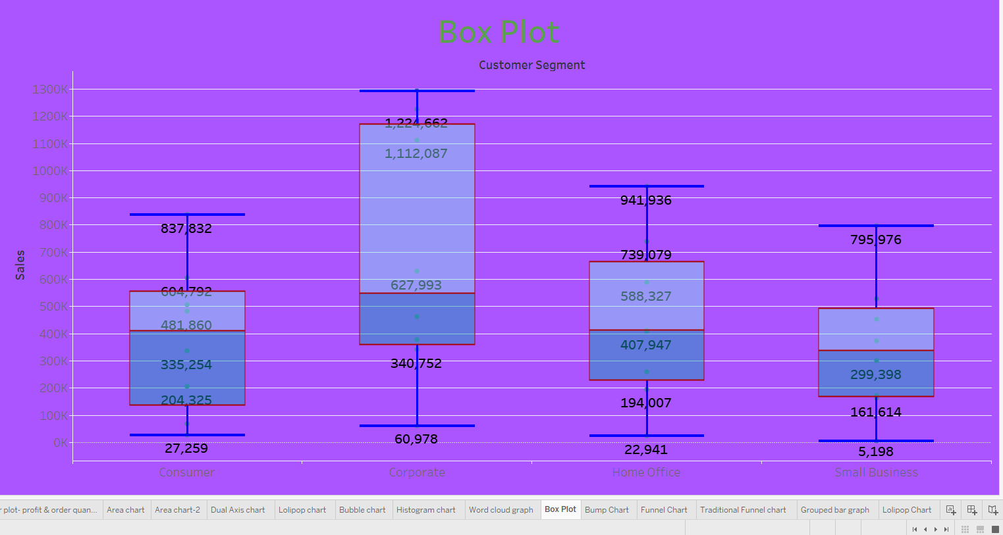
INSIGHTS
The Corporate segment exhibits the highest sales variability and the largest single transaction volume at 1,224,662, while the Small Business segment maintains the most compact sales range with a maximum of 795,976.

Slide 22
