Slide 1
Employee Data Analysis using Excel
STUDENT NAME: C.Gayathri
REGISTER NO:312200839
DEPARTMENT:B.com(General) 3rd year
COLLEGE Pachaiyappa’s college for women

Slide 2
PROJECT TITLE
Employee Data Analysis using Excel

Slide 3


AGENDA
Problem Statement
Project Overview
End Users
Our Solution and Proposition
Dataset Description
Modelling Approach
Results and Discussion
Conclusion
3/21/2024 Annual Review

Slide 4

PROBLEM STATEMENT
Analyze the employee dataset using Excel to uncover insights on salary distribution, performance correlations, tenure, and work hours. Specifically, assess salary disparities across departments and positions, evaluate the link between performance ratings and salaries, calculate average employee tenure, and examine work hour patterns. The goal is to provide actionable insights for improving workforce management and operational efficiency.

Slide 5
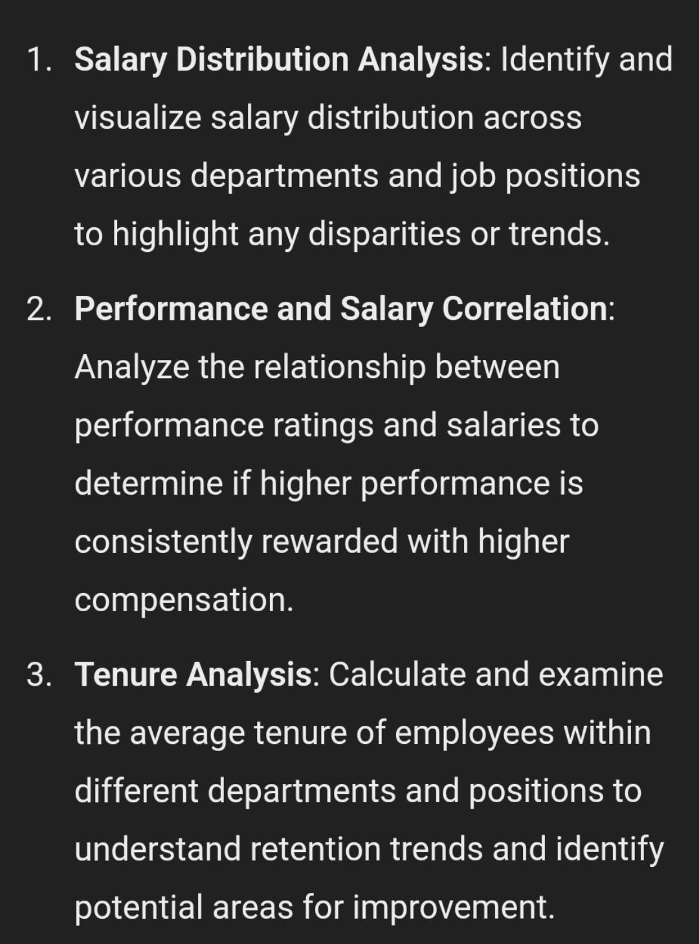

PROJECT OVERVIEW
.

Slide 6

WHO ARE THE END USERS?
Human Resources manager
Department Heads/Managers
Executives/Leadership
Finance team
Data Analysts

Slide 7

OUR SOLUTION AND ITS VALUE PROPOSITION
Salary Distribution: Creating visualizations to showcase salary ranges and averages across different departments and positions, highlighting any disparities.Performance and Salary Correlation: Analyzing the correlation between performance ratings and salaries to assess if higher performers receive appropriate compensation.Tenure Analysis: Calculating average tenure by department and position, and identifying trends in employee retention.Work Hours Review: Examining average work hours to identify discrepancies or inefficiencies.

Slide 8
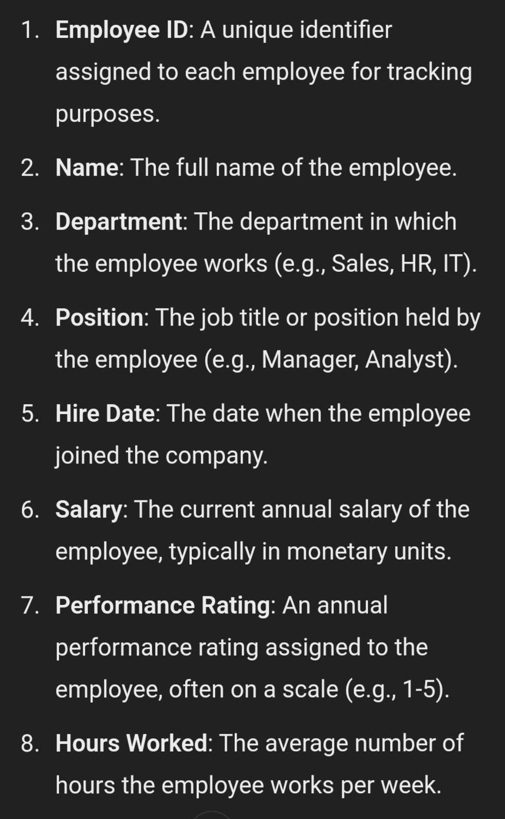
Dataset Description

Slide 9
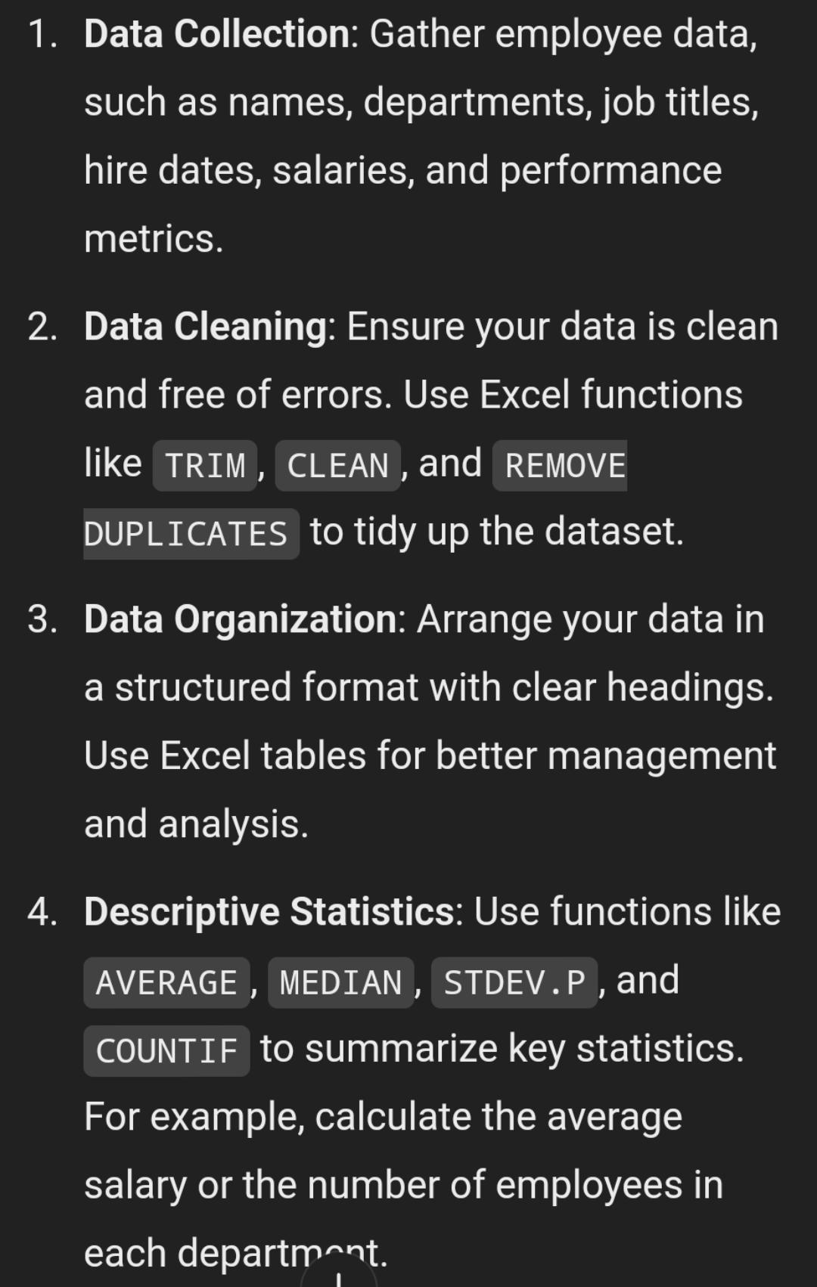

THE "WOW" IN OUR SOLUTION
3/21/2024 Annual Review
9

Slide 10
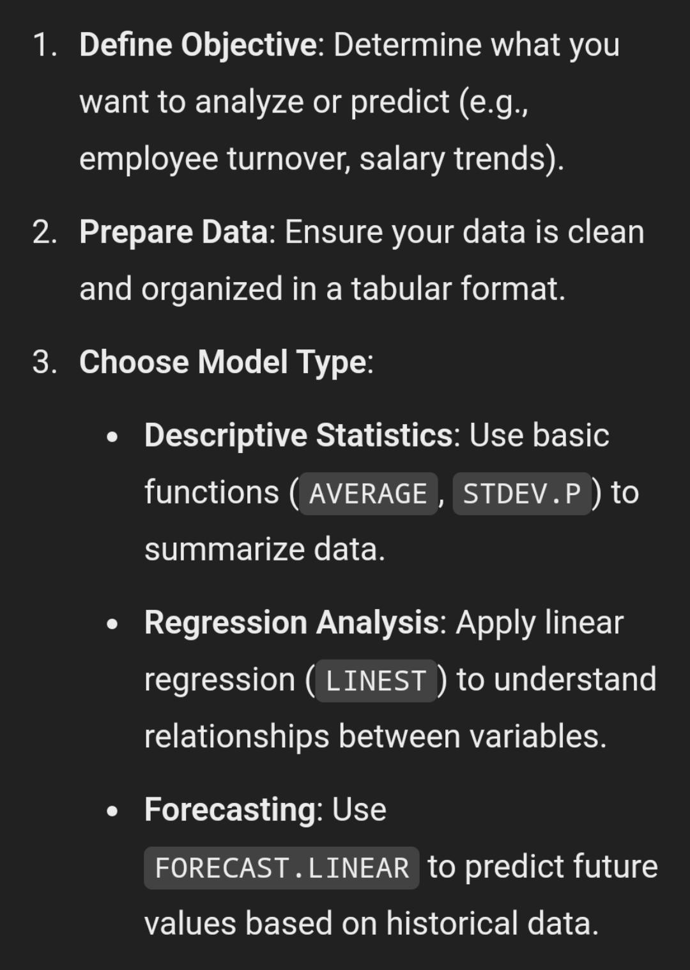
MODELLING
10

Slide 11
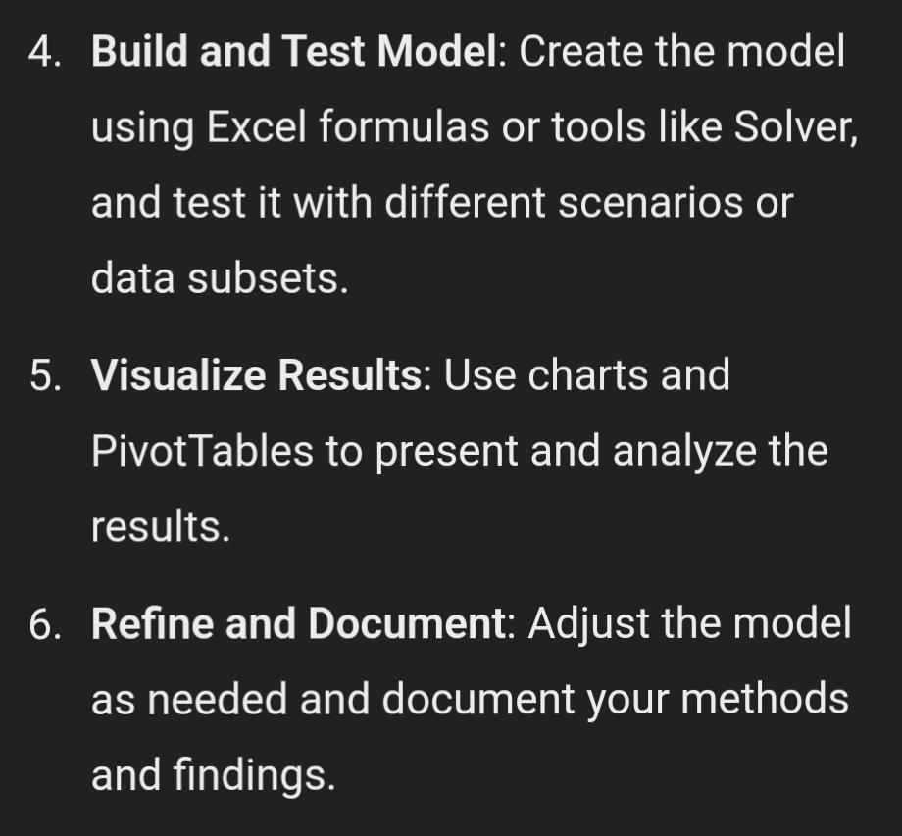
Modelling

Slide 12
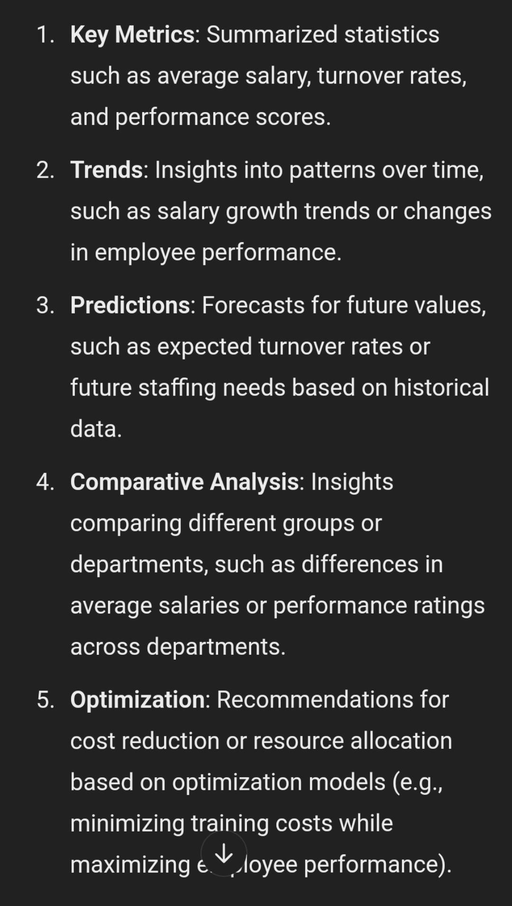
RESULTS
12

Slide 13
conclusion
In summary, the employee data analysis using Excel revealed key trends and patterns such as [insert key finding]. These insights suggest [insert implication]. To address these findings, I recommend [insert recommendation]. Further analysis may be needed to [insert next step], and it is important to consider [insert any limitations]

