Slide 2
Objectives
At the end of this module, you will be able to:
Understand Process of developing Programs
Understand and design Flow charts

Slide 3
Topic Agenda
Introduction to Programming
Developing Algorithms
Writing Flowcharts

Slide 4
Topic of Discussion
Introduction to Programming
Developing Algorithms
Writing Flowcharts

Slide 5
Introduction to Programming
A program is a set of instructions for a computer to perform a specific task.
Programs can be written in one or more programming language
Computers accept input, process it and generate output
COMPUTER
INPUT
OUTPUT
Notes:
Programming Language:
An artificial language used to feed instructions to the computer
Can be categorized as Machine language, Assembly language, Compiled Languages, Interpreted Languages, Object Oriented Languages … etc.
Languages which are more simpler, easier are referred as High-Level Languages
Low level languages provides little or no abstraction to the internal working of microprocessor

Slide 6
Process of Writing a Program
The process of writing a program involves following steps
Understanding the problem specification
Designing the program
Coding the program
Compiling
Run and Verifying the output

Slide 7
Understanding The Problem
Interpret the problem in your own words
Determine the outputs required
Identify the inputs required to obtain the desired output
List out the clarifications required
List the assumptions made
List the constraints / limitations

Slide 8
Designing And Coding
Designing
The programmer designs the program using design tools, such as Structured flowchart, Pseudo code
Coding
The logical tasks listed in the pseudocode or flowchart are translated in a particular programming language.
The programmer checks the code's logic and syntax to ensure that they are correct.

Slide 9
Compiling the Program
Computers can execute machine language code only.
The process of translating higher-level programming language code into machine language code is called compiling the program.
Special programs, called compilers and interpreters, perform this task.
Code that has errors in it cannot be compiled. The compiler will flag the error, and the programmer must fix the error before trying to compile the code again.

Slide 10
Running and Verifying Output
Once a program is compiled, it can be executed.
The programmer checks the program's output to ensure that it is correct
Logic of the program can be checked by using sample inputs and comparing the output obtained with the actual output

Slide 11
Topic of Discussion
Introduction to Programming
Developing Algorithms
Writing Flowcharts

Slide 12
Developing Algorithm
An algorithm is a set of instructions for solving a problem.
It is a basic technique of how to do a specific task
It takes input, processes it according to a set of instructions, and generates output.
An algorithm must provide correct output for every possible input condition.
An algorithm must have a definite end point so that when the input has been processed and the desired output achieved, the process stops.

Slide 13
Algorithm Example (1 of 2)
Problem: Calculate the sum and average of 3 subject marks of a student
Input : 3 marks - m1, m2, m3
Output : Sum and average
Method:
sum = m1 + m2 + m3
average = sum / 3
print “Total Marks is : “ sum
print “Average Marks is : “ average

Slide 14
Algorithm Example (2 of 2)
Problem: Find the maximum of 3 numbers
Input : 3 numbers n1,n2 & n3
Output : Maximum of n1,n2 & n3
Method:
if (n1>n2 and n1 > n3)
print "Maximum is n1"
else if(n2>n1 and n2 > 3)
print "Maximum is n2"
else
print "Maximum is n3"

Slide 15
Writing Pseudocode
A pseudocode is an algorithm expressed in a natural language rather than in a programming language.
It is done in design phase.
Provides programmers a detailed template for the next step of writing instructions in a specific programming language.
Pseudocode is used to bridge the gap between algorithms and programming languages – it is an outline of a computer program, written in a format that can easily be converted into programming statements.
Notes:
Group instructions into modules. There is no absolute standard for pseudocode, these guidelines can be followed:
Use simple English
Write each instruction on a separate line
Use indentation where appropriate
Provide only one entry and one exit point for an algorithm

Slide 16
Pseudocode Example
Begin
Amount = 0
Interest = 0
Counter=0
Do while Counter <= 10
Accept Amount
Calculate Interest = Amount * 0.05
Display Interest
Counter=Counter+1
End of Do
End

Slide 17
Datatype , Variables & Constants
Data type
A Data Type defines how data is to be interpreted
A data type indicates what values can be taken and what operations can be performed
Variables
Variables are programmable placeholders for holding character, string, numeric, and Boolean values
They can be declared, initialized and processed
Constants
Constants are values that don't change throughout an application's lifetime
Notes:
Data Type can be further categorized as
Fundamental Data Types
Composite Data Type or User Defined Data Type

Slide 18
Statement ,Expression, and Operators
Statement: A statement is a unit of code which performs an operation.
Example: Print sum, name = “Rama” etc.
Operators and operands: Operators are special symbols that represent computations like addition and multiplication. The values the operator is applied to are called operands.
Expression: An expression is a combination of operators and operands that ascertains a value
Notes:
Operators and operands, Expression
An operator is a symbol that represents a specific action that must be performed on data
Operator Types :
Assignment
Logical
Relational
Arithmetic
Operators are evaluated in a specific order according to operator precedence ( highest to lowest)
Parentheses
Multiplication and division
Addition and subtraction

Slide 19
Control Structures - Overview
Sequence | Selection | Looping
Instructions are executed in the sequence | Condition based execution | Repeatedly execute a piece of code until condition is true / false
 | If Then | While Loop
 | If Then Else | Do While Loop
 |  | For Loop

Slide 20
Control Structures
There are basically three control structures used to write algorithms:
Sequence: The instructions are executed in the sequence in which they appear, and the program does not skip or repeat any of the instructions
Selection: Selection implies that a choice will be made, which depends on the value of a condition specified by the programmer
Repetition: Repetition repeats a section of code while a certain condition holds true.

Slide 21
Sequence
A computer program executing in sequence performs each instruction
once only. The instructions are executed in the sequence in which they
appear, and the program does not skip or repeat any of the instructions
Begin
Read Num1
Read Num2
Calculate Difference = Num1-num2
Print Difference
End

Slide 22
Selection
Selection implies that a choice will be made, which depends on the value of a condition specified by the programmer
Two forms of selection are there:
If…then
If…then…else
If a = 0 then Print“ A is zero” EndIf
If a > 0 then
Print “ A is positive” Else Print “ A is not positive”
EndIf

Slide 23
Hands-On Activity
Write a pseudo code for calculating the maturity amount for a Fixed Deposit account.
Deposit Amount: 25000, Number of Years : 2
Formula: Maturity Amount = Deposit Amount + (Deposit Amount * (1 + (Rate of interest / 4)))
If the account holder is a senior citizen, then the rate of interest is as follows.
If the account holder is not a senior citizen, then the rate of interest is as follows.
Amount | Rate of Interest
1000-25000 | 8.5%
250001-100000 | 9%
>100000 | 9.5%
Amount | Rate of Interest
1000-25000 | 7.5%
250001-100000 | 8%
>100000 | 8.5%

Slide 24
Looping
Repetition can be implemented using:
While Loop
Do While Loop
For Loop
While Loop
Do While Loop
For Loop
sum = 0 While (i < 100) DO sum=sum+i
i=i+1 End While
sum=0
Do sum=sum+i
i=i+1 While (i<=100)
For i = 1 to 100
sum=sum+i
i=i+1 End For

Slide 25
Hands-On Activity
Write a pseudo code for calculating the factorial of a number.
Example: 5! = 5*4*3*2*1

Slide 26
Topic of Discussion
Introduction to Programming
Developing Algorithms
Writing Flowcharts

Slide 27
Flowchart
The flowchart is a means of visually presenting the flow of control through an information processing systems, the operations performed within the system and the sequence in which they are performed.
It is a graphic representation of how a process works, showing, at a minimum, the sequence of steps.
Flowcharts are generally drawn in the early stages of formulating computer solutions.

Slide 28
Flowchart Symbols
Flowcharts are usually drawn using some standard symbols; Some standard symbols, which are frequently required for flowcharting many computer programs are shown below
Start or End of the program
Computational Step or processing function of a program
Input or output operation
Decision Making and branching
Notes:
A set of useful standard Flowchart Symbols:
Rounded box : use it to represent an event which occurs automatically.
Rectangle or box : use it to represent an event which is controlled within the process. Typically this will be a step or action which is taken.
Diamond : use it to represent a decision point in the process.
Circle : use it to represent a point at which the flowchart connects with another process.
Communication: Flowcharts are better way of communicating the logic of a system
Effective analysis: Problem can be analyzed in more effective way.
Proper documentation: Flowcharts serve as a good program documentation
Efficient Coding: Flowcharts act as a guide or blueprint during the systems analysis and program development phase.
Proper Debugging: Flowchart helps in debugging process.
Efficient Program Maintenance: The maintenance of operating program becomes easy with the help of flowchart.

Slide 29
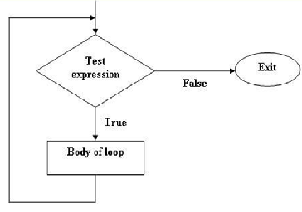
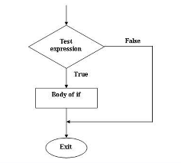
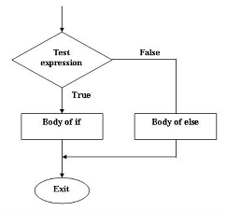
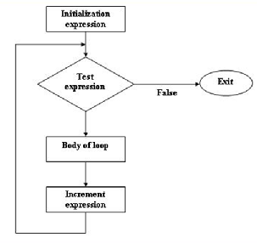
Condition & Looping Symbols
Notes:
LIMITATIONS OF USING FLOWCHARTS
Complex logic: Sometimes, the program logic is quite complicated. In that case, flowchart becomes complex and clumsy.
Alterations and Modifications: If alterations are required the flowchart may require re-drawing completely.
Reproduction: As the flowchart symbols cannot be typed, reproduction of flowchart becomes a problem

Slide 30
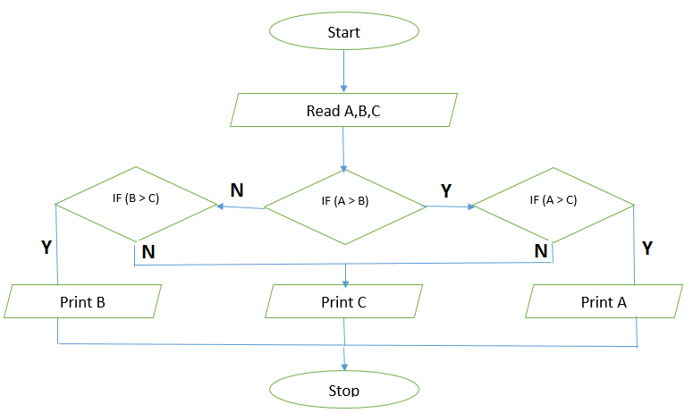
Flowchart 1/3
Problem : To find Max of Three Nos

Slide 31
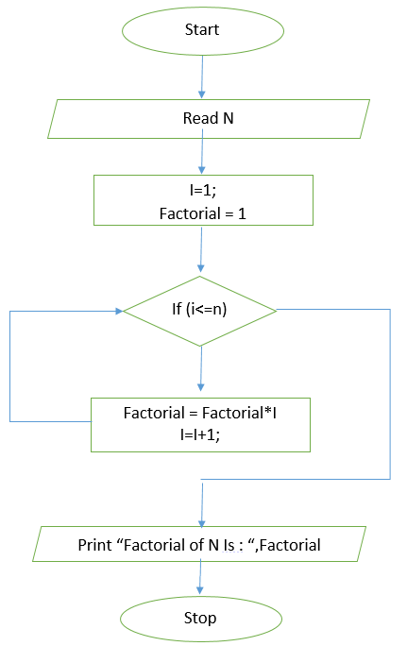
Flowchart 2/3
Problem : To find the factorial of a given number
Notes:
Algorithm 1:
Input : n
Output : factorial of n
Method:
factorial = 1;
for(i=0;i<=n;i++)
factorial=factorial*i;
Display "Factorial : " , factorial

Slide 32
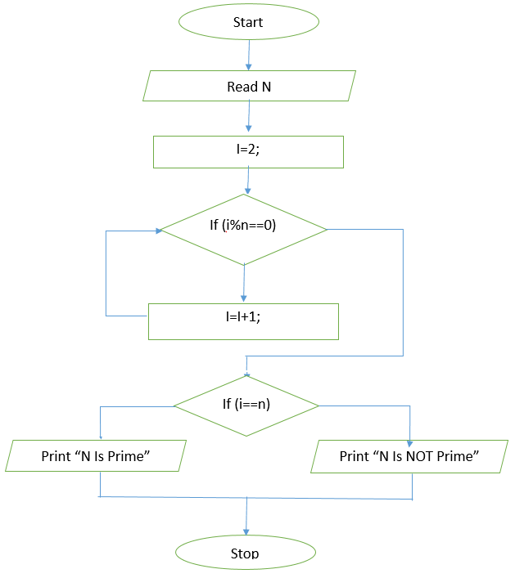
Flowchart 3/3
Problem : To verify whether a number is prime number or not
Notes:
Algorithm 2:
Input : n
Output : n is prime or not
Method:
for(i=2;i<n;i++)
{
if( n%i==0)
break;
}
if(i!=n)
display "n is Prime "
else
display "n is not Prime "

Slide 33
Hands-On Activity
Write a pseudo code and design a flow chart for reversing a number

Slide 34
Summary
At the end of this module, you are able to:
Develop Programs
Write Algorithm
Write Flowcharts

Slide 35
Thank You

