Slide 1
Task-4: Data Storytelling & Statistical Validation

Slide 2
Problem Statement
Analyze sales data to understand business performance and identify insights.

Slide 3
Dataset Overview
Dataset: Sales Data
Columns: Sales, Profit, Category, Region, Month
Total Records: (you can say ~8 or your dataset size)

Slide 4
EDA Insights
Technology category has highest revenue
Office category lowest
Average sales around 1500
Data shows variation across regions

Slide 5
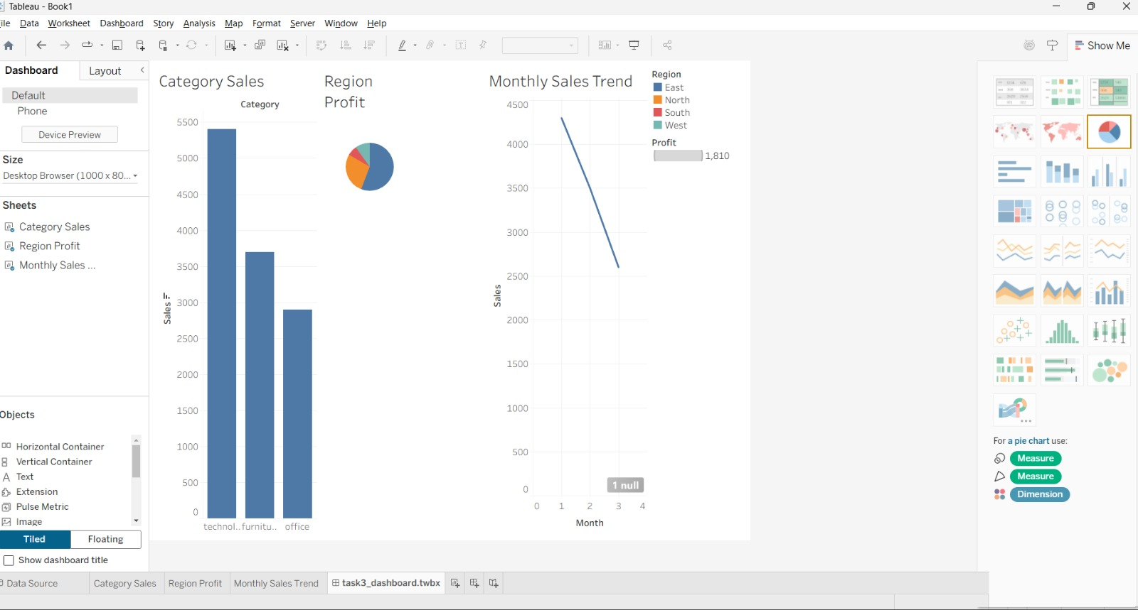
Dashboard Insights
East region highest profit
South region lowest
Sales trend increasing

Slide 6
Segmentation Analysis
High segment → highest profit
Medium → stable
Low → least profit

Slide 7
Hypothesis Testing
H0: No difference in sales between categories
H1: Significant difference exists
Test Used: T-Test
P-value: 0.89
Conclusion: No significant difference in sales between categories

Slide 8
Test Results
T-test performed
p-value < 0.05
Conclusion: Significant difference exists

Slide 9
Business Recommendations
Focus on technology products
Improve performance in South region
Target high-value customers
Optimize low-performing categories

Slide 10
Conclusion
Data-driven insights help improve business decisions
Insights from data can improve profitability and growth.

