Slide 1



Predicting Solar Power Output Using Linear Regression

Slide 2

Learning Objectives
1.Understand solar power generation trends
2.Implement machine learning models for prediction
GOAL
Source :
www.freepik.com/

Slide 3
Tools used: Python
Jupyter Notebook
Pandas
Matplotlib
Scikit-Learn
Numpy
Tools and Technology used:

Slide 4
Data Preprocessing
Exploratory Data Analysis (Histograms, Trends)
Machine Learning Model Development
Methodology

Slide 5
Problem Statement:
How can we predict solar power generation based on historical data?

Slide 6
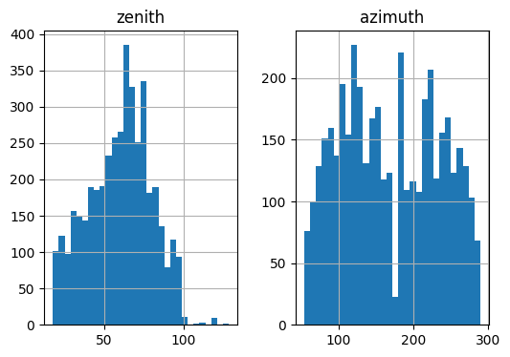
Solution:
Mean Absolute Error on Train Set: 392.4211815

Slide 7
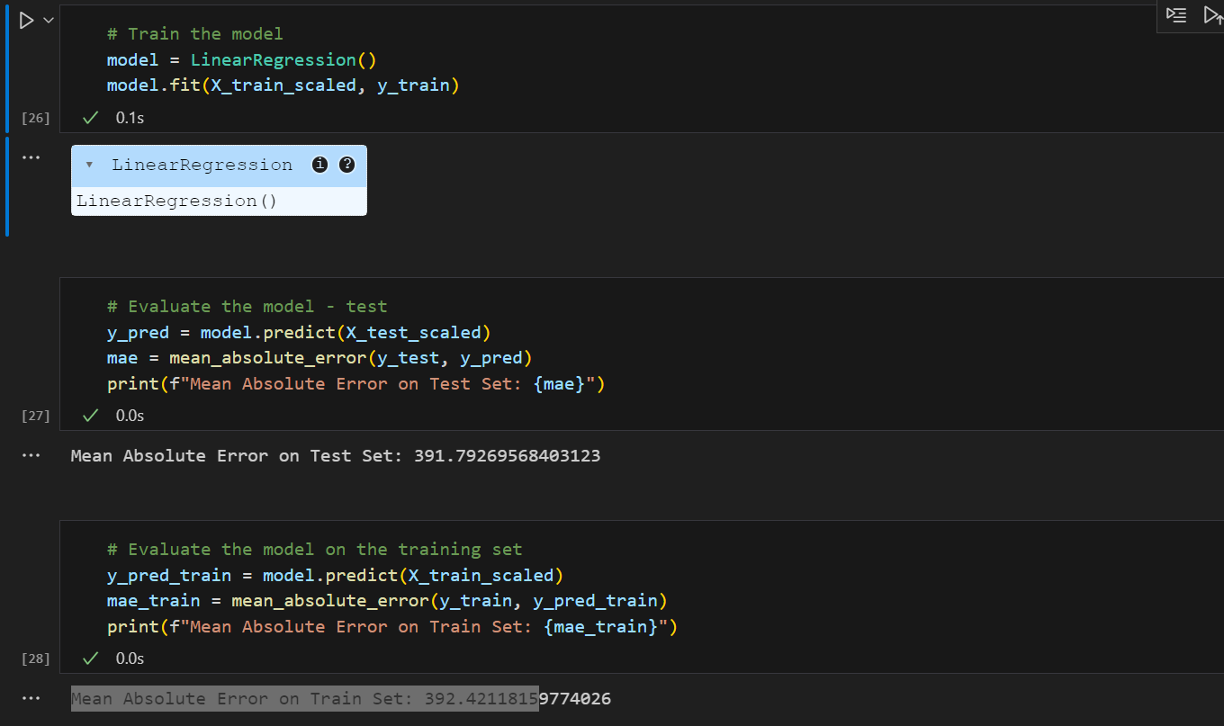
Screenshot of Output:

Slide 8
Conclusion:
Linear regression effectively models the relationship between environmental factors and solar power output, offering reliable predictions.
Accurate forecasting helps optimize energy production, improve grid management, and support the integration of renewable energy sources.
While linear regression provides a solid foundation, incorporating more advanced models or additional data can further enhance prediction accuracy.
This approach contributes to making solar energy systems more efficient, sustainable, and cost-effective.

