Slide 1


Community Detection Problem
GECCO SIGEVO Summer School S3 – 2024
Gayathri Rangu, Indian Institute of Technology Guwahati, India
Ida Gjergji, TU Wien, Austria
Shuaiqun Pan, Leiden University, The Netherlands

Slide 2

Recap: Community Detection Problem
A fully-connected undirected graph
Vertices → users
Weighted edges → intensity of interactions between users
Edge weights can be positive or negative
Positive weights indicate affinity between users
Negative weights indicate a lack of affinity

Slide 3
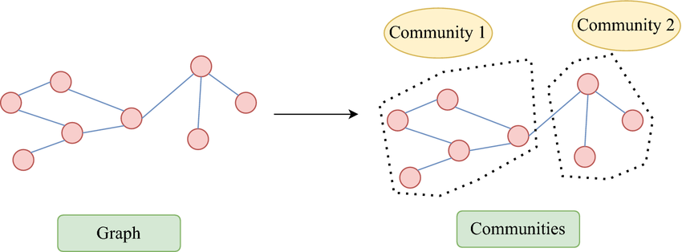
Recap: Community Detection Problem
Community Identification: Groups of users connected mostly by positively weighted edges
Objective: Find groups of users that maximize the total internal edge weight – (sum of weights of edges within a group)
Problem Focus: Optimize the grouping of users to enhance the total internal edge weight across all groups. - Balance between including as many positive edges as possible and minimizing negative edges within groups.

Slide 4
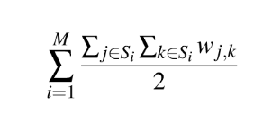
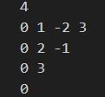

Nature of the Problem
Can be classified as a Combinatorial problem
Utilized the Constructive search and Local search approaches
Input:
Output:
Solution contains a list of communities
Objective function:

Slide 5
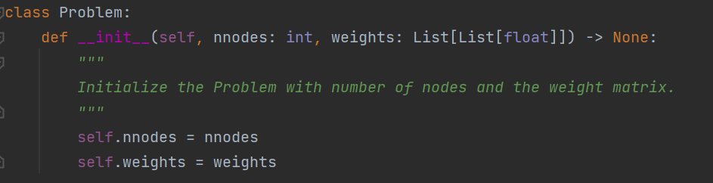
Code
Number of nodes
Weight matrix

Slide 6
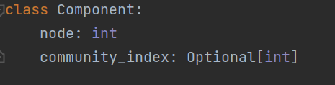
Code
Component comprises:
vertex number
index of the community

Slide 7
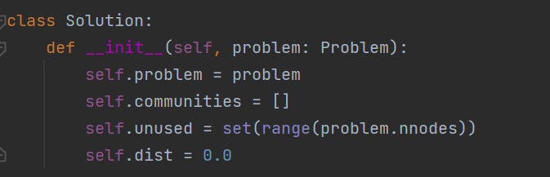
Code

Slide 8
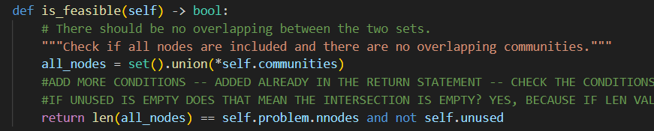
Constructive Search
A solution is considered feasible if it satisfies the following conditions:
Union of all communities must be equal to the total nodes
Communities should be disjoint sets

Slide 9
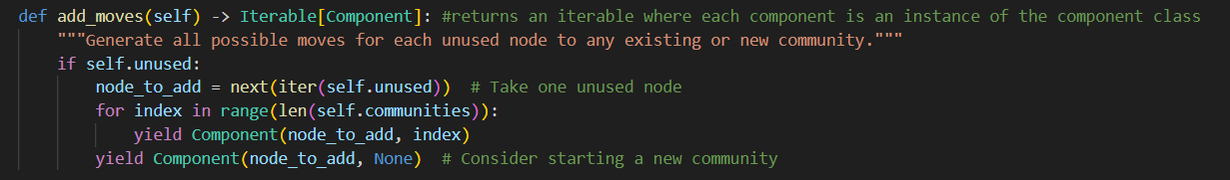
Constructive Search
Adding moves

Slide 10

Constructive Search
Adding nodes to a community:
Check community index
Calculate weights after adding the node to the community
Decision to add the node to the community

Slide 11
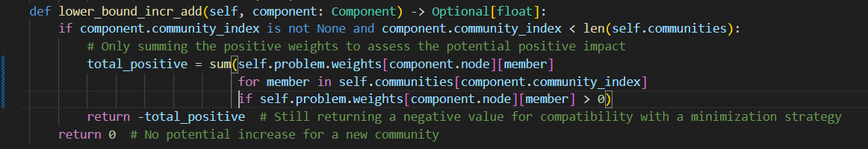
Constructive Search
Lower bound

Slide 12
Local Search
For any selected node:
Replace the node in a randomly selected community
Replace the node in a empty community (if that is not already the case)
Replace the node in the community that bring the most improvement

Slide 13
Future Work
Implementing local search specific functions
Comparing both the methods – which one is better?
Looking at hybrid method (local + constructive) – Is it any better? Advantages/Disadvantages!
Please feel free to ask any questions/ suggest improvements ☺

