Slide 1


Community Detection Problem
GECCO SIGEVO Summer School S3 – 2024
Gayathri Rangu, Indian Institute of Technology Guwahati, India
Ida Gjergji, TU Wien
Shuaiqun Pan,

Slide 2

Recap: Community Detection Problem
A fully-connected undirected graph
Vertices → users
Weighted edges → intensity of interactions between users
Edge weights can be positive or negative
Positive weights indicate affinity between users
Negative weights indicate a lack of affinity

Slide 3
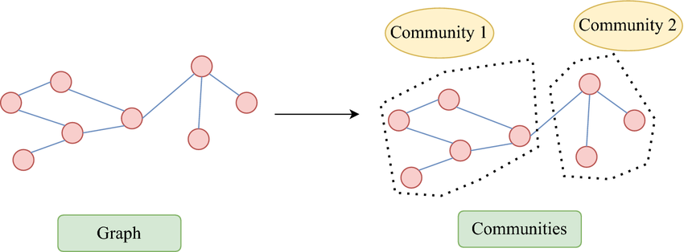
Recap: Community Detection Problem
Community Identification: Groups of users connected mostly by positively weighted edges
Objective: Find groups of users that maximize the total internal edge weight – (sum of weights of edges within a group)
Problem Focus: Optimize the grouping of users to enhance the total internal edge weight across all groups. - Balance between including as many positive edges as possible and minimizing negative edges within groups.

Slide 4
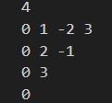

Nature of the Problem
Can be classified as a Combinatorial problem
Utilized the Constructive search and Local search approaches
Input:
Output:
Solution contains a list of communities

Slide 5
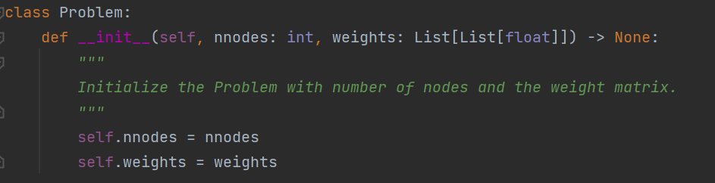
Code
Number of nodes
Weight matrix

Slide 6
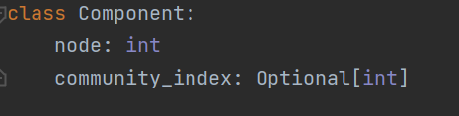
Code
Component comprises:
vertex number
index of the community

Slide 7
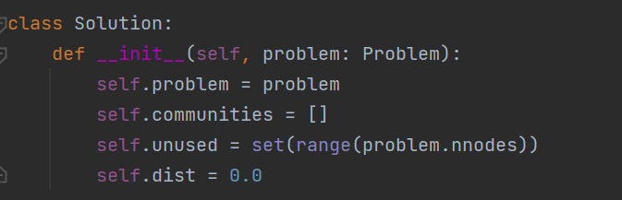
Code

Slide 8
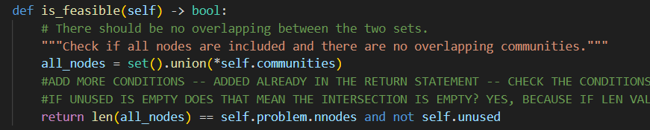
Constructive Search
A solution is considered feasible if it satisfies the following conditions:
Union of all communities must be equal to the total nodes
Communities should be disjoint sets

Slide 9
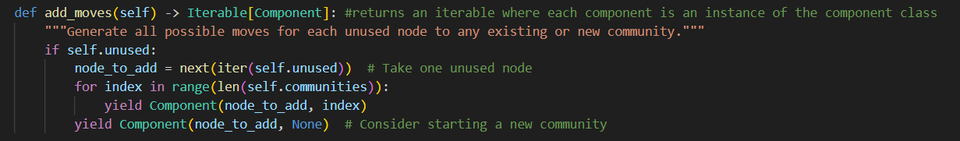
Constructive Search
Adding moves

Slide 10
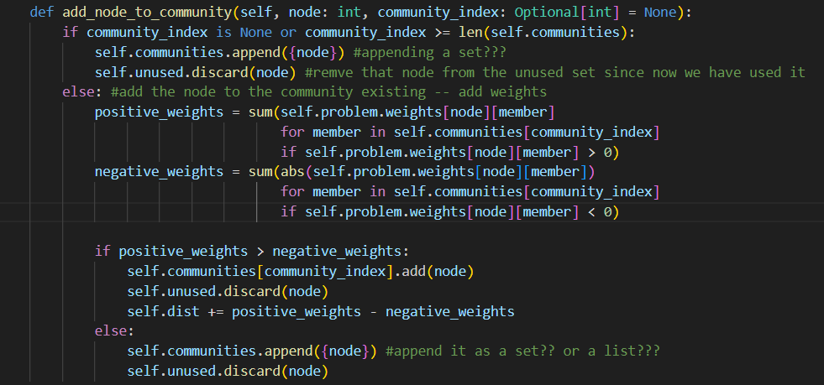
Constructive Search
Adding nodes to a
community

Slide 11
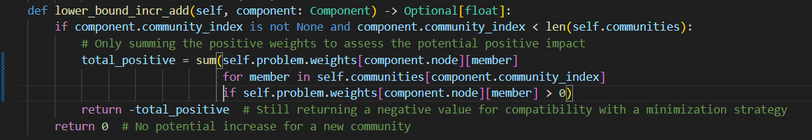
Constructive Search
Lower bound

Slide 12
Local Search
For any selected node:
Replace the node in a randomly selected community
Replace the node in a empty community (if that is not already the case)
Replace the node in the community that bring the most improvement

