Slide 1
Clickbait Detection and News-bias Classification
Sanika Mhadgut - J031
Gayathri Shrikanth - J046

Slide 2
The Real-time Media Bias Detector...

Slide 3
What is Bias?
Media bias is the bias or perceived bias of journalists and news producers within the mass media in the selection of many events and stories that are reported and how they are covered. The term "media bias" implies a pervasive or widespread bias contravening the standards of journalism, rather than the perspective of an individual journalist or article.
Three types of Biases:
Left-wing politics supports social equality and egalitarianism, often in opposition to social hierarchy.
Right-wing politics involves in varying degrees the rejection of some egalitarian objectives of left-wing politics, claiming either that social or economic inequality is natural and inevitable or that it is beneficial to society.
Neutral politics
Our Aim : To identify the direction and degree of media bias in various political news article from newspapers around the world.

Slide 4
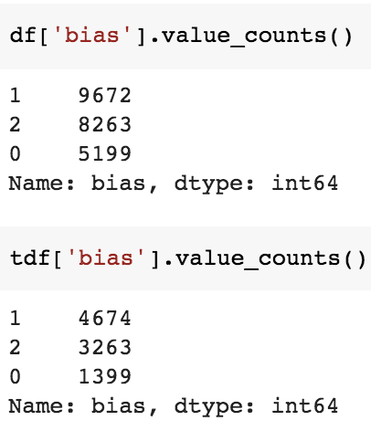
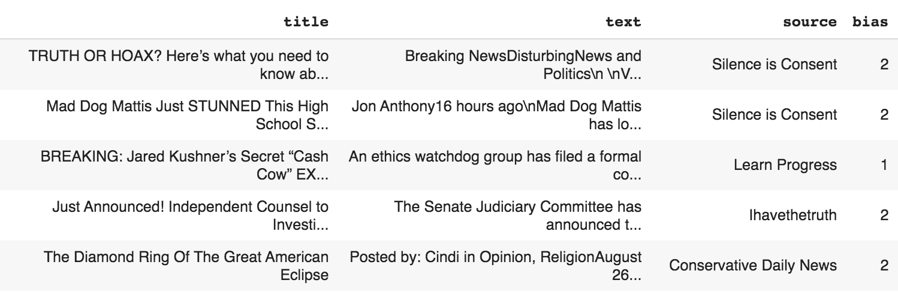
The Dataset
Data from a hand-picked subset of sites that are labeled as "right" - 2, ""left" - 1 and "least-biased" - 0 by mediabiasfactcheck.com.

Slide 5
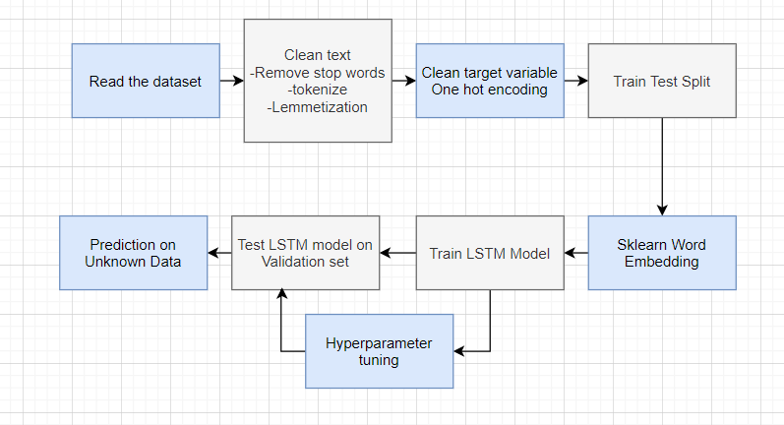
The Pipeline

Slide 6
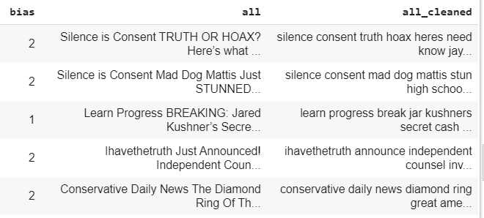
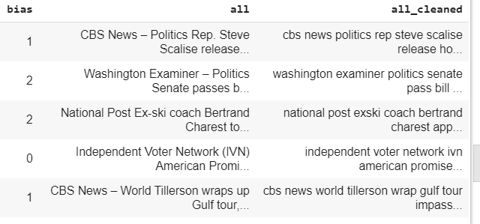
Preprocessing
Before Cleaning
Function 1 - def read_bias_data(f1, f2):
Read the Dataset and assign respective column names
Drop irrelevant/ redundant columns
Drop Na Values
Create a column called “all” containing data from text, source and title column merged together for maximum feature extraction.
Function 2 - def label_encode(df, tdf):
Label encode labels like “lc”, “rc”, “neutral” to a standard format. (0- Neutral, 1- Left, 2-Right)
Function 3 - def clean_text(text):
Convert text to lower case, remove HTML tags, stop words, punctuations, Numbers, Replace contractions using Regex, Lemmatization.
Function 4 - def tokens(str):
Break the text to tokens
After Cleaning

Slide 7
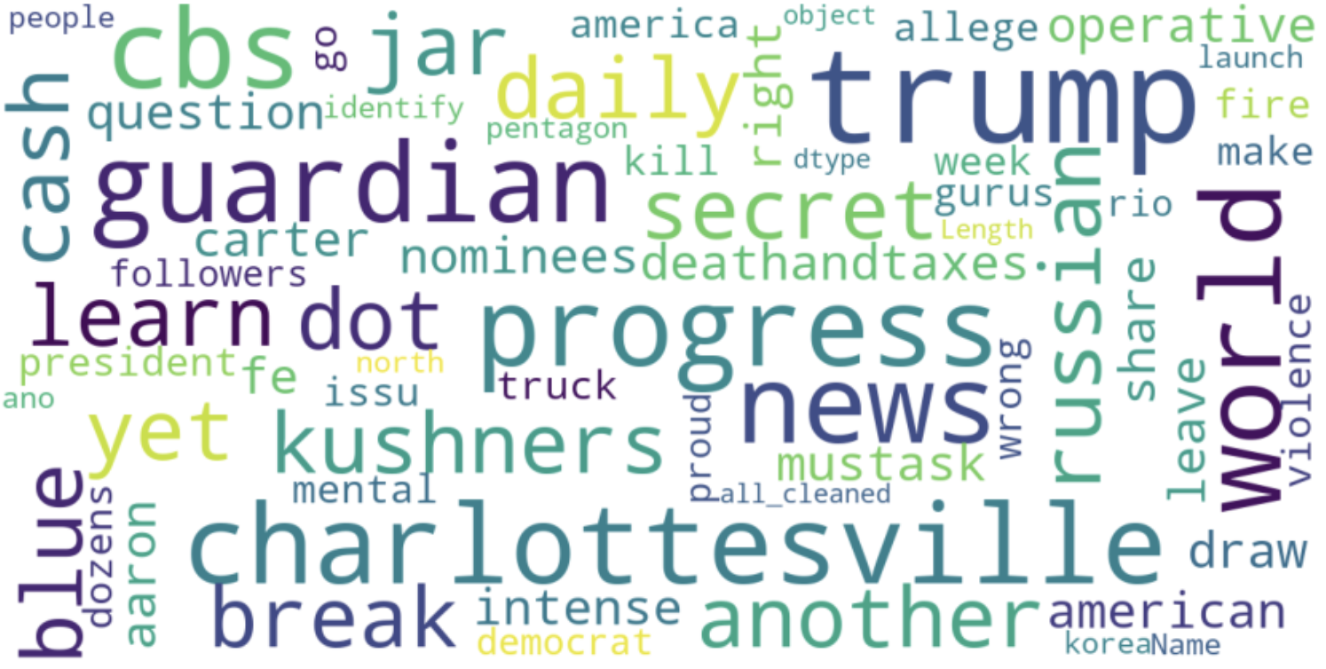
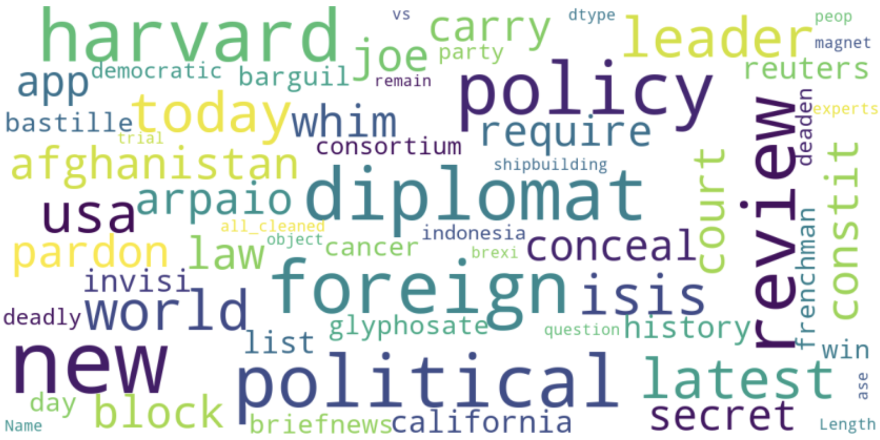
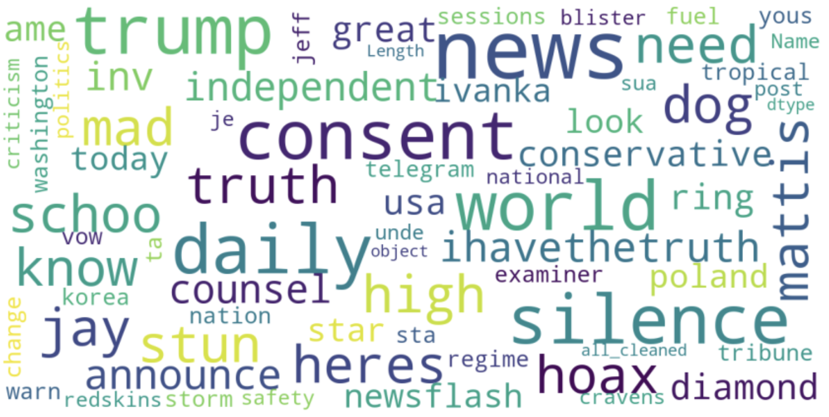
Data Visualization
Word Cloud for Left Bias
Word Cloud for Least Bias
Word Cloud for Right Bias

Slide 8
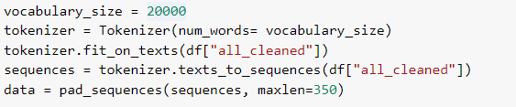
Word Embedding
Countvectorizer, bag of words and TF-IDF approaches can also be used to generate numeric feature vectors from text data.
Potential drawback - Feature vector for each document can be huge therefore causing wastage of space and increasing algorithm complexity exponentially.
In word embeddings, every word is represented as an n-dimensional dense vector. The words that are similar will have similar vector.
fit_on_texts - Updates internal vocabulary based on a list of texts.
It creates the vocabulary index based on word frequency.
texts_to_sequences - Transforms each text in texts to a sequence of integers. So it basically takes each word in the text and replaces it with its corresponding integer value from the word_index dictionary.
Notes:
https://stackabuse.com/python-for-nlp-word-embeddings-for-deep-learning-in-keras/

Slide 9

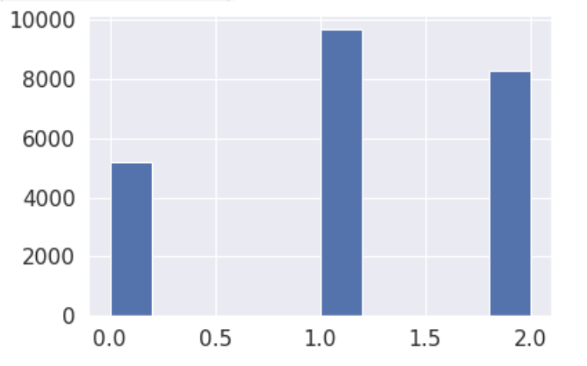



Overcoming Class Imbalance
Resampling involves creating a new transformed version of the training dataset in which the selected examples have a different class distribution.
Random Oversampling randomly duplicate examples in the minority class
Before Oversampling
After Oversampling
Class Count After Oversampling

Slide 10
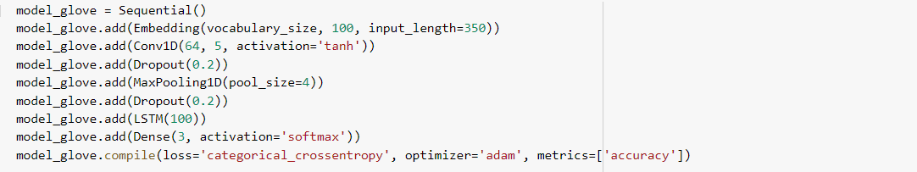
Model
The Embedding Layer-The parameters in the embedding layer are size of the vocabulary, number of the dimensions for each word vector and length of the input sentence.
2 Dropout layers to prevent Overfitting.
CNN CONV1D Layer
LSTM Layer
Output Layer- Dense NN layer with Softmax activation for 3 output classes
Optimizer-adam
Loss function- categorical_cross entropy

Slide 11
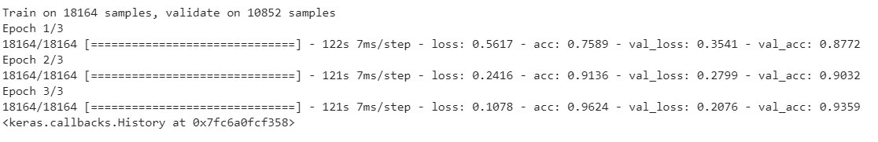
Results
Use of Early Stopping to prevent overfitting.
Output
Final training accuracy: 96.24% Final Validation Accuracy: 93.59%

Slide 12
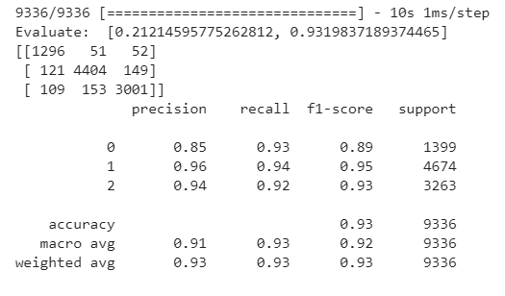
Output on Unseen Test Set
Testing Accuracy= 93.19% Precision for the 3 classes are: 0.85, 0.96, 0.94

Slide 13
Clickbait or Not?
A Classification model...

Slide 14
What is Clickbait?
Ever since the boom of social media, more and more people use it to get and spread information. However, the negative effect of it is that increasing number of fake news and posts with clickbait shows up and confuses people from time to time.
Clickbait refers to social media posts that are, at the expense of being informative and objective, designed to entice its readers into clicking an accompanying link.
Clickbait tweets typically aim to exploit the "curiosity gap", providing just enough information to make readers curious, but not enough to satisfy their curiosity without clicking through to the linked content.
Our Aim
To classify whether a social media post text is a clickbait or not.

Slide 15
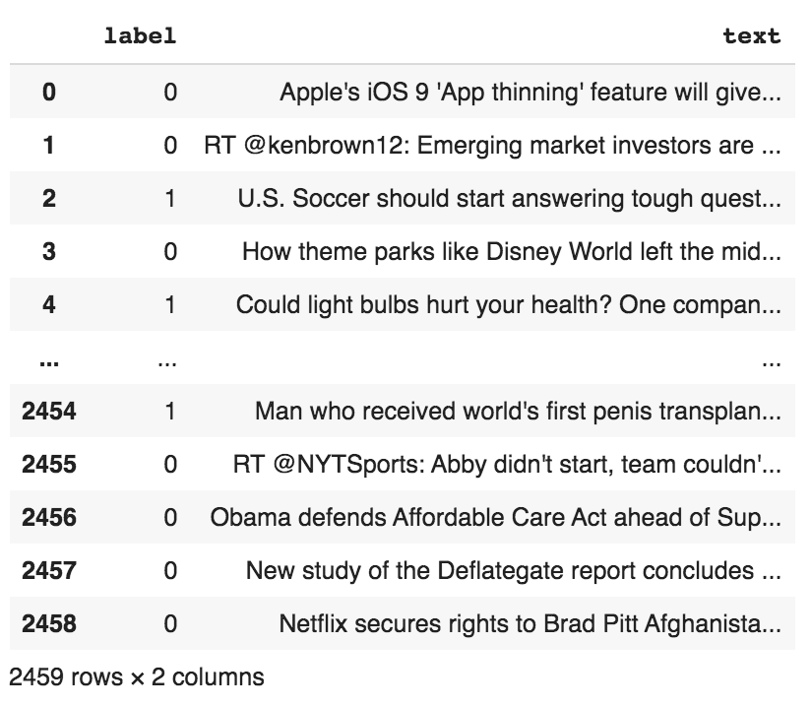
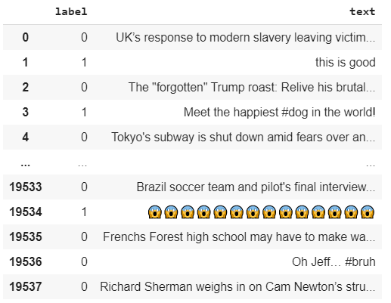
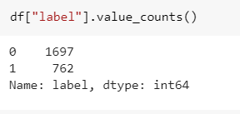
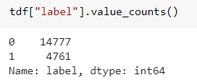
The Dataset
In this dataset, there are a small training set including 2495 posts, a large training/validation set including 19538 posts, and an unlabeled test set without labels.

Slide 16
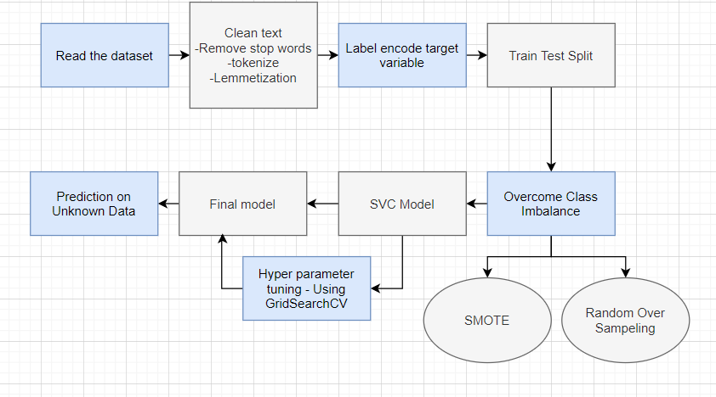
The Pipeline

Slide 17
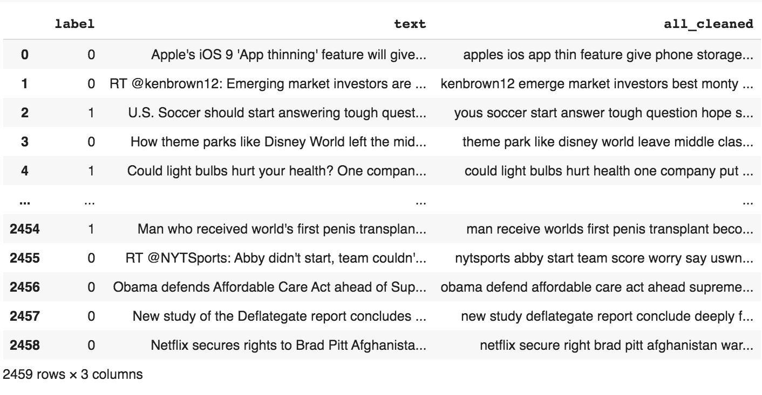
Preprocessing
Function 1 - def read_clickbait_data(fi, ft):
Read the Dataset and assign respective column names
Merge text and truth class column
Label encode truth class column
Create a column called “text” containing data from text
Function 2 - def clean_text(text):
Convert text to lower case, remove HTML tags, stop words, punctuations, Numbers, Replace contractions using Regex, Lemmatization.
Function 3 - def tokens(str):
Break the text to tokens
Before Cleaning
After Cleaning

Slide 18
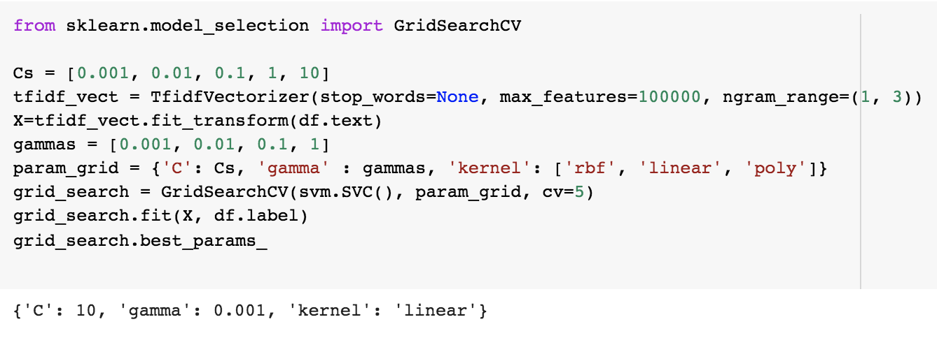
TF-IDF & Grid Search CV
Here, we have used TF-IDF approach to convert a collection of raw documents to a matrix of TF-IDF features.
TFIDF, short for term frequency–inverse document frequency, is a numerical statistic that is intended to reflect how important a word is to a document in a collection or corpus.
Grid search is an approach to parameter tuning that will methodically build and evaluate a model for each combination of algorithm parameters specified in a grid.
TFIDF parameters:
Ngram_range: The lower and upper boundary of the range of n-values for different n-grams to be extracted. (1,3) means tri-gram.
Max_features: 100000, build a vocabulary that only consider the top max_features ordered by term frequency across the corpus.
Output parameters
Notes:
https://stackabuse.com/python-for-nlp-word-embeddings-for-deep-learning-in-keras/

Slide 19
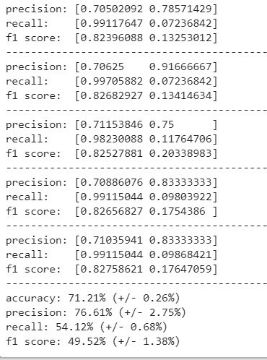
Model
SVC Model Accuracy
SVC (Support Vector Classifier)
Support vector machines is an algorithm that determines the best decision boundary between vectors that belong to a given group (or category) and vectors that do not belong to it.
SVC is a supervised machine learning classifier that uses classification algorithms for two-group classification problems. On training labeled data for each category, they're able to categorize new text.

Slide 20
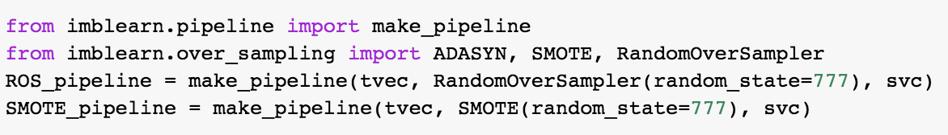


Handling Class Imbalance
This bias in the training dataset can influence many machine learning algorithms, leading some to ignore the minority class entirely.
Random Over Sampling - Random oversampling involves randomly selecting examples from the minority class, with replacement, and adding them to the training dataset.
SMOTE - Synthetic Minority Oversampling Technique.This is a type of data augmentation for the minority class. It is a simple approach involves duplicating examples in the minority class, although these examples don’t add any new information to the model. Instead, new examples can be synthesized from the existing examples.

Slide 21
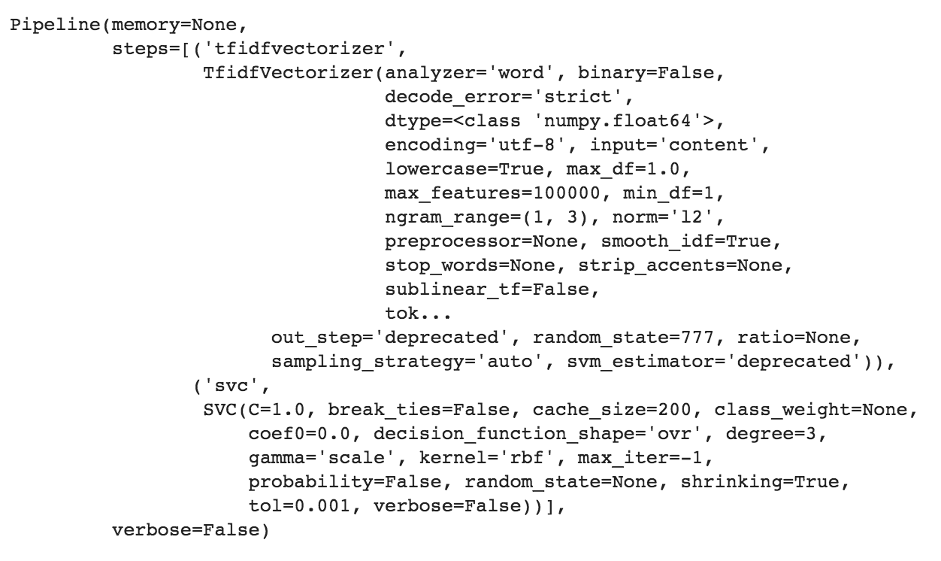
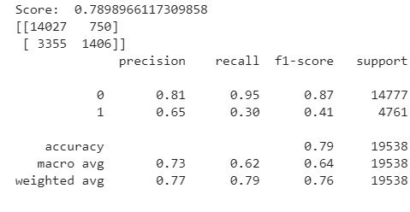
Results
Pipeline
Accuracy score after SMOTE Oversampling
Final Testing Accuracy: 78.98%

Slide 22
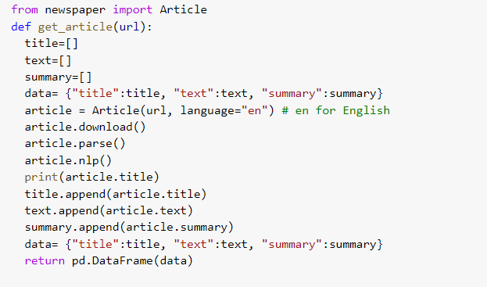
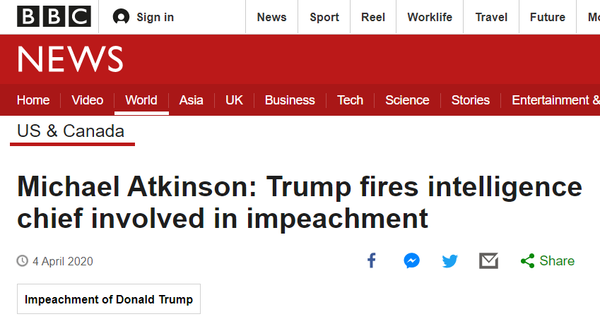
Prediction on new data
Given a link, data is downloaded and extracted via Web-Scraping.

Slide 23
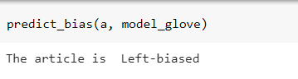
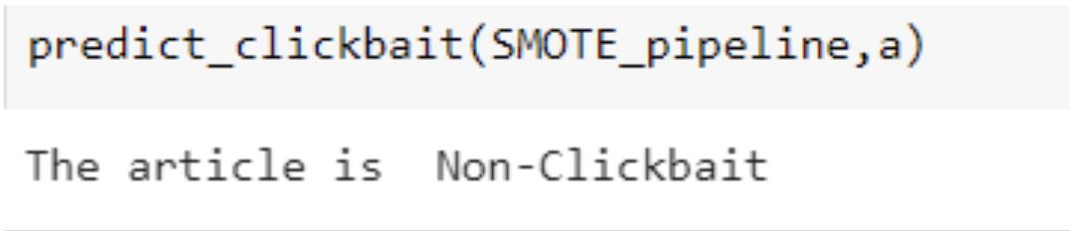
Final Result
predict_bias(a, model_glove)
Calls the SVC Clickbait pipeline to classify if the new Article is a clickbait or not.
predict_clickbait(SMOTE_pipeline, a)
Calls the SVC Clickbait pipeline to classify if the new Article is a clickbait or not.

Slide 24
Future Scope
Improve model accuracy and reduce Overfitting.
Scrape data for training based on classification from multiple bias detection websites.
Use of more current news data for training.
Deployment of the model.
Use of the model like a chrome extension which tags all News links as Biased or Clickbait

