Slide 1
GROUP 5 AIR QUALITY ANALYSIS AND PREDICTION IN TAMIL NADU GAYATHRI T

Slide 2
INTRODUCTION
Major concerns in industrial cities which experience air pollution, can be harmful not only for the environment but also for human health. Due to this urban resident are more likely to live in less polluted neighbourhood to avoid the health impact of air pollution. Atmospheric pollution can be classified into three types based on the source mobile, stationery and area sources. Mobile sources are due to the motor vehicles, airplanes, locomotives and other engines and equipment that are able to move to different locations

Slide 3
Stationary sources include foundries, fossil fuel burning, food processing plants, power plants, refineries and other industrial sources. Area sources is caused by certain local actions. Air pollution can be caused due to the pollutants which are emitted directly from a source or which are not directly emitted as such. It can result in the degradation of ambient air quality in the industrial cities also daily exposure of people to air pollution results in diseases like asthma, wheezing, and bronchitis.

Slide 4
COLUMNS USED:
Standard code
Sampling Date
State
City/Town/Village
Location of agency
Type of location
SO2
NO2
RSPM/PM10
10.PM2.5

Slide 5
Visualization
Visualize the customer segments using techniques like scatter plots, bar charts, and heatmaps. Interpretation: Analyze and interpret the characteristics of each customer segment to derive actionable insights for marketing strategies.

Slide 6
Importing the libraries:
Import three basic libraries which are very common in machine learning and will be used every time you train a model
NumPy: it is a library that allows us to work with arrays and as most machine learning models work on arrays NumPy makes it easier
matplotlib: this library helps in plotting graphs and charts, which are very useful while showing the result of your model
Pandas: pandas allows us to import our dataset and also creates a matrix of features containing the dependent and independent variable.
Seaborn : seaborn helps in visualization

Slide 7
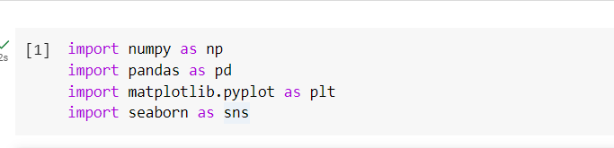

Slide 8
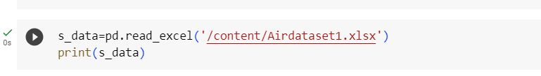
Load the dataset: (DATASET 1)
Data sets are available in .csv format. A CSV file stores tabular data in plain text.
Each line of the file is a data record. We use the read.csv method of the pandas library to read a local CSV file as a data frame.
Load our customer data from the CSV file

Slide 9
Head() Function:
The head() function is used to get the first n rows.
This function returns the first n rows for the object based on position.
It is useful for quickly testing if your object has the right type of data in it.
If the value of the n is not assigned it returns a default value of first 5 rows

Slide 10
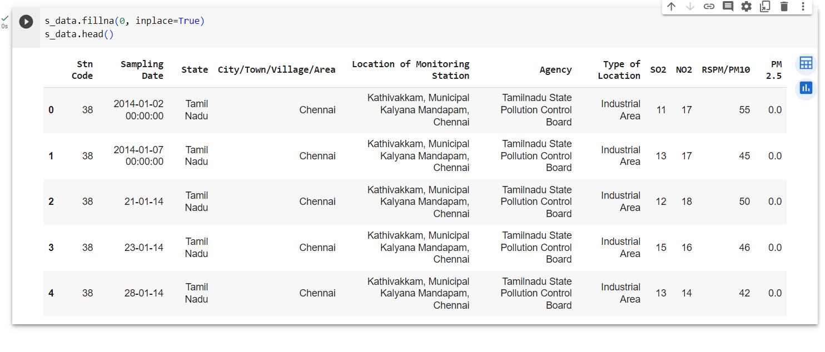

Slide 11
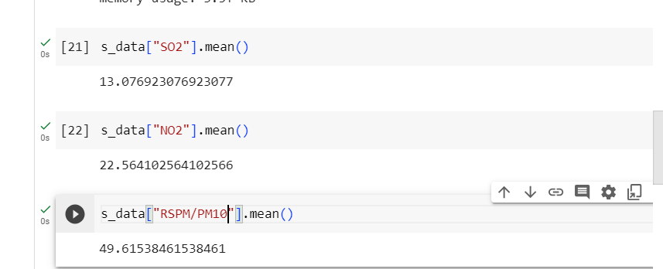
AVERAGE FOR SO2,NO2,RSPM/PM10

Slide 12
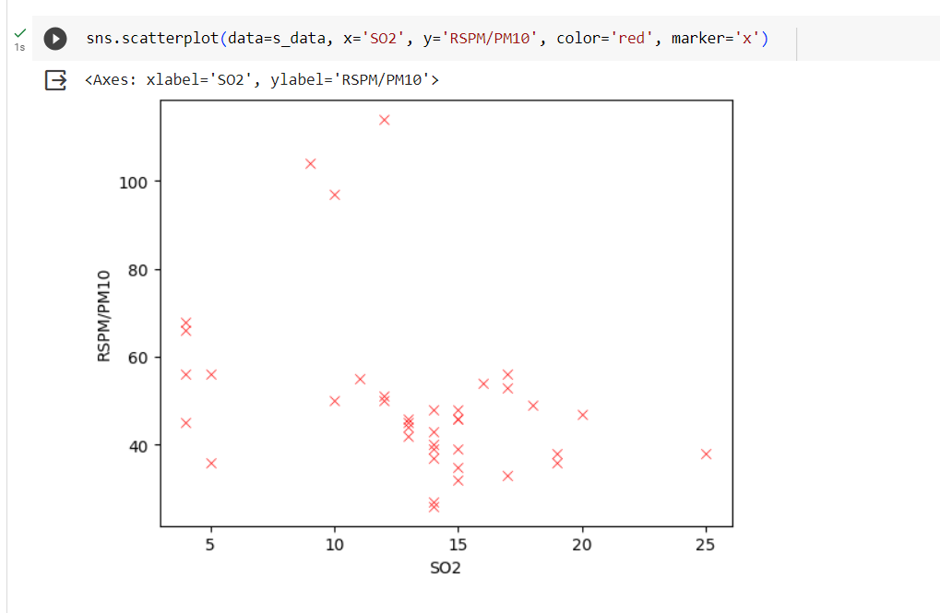

Slide 13
Correlation:
Correlation is a statistical measure that indicates the extent to which two or more variables fluctuate in relation to each other.
Correlation describes the relationship between variables. It can be described as either strong or weak, and as either positive or negative.

Slide 14
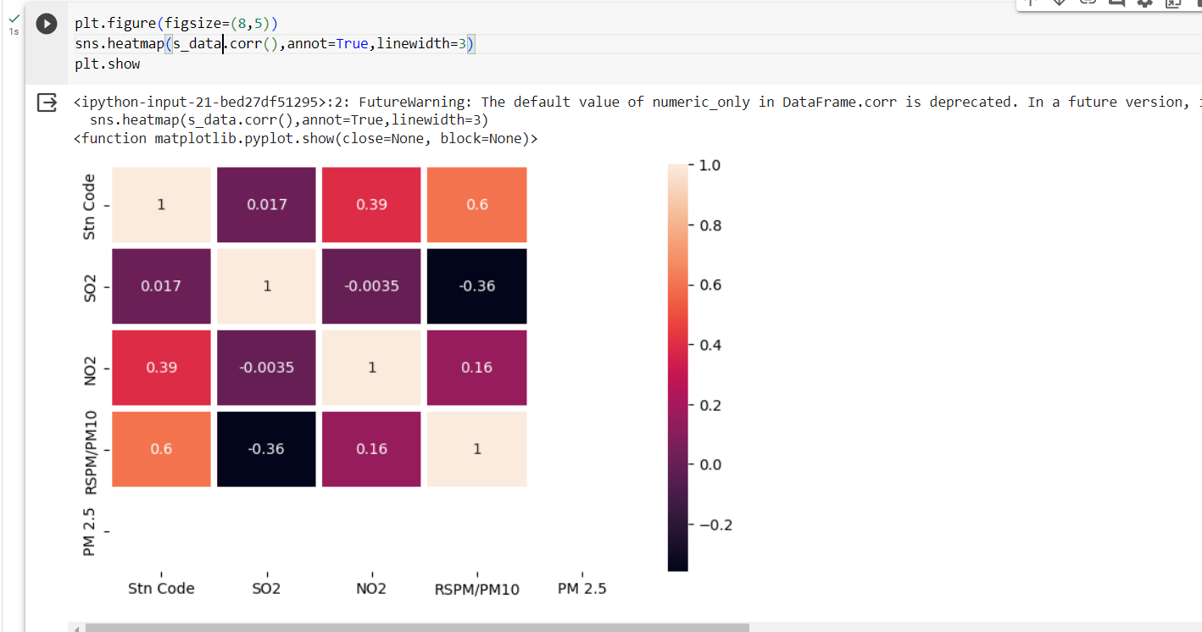

Slide 15
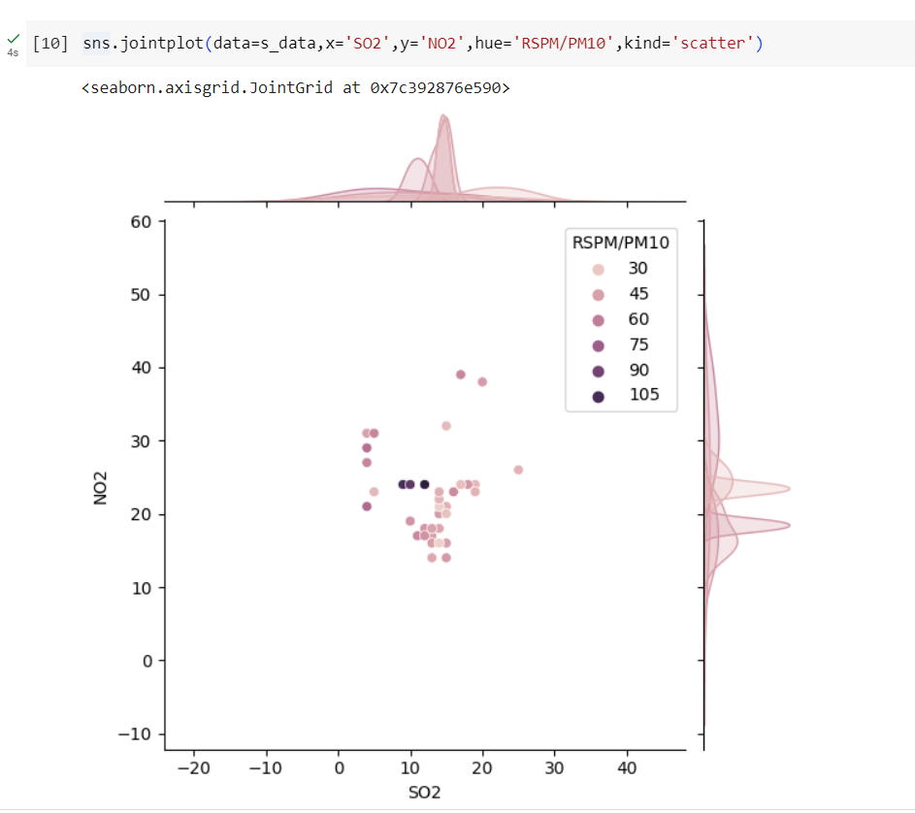

Slide 16
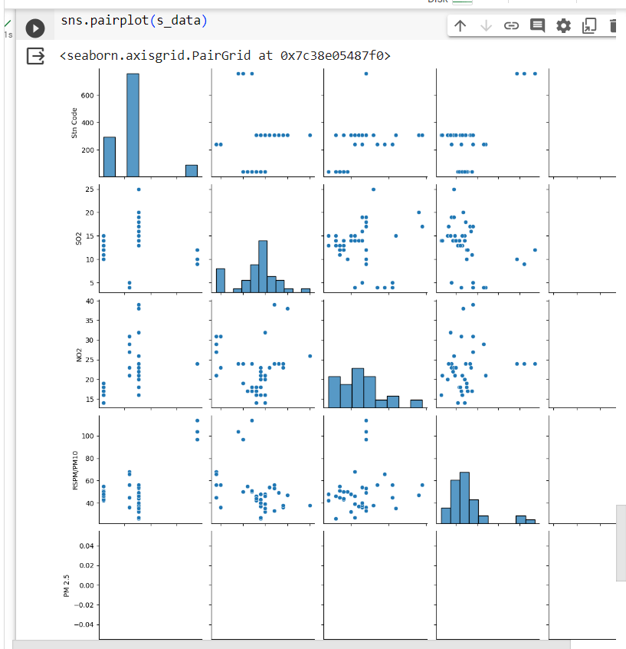

Slide 17
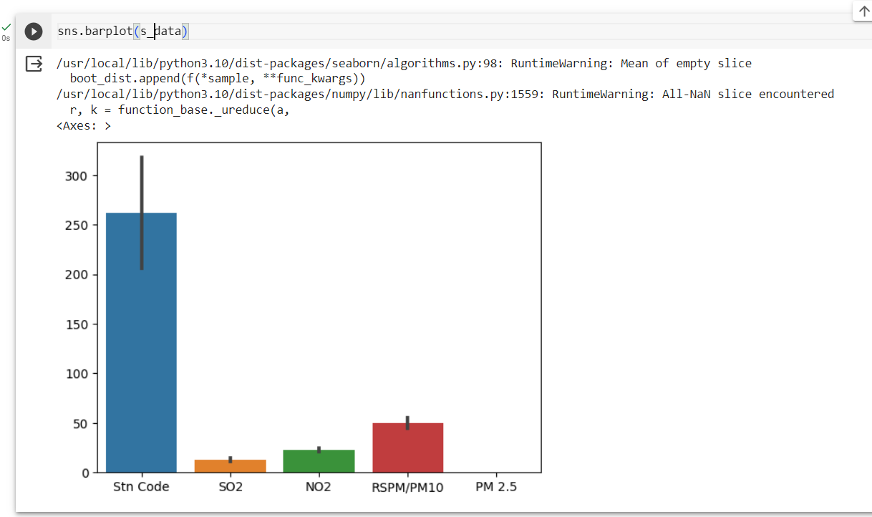

Slide 18
Missingno Function:
"missing no" is a Python library used for visualizing and analyze missing data in a dataset.
It provides various visualization tools to quickly understand and identify missing values in your data, allowing you to make informed decisions on how to handle or impute missing data.

Slide 19
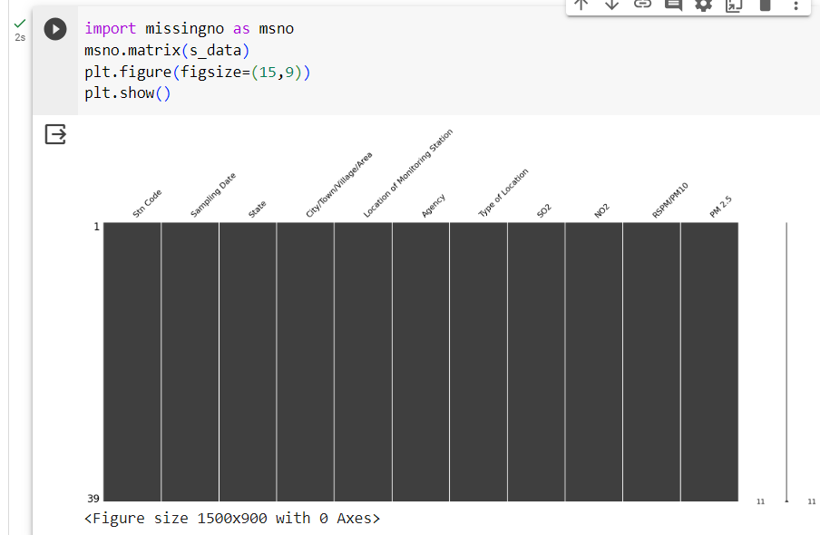

Slide 20
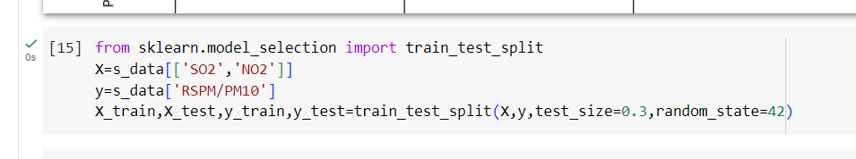

Slide 21
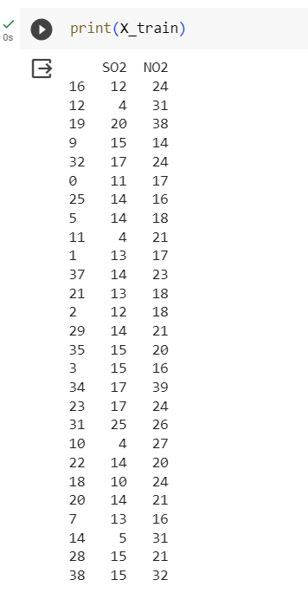

Slide 22
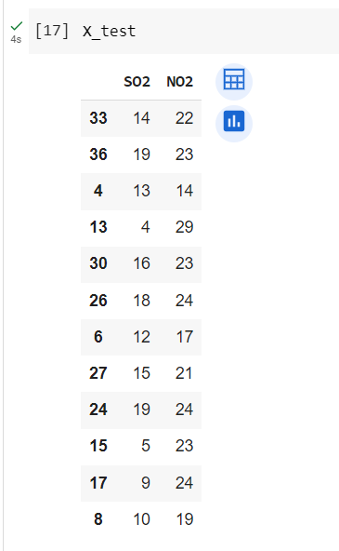

Slide 23
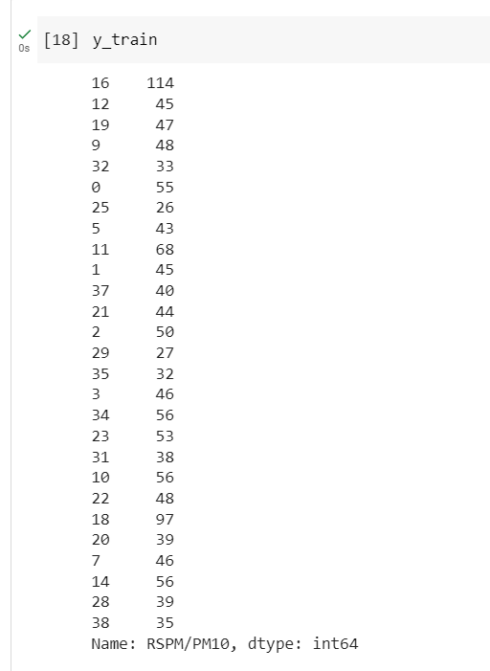

Slide 24
