Slide 1
Group 5 AIR QUALITY ANALYSIS AND PREDICTION IN TAMIL NADU
GAYATHRI T

Slide 2
INTRODUCTION
Major concerns in industrial cities which experience air pollution, can be harmful not only for the environment but also for human health. Due to this urban resident are more likely to live in less polluted neighbourhood to avoid the health impact of air pollution. Atmospheric pollution can be classified into three types based on the source mobile, stationery and area sources. Mobile sources are due to the motor vehicles, airplanes, locomotives and other engines and equipment that are able to move to different locations

Slide 3
Exploratory Data Analysis (EDA):
Analyze and visualize the data to identify trends, patterns, and correlations in air quality parameters. Use techniques such as histograms, scatter plots, and correlation matrices.
Use statistical techniques and visualizations to gain insights into the data.
Visualize the data to gain insights into its distribution, patterns, and relationships between variables. Visualization can help in the exploratory data analysis (EDA) phase.
Explore the impact of factors such as pollutants, weather conditions, and geography on air quality. This step helps in understanding the drivers of air quality changes.

Slide 4
COLUMNS USED:
Standard code
Sampling Date
State
City/Town/Village
Location of agency
Type of location
SO2
NO2
RSPM/PM10
10.PM2.5

Slide 5
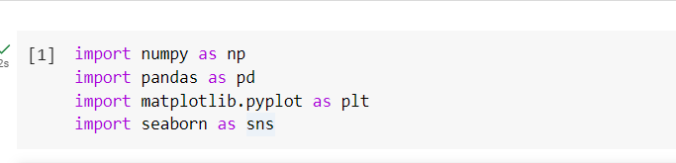
Import three basic libraries which are very common in machine learning and will be used every time you train a model NumPy: it is a library that allows us to work with arrays and as most machine learning models work on arrays NumPy makes it easier matplotlib: this library helps in plotting graphs and charts, which are very useful while showing the result of your model Pandas: pandas allows us to import our dataset and also creates a matrix of features containing the dependent and independent variable. Seaborn : seaborn helps in visualization

Slide 6
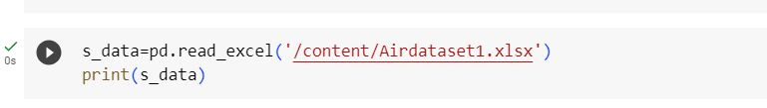
Load the dataset: (DATASET 1)
Data sets are available in .csv format. A CSV file stores tabular data in plain text.
Each line of the file is a data record. We use the read.csv method of the pandas library to read a local CSV file as a data frame.

Slide 7
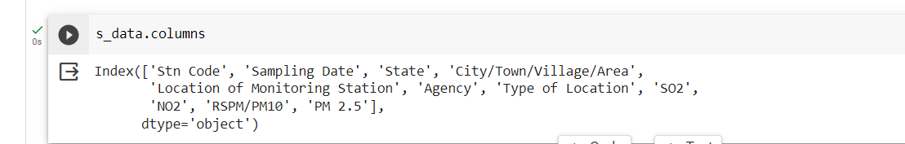
Dataset columns :
Dataset columns :
For example the Grades column, we could simply use the loc function and specify the name of the column in order to retrieve it.

Slide 8
Head() Function:
The head() function is used to get the first n rows.
This function returns the first n rows for the object based on position.
It is useful for quickly testing if your object has the right type of data in it.
If the value of the n is not assigned it returns a default value of first 5 rows

Slide 9
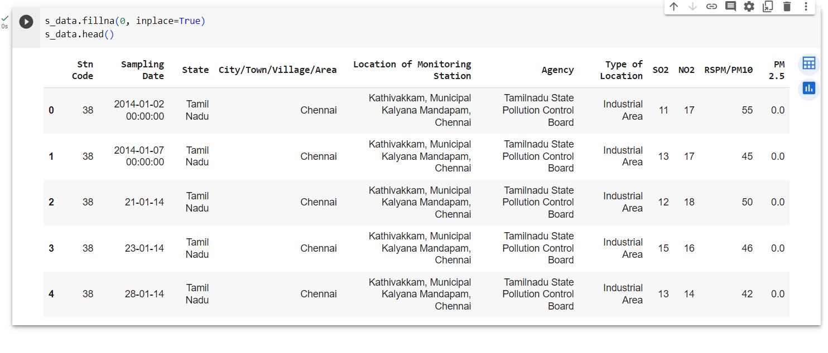

Slide 10
DESCRIBE FUNCTION:
Describe Function:
The describe() function in pandas, a popular Python data analysis library, is used to generate summary statistics of a Series.
It provides a quick overview of the key statistics for numerical data in the dataset, including:
Count: The number of non-null values.
Mean: The average of the values.
Standard Deviation (std): A measure of the spread or dispersion of the data.
Minimum: The minimum value in the dataset.

Slide 11
DESCRIBE FUNCTION:
25th Percentile (25%): The value below which 25% of the data falls (the first quartile).
Median (50% or the 2nd quartile): The middle value when the data is sorted.
75th Percentile (75%): The value below which 75% of the data falls (the third quartile).
Maximum: The maximum value in the dataset.

Slide 12
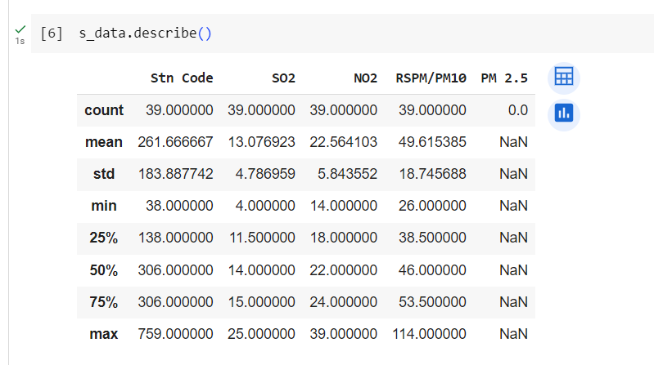

Slide 13
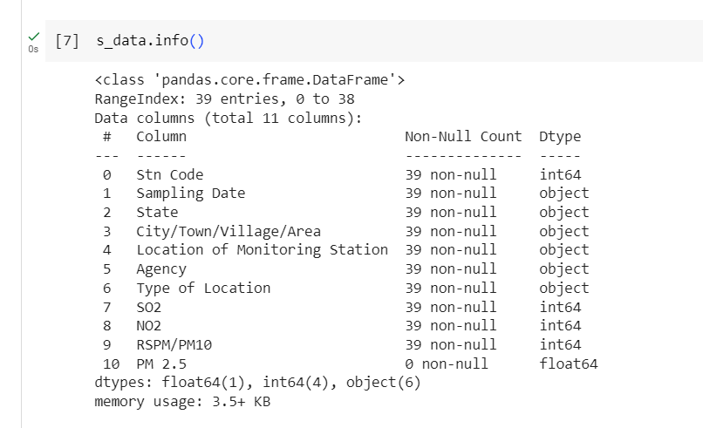
Info() Function:
The info() method prints information about the data frame.
The information contains the number of columns, column labels, column data types, memory usage, range index, and the number of cells in each column (non-null values).

Slide 14
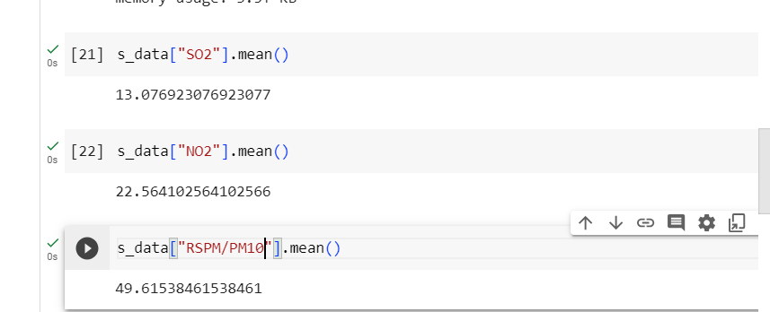
AVERAGE FOR SO2,NO2,RSPM/PM10

Slide 15
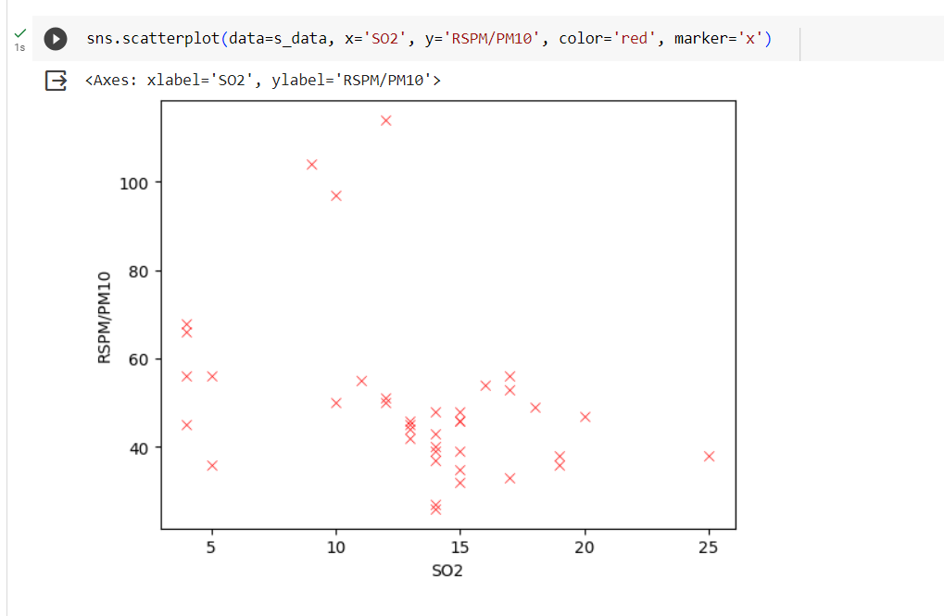

Slide 16
Corelation:
Correlation is a statistical measure that indicates the extent to which two or more variables fluctuate in relation to each other.
Correlation describes the relationship between variables. It can be described as either strong or weak, and as either positive or negative.

Slide 17
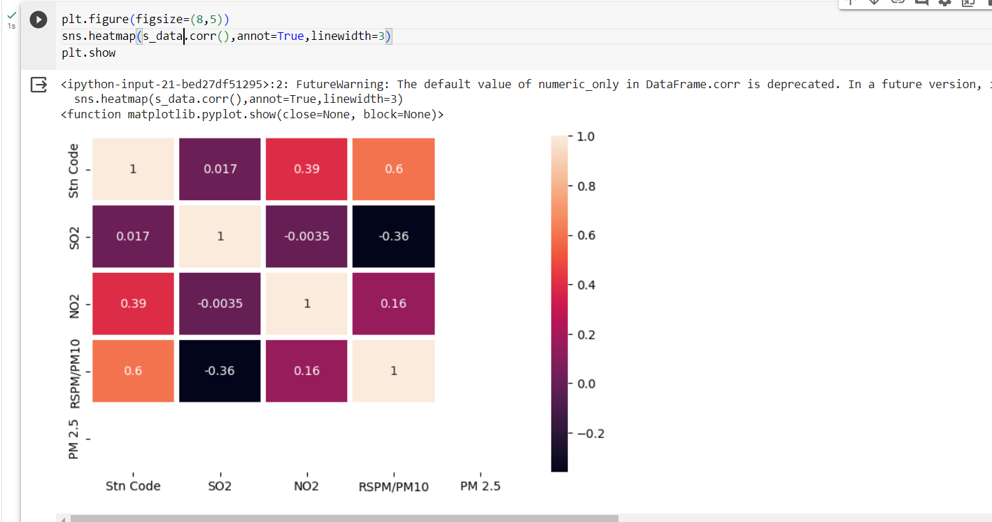

Slide 18
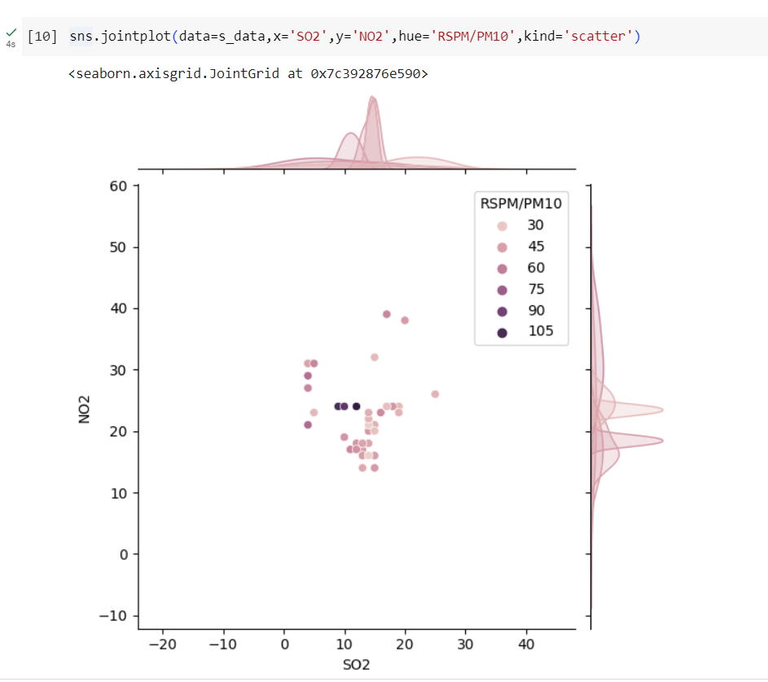

Slide 19
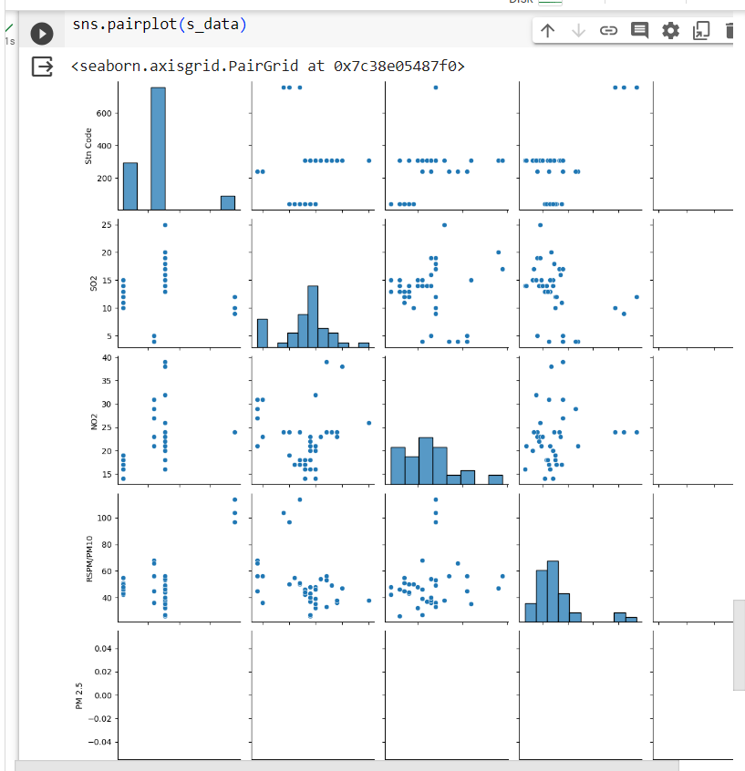

Slide 20
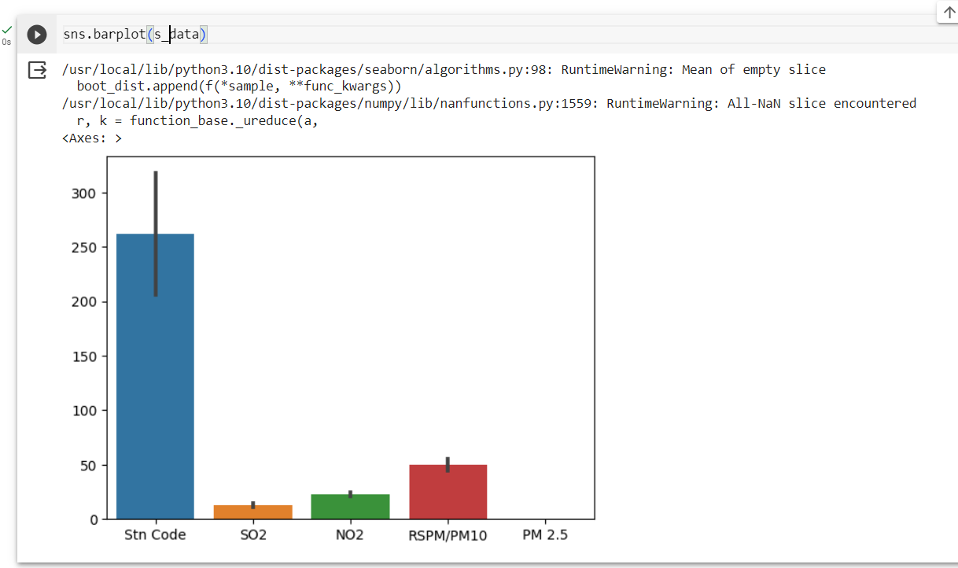

Slide 21
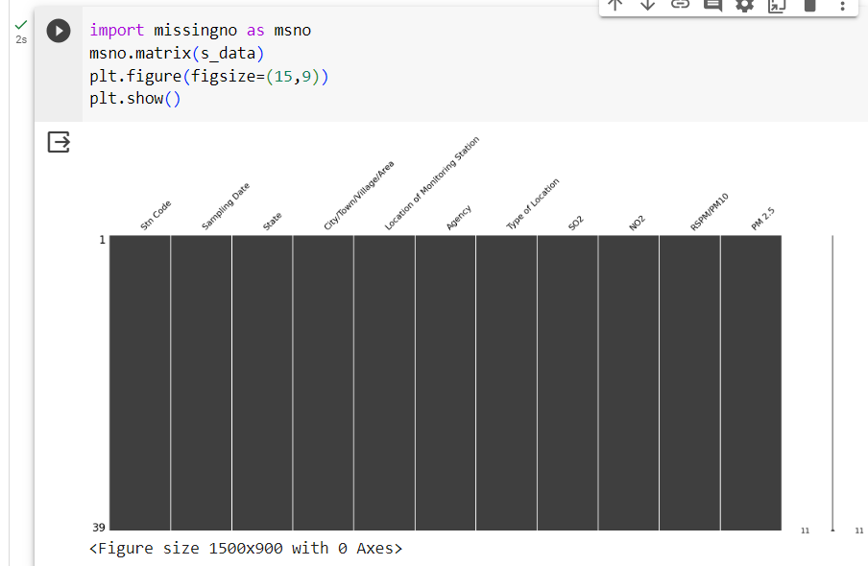

Slide 22
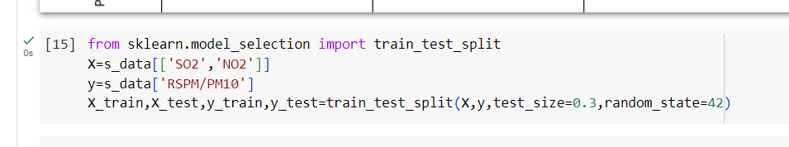

Slide 23
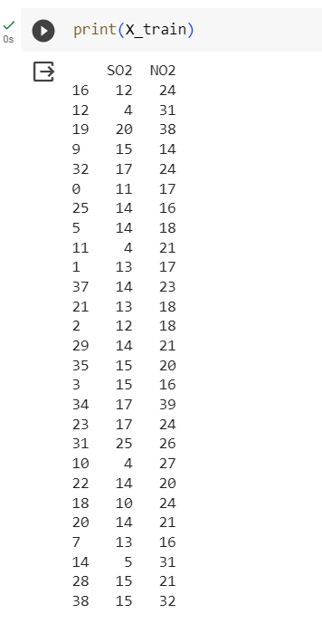

Slide 24
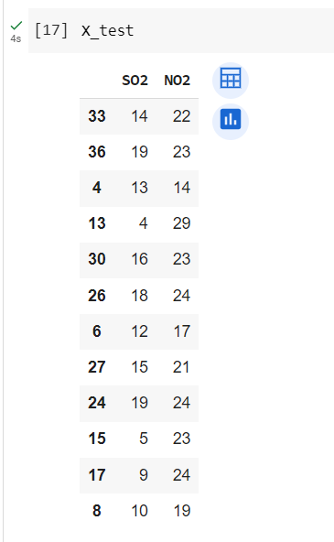

Slide 25
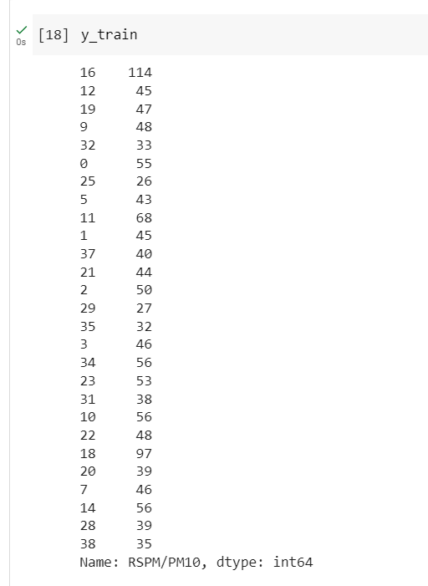

Slide 26
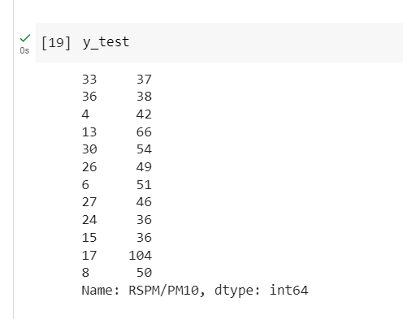

Slide 27
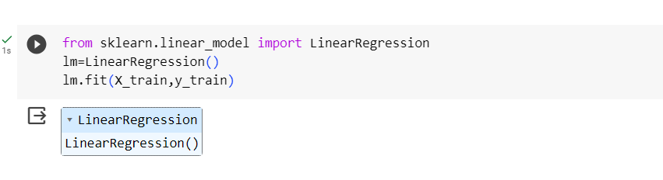

Slide 28
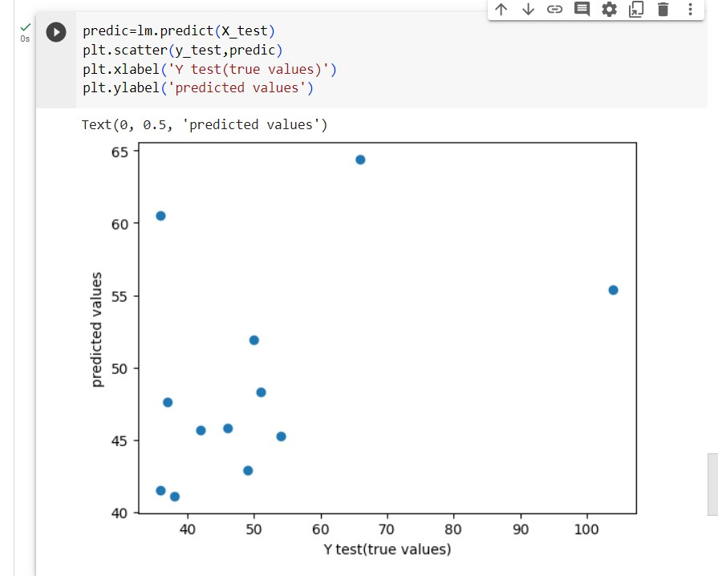

Slide 29
