Slide 1
Cross-sell Prediction
Gayathri G

Slide 2
Problem statement
An insurance company, wants a predictive model to determine if health insurance policyholders will also purchase vehicle insurance.
Vehicle insurance, like health insurance, involves customers paying premiums to cover potential losses (e.g., accidents).
Using data on demographics (age, gender, region type), vehicle details (age, damage history), and policy attributes (premium amount, sourcing channel), the model will help optimize communication strategies and improve business planning.

Slide 3
DATASET Overview
Column | Definition
Id | Unique ID for the customer
Gender | Gender of the customer
Age | Age of the customer
Driving_License | 0 : Customer does not have DL, 1 : Customer already has DL
Region_Code | Unique code for the region of the customer
Previously_Insured | 1 : Customer already has Vehicle Insurance, 0 : Customer doesn't have Vehicle Insurance
Vehicle_Age | Age of the Vehicle
Vehicle_Damage | 1 : Customer got his/her vehicle damaged in the past. 0 : Customer didn't get his/her vehicle damaged in the past.
Annual_Premium | The amount customer needs to pay as premium in the year
Policy_Sales_Channel | Anonymised Code for the channel of outreaching to the customer ie. Different Agents, Over Mail, Over Phone, In Person, etc.
Vintage | Number of Days, Customer has been associated with the company
Response | 1 : Customer is interested, 0 : Customer is not interested

Slide 4
Data understanding and initial observations
1) Unique Identifier Column:
The id column contains unique values for each record, so it does not contribute to the prediction and can be dropped during preprocessing.
2) Null Values:
There are no missing values in any column of the dataset, ensuring no need for imputation.
3) Duplicate Values:
The dataset does not contain any duplicate rows, indicating clean data.
4) Categorical and Numerical Features:
Categorical Columns: These can be encoded using one-hot encoding to transform them into numerical format.
Numerical Columns: These features will be standardized using StandardScaler to ensure they have a mean of 0 and a standard deviation of 1 for consistent scaling

Slide 5
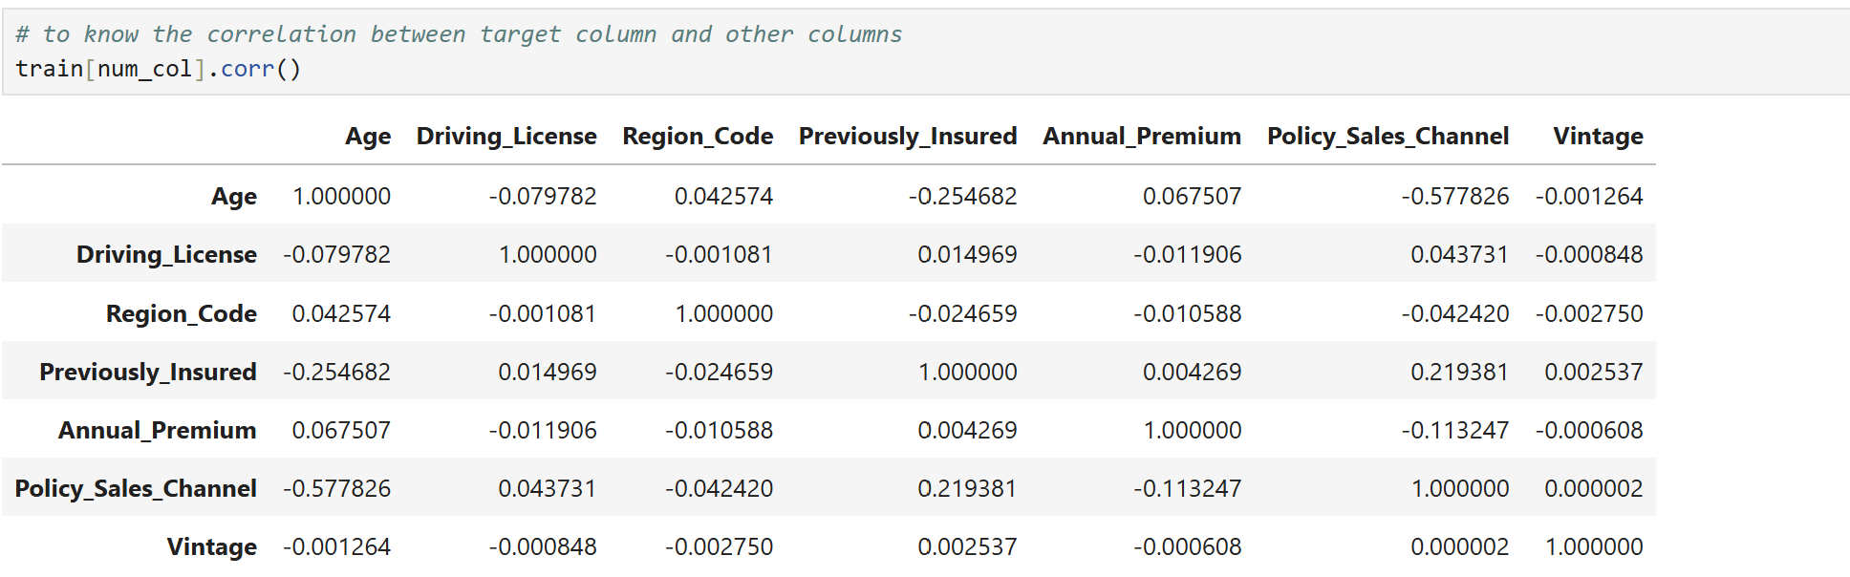
Exploratory Data Analysis (EDA) Visualize Distributions, Univariate Analysis, Bivariate Analysis, etc.
I first analyzed the correlation between the target variable and other columns, but there is no significant correlation between them.

Slide 6
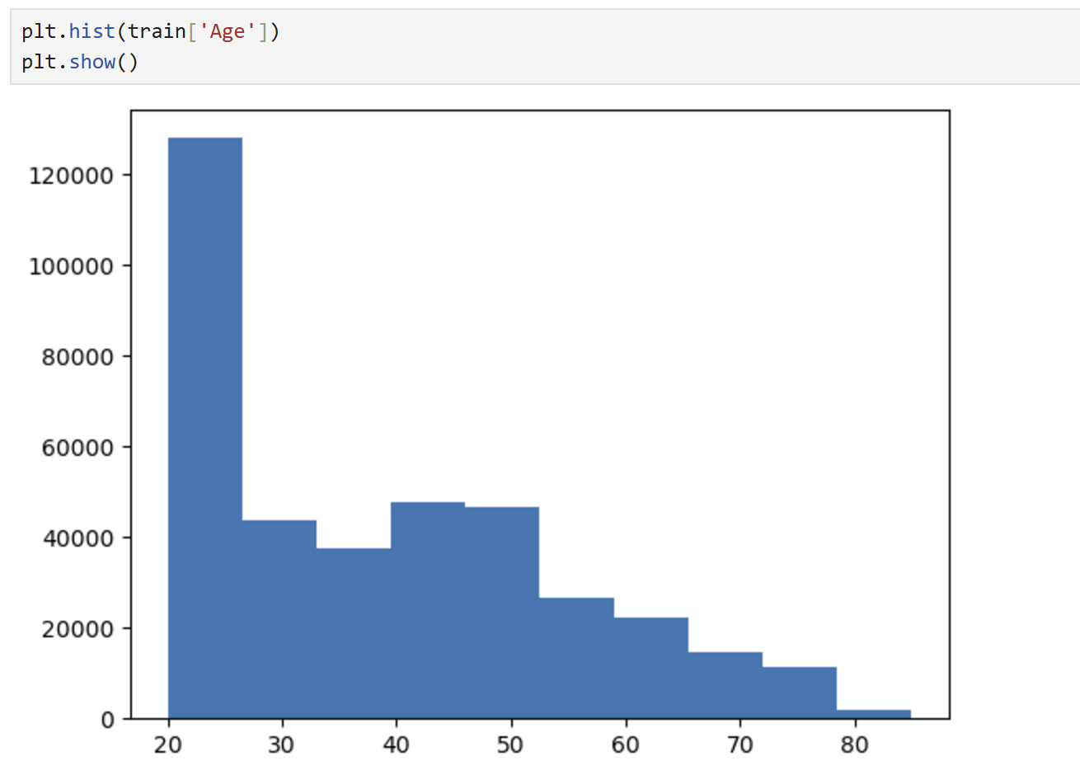
Visualize Distributions, Univariate Analysis, Bivariate Analysis, etc
Histogram for age column

Slide 7
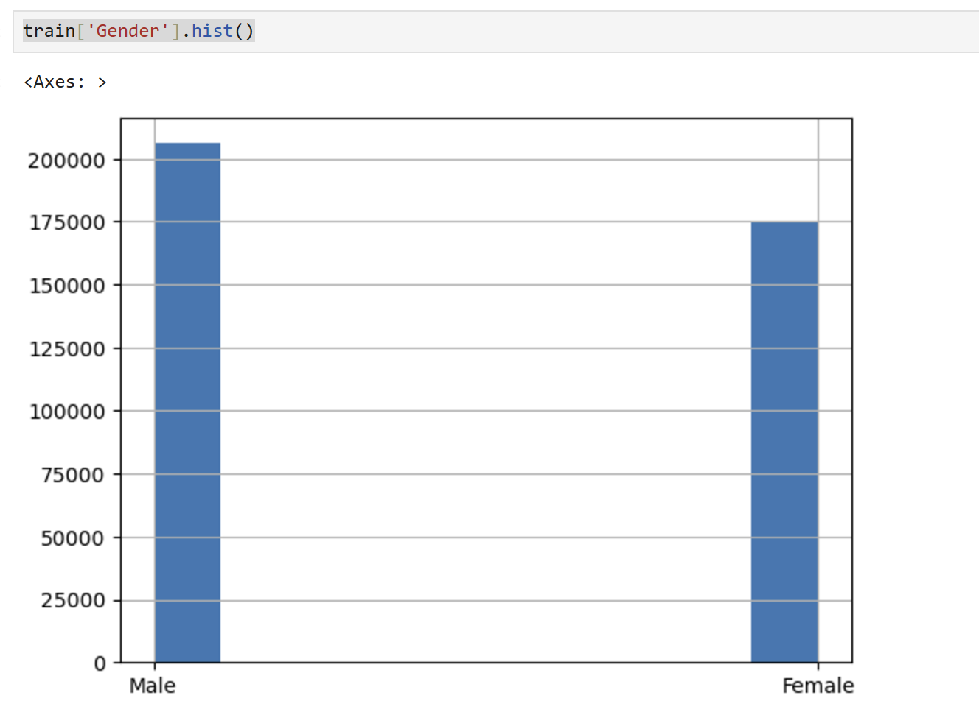
Histogram for Gender column

Slide 8
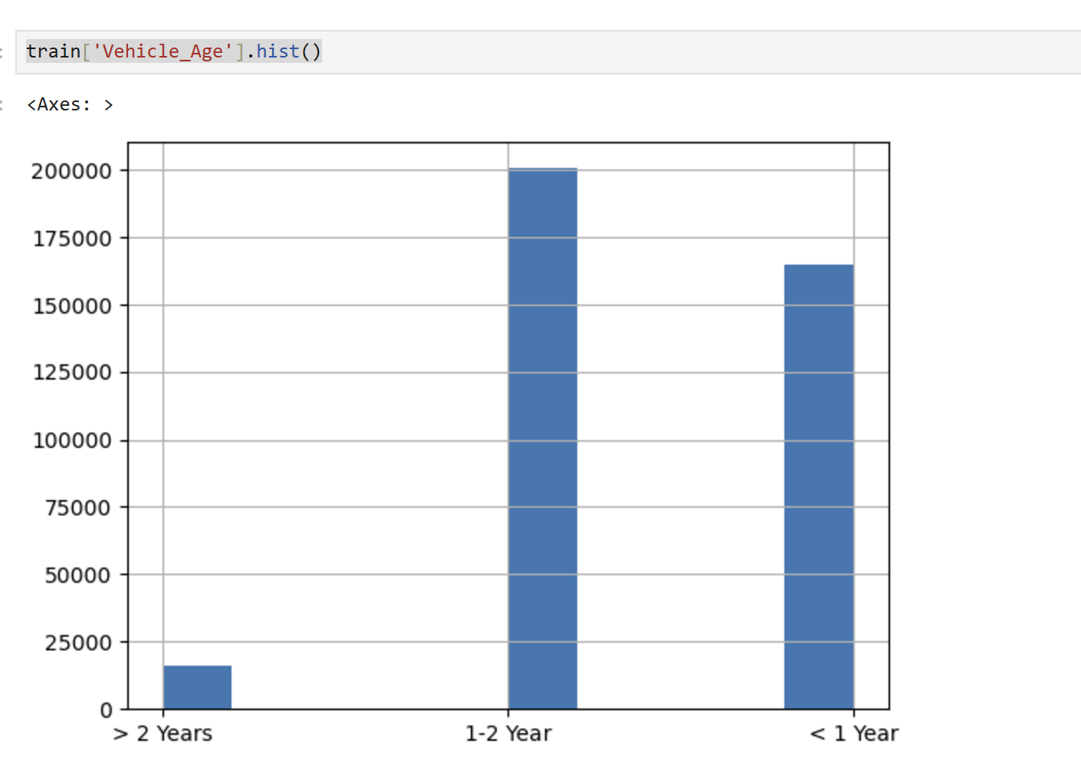
Histogram for Vehicle_age column

Slide 9
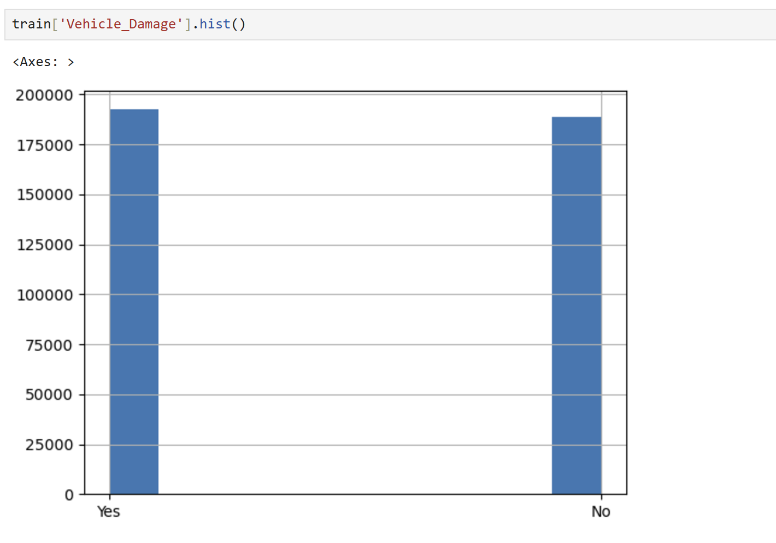
Histogram for Vehicle_Damage column

Slide 10
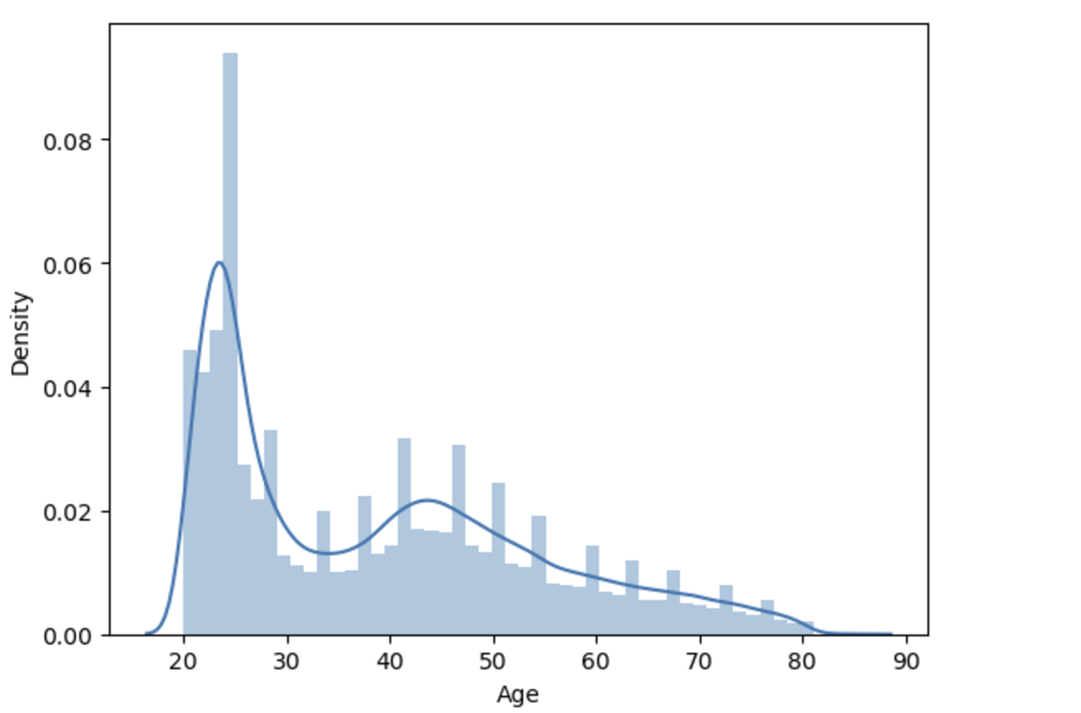
A distplot is a combination of a histogram and a KDE (Kernel Density Estimate) plot.
Here I plot a distplot for Age column.

Slide 11
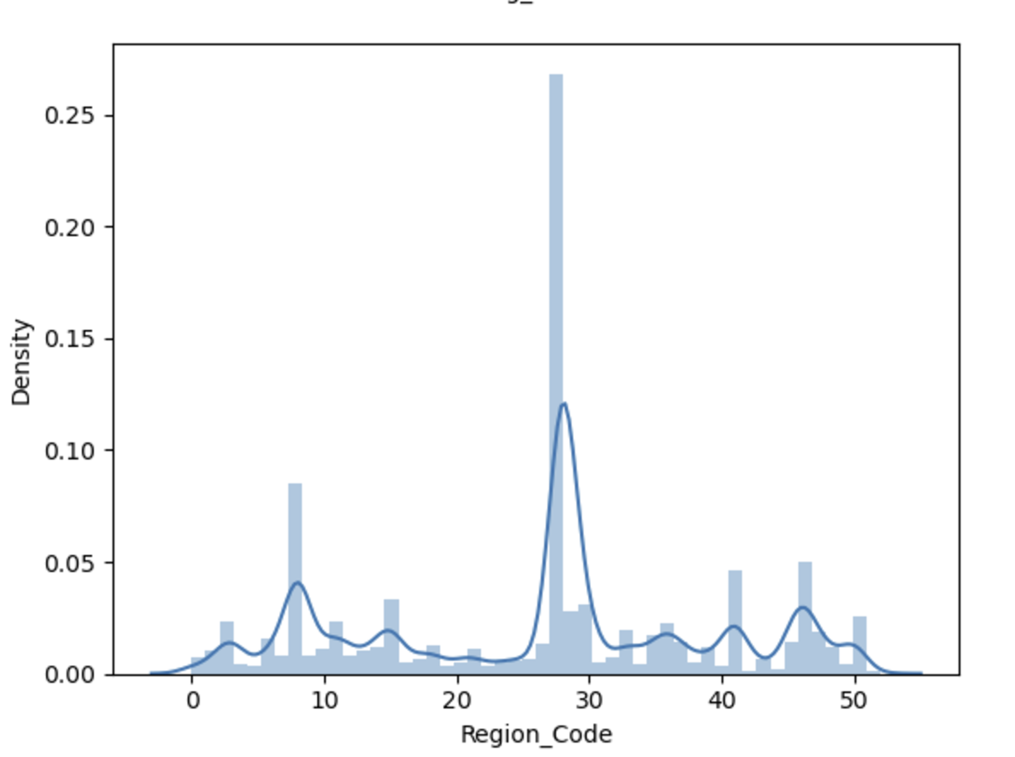
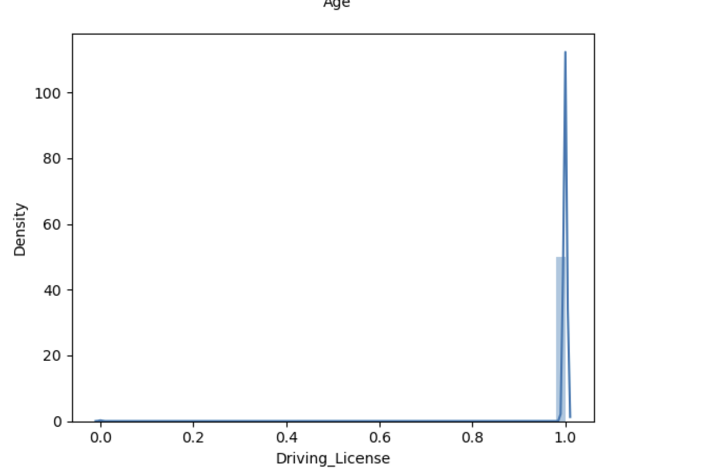
Distplot for Driving_license column and Region code column

Slide 12
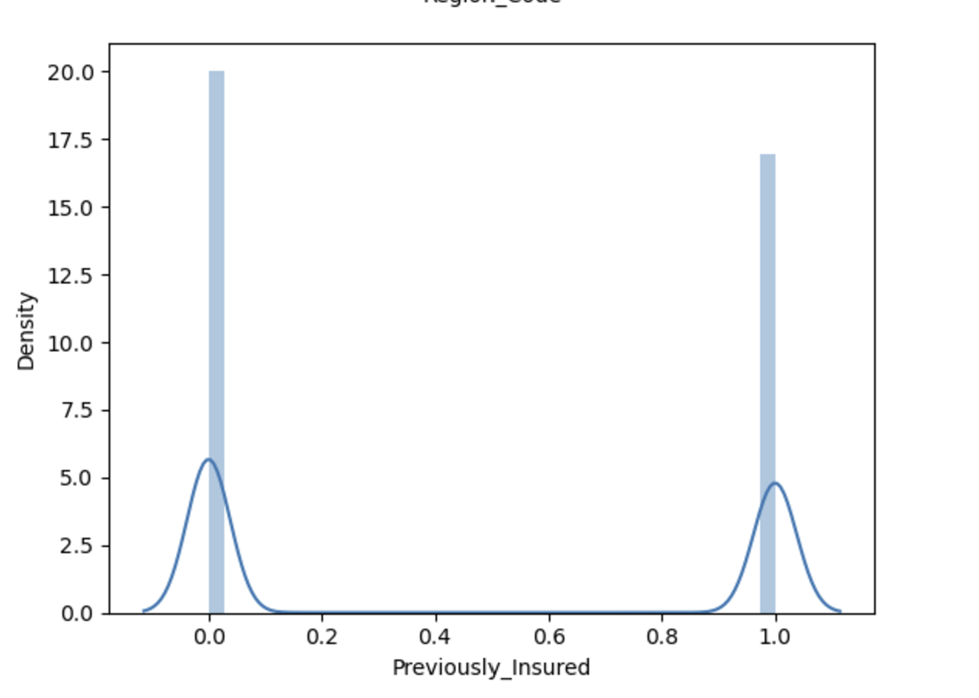
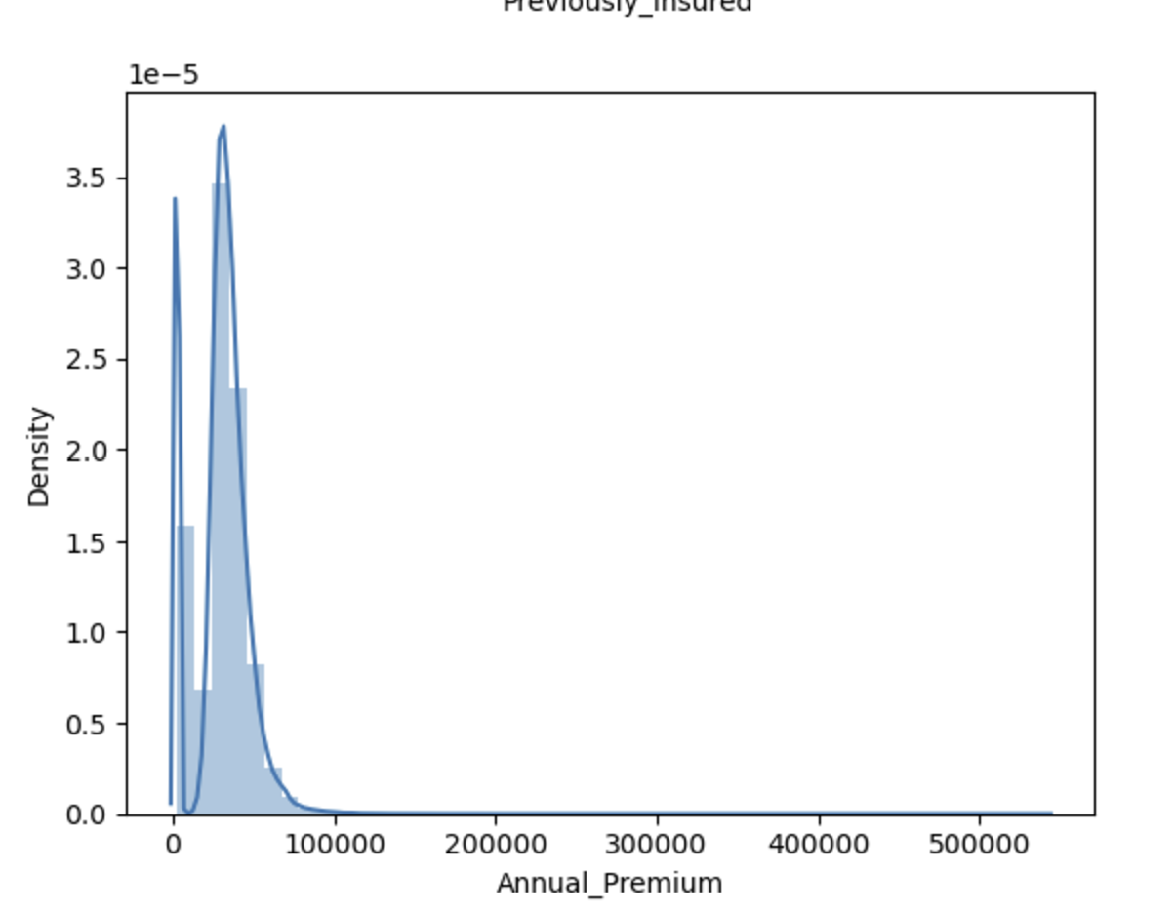
Distplot for Previously_insured column and Annual_premium column

Slide 13
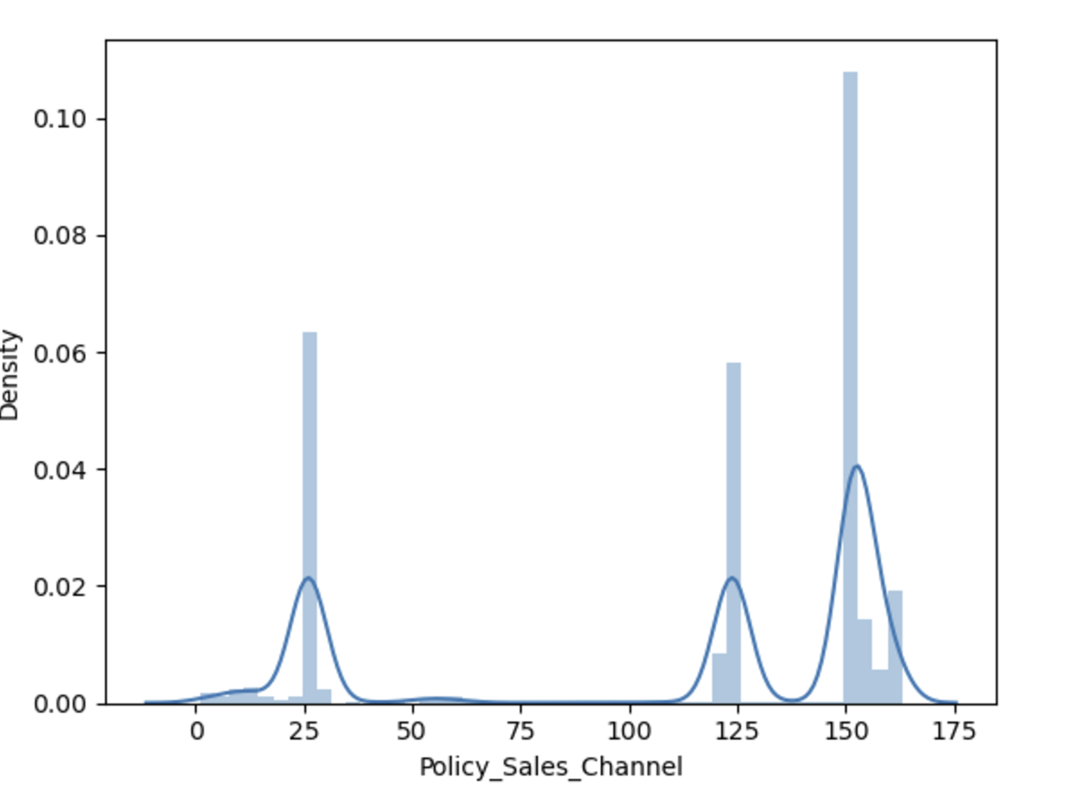
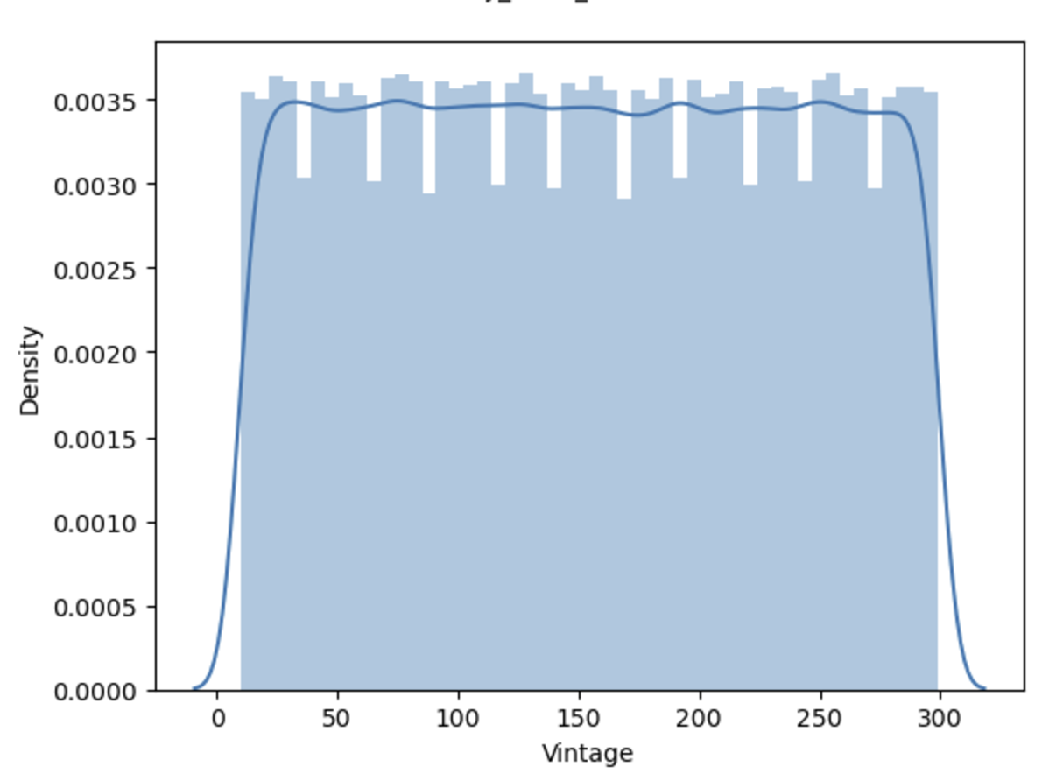
Distplot for Policy_sales_channel column and Vintage column

Slide 14
Model Building & Model Evaluation and Tuning
1) I built several models to achieve the best results, including:
Decision Tree
Random Forest
Various boosting algorithms , etc.,
2) I experimented with different combinations of balanced and unbalanced datasets.
3) To compare the performance, I created a table that includes:
The strategies used for each model
The roc_auc scores for both train and test datasets

Slide 15
4) I updated the table with the scores obtained from the hackathon platform to benchmark the results.
5) I also focused on improving model performance by:
Applying hyperparameter tuning
Using cross-validation to ensure reliable results

Slide 16
Classification Analysis
MODEL | Analyticsvidhya Score
KNeighborsClassifier | 0.5627559215
Knn with gridsearch | 0.5553190679
knn_gridseach_undersampling | 0.7759202030
decisiontree | 0.7185903755
decisiontree_gridsearch | 0.7959695870
randomforest | 0.7851375459
randomforest_gridsearch | 0.7963905088
gradientboosting | 0.7997753033
gradientboosting_gridsearch | 0.8016131634
adaboost | 0.7976351213

Slide 17
Classification Analysis
MODEL | Analyticsvidhya Score
adaboost gridsearch | 0.8003088667
xgboost | 0.7972286677
Xgboost gridsearch | 0.7915485662
xgboost1 | 0.7769758089
xgboost_2 | 0.8009354736
Lgbm classifier | 0.8017402724
XGboost3 | 0.7999088327
XGboost4 | 0.6414299066
catboost1 | 0.5941838756
XGboost_stratified_data | 0.8009354736

Slide 18
Classification Analysis
MODEL | Analyticsvidhya Score
xgboost_stratified 2 | 0.7025514109
gradientboosing_tuning1 | 0.8016056990
gradientboosting_tuning2 | 0.8016131634
xgboost_stratified_data1 | 0.7508687468
gradientboosting_tuning4 | 0.8016056990
gradientboosting_tuning5 | 0.8014115336
gradientboosting_tuning6 | 0.8014879282
gradientboosting_tuning8 | 0.7997857476

Slide 19
Deployment
Based on the Analytics Vidhya leaderboard score from the various models evaluated, I selected the best performing one. Then I save the model as a pickle file.
Next, I developed a FastAPI application for the model, connected it to Google Cloud Platform (GCP) and AWS and successfully deployed it.
I created a web application(streamlit) for the model, integrated it with GCP and AWS and deployed it as well
Overall GitHub link
[which contains all deployed(AWS,GCP) links and Docker image and the PowerPointpresentation].
https://github.com/Gayathrigopi98/cross-sell-model.git

Slide 20
Deployed links
GCP – github – Fastapi link
https://cross-sell-model-fastapi-46604026246.us-central1.run.app/docs#/default/predict_predict_post
GCP – github – Streamlit link
https://cross-sell-model-webapp-46604026246.us-central1.run.app
AWS – docker – Fastapi link
https://container-service-1.m6kb1avhqx16c.ap-south-1.cs.amazonlightsail.com/docs#/default/predict_predict_post
AWS – docker - Streamlit link
https://container-service-2.m6kb1avhqx16c.ap-south-1.cs.amazonlightsail.com/
Docker images:-
Fastapi - gayathri1708/fastapi-aws:1.0
Streamlit - gayathri1708/streamlit-aws:1.0

Slide 21
Conclusion
In this project, I developed a predictive model for an insurance company to identify health policyholders likely to purchase vehicle insurance. After experimenting with multiple models, the Gradient Boosting model emerged as the best performer, achieving a commendable Analytics Vidhya Score of 0.8016.
The model leverages key data, including demographics, vehicle details, and policy attributes, to enable the company to:
Optimize communication strategies by focusing on high-probability customers.
Enhance business planning by predicting cross-selling opportunities.
This solution helps to improve the company's efficiency and boost revenue.

Slide 22
Thank you

