Slide 1



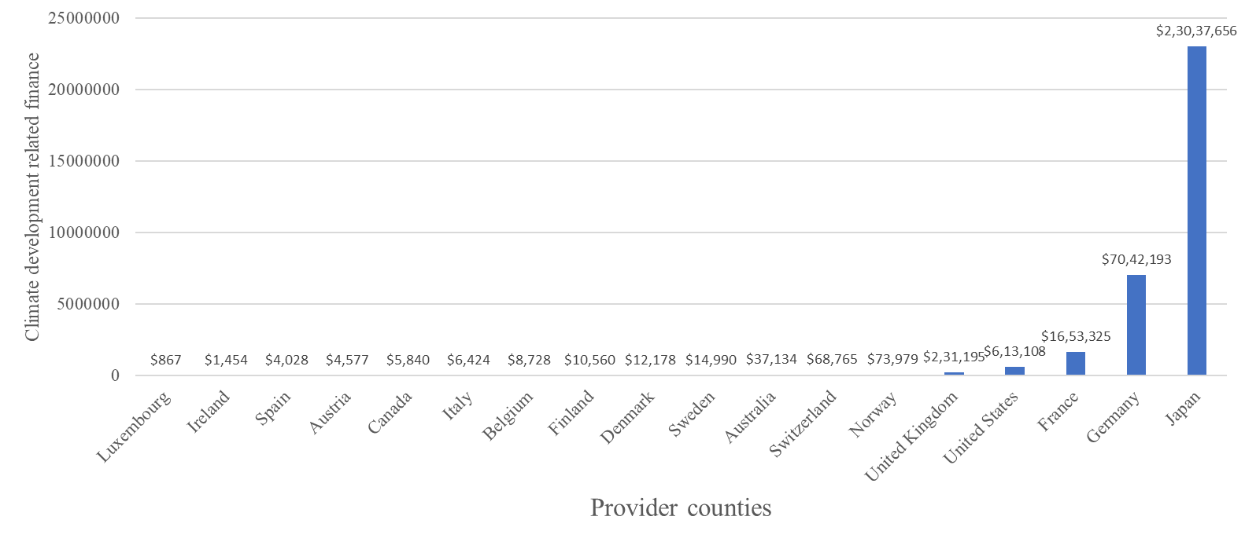
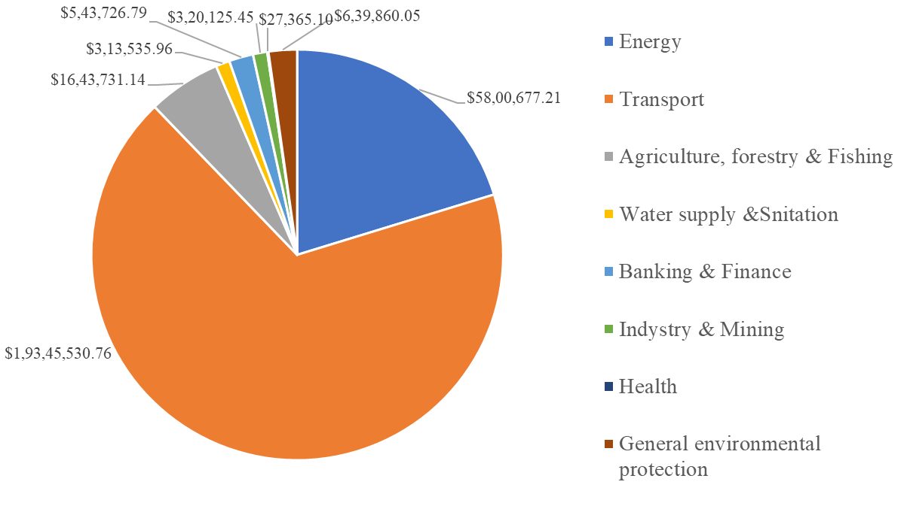

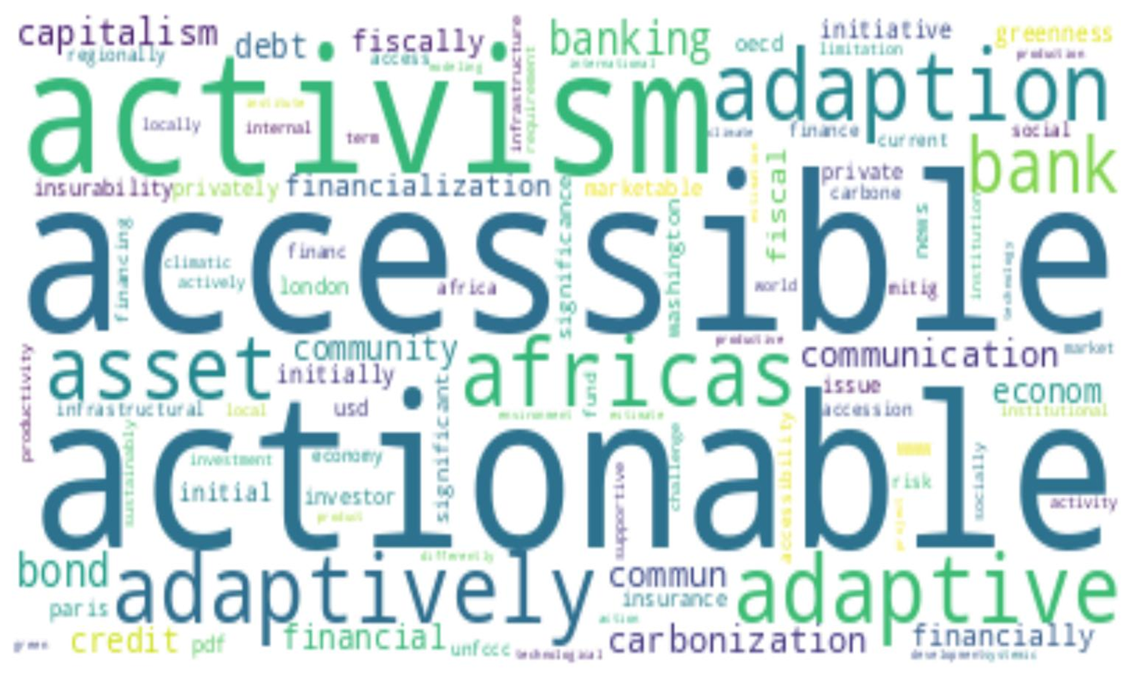
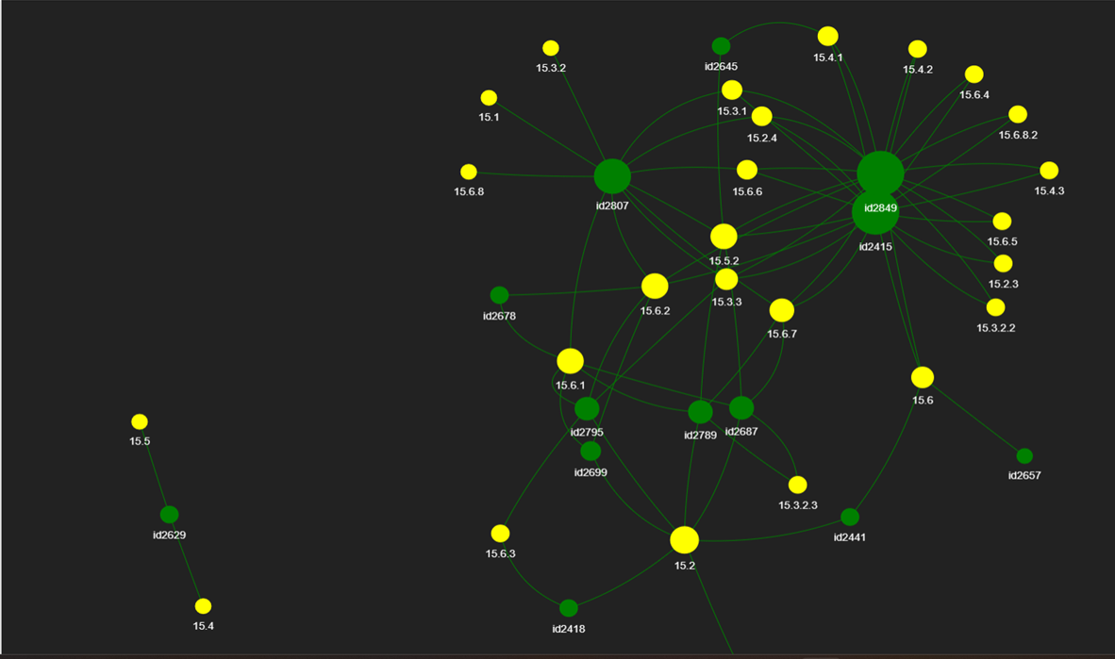



CLIIMATE KNOWLEDGE EXTRACTION USING TEXT AND DATA MINING
AN IPCC CHAPTER CASE STUDY
J. V. S. S. GAYATHRI; BIODIVERSITY INFORMATICS LAB, NIPGR, NEW DELHI, 110067, INDIA
VIGNAN’S FOUNDATION FOR SCIENCE RESEARCH AND TECHNOLOGY, VADLAMUDI, GUNTUR DISTRICT, ANDHRA PRADESH, 522213, INDIA
Introduction
Methodology
The world is loosing all the knowledge that is locked away in PDF’s.
One such source of knowledge is IPCC reports, which contain vast amounts of climate knowledge that is necessary for the world to know.
These IPCC reports are often written by scientific literature experts, which makes it difficult to be understood by a commoner.
Our team, #ScemanticClimate, works towards extracting the locked away knowledge by developing a software Pyami, which is a combination of different other software’s along with wikibase that helps us liberate the climate knowledge.
Mining into this specific chapter of IPCC AR6 WG3, “Finance and Investment” helps us understand the finance flows all over the world and also the ‘climate related development finance’ flow in India.
As a part of this exploring different text mining and visualization tools, provides us insights on what features that are required in this upcoming software.
Lastly, moving towards knowledge graphs, which are a major part of the knowledge representation.
IPCC chapter ‘Finance & Investment’
#SemanticClimate
Data mining(OECD), chapter analysis, wikidatabase
Fig 1
Fig2
Case study – ‘climate finance India’
Text mining & Text Visualization
Py4ami software
Fig3
Fig4
Conclusions
The concept of Data mining, Text mining, and text visualization was made familiar.
Importance of incorporating climate knowledge into every possible education sector is defined.
Exploration of various tools(Open AI),Pyami
WIKIDATA
Tools comparison, Observations and future prospects
Bibliography
Data mining - Pattern mining | Britannica.” https://www.britannica.com/technology/data-mining/Pattern-mining (accessed Apr. 18, 2023).
[2] B. M. Ramageri, “DATA MINING TECHNIQUES AND APPLICATIONS,” Indian Journal of Computer Science and Engineering, vol. 1, pp. 301–305.
[3] “Text Mining in Data Mining - GeeksforGeeks.” https://www.geeksforgeeks.org/text-mining-in-data-mining/ (accessed Apr. 18, 2023).
[4] “The Paris Agreement | United Nations.” https://www.un.org/en/climatechange/paris-agreement (accessed Apr. 18, 2023).
[5] “Climate Finance | United Nations.” https://www.un.org/en/climatechange/raising-ambition/climate-finance (accessed Apr. 18, 2023).
Results
knowledge of ‘climate related development finance’ of India’ is analyzed and visualized. (fig1)
More finance in India is invested in sectors: Transport, energy, agriculture & forestry, General environmental development and Banking and finance – results through text and data mining.(fig2)
Exploration of various text mining tools , results, observations and drawbacks – acting as a prototype to the developing software, pyami.(fig3)
Building knowledge graphs, from the chapter.(fig4)
Links:
py4ami · PyPI
Github: petermr/pyami: Semantic Reader of the Scientific Literature (github.com)
https://github.com/petermr/semanticClimate/tree/e93aedce33dddb9f2657f0d2b09b55137c17a6eb/ipcc/ar6/wg3/Chapter15
Acknowledgements
A sincere thanks to Dr Gitanjali Yadav (Scientist, NIPGR; Lecturer, University of Cambridge and Peter Murray Rust (Reader Emeritus, University of Cambridge, UK) , Dr. Anand Kumar Nelapati, Assistant Professor, Department of Biotechnology, VFSTR

