Slide 1
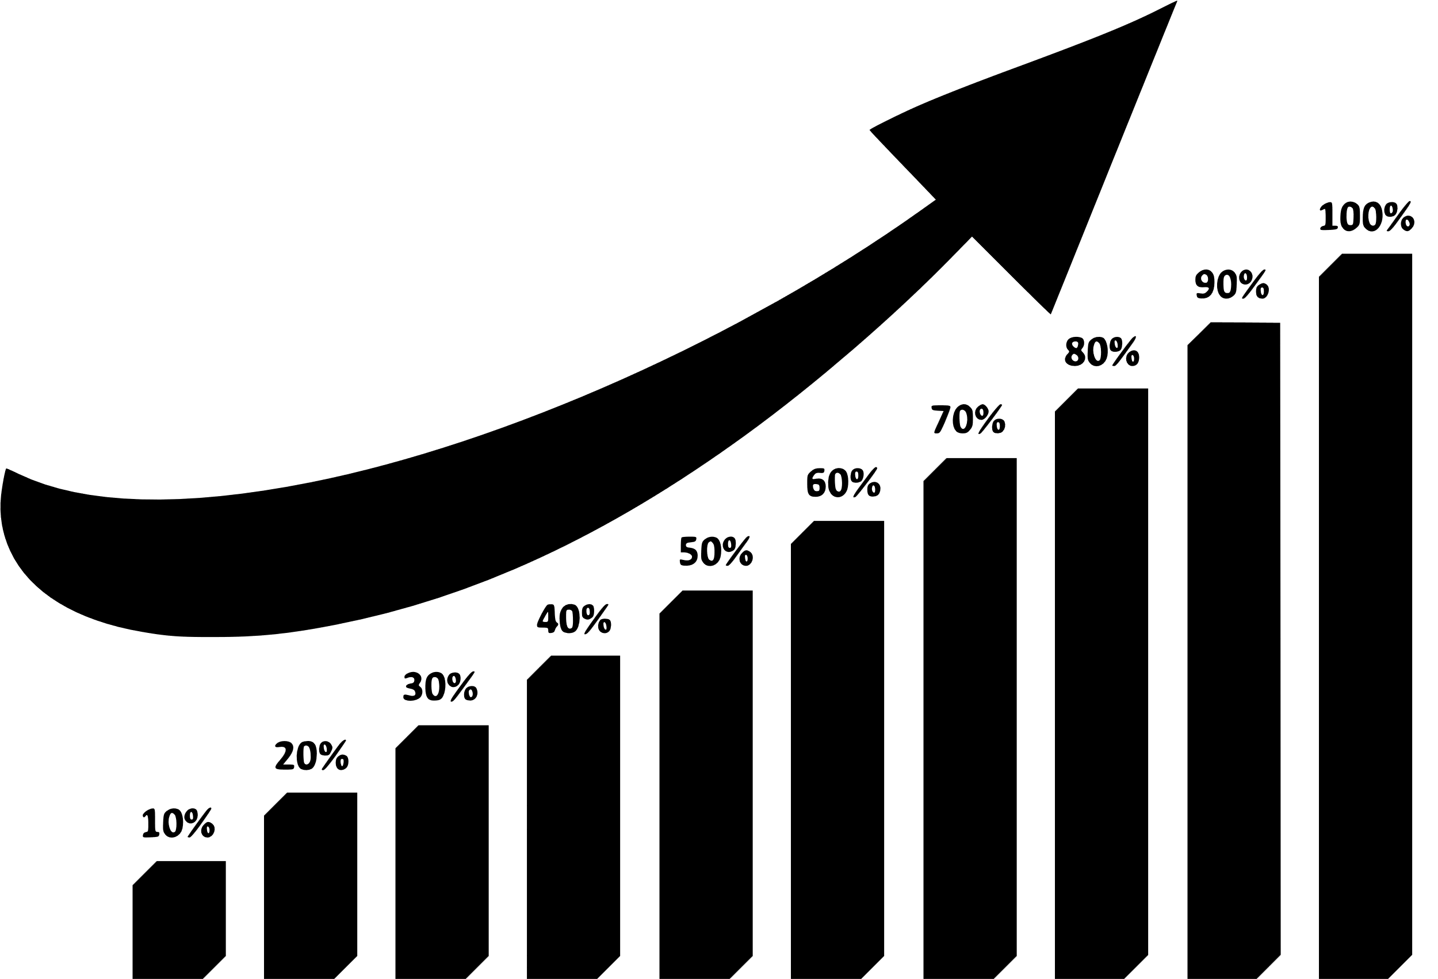
Sales Analysis Project
Presented by
Gayathri Mooram

Slide 2

Summery
This Power BI Sales Analysis Dashboard provides a comprehensive view of key sales metrics such as total revenue, orders, cost, profit, and average order value. It highlights monthly and daily profit trends, revealing peak performance in July and December. Mobile devices account for the majority of revenue, emphasizing the importance of mobile platforms. Top-performing product categories include Clothing, Games, and Appliances. Geographically, Portugal leads in revenue generation, followed by France and Sweden. Interactive filters allow users to explore data by year, month, category, and device type for in-depth insights.

Slide 3


KPI’s
Total Revenue
Total Orders
Total Cost
Total Profit
Average Order Value (AOV)
Profit Percentage / Margin
Total_revenue by Top 5 Country
Profit by Month
Total_Revenue by Device_Type
Total_Revenue by Top 5 Country

Slide 4
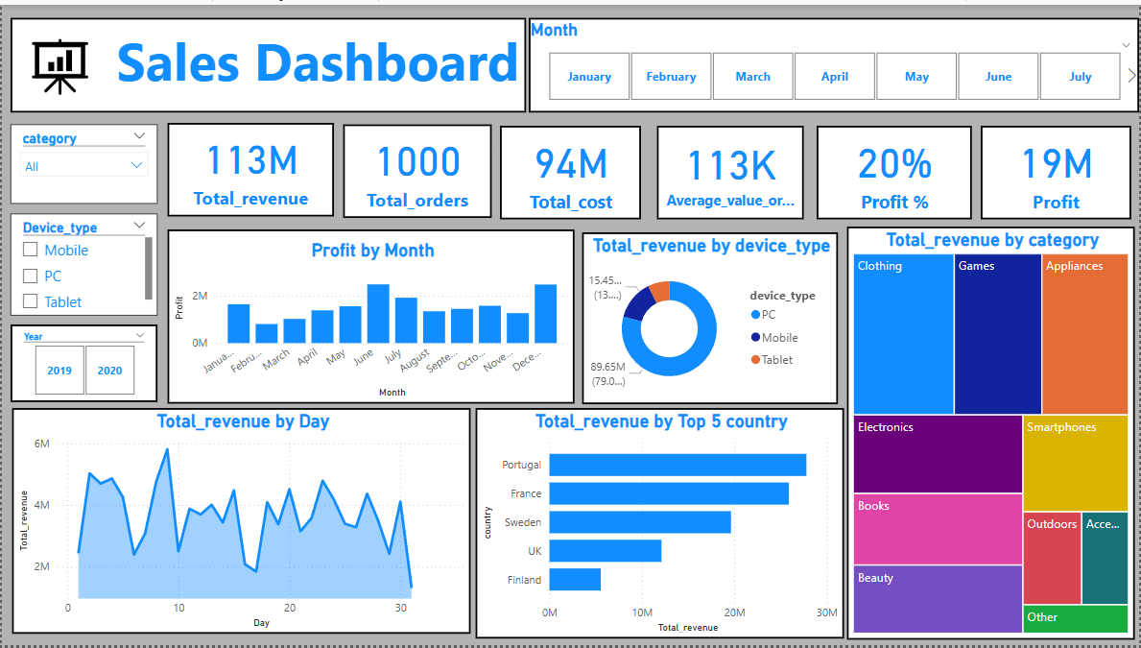

Slide 5
📅 Monthly Insights
Profit by Month: Highest profit occurred in July, followed by December.
Displays steady profit growth mid-year with a slight dip in some months.

Slide 6
📈 Revenue Trends
Total Revenue by Day: Shows daily fluctuations; peak days reach around 6M.
Indicates strong periodic sales spikes, potentially promotional periods or seasonal impact.

Slide 7
📊 Revenue Breakdown
By Device Type:
Mobile dominates with 79.08% of total revenue.
PC: 13.6%
Tablet: Lowest share.
By Category:
Top revenue-generating categories: Clothing, Games, and Appliances.
Other key contributors include Electronics, Smartphones, and Books.

Slide 8
🌍 Top 5 Countries by Revenue
Portugal (~28M)
France
Sweden
UK
Finland
Portugal is the leading market in terms of revenue.

Slide 9

Key Takeaways
Strong Revenue Performance with 113M in total sales and a healthy 20% profit margin.
Mobile Devices dominate the market, contributing 79% of total revenue.
Top-Selling Categories: Clothing, Games, and Appliances drive the highest sales.
Peak Profit Months are July and December, showing strong seasonal demand.
Portugal leads as the highest revenue-generating country, followed by France and Sweden.
Interactive Filters for Category, Device Type, Year, and Month enable flexible, in-depth analysis.
This Photo by Unknown Author is licensed under CC BY-SA

Slide 10

💡 Business Ideas
This Photo by Unknown Author is licensed under CC BY-SA
.Optimize for Mobile Shopping Since 79% of revenue comes from mobile, invest in improving mobile UX, launching app-exclusive deals, and running mobile-first campaigns.
Seasonal Promotions Strategy With profit peaks in July and December, plan ahead with targeted sales, product launches, and marketing around these high-performing months.
Focus on High-Performing Categories Promote and expand inventory in top-selling categories like Clothing, Games, and Appliances. Introduce related products or bundles to increase AOV.

Slide 11
💡 Business Ideas
This Photo by Unknown Author is licensed under CC BY-SA
Geo-Targeted Campaigns Since Portugal, France, and Sweden are top revenue generators, launch localized promotions, language-specific ads, and regional discounts.
Premium Product Line Expansion With an Average Order Value of 113K, consider adding or highlighting premium or luxury products that match customer spending behavior.
Boost Conversion with Data-Driven Personalization Use device, category, and regional preferences to personalize recommendations, emails, and homepages for better engagement and sales.

Slide 12


