Slide 1
Employee Data Analysis using Excel
STUDENT NAME: Gayathri s
REGISTER NO: 312220243
DEPARTMENT: Commerce
COLLEGE : Jeppiaar college of arts and

Slide 2
PROJECT TITLE
Employee Performance Analysis using Excel

Slide 3


AGENDA
Problem Statement
Project Overview
End Users
Our Solution and Proposition
Dataset Description
Modelling Approach
Results and Discussion
Conclusion
3/21/2024 Annual Review

Slide 4

PROBLEM STATEMENT
To write a problem statement on employee performance, you need to identify the specific area of performance that is problematic, such as low productivity, high absenteeism, or poor quality of work.

Slide 5

PROJECT OVERVIEW
Basically, the first table of the performance appraisal form provides basic information about the employee that you (or the HR team) should fill out. Furthermore, it will provide a snapshot of employee background that can help guide a better evaluation.
Performance-Review-Template-Someka-S00 All you need to rate your employee’s performance factor at a time considering that factor only. So, you can input “X”, “OK”, A, B, C, or whatever you would like to add.

Slide 6

WHO ARE THE END USERS?
The end users of employee performance analysis using Excel can be managers and employees:
- Managers Managers can use Excel to analyze performance data to identify strengths and areas for improvement. They can also use Excel to set clear, data-driven goals and provide insights into workforce trends and behaviors. - Employees Employees can receive precise feedback based on objective metrics. They can also be involved in the performance review process by discussing the review with their manager.

Slide 7

OUR SOLUTION AND ITS VALUE PROPOSITION
Employee performance analysis using Excel can be a powerful tool to help organizations evaluate and improve their workforce's productivity and efficiency. Here's a potential solution and value proposition 1. Data Collection: Gather employee performance data, including metrics such as sales numbers, project completion rates, customer satisfaction scores, and attendance records. 2. Excel Dashboard: Create a comprehensive Excel dashboard to organize, analyze, and visualize the data. *Value Proposition:* 1. Data-Driven Decision 2. Enhanced Productivity 3. Employee Engagement 4. Competitive 5. Cost Savings: Optimal

Slide 8
Dataset Description
Here are some things to consider when using Excel to analyze employee performance data:
- Data format - Descriptive analytics - Employee performance analytics - Visual highlighting - GitHub - Gigasheet - Kaggle

Slide 9

THE "WOW" IN OUR SOLUTION
Here's the 'WOW' factor in our employee performance analysis solution using Excel: *WOW Factors:* 1. *Automated Performance Scoring 2. *Interactive Dashboards 3. *Real-time Feedback 4. *Predictive Analytics 5. *Customizable Visualization 6. *Integration with Existing Systems *WOW Benefits:* 1. *Unparalleled Insights 2. *Boosted Productivity 3. *Enhanced Employee Experience 4. *Competitive Edge The 'WOW' factor in our solution lies in its ability to transform employee performance analysis into a dynamic, data-driven, and employee-centric process, driving business success and excellence.
3/21/2024 Annual Review
9

Slide 10
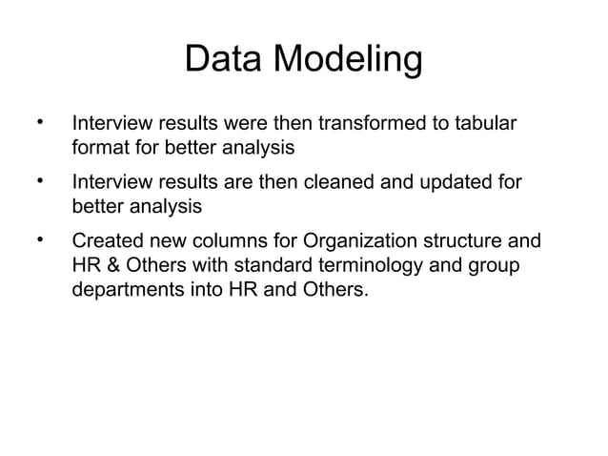
MODELLING
10

Slide 11
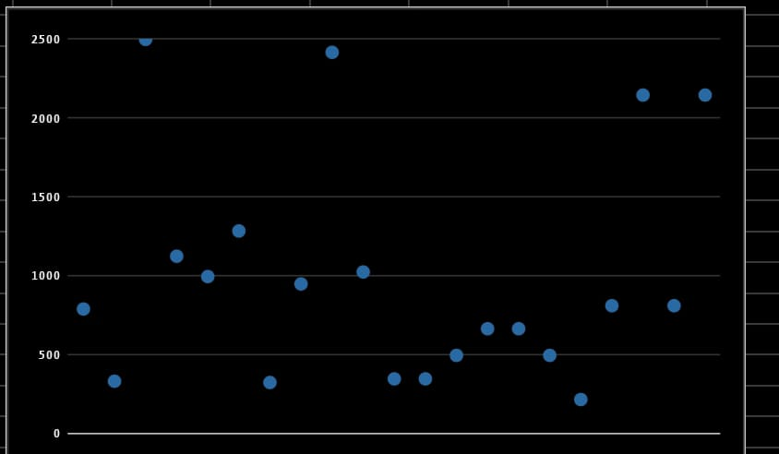
RESULTS
11

Slide 12
conclusion
Our employee performance analysis using Excel has provided valuable insights into individual and team performance, enabling data-driven decisions to drive business growth. By leveraging Excel's powerful analytics and visualization capabilities, we have: 1. *Identified top performers* and recognized their achievements, fostering a culture of excellence. 2. *Pinpointed areas for improvement*, providing targeted coaching and development opportunities. 3. *Uncovered trends and patterns*, informing strategic initiatives to enhance team performance. 4. *Streamlined performance management*, saving time and resources through automation and efficient reporting. 5. *Enhanced employee engagement*, providing regular, objective feedback and promoting growth.

