Slide 1
FAKE NEWS DETECTION USING NPL
“WHEN FAKE NEWS IS REPLACED, IT BECOMES DIFFICULT FOR THE PUBLIC TO DISCERN WHAT’S REAL”.
We consume news through several mediums throughout the day in our daily routines, but sometimes it becomes different to decide which one is fake and which one is authentic.
Due to the exponential growth of information online, it is becoming impossible to decipher the true from the false.
Fake news is the deliberate spread of misinformation via traditional
news media or via social media false news spreads extraordinary fast.
INTRODUCTION:

Slide 2
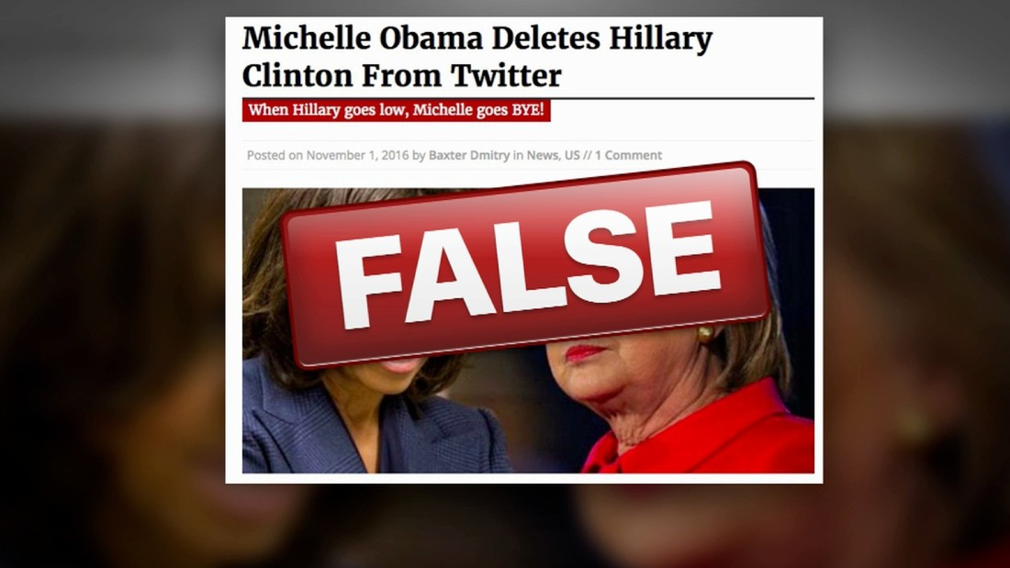
MICHELLE NEVER DELETED CLINTON TWIITER ACCOUNT

Slide 3
People are spreading more and more time interacting on social media, as the wide adoption of smartphones makes their access available almost anytime and anywhere, which is not the case with traditional media.
It has many similarities with spam messages since they share common features such as grammatical mistakes and false information.
A sort of sensationalist reporting, counterfeit news embodies bits of information that might be lies and is, for the most part, spread and other online medias.
Such fake news things contain bogus and additionally misrepresented cases and may wind up being virtualized by calculation , and clients may wind uo in a channel.

Slide 4
CHALLENGES:
Every news that we consume is not real. If you listen to fake news it means you are collecting the wrong information from the world which can affect society because a person’s view or thoughts can change after consuming fake news which the user perceives to be true.
People can download articles from sites, share the information, re-share the information from others and by the end of the day the false information has gone so far from its original site that it becomes indistinguishable from real news.
Fake news presents strong, often prejudiced opinions, as fact. It can also direct these opinions to those most likely to agree to reinforce them.

Slide 5
SOLUTION:
Since all the news we encounter in our day-to-day life is not authentic, how do we categorize if the news is fake or real ? In this project, we will focus on text-based news and try to build a model that will help us to identify if a piece of given news is fake or real.
It is vital to recognize and differentiate between false and accurate news online. One news information includes various unstructured format data(such as documents, videos and audio), but we will concentrate on the text format news here.
With the progress of machine learning and natural language processing, we can now recognize the misleading and false character of on article or statement
OVERVIEW OF STEPS TO BE FOLLOWED:

Slide 6
