Slide 1
Stopwatch / Digital Clock Project
Mini Project on Timekeeping Application
Presented by: [Nalla Gayatri]

Slide 2
Introduction
Timekeeping is essential in many applications.
This project focuses on designing a digital clock or stopwatch.
Allows real-time display and stopwatch controls.
Built using Python / C / JavaScript / Arduino.

Slide 3
Objective
• Design a working digital clock or stopwatch
• Implement time-based logic
• Create a user-friendly interface (CLI/GUI)

Slide 4
Features
• Displays real-time hours, minutes, and seconds
• Stopwatch: Start, Stop, Reset
• Optional: Lap time, countdown, or alarms
• Accuracy in time calculations

Slide 5
Tools and Technologies
• Programming Language: Python / C / JavaScript / Arduino
• IDE: VS Code / IDLE / Code::Blocks / Arduino IDE
• Libraries: time, tkinter, setInterval(), millis()

Slide 6
Working Principle
• Clock uses system time (e.g., time module or Date object)
• Stopwatch calculates elapsed time using time snapshots or millisecond counter

Slide 7
Code Structure
• Clock Mode: getTime(), format & update
• Stopwatch Mode: start_time, elapsed_time, buttons
• Timer logic using loop or interval

Slide 8
Sample Code (Python)
from tkinter import *
import time
def update_clock():
current_time = time.strftime('%H:%M:%S')
label.config(text=current_time)
label.after(1000, update_clock)
root = Tk()
label = Label(root, font=('Arial', 48))
label.pack()
update_clock()
root.mainloop()

Slide 9
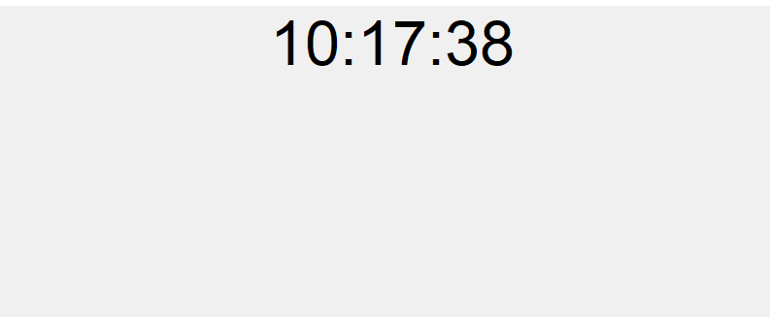
Work Flow

Slide 10
Challenges Faced
• Accurate time delay handling
• Synchronizing button inputs
• GUI refresh and responsiveness
• Pause/resume logic

Slide 11
Learnings
• Time libraries and functions
• GUI or hardware interface control
• Event-driven programming
• Debugging real-time systems

Slide 12
Future Enhancements
• Countdown timer
• Alarm setting
• Lap timer
• Voice/sound notifications
• Mobile/web deployment

Slide 13
Conclusion
• Created functional clock and stopwatch
• Understood time-based logic and interface design
• Demonstrated time tracking via programming

