Slide 1
SECURE DATA HIDING IN IMAGES USING STEGANOGRAPHY
STEGANOGRAPHY PROJECT
Presented By: GAYATRI SAMPAT SHIVJATAK
Student Name : GAYATRI SAMPAT SHIVJATAK
College Name & Department : BHAVAN’S COLLEGE ANDHERI (WEST) COMPUTER SCIENCE DEPARTMENT

Slide 2
OUTLINE
Problem Statement
Technology used
Wow factor
End users
Result
Conclusion
Git-hub Link
Future scope

Slide 3
Problem Statement
Steganography is a technique for securely hiding data within an image, making it undetectable to unauthorized users. This project focuses on image-based text steganography, where text is embedded within an image and retrieved using a decryption process. Additionally, it integrates encryption and password protection for added security.
Unlike cryptography, which encrypts data, steganography conceals information in such a way that its existence remains unknown. This project enhances secure data transmission while ensuring confidentiality and integrity.

Slide 4
Technology used
Libraries Used:
cv2 – For image processing (loading, modifying, and saving images).
os – For file handling and system interactions.
tkinter – For building a graphical user interface (GUI). cryptography – For encrypting hidden text before embedding it into the image.
Platform Used:
Python 3.13.2 (with IDE support).

Slide 5
Wow factors
Encryption & Password Protection – Adds an extra security layer by encrypting hidden text, ensuring only authorized users can access it.
User-Friendly GUI – Simplifies interaction, making steganography accessible to non-technical users.
Secure Data Retrieval – Hidden messages can only be extracted with the correct password, preventing unauthorized access.
Multi-Layer Security – Combines encryption and steganography to enhance data confidentiality and prevent detection.

Slide 6
End users
This project is useful for:
Government & Military Organizations – To transmit classified messages securely.
Businesses & Corporations – To protect sensitive corporate data.
Journalists & Whistleblowers – To share confidential information without detection.
Individuals – To ensure private communication over digital channels.

Slide 7
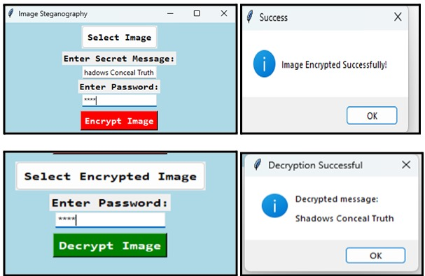
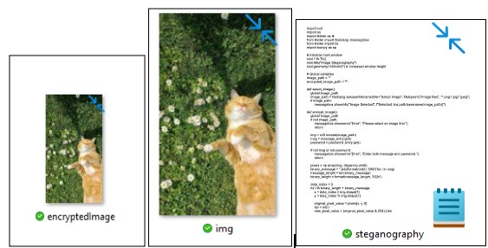
Results

Slide 8
Conclusion
Steganography is a powerful method for concealing sensitive information within digital images.
Integrating encryption and password protection ensures that hidden data remains secure and accessible only to authorized users, enhancing confidentiality in digital communication.

Slide 9
GitHub Link
https://github.com/Gayatri-973/AICTE_Project.git

Slide 10
Future scope(optional)
Implementation of stronger encryption algorithms and AI-driven techniques to further improve data security.
Expansion of steganography applications to cloud environments, IoT networks, and real-time video streams for broader secure communication solutions.
Exploration of cross-media steganography to hide data across different formats such as audio and video.
Integration of blockchain technology to verify the authenticity and integrity of hidden data.

Slide 11
THANK YOU

