Slide 1
An Explainable AI-Based Skin Disease Detection
Submitted by
GAYATRI S BALLARI
(01fE20MCS009)

Slide 2
OUTLINE OF THE PRESENTATION
INTRODUCTION
LITERATURE SURVEY
PROBLEM STATEMENT
OBJECTIVES
DATASET
MODEL DESIGN
IMPLEMENTATION
RESULT
CONCLUSION
REFERENCES

Slide 3
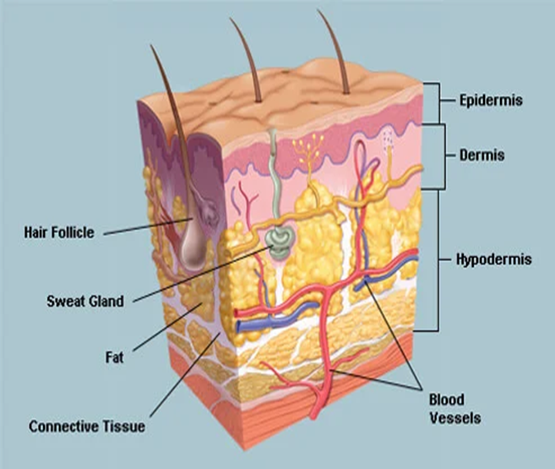
INTRODUCTION
In the world today there are number of skin diseases which are found in humans, animals and plants.
The illness caused by bacteria or infections will be known as skin disease like yeast infection, allergy, eczema, brown spot.

Slide 4
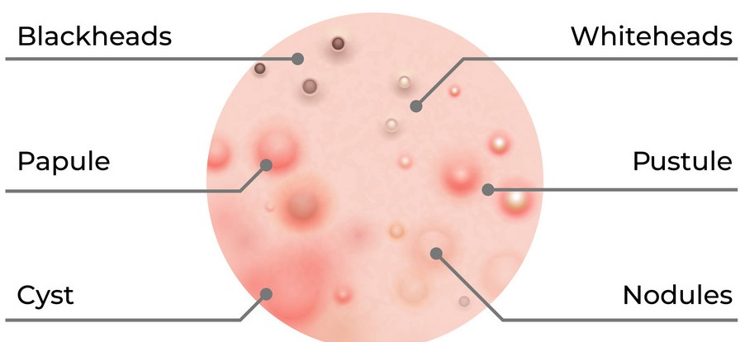
.
These skin diseases have dangerous effect on skin and they keep on spreading over time.
To control them from spreading it is necessary to identify these diseases at their starting stages.
Skin disorders vary greatly in symptoms and severity. They can be temporary or permanent, and may be painless or painful.

Slide 5
Some have situational causes, while others may be genetic. Some skin conditions are minor, and others can be life-threatening.
Skin diseases are conditions that affect your skin. These diseases may cause rashes, inflammation, itchiness or other skin changes.
Some skin conditions may be genetic, while lifestyle factors may cause others.
Skin disease treatment may include medications, creams or ointments, or lifestyle changes.

Slide 6
.
ACNE
Commonly located on the face, neck, shoulders, chest, and upper back
Breakouts on the skin composed of blackheads, whiteheads, pimples, or deep, painful cysts and nodules
COLD SORE
Red, painful, fluid-filled blister that appears near the mouth and lips
Outbreaks may also be accompanied by mild, flu-like symptoms such as low fever, body aches, and swollen lymph nodes.
BLISTER
Characterized by watery, clear, fluid-filled area on the skin
May be smaller than 1 cm (vesicle) or larger than 1 cm (bulla) and occur alone or in groups

Slide 7
HIVES
Itchy, raised welts that occur after exposure to an allergen
Red, warm, and mildly painful to the touch
Can be small, round, and ring-shaped or large and randomly shaped
ECZEMA
Yellow or white scaly patches that flake off
Affected areas may be red, itchy, greasy, or oily
Hair loss may occur in the area with the rash
PSORIASIS
Scaly, silvery, sharply defined skin patches
Commonly located on the scalp, elbows, knees, and lower back
May be itchy or asymptomatic

Slide 8
.
Explainable Artificial intelligence
XAI is a domain in which the techniques are developed and designed to explain the predictions by ML/DL systems.
XAI task is to make AI,ML and DL more understanding to human users.
SHAP:
SHAP provides local model interpretability.
SHAP modifies a single data sample by tweaking the feature values and observes the resulting impact on the output.
Black box
machine learning model
Input
Output

Slide 9
.
GRAD CAM
Gradient-weighted Class Activation Mapping (Grad-CAM), uses the gradients of any target concept flowing into the final convolutional layer to produce a coarse localization map highlighting the important regions in the image for predicting the concept. Grad-CAM is a strict generalization of the Class Activation Mapping. Unlike CAM, Grad-CAM requires no re-training and is broadly applicable to any CNN-based architectures.

Slide 10
PROBLEM STATEMENT
Automated detection of Skin disease using deep learning technique and provide Explain-ability techniques to help us better understands our model's predictions, and how we could further improve its performance.

Slide 11
OBJECTIVES
Objectives of the proposed work are;
To demonstrate the use of machine learning model on color images for the recognition of Skin disease.
To assess the role of XAI based automated model for detection of Skin disease by color images.

Slide 12
DATASET
We use a dataset created by Skin Cancer MNIST :HAM10000 picture Archive communication system for a challenge based on a problem on Kaggle .
The dataset is labeled dataset with acne and some skin allergies images rated with expert opinion on images.

Slide 13
BLOCK DAIGRAM OF PROPOSED METHODOLOGY
FEATURE EXTRACTION
PRE-PROCESSING
(RESNET-50& RESNET-18)
INPUT COLOUR IMAGE
Training and
validation
EXPLAINATION

Slide 14
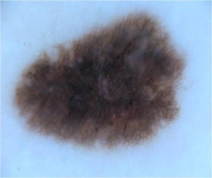
MODEL DESIGN
Training and validation
Decision
Resnet-50
Resnet-18
Explainer
.
Data and predictions
Human makes decision
Model
Explanation
XAI attempts to play the role of the ‘explainer’, explaining predictions for each data sample.

Slide 15
IMPLEMENTATION
As part of this study, we extended our deep learning model by using the XAI models.
The SHAP model is designed to help build a solid understanding of how to compute and interpret Shapley-based explanations of machine learning models.
Gradient-weighted Class Activation Mapping (Grad-CAM), uses the class-specific gradient information flowing into the final convolutional layer of a CNN to produce a coarse localization map of the important regions in the image.

Slide 16
CONCLUSION
The model was able to successfully extract feature from the dataset. The results obtained with deep learning based Resnet-50 model is of 91.62%.
The output of SHAP and GRAD CAM is a list of explanations, reflecting the contribution of each feature to the prediction of a data sample.
On Comparing the SHAP and GRAD CAM results the gradcam gives the better explanation than SHAP model.

Slide 17
THANK YOU

