Slide 1
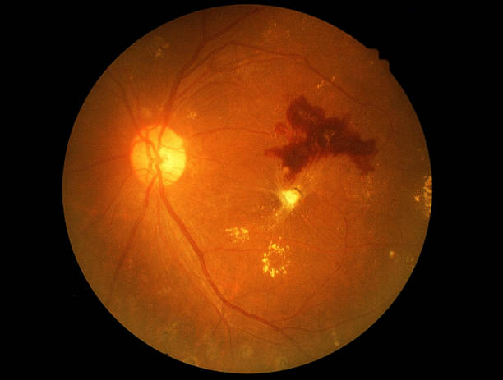
An Explainable AI-Based Diabetic Retinopathy Detection
Submitted by
GAYATRI S BALLARI

Slide 2
OUTLINE OF THE PRESENTATION
INTRODUCTION
LITERATURE SURVEY
PROBLEM STATEMENT
OBJECTIVES
DATASET
MODEL DESIGN
IMPLEMENTATION
RESULT
CONCLUSION
REFERENCES

Slide 3
INTRODUCTION
Diabetic retinopathy is a leading problem throughout the world and many people are losing their vision because of this disease.
The disease can get severe if it is not treated properly at its early stages.
The damage in the retinal blood vessel eventually blocks the light that passes through the optical nerves which makes the patient with Diabetic Retinopathy blind.

Slide 4
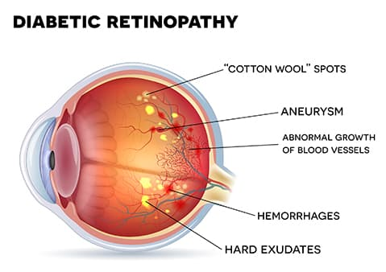
.
Diabetic retinopathy is the leading cause of blindness in the working-age population of the developed world.
The condition is estimated to affect over 93[3] million people.
Development and progression of diabetic retinopathy, including glycemic control, duration of diabetes mellitus, hypertension.

Slide 5
.
Condition Of Diabetic Retinopathy In India
Currently, In India diabetes is a disease that affects over 65[2] million persons in India.
Diabetes-related eye disease, of which retinopathy is the most important, affects nearly one out of every ten persons with diabetes, according to point prevalence estimates.
Early detection of significant DR remains the fundamental goal in the effort to reduce visual disability in patients with diabetes.

Slide 6
.
Explainable Artificial intelligence
XAI is a domain in which the techniques are developed and designed to explain the predictions by ML/DL systems.
XAI task is to make AI,ML and DL more understanding to human users.
LIME:
LIME provides local model interpretability.
LIME modifies a single data sample by tweaking the feature values and observes the resulting impact on the output.
Black box
machine learning
model
Input
Output

Slide 7
PROBLEM STATEMENT
Automated detection of Diabetic retinopathy using deep learning technique and provide Explain-ability technique to help us better understands our model's predictions, and how we could further improve its performance.

Slide 8
OBJECTIVES
Objectives of the proposed work are;
To demonstrate the use of machine learning model (VGG-16) on color fundus images for the recognition of diabetic retinopathy.
To assess the role of XAI based automated model (LIME) for detection of diabetic retinopathy(DR) by fundus images.

Slide 9
DATASET
We use a dataset created by Eyepacs, picture Archive communication system[2] for a challenge based on a problem on Kaggle[1] .
The dataset is labeled dataset with both left and right eye images rated with expert opinion on images.

Slide 10
BLOCK DAIGRAM OF PROPOSED METHODOLOGY
FEATURE EXTRACTION
PRE-PROCESSING
(VGG-16)
INPUT RETINAL IMAGE
EXUDATES
EXPLAINATION
(LIME)
CLASSIFICATION
NON-EXUDATES

Slide 11
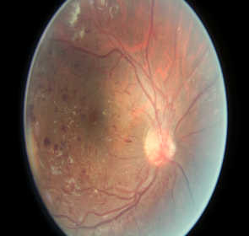
MODEL DESIGN
DR
No DR
DR
No DR
Decision
VGG-16
Explainer
(LIME)
.
Model
Data and predictions
Human makes decision
Explanation
LIME attempts to play the role of the ‘explainer’, explaining predictions for each data sample.

Slide 12
IMPLEMENTATION
As part of this study, we extended our machine learning model by using the Local Interpretable Model-agnostic Explanations (LIME) model.
The LIME model can explain inferences produced by machine learning models by performing a local approximation of the inference point.
Features with high positive weight in the linear regression approximation support the prediction decision, while features with negative weight oppose the decision.

Slide 13
CONCLUSION
The model was able to successfully classify images into DR and non-DR classes. The results obtained with deep learning based VGG16 model is of 91.62%.
The output of LIME is a list of explanations, reflecting the contribution of each feature to the prediction of a data sample.

Slide 14
REFERENCES
kaggle Challenge Diabetic Retinopathy Detection. https://www.kaggle.com/c/ diabetic-retinopathy-detection
Wong Li Yun , U. Rajendra Acharya, Y.V. Venkatesh, Caroline Chee, Lim Choo Min, E.Y.K. Ng Identification of different stages of diabetic retinopathy using retinal optical images. July 2007

Slide 15
THANK YOU

