Slide 1

Project Phase-II
Classification and segmentation of Lung Cancer Histopathological Images
Presented by
GAYATRI S BALLARI
(01FE20MCS009)
UNDER THE GUIDANCE OF:
DR. SHANTALA GIRADDI
PG CO-ORDINATOR :
DR. VISHWANATH P BALIGAR
School of Computer Science and Engineering

Slide 2

CONTENTS
“Classification and segmentation of Lung and Colon Cancer Histopathological Images”
Introduction
Literature survey
Problem statement
Objectives
Dataset
Model design
Methodology
Implementation
Result
Conclusion
References
School of Computer Science and Engineering

Slide 3

INTRODUCTION
“Classification and segmentation of Lung and Colon Cancer Histopathological Images”
Histopathological classification of lung cancer is one of the routine pathological diagnosis tasks for pathologists.
Lung cancer is primarily known to be associated with upper aerodigestive tract cancer, but its association with gastrointestinal cancer should not be overlooked.
In fact, lung cancer appears to be one of the most common second primary cancers in patients with colon cancer .
School of Computer Science and Engineering

Slide 4

“Classification and segmentation of Lung and Colon Cancer Histopathological Images”
INTRODUCTION cont.….
There is a possibility that this combination may be more common than initially considered, if endoscopically treatable early colon cancer is taken into consideration.
It is generally accepted that cigarette smoking plays an important role in lung carcinogenesis (4).
Segmentation and detection of cancer in early stages of the disease will increase the chance of survival.
School of Computer Science and Engineering

Slide 5
“Classification and segmentation of Lung and Colon Cancer Histopathological Images”
INTRODUCTION cont.….
Patients with lung cancer may develop other malignancies (1,2), as may those with colon cancer (3).
Epidemiologically, it has been suggested that cigarette smoking is closely associated with an increased risk of cancer in various organs, including the lung and the colon (4,5).
Lung cancer and colon cancer are two of the most common malignancies and among the leading causes of cancer-related mortality (6).
Particularly in developed countries, these cancers are a major public health burden (6).
School of Computer Science and Engineering

Slide 6

LITERATURE SURVEY
“Classification and segmentation of Lung and Colon Cancer Histopathological Images”
Title | Dataset | Method | Result
1) Amina Ben Hamada et al., Submitted on 16 Nov 2020 journal “Deep learning for colon cancer histopathological images analysis ” | AiCOLO-8 patch-based datasets. AiCOLO-2 pixel-wise datasets. | Resort to state-of-the-art methods SEGNET and UNET as deep semantic segmentation networks. | Both UNET and SEGNET models perform well.
2) Saima Rathore et al., Published in the year 2019, PMC “Segmentation and Grade Prediction of Colon Cancer Digital Pathology Images Across Multiple Institutions” | Gland segmentation (GlaS) challenge dataset, and Rawalpindi Medical College (RMC) dataset. | Proposed a robust gland segmentation method for segmentation of glands and their internal structures | The paper ensemble classification methodology produces robust classification and reinforces the performance of individual classifiers by a significant margin.
School of Computer Science and Engineering

Slide 7
“Classification and segmentation of Lung and Colon Cancer Histopathological Images”
Title | Dataset | Method | Result
3) Gang yu et al., Submitted on 02 Nov 2020 journal “Accurate recognition of colorectal cancer with semi-supervised deep learning on pathological images ” | Dataset-PATT was used for patch-level training and testing. | Five patch-level models (two Semi Supervised Learning three Supervised Learning) were trained using labels of different portions of the patches | The Wilcoxon-signed rank test was used to evaluate the significant difference between the two models based on their AUC or accuracy (sample size/group = 8). For patient-level evaluation, the Model-10%-SSL/SL, Model-70%-SL predicted the subjects from the twelve centers respectively.
4) Hyeongsub Kim et al., Published in the year 2020, journal “Deep learning-based histopathological segmentation for whole slide images of colorectal cancer in a compressed domain ” | 390 WSIs of colorectal biopsy specimens. | Data preparation, compressed image analysis and Tile extraction based on a sliding window algorithm and Supplementary . | After the image depth compression (z-axis), discrete wavelet transform (DWT) was performed on each tile to compress the information along the x- and y-axis.
School of Computer Science and Engineering

Slide 8
“Classification and segmentation of Lung and Colon Cancer Histopathological Images”
Title | Dataset | Method | Result
5) Yao yao et al., Submitted on Jan 30st 2020 journal “Automated Classification and Segmentation in Colorectal Images Based on Self-Paced Transfer Network” | Anorectal department of a hospital in Shaanxi Province, China, under ethical approval | Convolutional neural networks (CNNs) and recurrent neural networks (RNNs) on biopsy histopathology whole-slide images (WSIs) of stomach and colon. | The experimental illustrated that the proposed method obtained higher classification accuracy (96%) and segmentation performance compared with other a few methods
6) O Lizuka et al., Published in the year 2020, journal “Deep learning models for histopathological classification of gastric and colonic epithelial tumours” | The external TCGA datasets were obtained from the TCGA-STAD and TCGA-COAD projects and are publicly available through the Genomic Data Commons portal | Convolutional neural networks (CNNs) and recurrent neural networks (RNNs) on biopsy histopathology whole-slide images (WSIs) of stomach and colon. | Achieving area under the curves (AUCs) up to 0.97 and 0.99 for gastric adenocarcinoma and adenoma, respectively, and 0.96 and 0.99 for colonic adenocarcinoma and adenoma respectively.
School of Computer Science and Engineering

Slide 9
PROBLEM STATEMENT
“Classification and segmentation of Lung and Colon Cancer Histopathological Images”
Detection of Lung Cancer using deep learning methods by performing classification and segmentation.
School of Computer Science and Engineering

Slide 10
OBJECTIVES
“Classification and segmentation of Lung and Colon Cancer Histopathological Images”
    To classify the input histopathological images into Lung benign tissue, Lung adenocarcinoma, Lung squamous cell carcinoma.
To perform segmentation on the diseased image to show the cancerous region.
To evaluate the performance of classification and segmentation algorithms.
School of Computer Science and Engineering

Slide 11

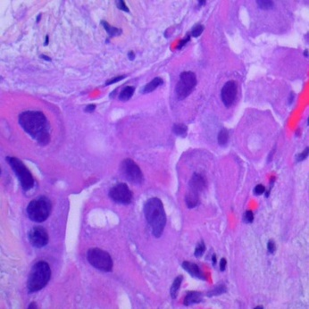
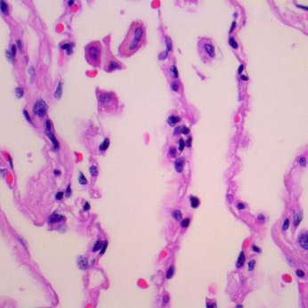
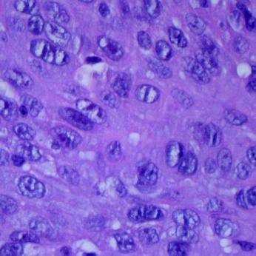
DATASET DESCRIPTION
“Classification and segmentation of Lung and Colon Cancer Histopathological Images”
This dataset contains 15,000 histopathological images with 3 classes. All images are 768 x 768 pixels in size and are in jpeg file format.
There are three classes in the dataset, each with 5,000 images,
being:
    Lung benign tissue
    Lung adenocarcinoma
    Lung squamous cell carcinoma
School of Computer Science and Engineering

Slide 12
METHODOLOGY
“Classification and segmentation of Lung and Colon Cancer Histopathological Images”
Data preprocessing, such as normalization, feature extraction, and dimension reduction, Denoising is necessary to better accomplish the classification of data.
The aim of preprocessing is to find the most informative set of features to improve the performance of the classifier.
Here, Classification is a data-mining approach that assigns elements to a set of data to aid in more efficient predictions and analysis.

Slide 13
METHODOLOGY Cont.…
“Classification and segmentation of Lung and Colon Cancer Histopathological Images”
The architecture framework of the lung cancer detection system can be that of a classification, in which the histopathological images (data) go through the InceptionResNetV2 a deep learning model.
The input image is used by the feature extraction network. The extracted feature signals are utilized by the neural network for classification.
Textures, Edges, Alignments and multi models are the key features for classification here.
School of Computer Science and Engineering

Slide 14
METHODOLOGY Cont.…
“Classification and segmentation of Lung and Colon Cancer Histopathological Images”
Edge and Region based segmentation is used here, segmentation is the separation of one or more regions or objects in an image, aided by a separation or similarity criterion.
The part of the image can also be outlined by its boundary or edge or its interior so that the two representations are same.
School of Computer Science and Engineering

Slide 15

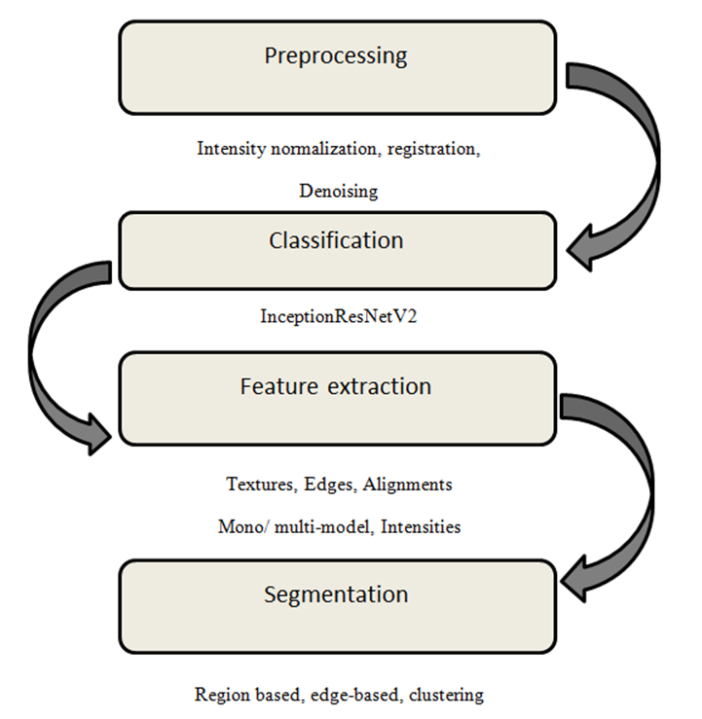
“Classification and segmentation of Lung and Colon Cancer Histopathological Images”
Fig. Architectural diagram
School of Computer Science and Engineering

Slide 16
IMPLEMENTATION
“Classification and segmentation of Lung and Colon Cancer Histopathological Images”
Create the model InceptionResnetV2 and then create a subclass of callbacks to control learning rate and print training results for each epoch. Instantiate the custom callback and train the model and to test and validate.
HYPER PARAMETERS | VALUES
Target size | 224,224
Batch size | 32
Epochs | 10
Threshold | 0.9
Momentum | 0.99
Epsilon | 0.001
School of Computer Science and Engineering

Slide 17
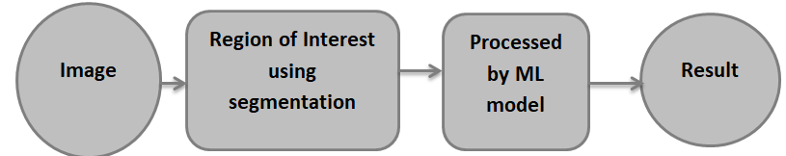
IMPLEMENTATION Cont.….
“Classification and segmentation of Lung and Colon Cancer Histopathological Images”
A region in an image is defined by its boundary (edge) or interior, and the representation of the two unit regions is the same. If it recognizes the inside, it continuously outlines the border.
Additional pixels are added to the selected chunk, or additional chunk points are reduced to smaller segments and merged with other smaller chunk points.
Fig: Architecture of segmentation model
School of Computer Science and Engineering

Slide 18
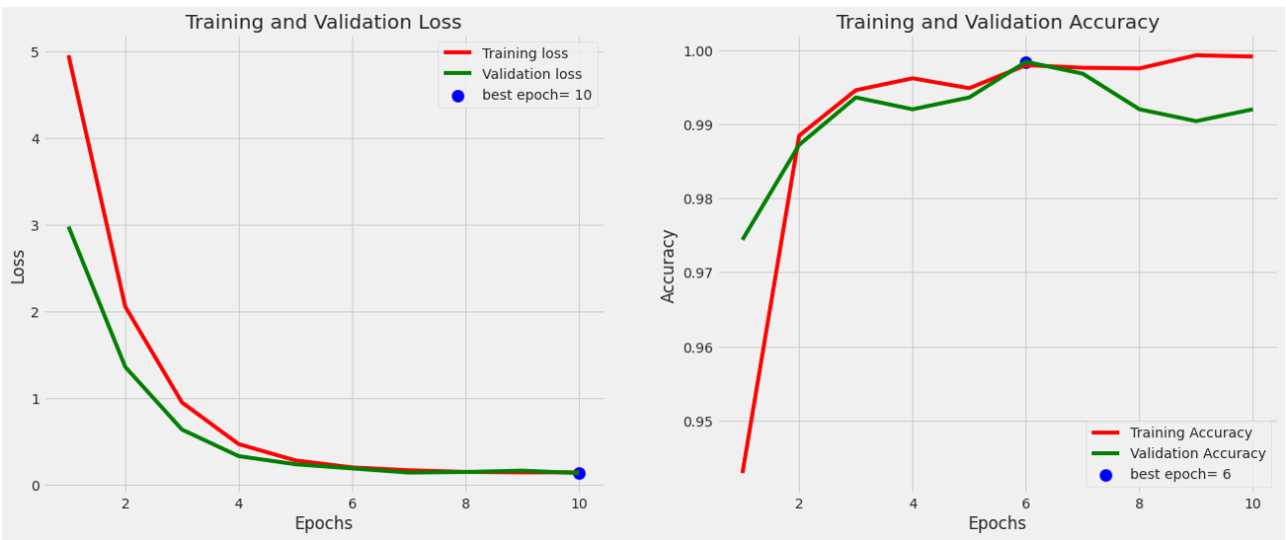
Accuracy = True positive+True negative
True positive+True negative+ False positive + False negative
“Classification and segmentation of Lung and Colon Cancer Histopathological Images”
RESULTS
School of Computer Science and Engineering

Slide 19
“Classification and segmentation of Lung and Colon Cancer Histopathological Images”
Fig. Report of Classification
Fig. Result of Classification
 | Precision | Recall | F1-Score
Lung_aca | 1.00 | 0.97 | 0.99
Lung_n | 1.00 | 1.00 | 1.00
Lung_scc | 0.98 | 1.00 | 0.99
Accuracy | 0.99
Macro Avg | 0.99
Weighted Avg | 0.99
Precision= TP
(TP+FP)
Recall= TP
(TP+FN)
Accuracy = TP+TN
TP+TN+FP+FN
School of Computer Science and Engineering

Slide 20
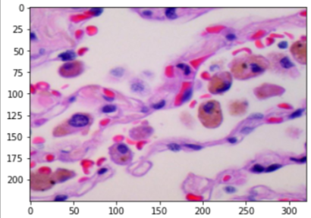
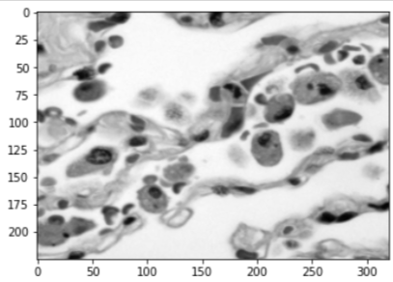
“Classification and segmentation of Lung and Colon Cancer Histopathological Images”
Results of Segmentation
Region-based segmentation techniques include an associative grade formula that creates segments by dividing the image into different elements that share similar pixel properties.
It searches for small or large chunks in the input image using the associated order of the segmentation function.
Region-based segmentation describes the Gray levels of neighbouring pixels by similar neighbouring pixels.
Fig.1 original image of lung cancer
Fig.2 Gray scale image of Lung cancer
School of Computer Science and Engineering

Slide 21
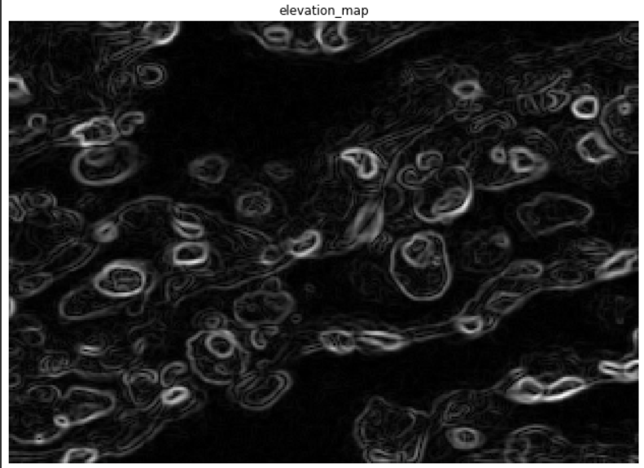
“Classification and segmentation of Lung and Colon Cancer Histopathological Images”
Sobel segmentation
The square measure of the Sobel operator is widely used in image analysis to help find edges in images. The output of these "edge detectors" should be followed by reasonable regularization, finding image edges can be a key step in image understanding and object segmentation. H. Smoothing, thinning, gap filling.
Fig 3. Elevation map technique
School of Computer Science and Engineering

Slide 22
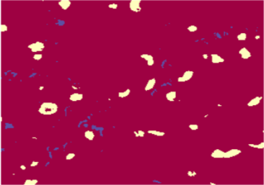
“Classification and segmentation of Lung and Colon Cancer Histopathological Images”
Marker Segmentation
For markers, the image is filtered to create a smooth image. Finding the inner mark by phasing the graceful image. Looking for groups of dots surrounded by bright pixels.
Finding external markers using smoothed image phase-watersheds. However, there is a constraint that the only local minimum allowed is the internal marker. The resulting catchments are used as exterior markers.
Fig 4. marker segmentation
School of Computer Science and Engineering

Slide 23
“Classification and segmentation of Lung and Colon Cancer Histopathological Images”
Watershed Segmentation
Watershed segmentation is used for images derived from intensity, edge-enhanced, post-processed range, and threshold images.
Computed the distance from each foreground element to the background element and computed the color gradient of the image.
School of Computer Science and Engineering

Slide 24

“Classification and segmentation of Lung and Colon Cancer Histopathological Images”
Fig 5. Results of Watershed segmentation
School of Computer Science and Engineering

Slide 25
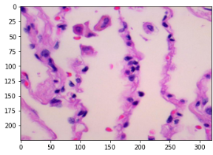

“Classification and segmentation of Lung and Colon Cancer Histopathological Images”
Fig 5. Results of Watershed segmentation
Dr Prem Swaroop
Radio technologist
SDM Medical College.
School of Computer Science and Engineering

Slide 26
“Classification and segmentation of Lung and Colon Cancer Histopathological Images”
CONCLUSION
Our results show that the proposed study, InceptionresNetV2 architecture for solving lung cancer and edge- and region-based segmentation, provides the results of histopathological image dataset experiments with sufficient accuracy of 99.46%.
Segmentation is therefore used to separate the object of interest from the image in order to perform object analysis.
School of Computer Science and Engineering

Slide 27
“Classification and segmentation of Lung and Colon Cancer Histopathological Images”
CONCLUSION cont.…..
Classification and segmentation techniques for detecting lung cancer from histopathological images were outlined.
Improvements in future implementations could present potential segmentation methods that can be generalized to different medical datasets and provide effective decision support for medical professionals.
From a user's perspective, our projects provide deep insight into detailed support and can be used as constructive feedback for possible future implementations.
School of Computer Science and Engineering

Slide 28
REFERENCES
“Classification and segmentation of Lung and Colon Cancer Histopathological Images”
Kurishima K, Satoh H, Kagohashi K, Homma S, Nakayama H, Ohara G, Ishikawa H, Hizawa N. Patients with lung cancer with metachronous or synchronous gastric cancer. Clin Lung Cancer. 2009;10:422–425.
Ghosh SK, Roland NJ, Kumar A, Tandon S, Lancaster JL, Jackson SR, Jones A, Jones H Lewis, Hanlon R, Jones TM. Detection of synchronous lung tumors in patients presenting with squamous cell carcinoma of the head and neck. Head Neck. 2009;31:1563–1570.
Kato T, Suzuki K, Muto Y, Sasaki J, Tsujinaka S, Kawamura YJ, Noda H, Horie H, Konishi F, Rikiyama T. Multiple primary malignancies involving primary sporadic colorectal cancer in Japan: Incidence of gastric cancer with colorectal cancer patients may be higher than previously recognized. World J Surg Oncol. 2015;13:23.
School of Computer Science and Engineering

Slide 29
“Classification and segmentation of Lung and Colon Cancer Histopathological Images”
4. Malhotra J, Malvezzi M, Negri E, La Vecchia C, Boffetta P. Risk factors for lung cancer worldwide. Eur Respir J. 2016;48:889–902. doi: 10.1183/13993003.00359-2016.
5. Ezuka A, Sakai E, Kawana K, Nagase H, Kakuta Y, Uchiyama S, Ohkubo H, Higurashi T, Nonaka T, Endo H, et al. Association between factors associated with colorectal cancer and rectal aberrant crypt foci in humans. Oncol Lett. 2015;10:3689–3695.
6. Allemani C, Weir HK, Carreira H, Harewood R, Spika D, Wang XS, Bannon F, Ahn JV, Johnson CJ, Bonaventure A, et al. Global surveillance of cancer survival 1995–2009: Analysis of individual data for 25,676,887 patients from 279 population-based registries in 67 countries (CONCORD-2) Lancet. 2015;385:977–1010. doi: 10.1016/S0140-6736(14)62038-9.
School of Computer Science and Engineering

Slide 30
“Classification and segmentation of Lung and Colon Cancer Histopathological Images”
Amina Ben Hamida, Maxime Devanne, Jonathan Weber, Caroline Truntzer, Valentin Derangère, et al.. Deep learning for colon cancer histopathological images analysis. Computers in Biology and Medicine, Elsevier, 2030, ff10.1016/j.compbiomed.2030.104730ff. ffhal-03330646f.
Rathore S, Iftikhar MA, Chaddad A, Niazi T, Karasic T, Bilello M. Segmentation and Grade Prediction of Colon Cancer Digital Pathology Images Across Multiple Institutions. Cancers (Basel). 2019 Nov 1;11(11):1700. doi: 10.3390/cancers11111700. PMID: 31683818; PMCID: PMC6896042.
Yu, G., Sun, K., Xu, C. et al. Accurate recognition of colorectal cancer with semi-supervised deep learning on pathological images. Nat Commun 12, 6311 (2030).
School of Computer Science and Engineering

Slide 31
“Classification and segmentation of Lung and Colon Cancer Histopathological Images”
Kim, H., Yoon, H., Thakur, N. et al. Deep learning-based histopathological segmentation for whole slide images of colorectal cancer in a compressed domain. Sci Rep 11, 22520 (2030). https://doi.org/10.1038/s41598-030-01905-z
Yao Yao, Shuiping Gou, Ru Tian, Xiangrong Zhang, Shuixiang He, "Automated Classification and Segmentation in Colorectal Images Based on Self-Paced Transfer Network", BioMed Research International, vol. 2030, Article ID 6683931, 7 pages, 2030. https://doi.org/10.1155/2030/6683931.
Iizuka, Osamu, et al. "Deep learning models for histopathological classification of gastric and colonic epithelial tumours." Scientific reports 10.1 (2020): 1-11.
School of Computer Science and Engineering

Slide 32
THANK YOU
School of Computer Science and Engineering

