Slide 1
UNIT-III Electro Chemical Machining

Slide 2
Introduction:
Electro chemical machining is a non traditional machining process.
In this process a combination of electrical energy and chemical energy is used to remove material from the workpiece.
The electrolyte is a conductor of electricity.
Characterized as “Reverse Electroplating” means it removes metal instead of adding.
Normally used for mass production and hard materials that are difficult to machine using conventional process.

Slide 3
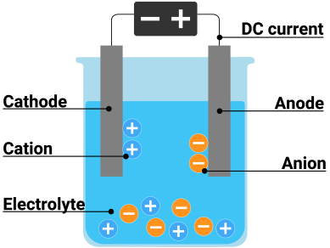
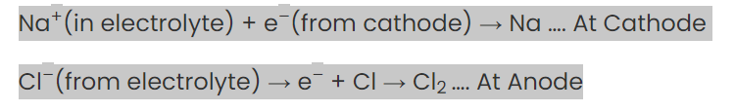
Electrolysis:

Slide 4
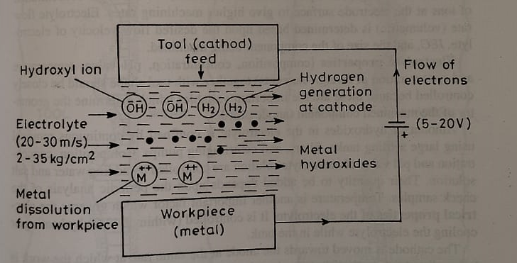
Principle:
The feature of electrolysis is that the electrical energy is used to produce a chemical reaction therefore the machining process based on this principle is known as electro chemical machining.
The process works on the principle of faradays laws of electrolysis.

Slide 5

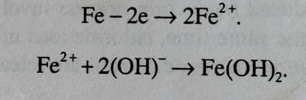


During electrolysis of water its molecules gain electrons from cathode so that they separate into free hydrogen gas and hydroxyl ions
As the anode dissolves negatively charged hydroxyl ions are electrically balanced by positively charged metal ions entering in to the electrolyte.
Metal ions combine with hydroxyl ions to form metal hydroxides
Ferrous hydroxides may further react with water and oxygen to form ferric hydroxide

Slide 6
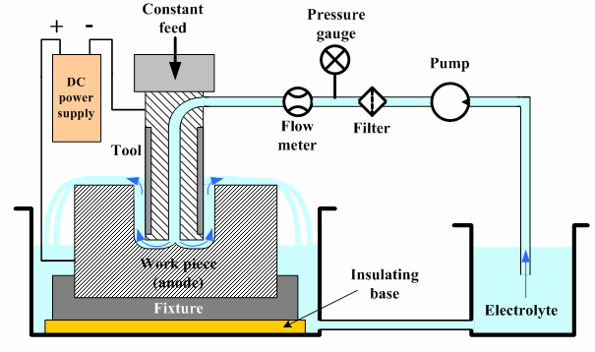
Schematic Representation of ECM:

Slide 7
Equipment used in ECM Process:
DC Power Supply
Electrolyte
Electrodes
The filter and settling tank
Tool feed system

Slide 8
DC Power Supply:
The DC power supply used in this process is from 3 to 30 V
The DC power supply is used to create a potential difference between the workpiece and the tool and make them act as anode and cathode respectively.
Table:
The table is used to hold the workpiece on top of it.
Work Piece:
This is the object from which material to be removed.
The workpiece is connected to the positive terminal of the DC power supply and acts as an anode.
Tool:
This tool is connected to the negative terminal and acts as a cathode.
The tool (cathode) should have good thermal conductivity and electrical conductivity and also should be corrosion proof.
The most commonly used tools in the ECM process are stainless steel,brass,copper etc

Slide 9
Feed Unit:
It is used to constantly move the tool downwards the workpiece.
Electrolyte:
The electrolyte is used to establish an electrical connection between the anode and the cathode so that positive and negative ions can flow from these two.
It is also used to remove the heat produced from the passage of the current.
The most commonly used electrolyte in ythe ECM process are salt electrolytes like sodium chloride and sodium nitrate.
Pump:
The pump is used to pump the electrolyte towards the gap between cathode and anode.
Filter:
The filter is used to filter the electrolyte and remove the unwanted particles from the electrolyte.

Slide 10
Pressure guage:
The pressure guage is used to control the pressure at which the electrolyte is supplied to the system of electrochemical machining.
Flowmeter:
Flow meter is used to regulate the flow of electrolyte which is supplied to the system.

Slide 11
In this process the workpiece is connected to the positive terminal and works as anode and the tool is connected to the negative terminal and works as a cathode.
As very high current is used, the tool and the workpiece are isolated from the system to prevent any short circuiting or leakage of the current.
The electrolyte is filtered are made to flow through the workpiece continuously.
The pressure at which the electrolyte is pumped depends on the application or requirement of the process.
The electrolyte which can be used in this process are
1.Sodium Chloride
2.Sodium Nitrate
3.Sodium Hydroxide
4.Sodium Sulphate
Any electrolyte used should have the capability to establish electrical contact between the cathode and anode.
The gap which is maintained between the tool and the workpiece is nearly 0.5mm.

Slide 12
Working:
The electrolyte is supplied to the system of anode and cathode i.e workpiece and tool using the pump.In between the pump and the system a filter is placed which is used to filter the electrolyte before reaching the system.
After passing through the filter and flow regulator the electrolyte reaches the space between the workpiece and the tool.
As the electrolyte reaches the gap between anode and cathode, electrical contact is established between the anode and the cathode.After the electrical contact is established, the positive ions start flowing from the workpiece towards the tool and negative ions start flowing from the tool towards the workpiece.
When the positive ions flow from the workpiece towards the tool the electrolyte carries away the positive ions with it stops it from reaching the tool.
So the material start removing from the w/p as +ve ions from the w/p are dissolve and carried away by electrolyte and materials are also removed due to the striking power of thje negative ions coming from the tool.
This material removal process from the w/p is continued until a cavity is created in the w/p which is a replica of the tool used in this process.

Slide 13
Advantages:
Metal is removed rapidly
Complex shaped w/ps can be machined economically.
No tool wear
Operations such as cutting,sawing,grinding,machining,contour milling,deburring and polishing can be done.
It gives good surface finish better corrosion resistence and better accuracy
Disadvantages:
Large floor space and high capital cost is required.
Difficult tool design.
Power consumption is high.
Machining is limited to electrical conductive materials only.
High tooling and initial cost
Not economical for small lots
It cannot produce sharp corners and edges

Slide 14
Applications:
Used to machine difficult to machine materials and complex shaped pparts.
Blind complex cavities ,curved surfaces, through cutting and large through cavites can be machined.
Drilling of long and slender holed can be achieved.Holes of dia 0.025mm can bbe produced.depth of holes can be as deep as 600mm.
Hollow shafts can be machined easily
Wire cutting can also be achieved
Operations such as sawing,honing,deburring and turning can be done.
Used for gas turbine blades

Slide 15
Metal removal rate in ECM:
MRR is an important characteristic to evaluate sufficiency of a non traditional machining process.In ECM material removal takes place due to atomic dissolution of work material
Electro chemical is given by faradays law
Faradays I law: states that the amount of electrochemical dissolution or deposition is proportional to the amount of charge passed through the electrochemical cell,which is expressed as
m∝Q
Where m=mass of material dissolved or deposited
Q= amount of charge passed
Faradays II law:
states that the amount of material deposited or dissolved further depends on electro chemical equivalence equivalence(ECE) of the material which is again the ratio of the atomic weight and valency.
m ∝ECE ∝ A/v

Slide 16
Tool Design:
Tool design is the main factor for the successful application of ECM process.
The criteria for a ECM tool are that it should be a good conductor of electricity and heat, easily machinable,resistant to chemical reactions without loosing it’s high electrolyte pressure
Surface finish and accuracy economical considerations of ECM:
Surface finish:

