Slide 1
ELECTRIC DISCHARGE MACHINING

Slide 2
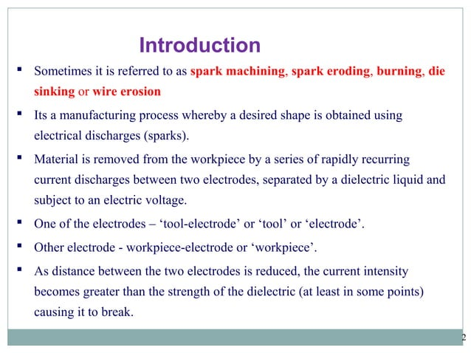

Slide 3
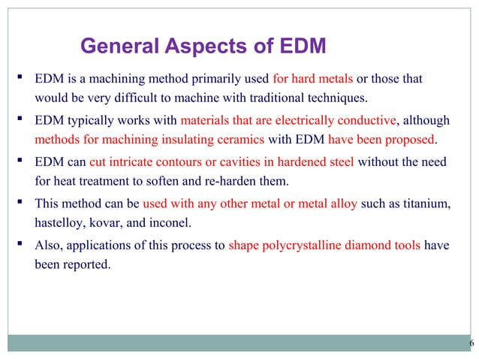

Slide 4
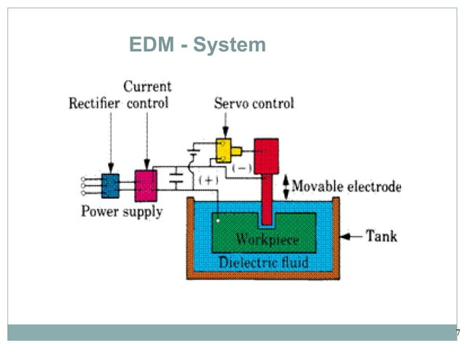

Slide 5
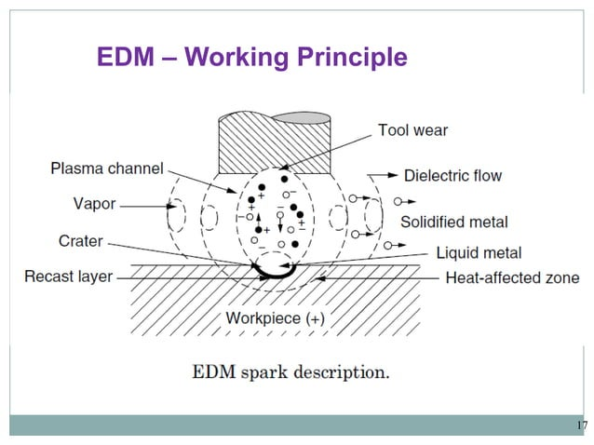

Slide 6
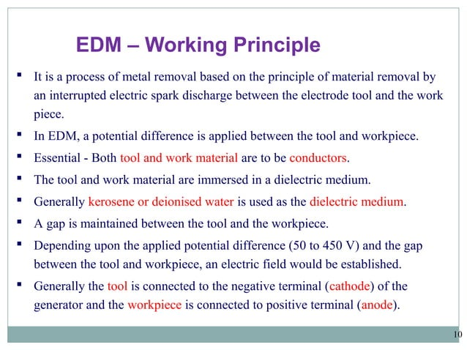

Slide 7
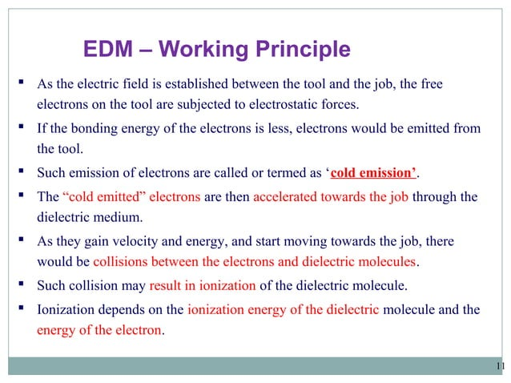

Slide 8
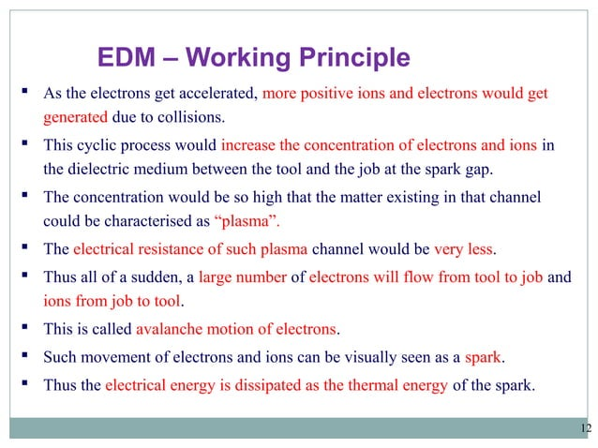

Slide 9
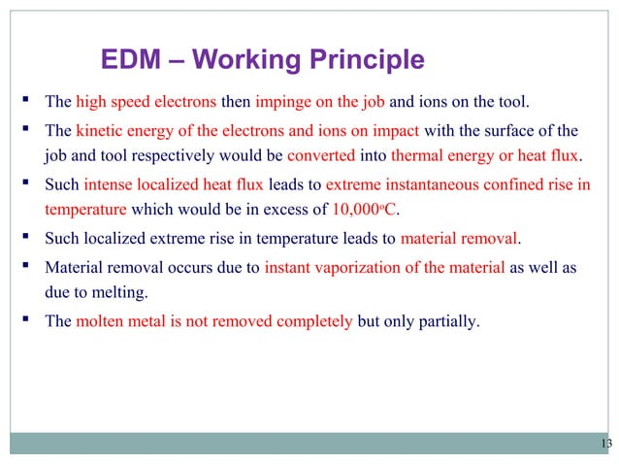

Slide 10
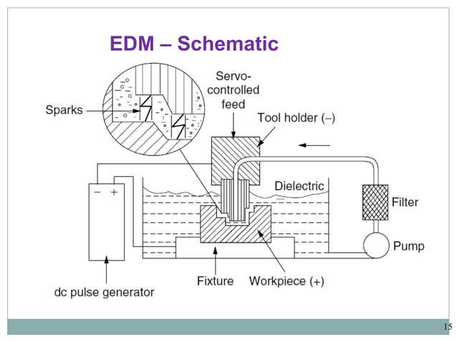

Slide 11
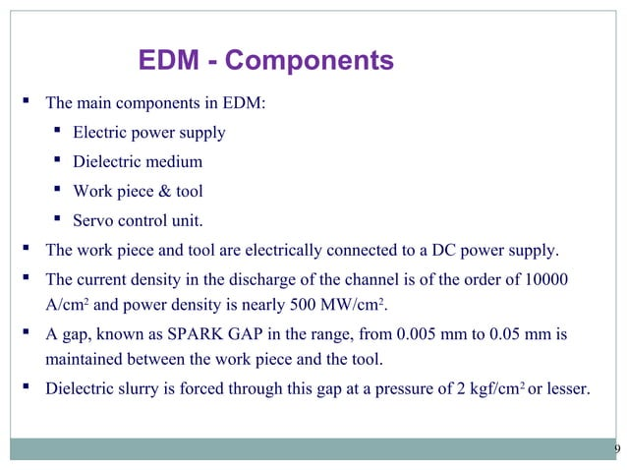

Slide 12
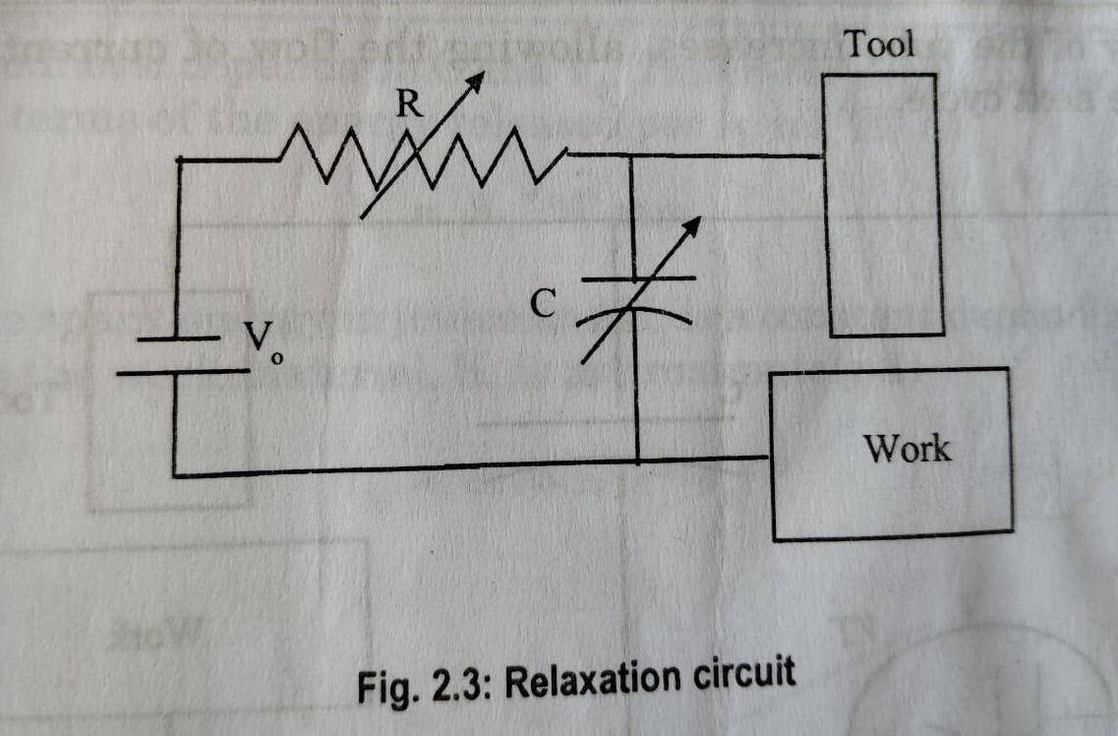
Power Circuits for EDM:
Resistance capacitance relaxation circuit with a constant DC source

Slide 13
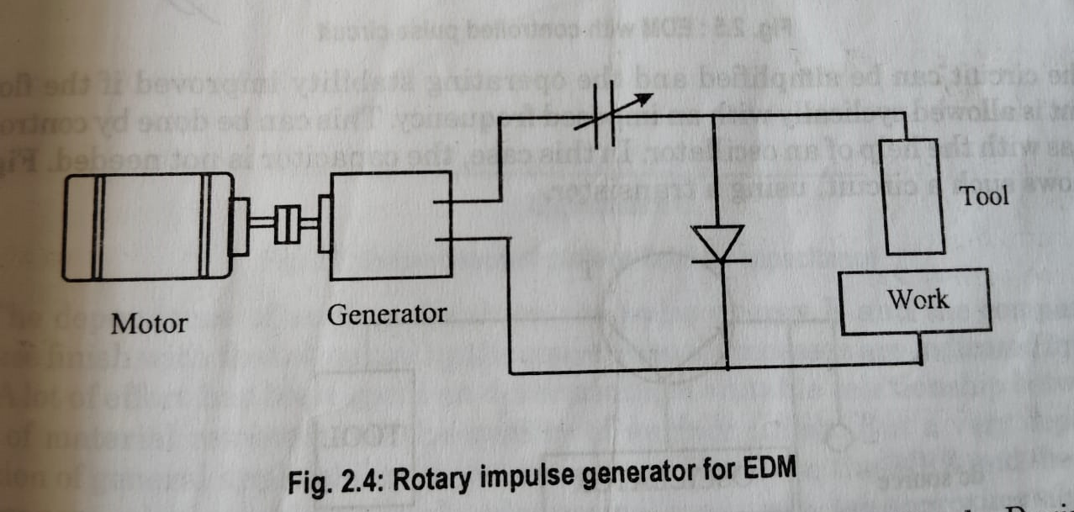
Power Circuits for EDM:
2) Rotary impulse generator

Slide 14
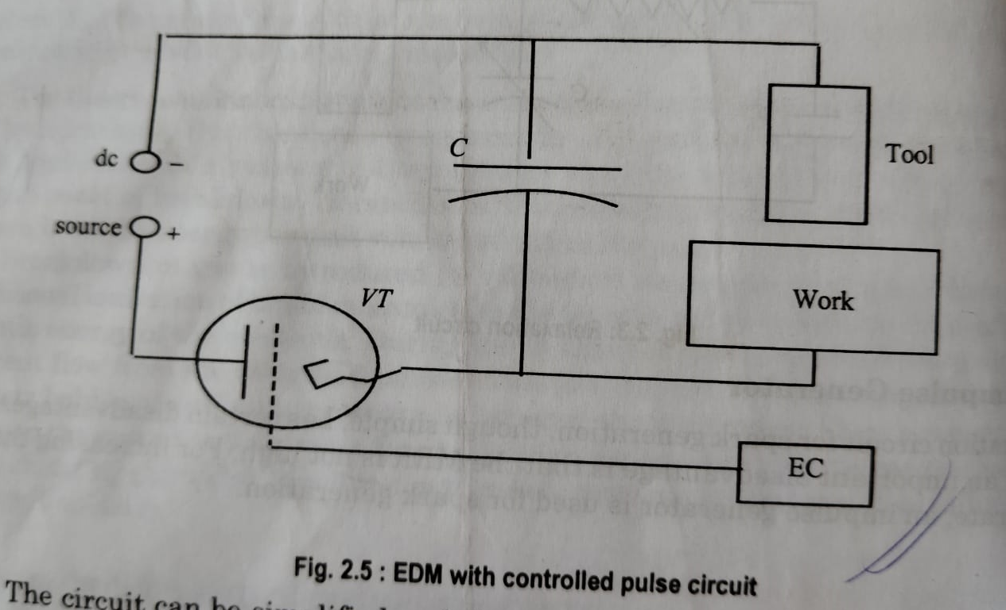
Power Circuits for EDM:
3) Controlled pulse circuits

Slide 15
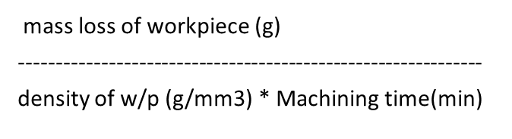

Mechanics of metal removal in EDM:
Metal removal rate is usually expressed as cubic mm per minute.
MRR influenced by machine settings, the melting point of workpiece, thermal conductivity of the w/p.

Slide 16
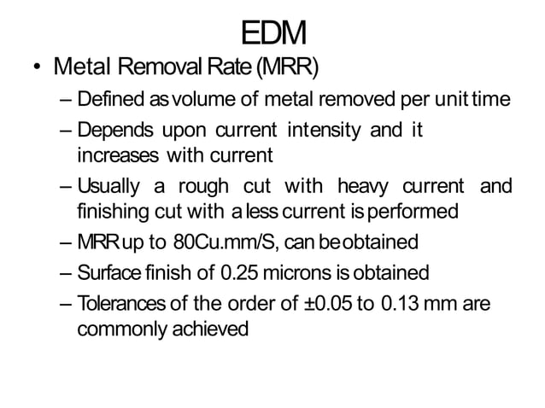

Slide 17
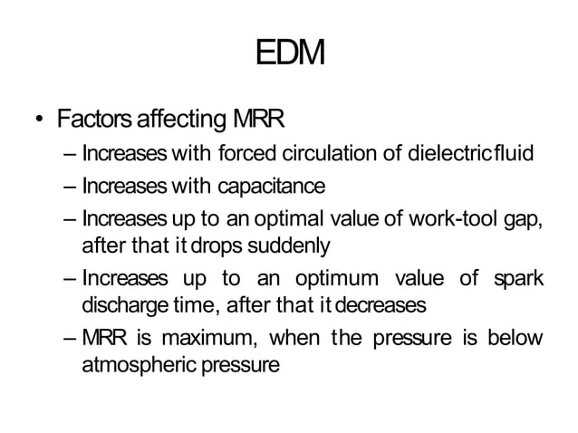

Slide 18
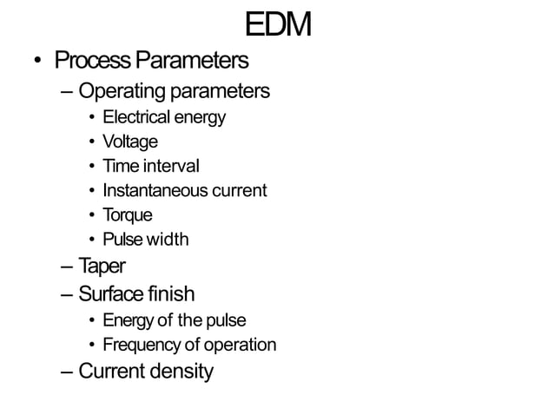

Slide 19
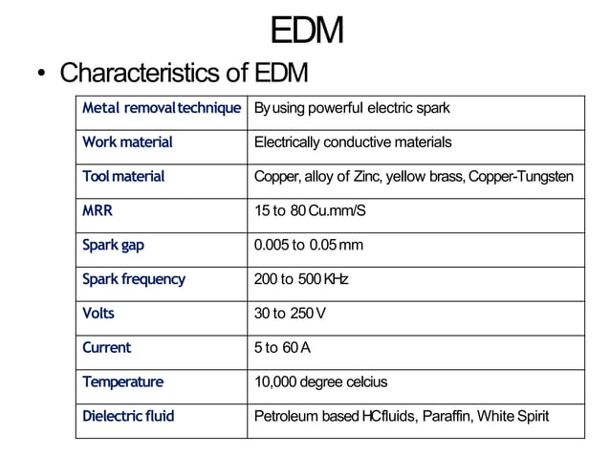

Slide 20
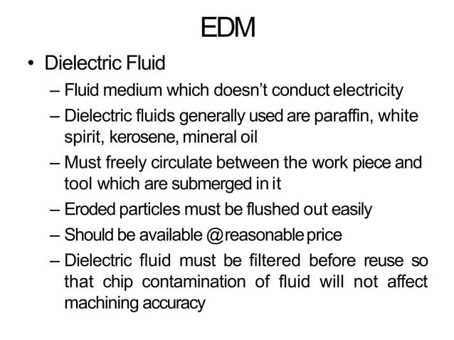

Slide 21
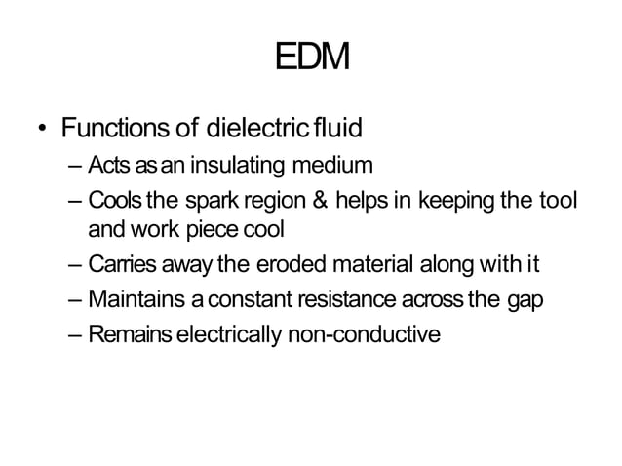

Slide 22
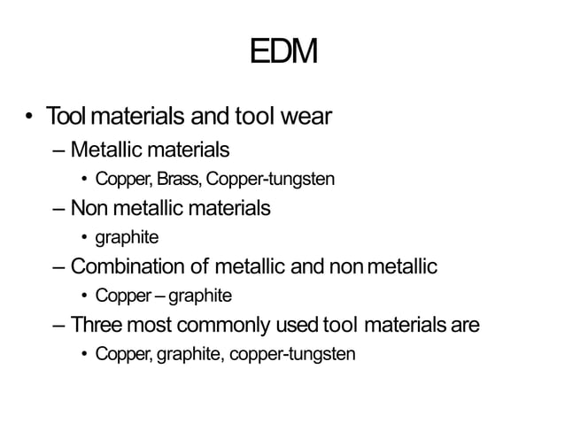

Slide 23
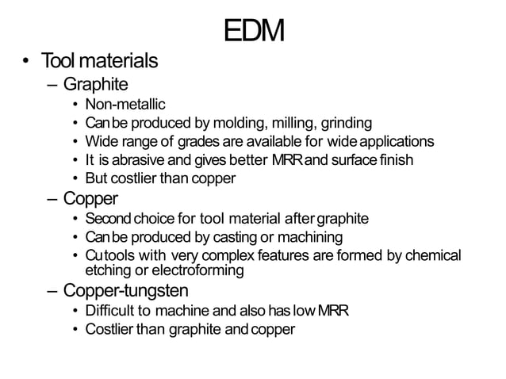

Slide 24
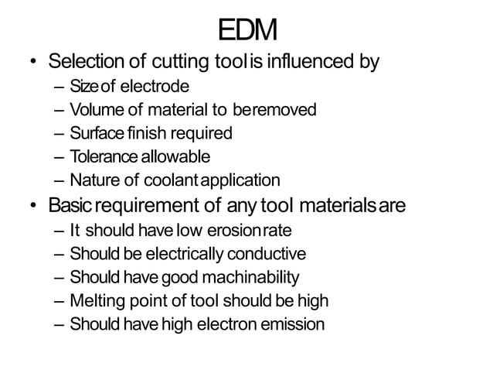

Slide 25
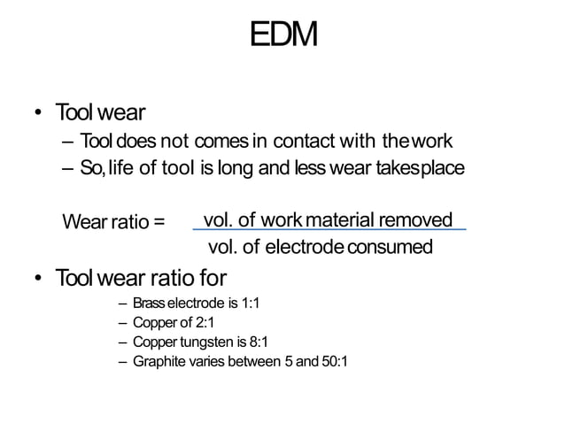

Slide 26
Accuracy of machining:
Factors responsible for inaccuracy in the size and shape are
Side sparks between the tool and the w/p
Value of capacitance
Machining area
Wear of the tool electrode
Inefficient cleaning of the dielectric fluid.
Inaccurate mounting of the w/p and the tool electrode
Displacement or deviation of the working head.
Surface Finish:
At higher pulse energies the surface will be rough.
The pulse energy is a function of the capacitance and the working voltage of the circuit.
Therefore, by varying these two parameters fine surface could be obtained.

Slide 27
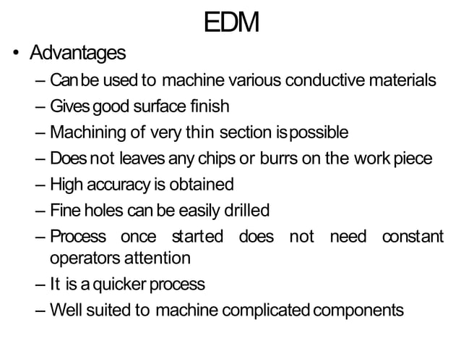

Slide 28
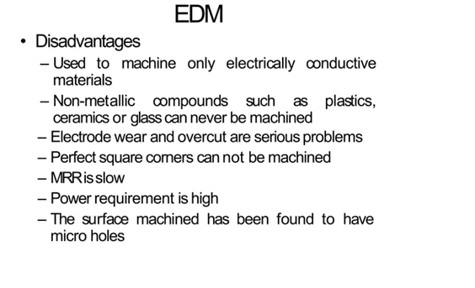

Slide 29
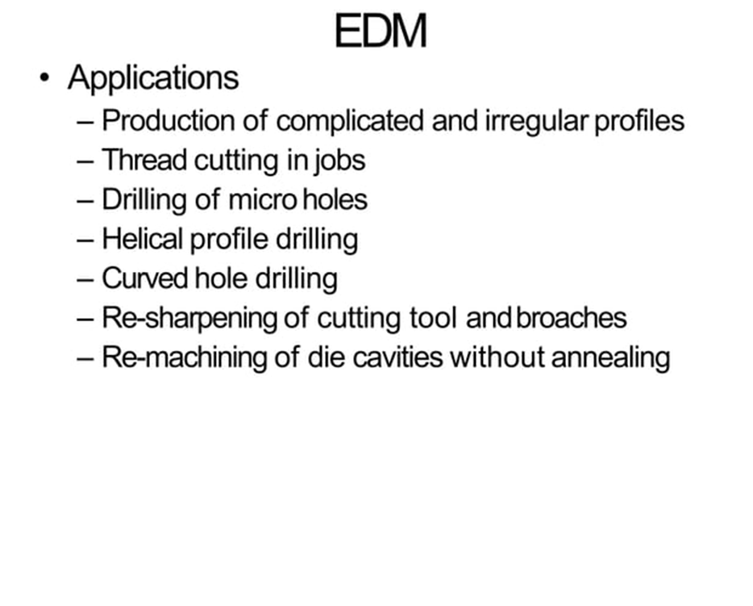

Slide 30
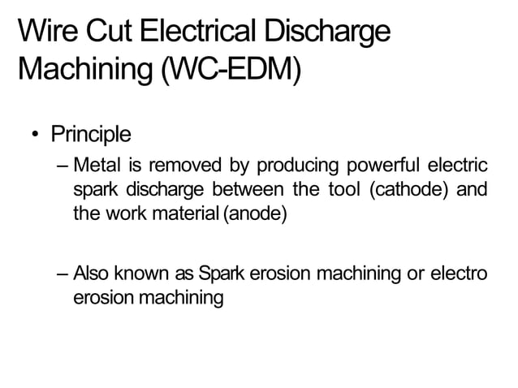

Slide 31
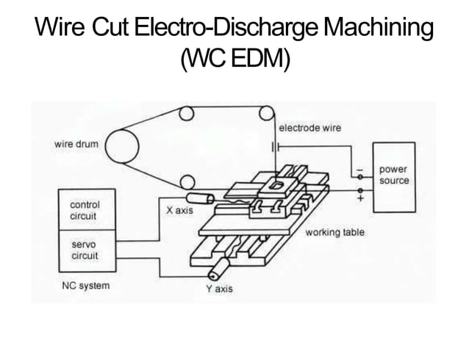

Slide 32
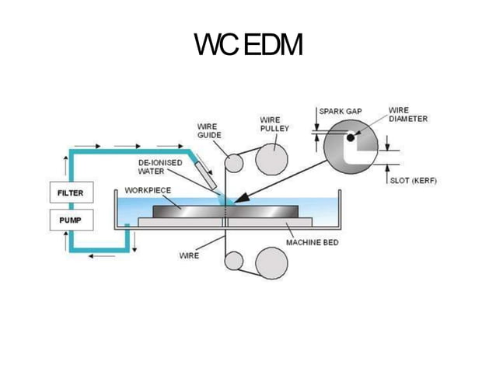

Slide 33
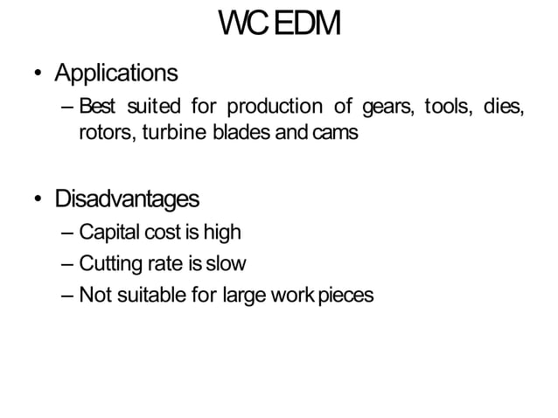

Slide 34
Advantages:
It can machine any complicated through hole dies of electrically conductive materials
The time utilization is high as it continuously work throughout the day.
Small batch productions including prototypes can be machined .
The process has high surface finish.

