Slide 1

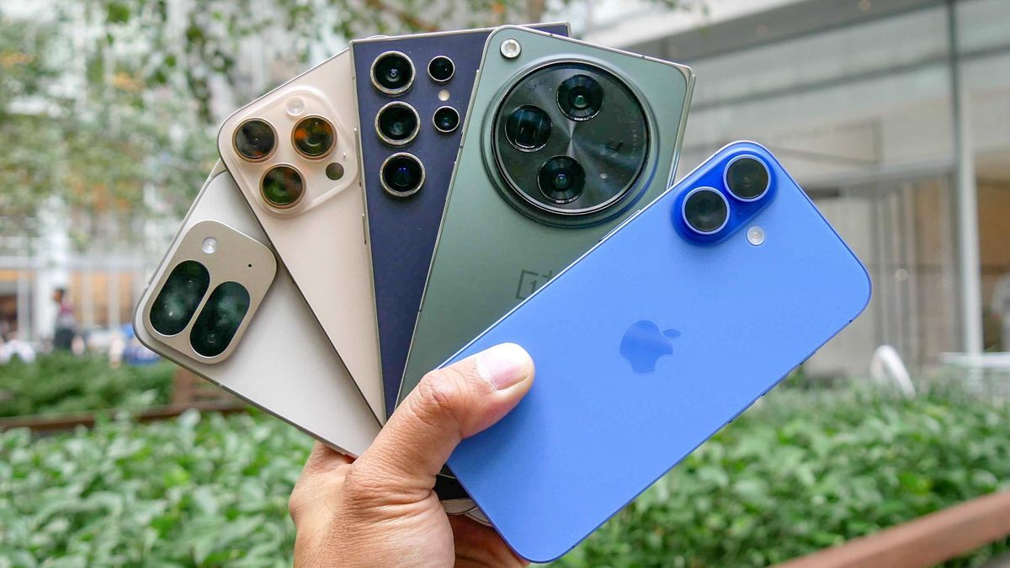
PROJECT TITLE
What Features Really Cost In Smartphones

Slide 2
About Me
I am Gayatri Pansare, a recent MCA graduate from Bharti Vidyapeeth with a strong foundation in computer applications and a keen interest in leveraging technology to solve real-world problems.
Currently, I am pursuing a Data Science course to further develop my analytical and programming skills
I chose this field because Data is the new fuel for decision-making, and I am passionate about uncovering insights hidden within datasets.
I enjoy solving real-world problems using data-driven approaches.
Here are my GitHub and LinkedIn profiles:
https://github.com/Gayatri-Pansare
https://www.linkedin.com/in/gayatripansare/

Slide 3
Problem Statement
In the rapidly evolving smartphone market, consumers face difficulty identifying devices that offer optimal value for money.
This project aims to analyze a dataset of smartphones—scraped from e-commerce platforms—to uncover patterns between pricing and technical specifications (such as RAM, storage, battery capacity, NFC, IR Blaster and processor type).
Objective:-
Identify the most influential features affecting smartphone pricing.
Cluster smartphones into value tiers (e.g., budget, mid-range, premium) to assist buyers in making informed decisions.
Provide insights into feature-price trade-offs across brands and models.

Slide 4
🔹 Web Scraping Process
1.Identify Target Website & Data
Selected Smartprix smartphone listings.
Defined required fields (Brand, Model, Price, Features, etc.).
2. Set Up Environment
Installed required libraries: Selenium,BeutifulSoup, Pandas, Time.
Configured WebDriver (e.g., ChromeDriver) for Selenium.
3. Access Web Pages
Used Selenium to open dynamic web pages and handle scrolling/loading.
Automated navigation across multiple pages of smartphone listings.
4. Extract Page Source
Collected the raw HTML source from Selenium.
Passed HTML into BeautifulSoup for parsing.

Slide 5
5.Parse & Extract Data
Located HTML tags & attributes containing required information.
Extracted fields: brand, model, price, specifications, ratings, etc.
6. Store Data
Structured extracted data into Python lists/dictionaries.
Converted into a Pandas DataFrame for cleaning and analysis.
7. Data Cleaning & Processing
Handled/Removed missing/duplicate values.
Standardized formats (e.g., price to numeric, camera megapixels, battery capacity).
8. Save Dataset
Exported the cleaned dataset into CSV/Excel for further analysis.

Slide 6
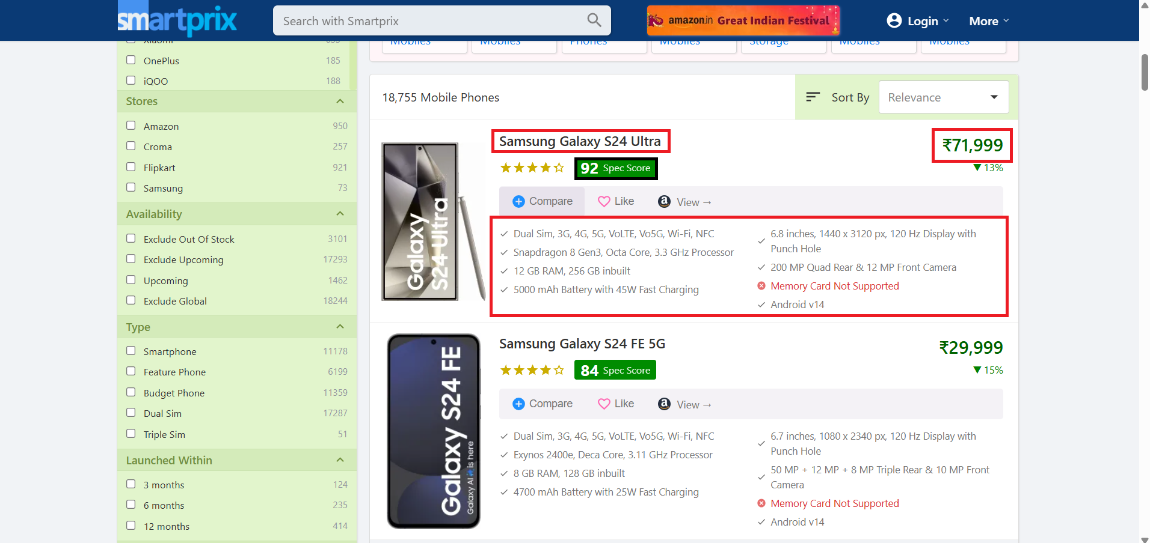
WEBSITE PREVIEW

Slide 7
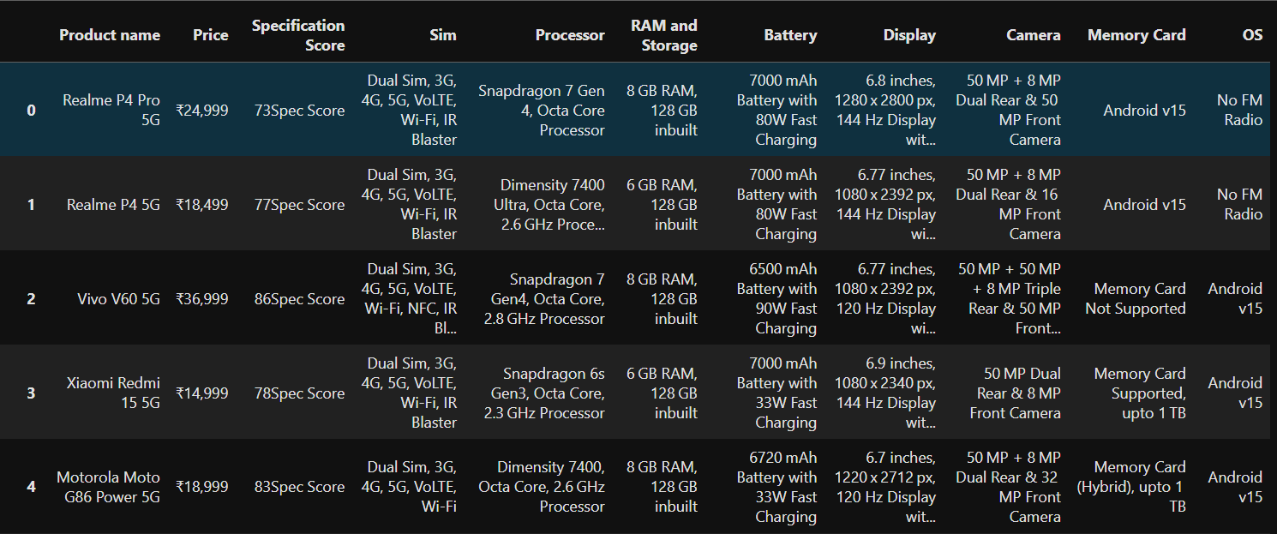
BEFORE CLEANING DATASET

Slide 8
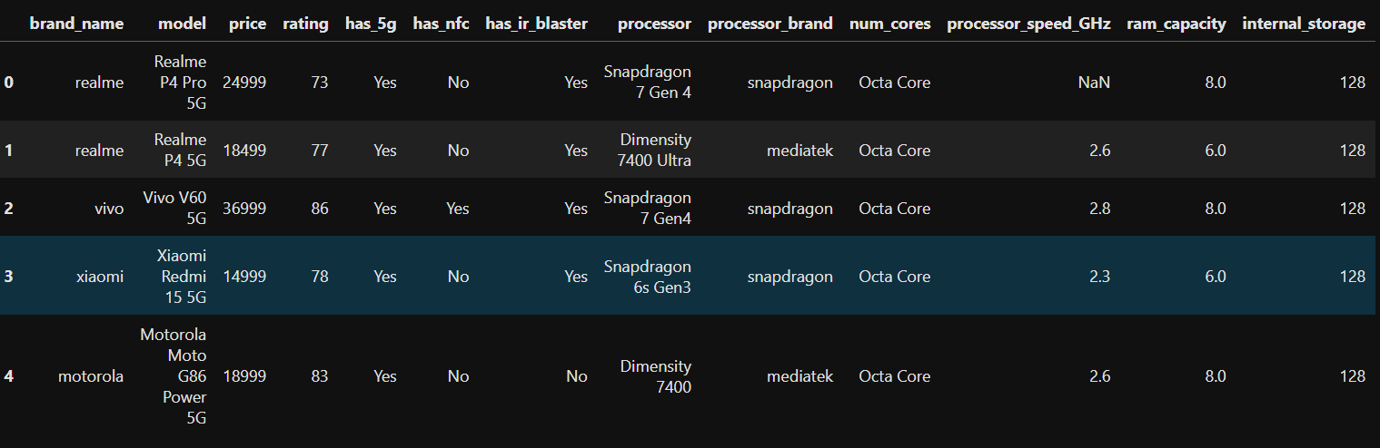
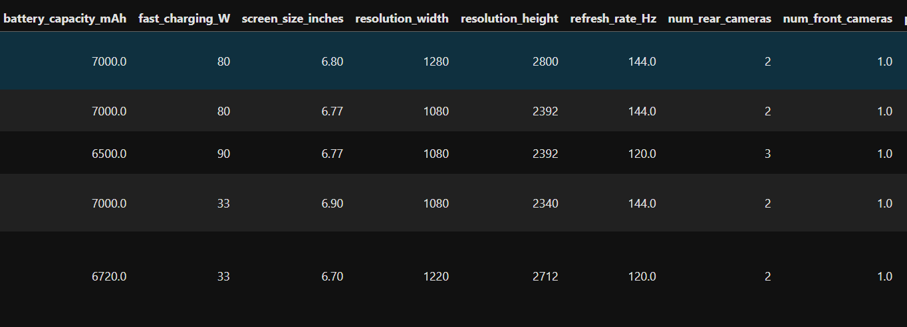
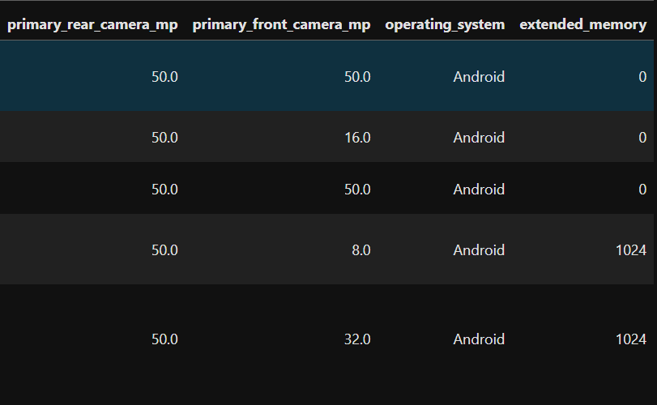
AFTER CLEANING DATASET

Slide 9
NUMERICAL COLUMNS DESCRIPTION
price – Price of the smartphone in INR.
rating – Rating based on features(1-100).
processor_speed – Maximum clock speed of the processor (in GHz).
ram_capacity – RAM size of the smartphone (in GB).
Internal_storage – Internal storage capacity (in GB).
battery_capacity – Battery capacity (in mAh).
fast_charging – Indicates smartphone’s fast-charging power (in Watts).
display_size – Screen size in inches.
resolution_width – Width resolution of the display (in pixels).
resolution_height – Height resolution of the display (in pixels).
refresh_rate – Indicates the display’s refresh rate in Hertz (Hz),
num_of_front_camera – Number of front cameras.
num_of_rear_camera – Number of rear cameras.
primary_camera_rear – Megapixels of the main rear camera.
primary_camera_front – Megapixels of the main front camera.
extended_memory – extended memory (in GB).

Slide 10
CATEGORICAL COLUMNS DESCRIPTION
brand_name – Name of the smartphone brand (e.g., Samsung, Apple, OnePlus).
model – Specific model name of the smartphone.
has_5g – Indicates whether the phone supports 5G connectivity (Yes/No).
has_nfc – Shows if the device has NFC feature for contactless transactions.
has_ir_blaster – States if the smartphone includes an IR blaster(Yes/No).
processor – Full processor name used in the smartphone.
processor_brand – Brand of the processor (e.g., MediaTek, Snapdragon).
num_cores – Number of CPU cores in the processor.
os – Operating system running on the smartphone (e.g., Android, iOS).

Slide 11
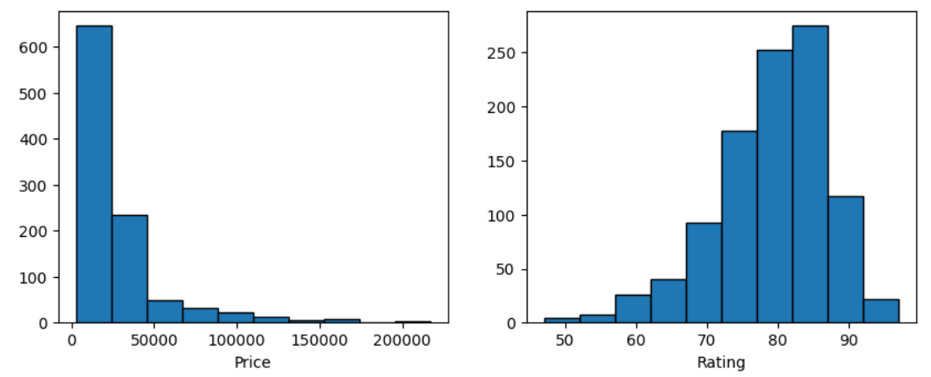
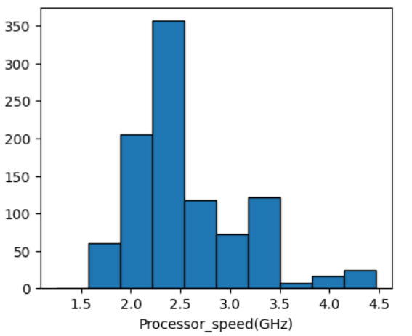
UNIVARIATE ANALYSIS ON NUMERICAL COLUMNS
Observation:-
Most smartphones in the dataset are concentrated within the budget to mid-range price segment (less than 25,000).
Most smartphones in the dataset have specification scores clustered in the range of 75–85, reflecting mid-to-high performance levels.
Most smartphones in the dataset have processor speeds clustered between 2.0–2.5 GHz, indicating a balanced performance range.

Slide 12
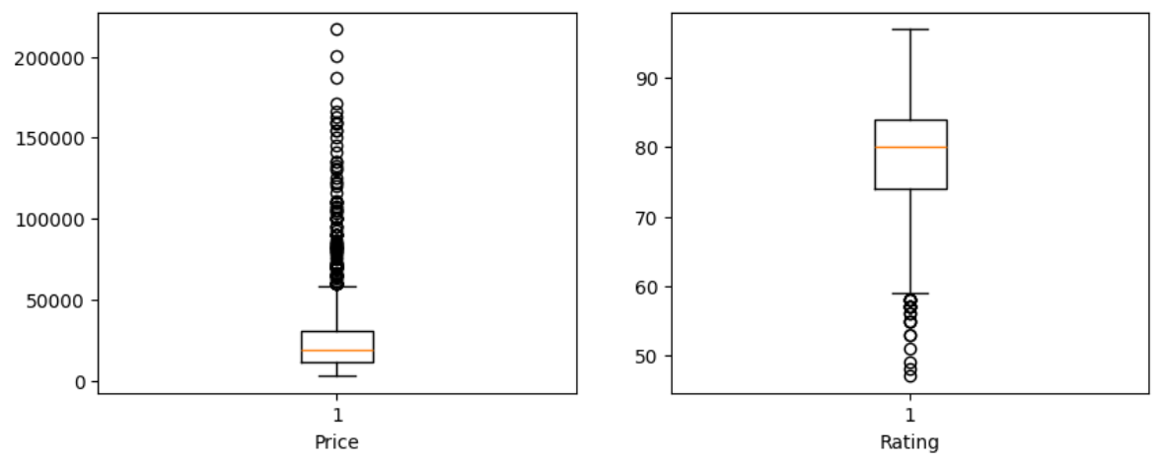
BOXPLOT
Observation:-
Boxplot analysis reveals the presence of outliers in both the price and rating columns.

Slide 13
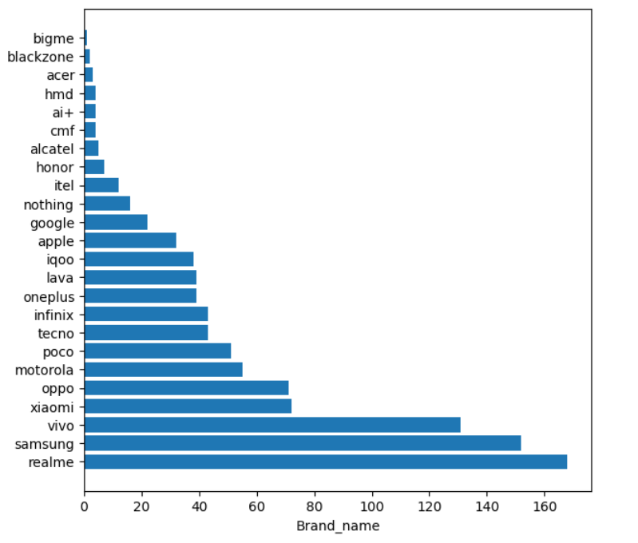
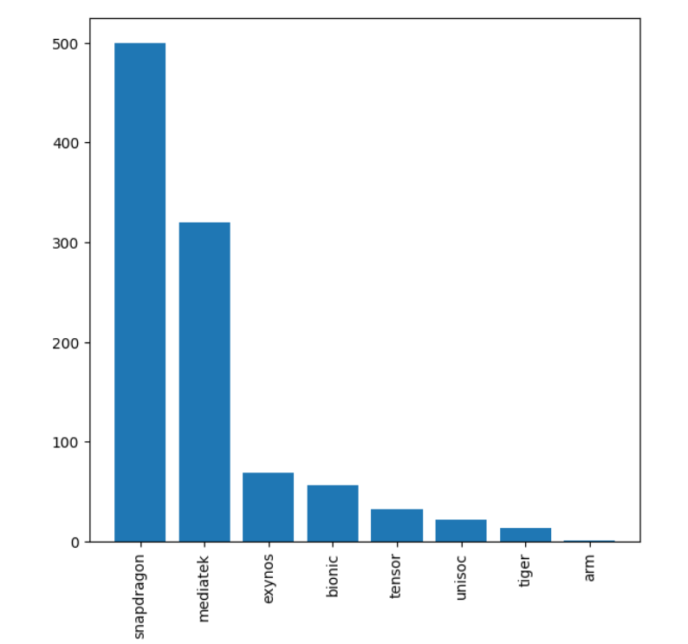
UNIVARIATE ANALYSIS ON CATEGORICAL COLUMNS
Observation:-
The bar plot shows that Realme, Samsung, and Vivo dominate the dataset with the highest number of smartphone models compared to other brands.
The bar plot indicates that Snapdragon and MediaTek are the most common processor brands, powering the majority of smartphones in the dataset.

Slide 14
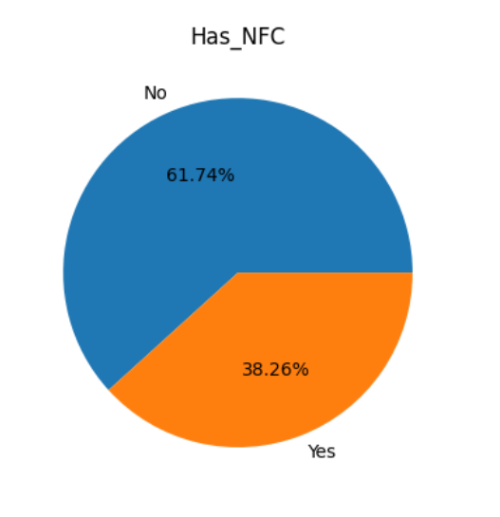
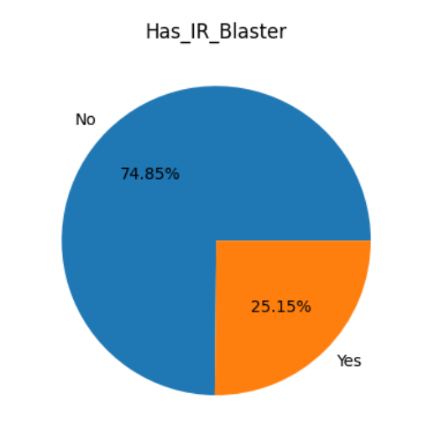
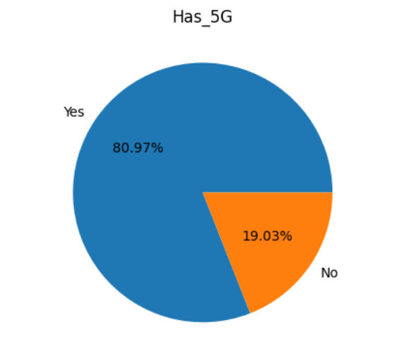
PIE CHART
Observation:-
The pie chart shows that a vast majority of smartphones (80.97%) support 5G connectivity, while only 19.03% lack this feature.
The pie chart reveals that 61.74% of smartphones are equipped with NFC, while 38.26% do not have this feature.
The pie chart shows that 74.85% of smartphones have an IR blaster, while 25.15% lack this feature.

Slide 15
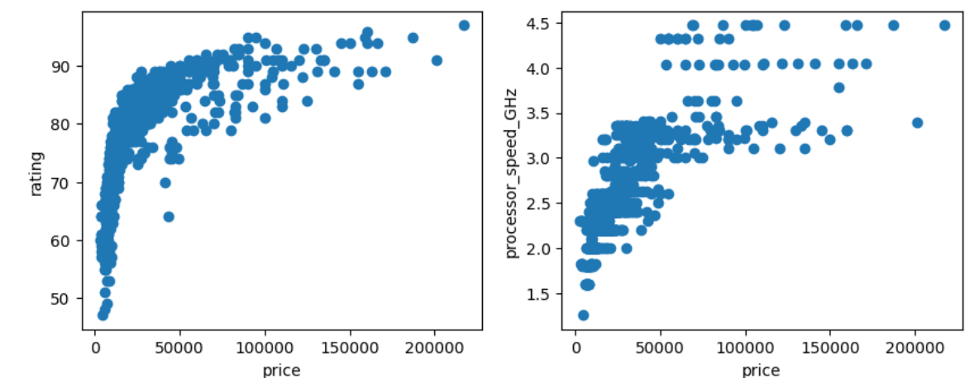
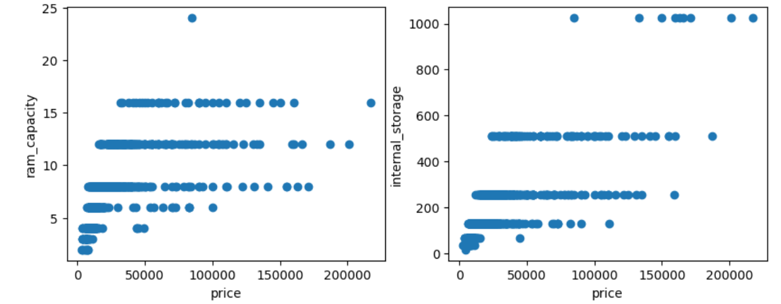
BIVARIATE ANALYSIS (NUMERECAL VS NUMERICAL)

Slide 16
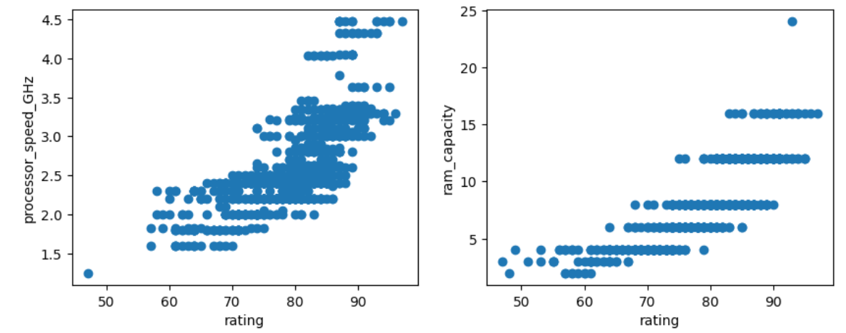
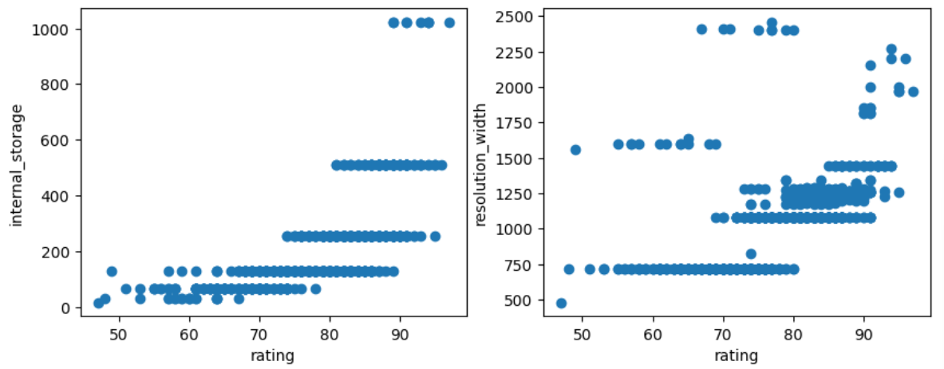
BIVARIATE ANALYSIS (NUMERECAL VS NUMERICAL)

Slide 17
Observations :-
The scatter plots reveal a positive correlation between price and key specifications—processor speed, RAM capacity, internal storage, and specification score—indicating that higher-priced smartphones generally offer better performance and features.
The scatter plots indicate a positive correlation between specification score and key hardware features—processor speed, RAM capacity, internal storage, and resolution width—showing that smartphones with higher specs tend to achieve higher specification scores.

Slide 18
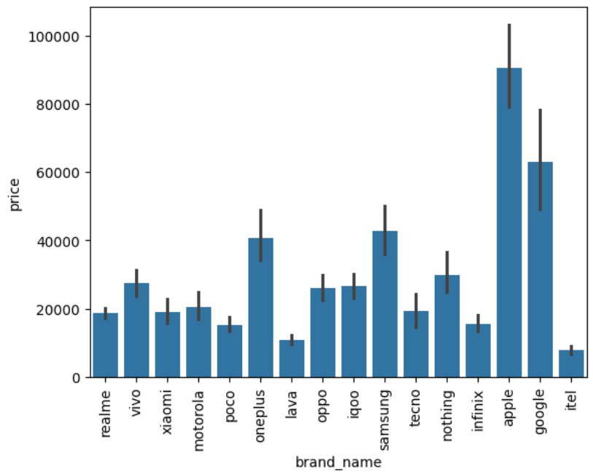
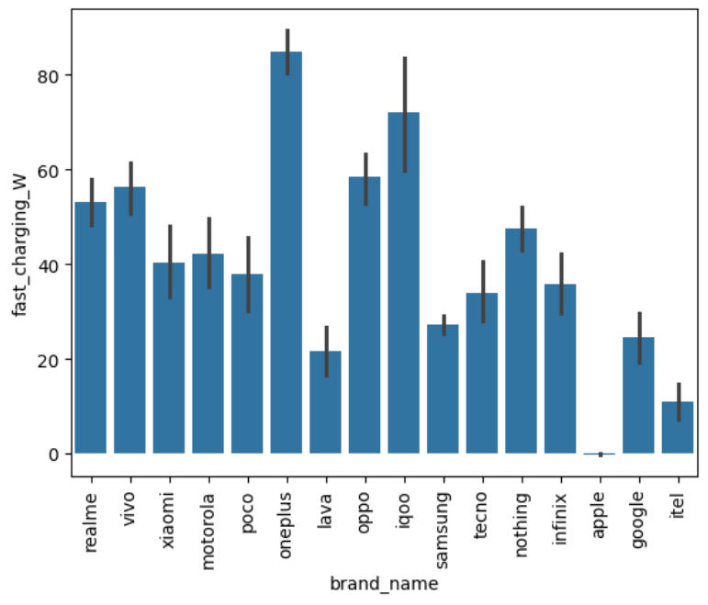
BIVARIATE ANALYSIS (NUMERECAL VS CATEGORICAL)
Observation:-
The bar plot shows that Apple, Google, Samsung, and OnePlus have the highest average prices (above ₹40,000), Nothing, Vivo, iQOO, Oppo, and Motorola fall in the mid-range (₹20,000–₹30,000), while Tecno, Xiaomi, Realme, Infinix, Poco, and Lava are priced in the budget segment (₹10,000–₹20,000), highlighting clear pricing tiers across brands.
The bar plot shows that OnePlus and iQOO smartphones have the highest average fast-charging capacity (above 70W), while Oppo, Vivo, Realme, and Nothing offer moderate fast-charging speeds ranging from 45–60W.

Slide 19
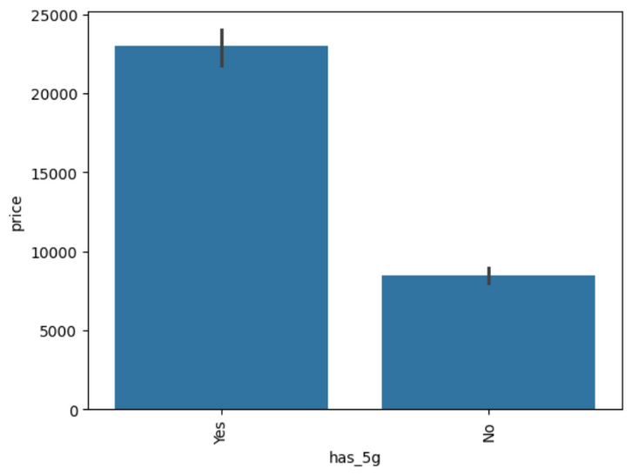
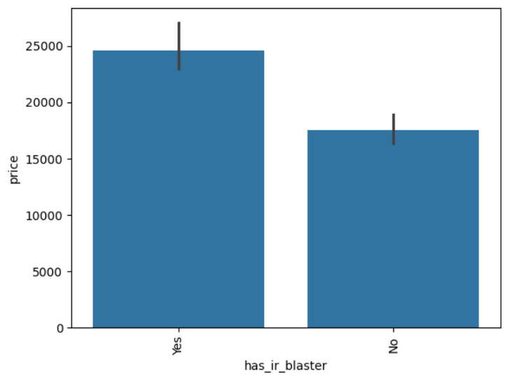
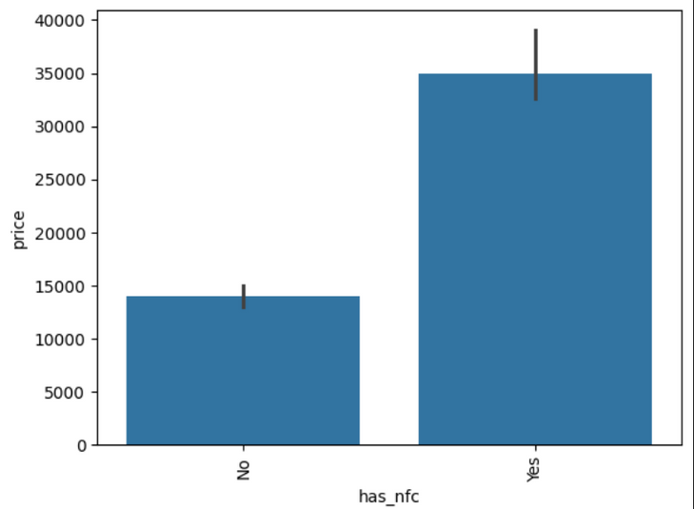
BIVARIATE ANALYSIS (NUMERECAL VS CATEGORICAL)
Observation:-
The bar plot shows that the median price of 5G smartphones is ₹22,999, while non-5G smartphones have a median price of ₹8,499, indicating that 5G-enabled devices are generally priced significantly higher; median was used as a measure due to the presence of outliers in the price column.
The bar plot shows that smartphones with NFC have a median price of ₹34,999, while those without NFC have a median price of ₹13,998, indicating that NFC-enabled devices are generally more expensive.
The bar plot shows that smartphones with an IR blaster have a median price of ₹24,599, while those without it have a median price of ₹17,999, suggesting that devices with IR blasters tend to be priced higher.

Slide 20
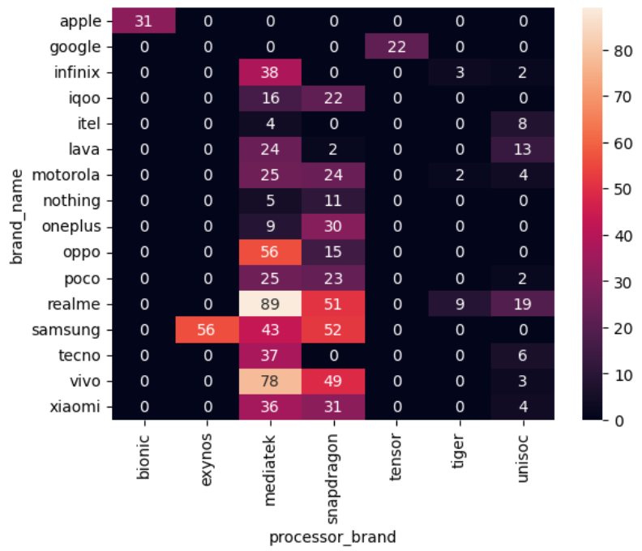
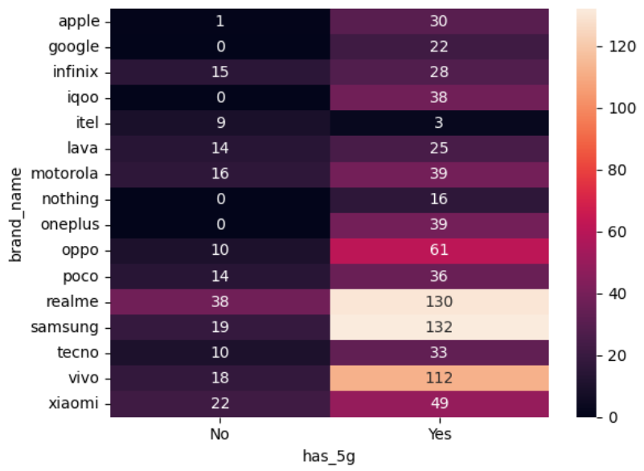
BIVARIATE ANALYSIS (CATEGORICAL VS CATEGORICAL)

Slide 21
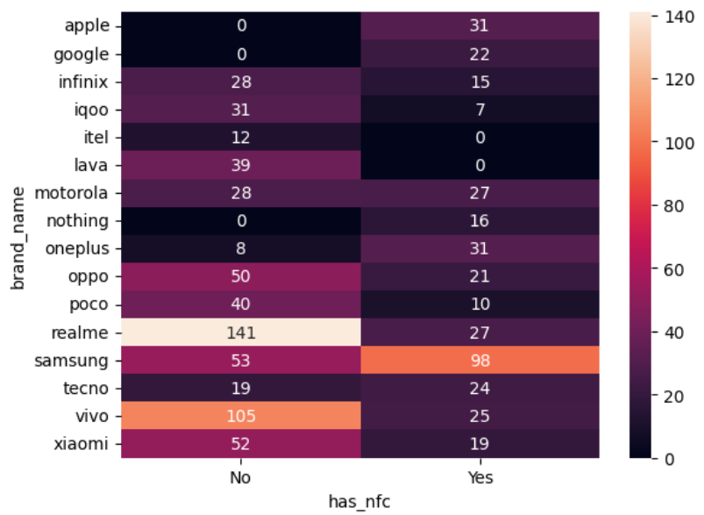
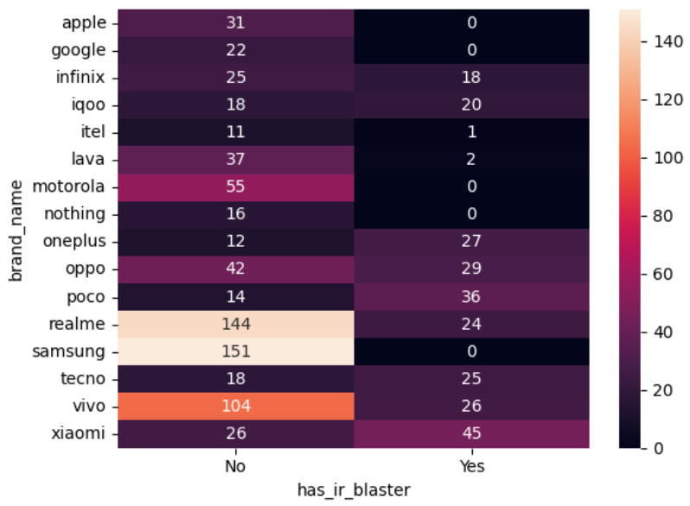
BIVARIATE ANALYSIS (CATEGORICAL VS CATEGORICAL)

Slide 22
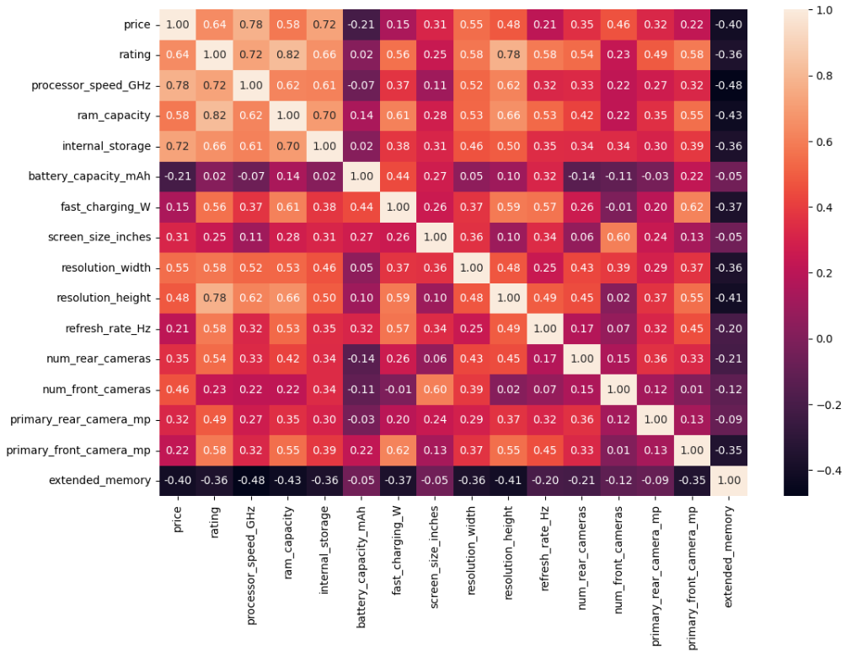
MULTIVARIATE ANALYSIS
Observation:-
The heatmap shows that price has weak correlations with battery capacity (-0.21), fast charging (0.15), screen size (0.31), refresh rate (0.21), number of rear cameras (0.35), primary rear camera (0.32), and primary front camera (0.22), indicating that these features have only a weak relationship with smartphone price.

Slide 23

Conclusion
Most smartphones are priced less than 25,000 with specification scores of 75–85.
Realme, Samsung, and Vivo dominate in model count, while Apple, Google, Samsung, and OnePlus are the most expensive.
Higher specs—processor speed, RAM, storage, display resolution and camera—generally correlate with higher prices and specification scores.
Features like 5G, NFC, and IR blaster are more common in costlier devices, while some hardware features show only a weak effect on price.

Slide 24

Thank you

