Slide 1
RESTAURANT-BOT
-GAYATRI SHASTRI

Slide 2
TABLE OF CONTENTS
01
04
About the Project
Sneak Peek
02
05
Major Requirements
Project Stages
03
06
Project Goals
Future Goals
Building a Restaurant - Bot
Demo-Time!
VS CODE
DOCKER
RASA
PYTHON
Flowchart
Learn how to build conversational AI based chatbot
Voice based

Slide 3
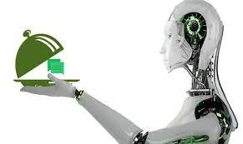
Why Restaurant-Bot?
* 24/7 Customer Service
* Marketing via Facebook Messenger
* Show your Menu
* Quick Reservations
* No downloads

Slide 4
ABOUT THE PROJECT
* Developed a chat bot system which will generate top
restaurants for a particular cuisine and location.
* It is based on RASA framework.
*Zomato API is used for search results.
* The Results are being displayed to the user and is being deployed at Facebook using ngrok application.

Slide 5
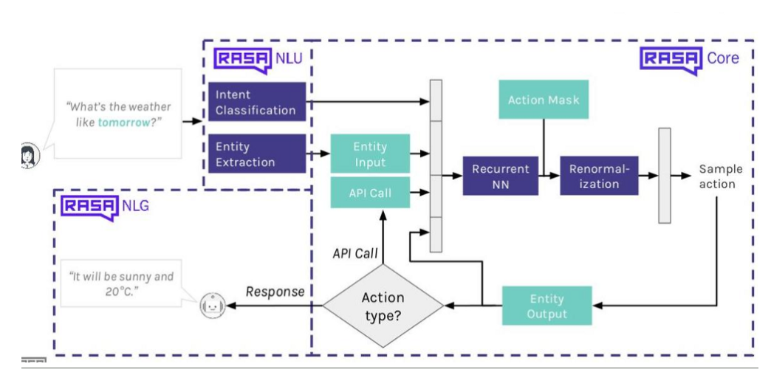
Overview of RASA Framework
Framework
RASA NLU:
* For understanding user messages
RASA Core:
For holding conversations and deciding what to do next

Slide 6
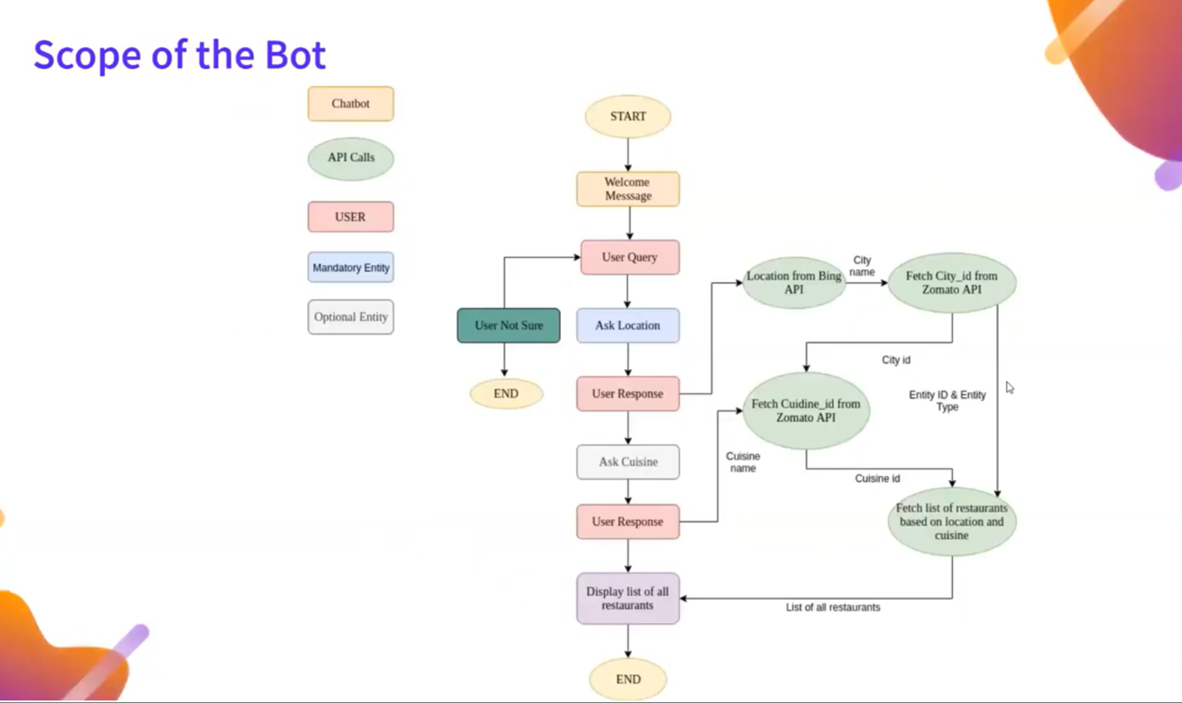

Slide 7
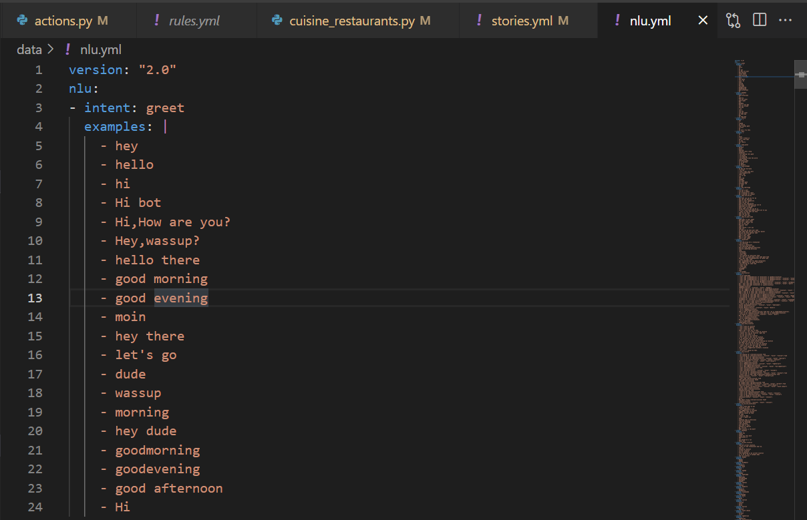
INTENT

Slide 8
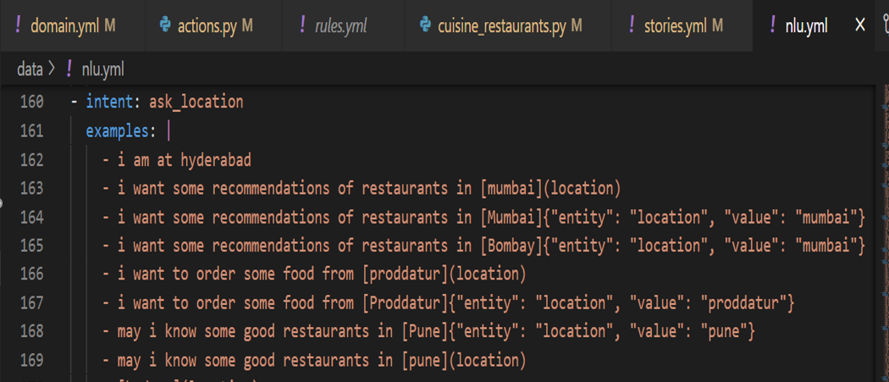
ENTITY

Slide 9
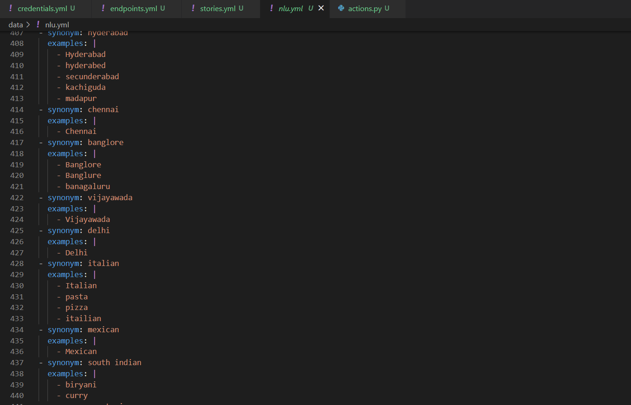
SYNONYMS FOR ENTITY

Slide 10
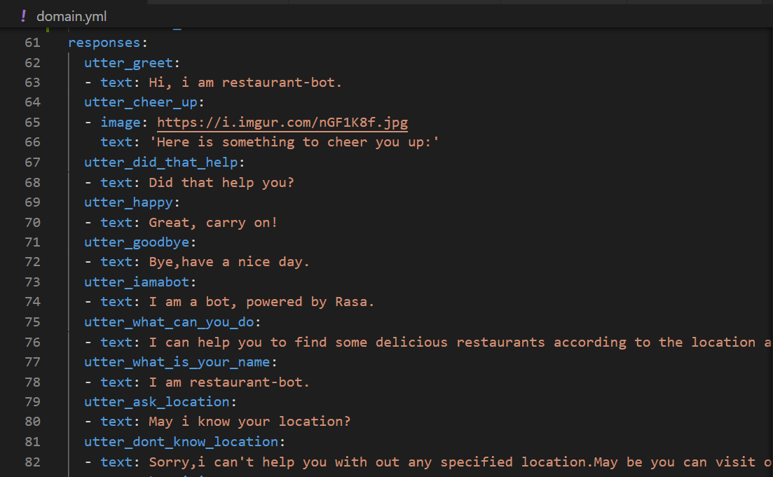
Domain File:

Slide 11
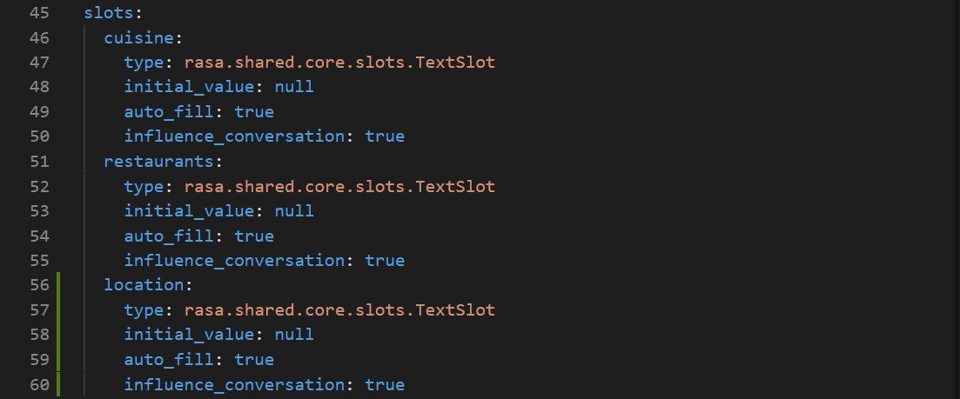
Slots in chatbots:

Slide 12
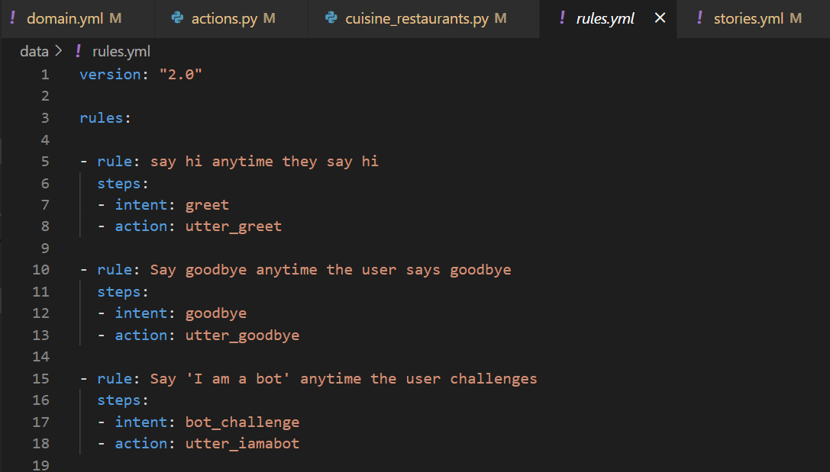
Rules in chatbots:

Slide 13
Rules in chatbots:

Slide 14
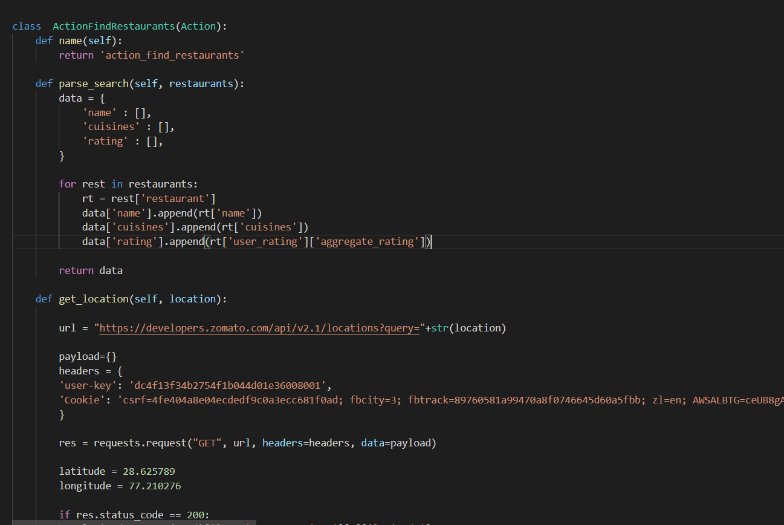
Custom actions in rasa:

Slide 15
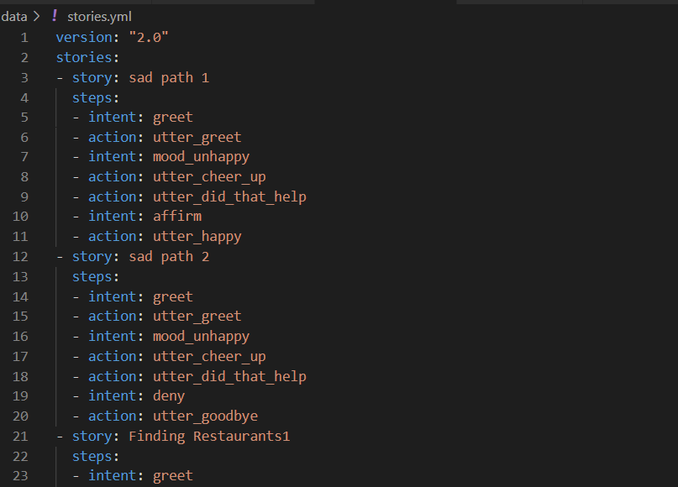
Stories:

Slide 16
Deployed in Facebook
DEMO TIME!!

Slide 17
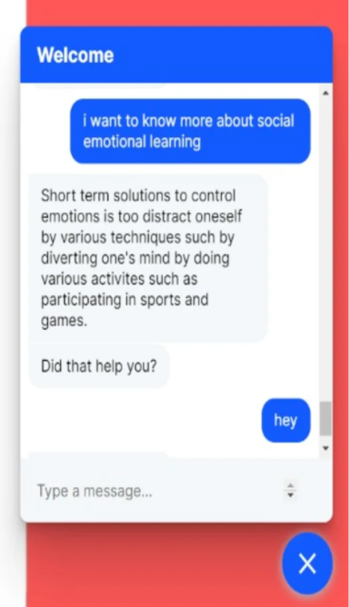
WHAT I WAS ALSO WORKING ON
* Integrate it with website (Done)
* Voice feature (In progress)

Slide 18
FUTURE
VOICE
MULTILINGUAL

Slide 19
THANK YOU !

