Slide 1
Predicting Credit Card Approval
DONE BY:
BATCH -4
Gayatri Shastri – 19251A0526
Aparna – 19251A0519
Sushma – 19251A0525
Likitha – 19251A0503

Slide 2
PROBLEM STATEMENT
Commercial banks receive a lot of applications for credit cards. Many of them get rejected for many reasons, like high loan balances, low income levels too many inquiries on an individual's credit report, for example. Manually analyzing these applications is mundane, error-prone, and time-consuming (and time is money!)..

Slide 3
SOLUTION
Luckily, this task can be automated with the power of machine learning and pretty much every commercial bank does so nowadays. In this project, we will build an automatic credit card approval predictor using machine learning techniques, just like the real banks do

Slide 4
Technology Used
*MACHINE LEARNING
*FLASK FOR DEPLOYMENT

Slide 5
Software Requirements
Software Requirements:
Platform -Windows 10 operating system.
Front End -HTML, CSS
Development Tool -Visual Studio Code, Jupyter Notebook
Back End -Flask
Other Technologies -Machine Learning
Hardware Requirements:
Name of the Processor - INTEL CORE i5
Hard Disk Capacity - 1 TB
RAM Capacity -8 GB

Slide 6
Machine Learning
UCI Credit Card Approval Dataset
Preprocess the dataset
Build a machine learning model
*Loading and viewing the dataset.
*Numerical and non-numerical features, that it contains values from different ranges, plus that it contains a number of missing entries
ML model that can predict if an individual's application for a credit card will be accepted
*to ensure the machine learning model we choose can make good predictions.
*data is in good shape, we will do some exploratory data analysis to build our intuitions
Step 01
Step 02
Step 03

Slide 7
Machine Learning
02
01
03
STEP 2
STEP 3
STEP1
Fitting a logistic regression model to the train set
Evaluating performance &
making the model perform better
Import Dataset

Slide 8
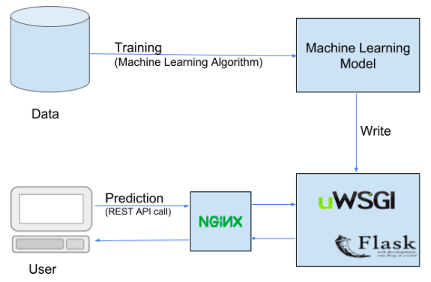
Flask for Deployment

Slide 9


