Slide 1

MSPM’S Deogiri Institute of Engineering and Management Studies, Aurangabad Department of Computer Science and Engineering Subject:Theory of Computation Topic:DFA Simulation Submitted by Shubham C.Dom(36155)
Gayatri P. Suryawanshi(36156) Under the Guidance of Prof. Sarika Chavan Asst.Prof.Department of CSE (Deogiri Institute Engineering and Management Studies) 2019-2020

Slide 2
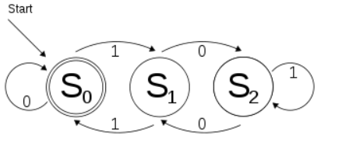
Problem Statement:
The program for DFA Simulation using programming

Slide 3
Algorithm and Approach Used:
We are implementing DFA Simulation algorithm in this program.
We are checking acceptability of string i.e the given string is accepted or not.

Slide 4
DFA Simulation
The DFA simulation should show the step-by-step computation.
It is nothing but the to display the initial state,the current state, the current input symbol, and an indication that the input is accepted or rejected.

Slide 5
Algorithm:
Algorithm to simulate DFA
Input: String X,DFA D.
Transition Function is moves(s,c);
Start state is s0;
Final States are F.
Output: “yes” if D accepts X;
“no” otherwise;
Algorithm:
currentState <-s0
currentChar <- nextchar;
While currentChar =eof {
currentState <- move(currentState,currentChar);
currentChar <- nextchar;
}
if currentState is in F then return “yes”
else return “no”

Slide 6
code
class Node:
def __init__(self, val):
self.val = val
self.links = []
def add_link(self, link):
self.links.append(link)
def __str__(self):
node = "(%s):\n" % self.val
for link in self.links:
node += "\t" + link + "\n"
return node
def __add__(self, other):
return str(self) + other
def __radd__(self, other):
return other + str(self)

Slide 7
def equals(self, node):
ok = (self.val == node.val)
if len(self.links) == len(node.links):
for i in range(len(self.links)):
ok = ok and (self.links[i] == node.links[i])
return ok
else:
return False
class Link:
def __init__(self, from_node, etiquette, to_node):
self.from_node = from_node
self.etiquette = etiquette
self.to_node = to_node
def __str__(self):
return "(%s --%s--> %s)" % (self.from_node.val, self.etiquette, self.to_node.val)
def __add__(self, other):
return str(self) + other
def __radd__(self, other):
return other + str(self)
def equals(self, link):
return (self.from_node == link.from_node) and (self.etiquette == link.etiquette) and (self.to_node == link.to_node)

Slide 8
class Automata:
def __init__(self, initial_node, nodes, terminal_node):
self.initial_node = initial_node
self.nodes = nodes
self.terminal_node = terminal_node
def get_next_node(self, current_node, etiquette):
for link in current_node.links:
if link.etiquette == etiquette:
return link.to_node
return None
def accepts(self, string):
node = self.initial_node
for character in string:
node = self.get_next_node(node, character)
return self.terminal_node.equals(node)
def __str__(self):
automata = "Initial node: %s\nTerminal node: %s\n" % (self.initial_node.val, self.terminal_node.val)
for node in self.nodes:
automata += node
return automata
def __add__(self, other):
return str(self) + other
def __radd__(self, other):
return other + str(self)

Slide 9
if __name__ == '__main__':
pass
s0 = Node("s0")
s1 = Node("s1")
s2 = Node("s2")
s0_0_s0 = Link(s0, '0', s0)
s0_1_s1 = Link(s0, '1', s1)
s1_0_s2 = Link(s1, '0', s2)
s1_1_s0 = Link(s1, '1', s0)
s2_0_s1 = Link(s2, '0', s1)
s2_1_s2 = Link(s2, '1', s2)
s0.add_link(s0_0_s0)
s0.add_link(s0_1_s1)
s1.add_link(s1_0_s2)
s1.add_link(s1_1_s0)
s2.add_link(s2_0_s1)
s2.add_link(s2_1_s2)
a = Automata(s0, [s0, s1, s2], s0)
print(a)
print(a.accepts('1011101')) #True
# print(a.accepts('10111011')) #False

Slide 10
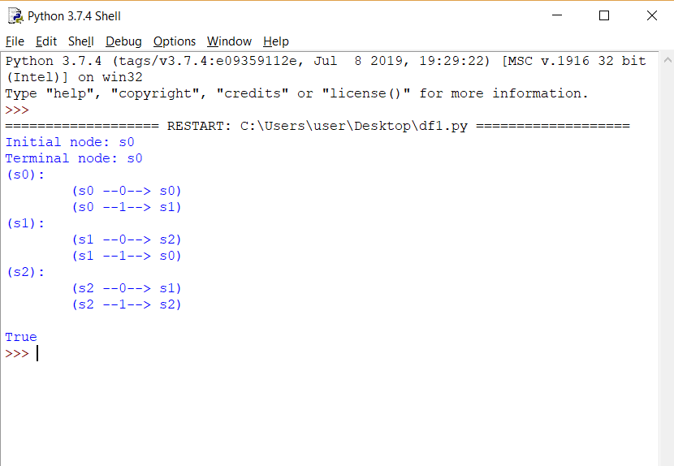
output

Slide 11
Applications
In compilers
String Acceptance
Text filters
Tracking System

Slide 12
Conclusion
In this way we implemented program for DFA Simulation for String Acceptance using Python.

Slide 13
THANK YOU!!

