Slide 1
Deploying Your Portfolio Web Page to GitHub Pages
A Step-by-Step Practical Class Guide

Slide 2
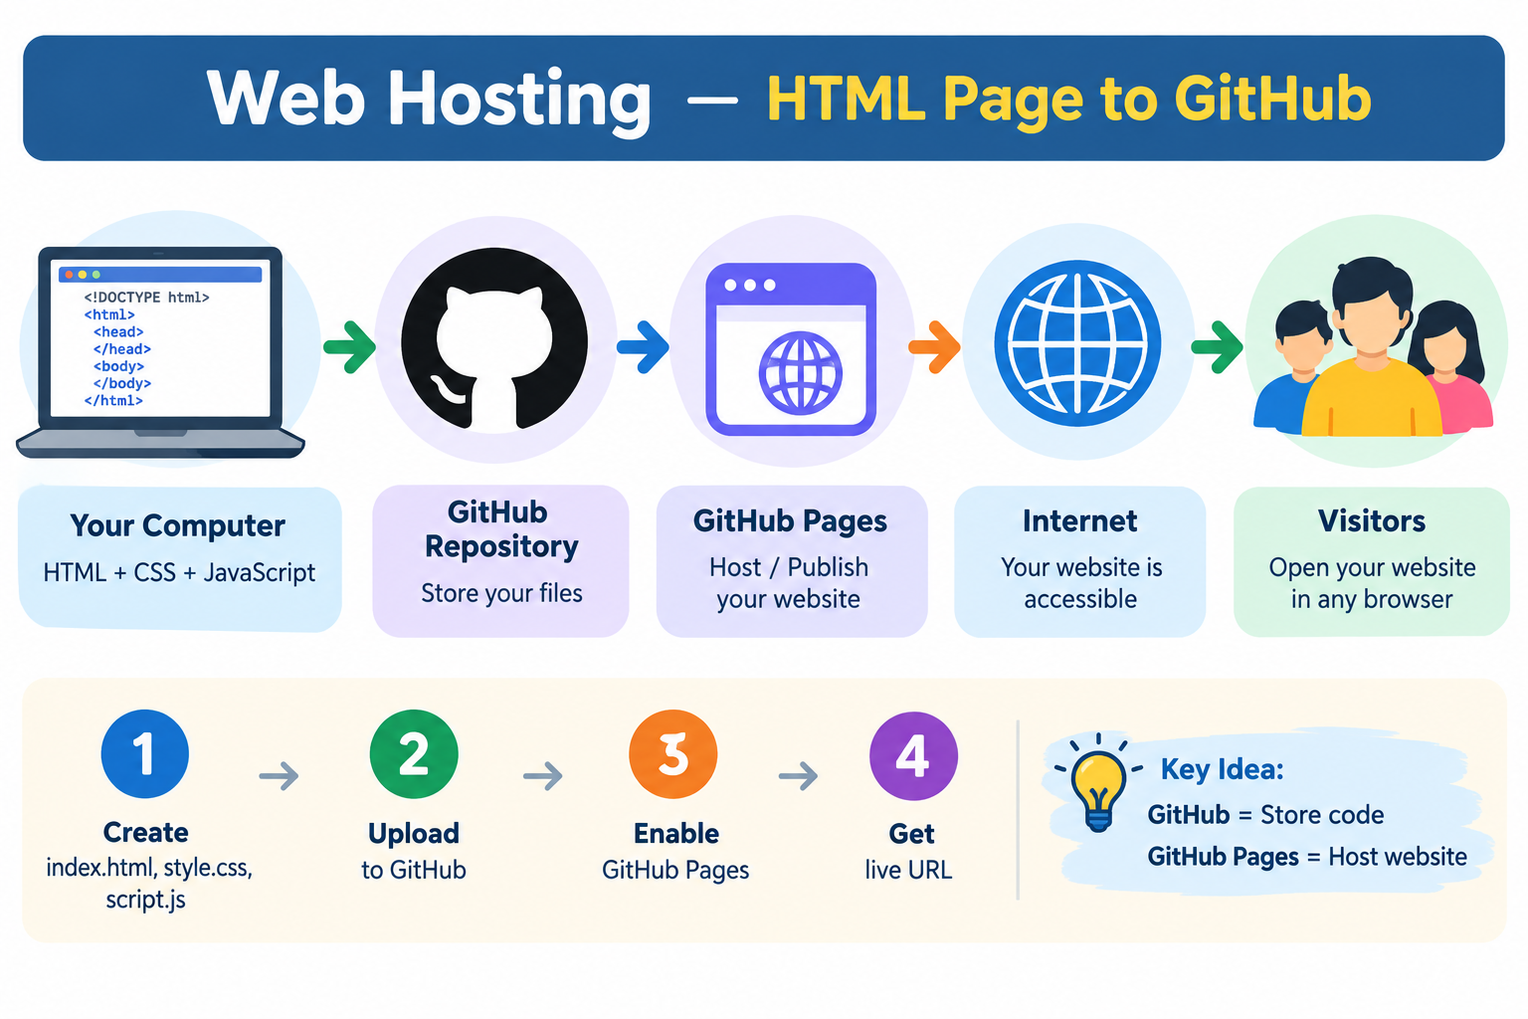

Slide 3
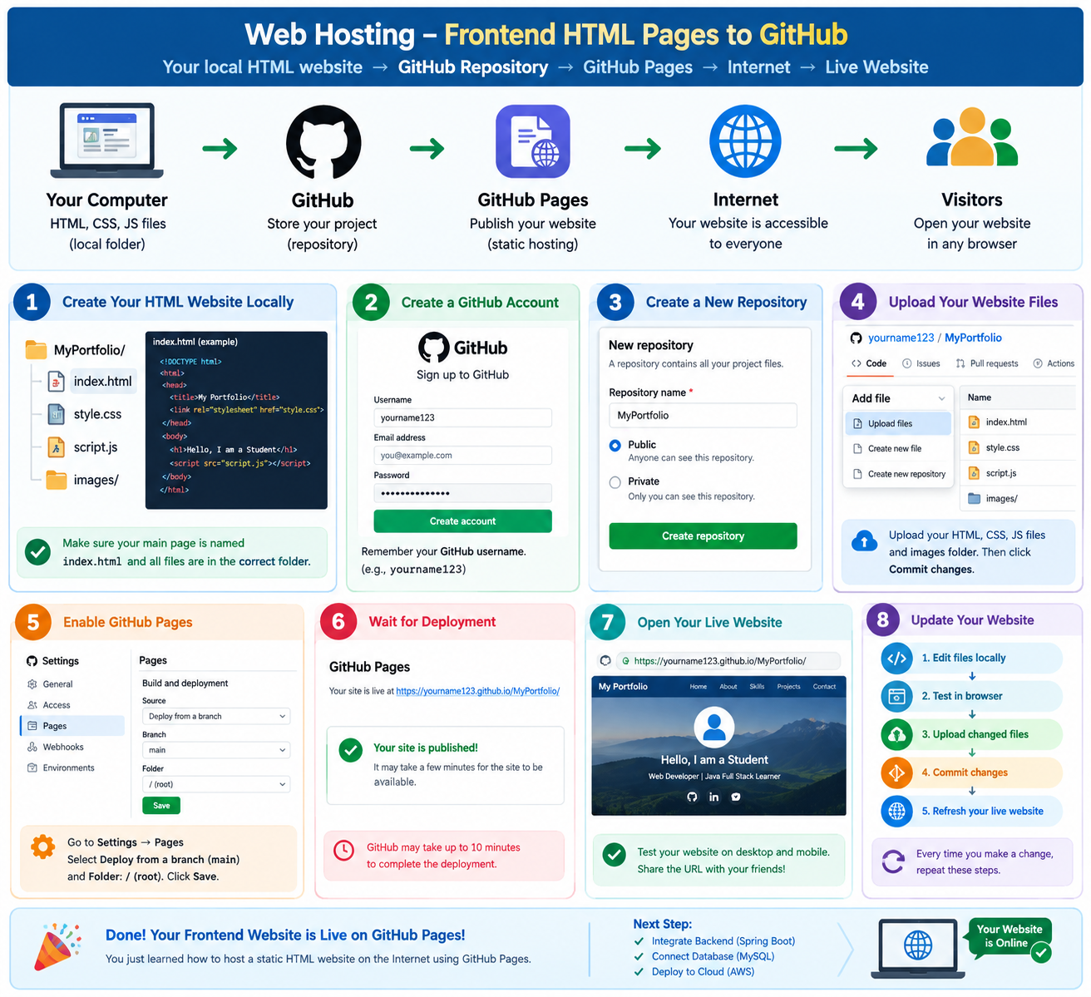

Slide 4
Web Hosting: HTML Page → GitHub
💻 LOCAL COMPUTER
HTML + CSS + JavaScript
↓
Upload
↓
🐙 GITHUB REPOSITORY
Store website files
↓
🌐 GITHUB PAGES
Host / Publish website
↓
🌍 INTERNET
↓
👥 LIVE WEBSITE
Anyone can open the URL

Slide 5
Student's Browser
│
│ HTTPS Request
↓
Internet
│
↓
GitHub Server
│
│ index.html
↓
Browser
│
↓
HTML + CSS + JavaScript
│
↓
Webpage displayed
web hosting.

Slide 6
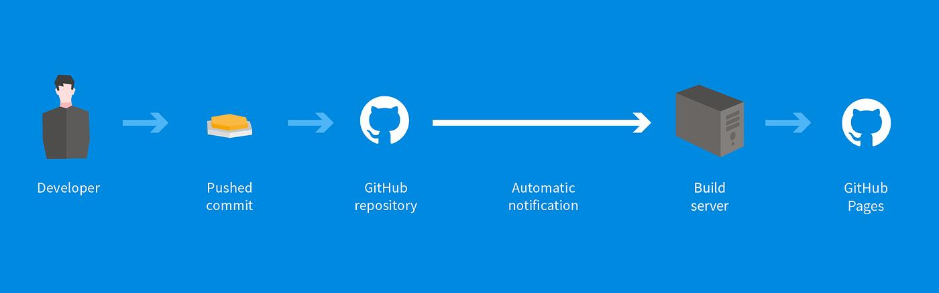
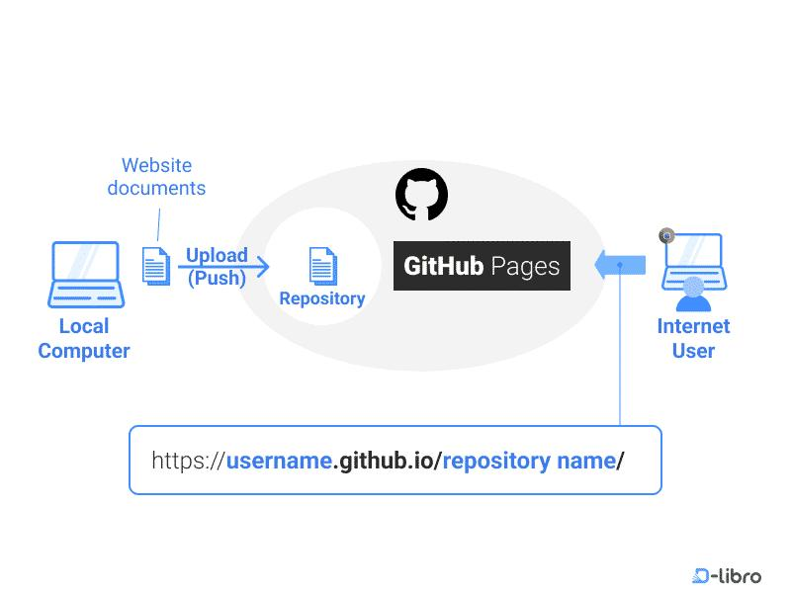

Slide 7
1. Prerequisites & Preparation
• Ensure your student profile website is contained in a single folder.
• The main entry point file must be named exactly 'index.html'.
• Keep all assets (CSS, images, JS) inside the folder with relative paths.
• Create a free account on GitHub (github.com) if you haven't already.

Slide 8
2. Creating a New Repository
• Log into GitHub and click the '+' icon in the top right -> 'New repository'.
• Repository Name: Use something clean like 'portfolio' or 'resume'.
• Visibility: Must be set to 'Public' for GitHub Pages to host it for free.
• Initialization: Check 'Add a README file' to create the main branch automatically.
• Click 'Create repository' at the bottom.

Slide 9
3. Uploading Your Resume Files
• Inside your new repository, click the 'Add file' dropdown -> 'Upload files'.
• Drag and drop all your website files (index.html, styles.css, etc.) into the box.
• Wait for all files to complete uploading successfully.
• Add a commit message like 'Initial portfolio website upload'.
• Click 'Commit changes' at the bottom to save your files.

Slide 10
4. Enabling GitHub Pages
• Navigate to the 'Settings' tab (gear icon) on your repository's top navigation bar.
• Scroll down the left sidebar menu and click on 'Pages' (under the Code and automation section).
• Under 'Build and deployment', look for the 'Source' dropdown and ensure it says 'Deploy from a branch'.
• Under 'Branch', change 'None' to 'main' (or your primary branch name).
• Leave the folder dropdown as '/ (root)' and click 'Save'.

Slide 11
5. Accessing Your Live Live URL
• Wait 1 to 2 minutes for GitHub to process and build your website.
• Refresh the 'Pages' settings page.
• A banner will appear at the top saying: 'Your site is live at...'.
• Click the link to open your live web page! Format: username.github.io/repository-name
• Copy this link to share with teachers, peers, or employers on your resume.

Slide 12
Practical Lab: Deploy student to GitHub Pages => Website to the Internet
Lab title: Deploy a Local HTML/CSS/JavaScript
Project: Student Portfolio
Technology:
HTML + CSS + JavaScript + GitHub Pages

Slide 13
1. Lab objective
By the end of this lab, the student will be able to:
Create a GitHub account
Create a repository
Upload an existing webpages
Enable GitHub Pages
Publish the website
Open the website from another device
Understand local hosting vs Internet hosting

Slide 14
↓
8 practical steps
1️⃣ Create → Student creates index.html, style.css, script.js
2️⃣ GitHub Account → Student signs in
3️⃣ Repository → Create StudentPortfolio
4️⃣ Upload → Upload HTML/CSS/JS/images
5️⃣ Pages → Settings → Pages → main → /root
6️⃣ Deploy → GitHub publishes the website
7️⃣ Live Website → Open the generated .github.io URL
8️⃣ Update → Edit → Test → Upload → Commit → Refresh
GitHub Pages is hosting the frontend/static website. Later, your students can connect it to Java + Spring Boot + MySQL + AWS for a complete Full Stack application.

Slide 15
Your Computer
↓
GitHub Repository
↓
GitHub Pages
↓
Internet
↓
https://username.github.io/student/
https://<owner>.github.io/<repositoryname>

Slide 16
GitHub Pages is designed to host static websites containing HTML, CSS and JavaScript directly from a GitHub repository.
Never deploy before testing locally.
Develop
↓
Test locally - Browser
↓
Deploy
↓
Test online -GitHub

Slide 17
PART C — Create GitHub account
If students don't already have an account, go to:
GitHub
Click:
Sign up
Create an account.
( Existing Gmail Account )
Students should remember their GitHub username because it becomes part of their website URL.
For example, if the username is:
lalithjain
the project website can be:
https://lalithjain.github.io/student_cit/

Slide 18
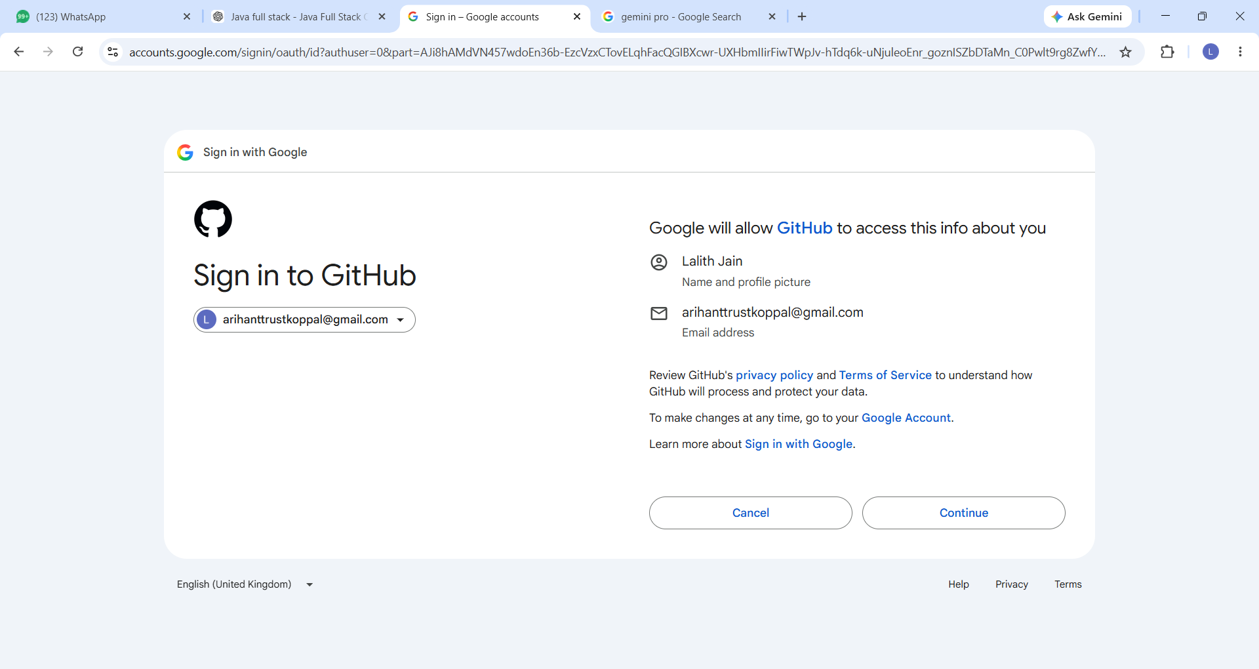

Slide 19
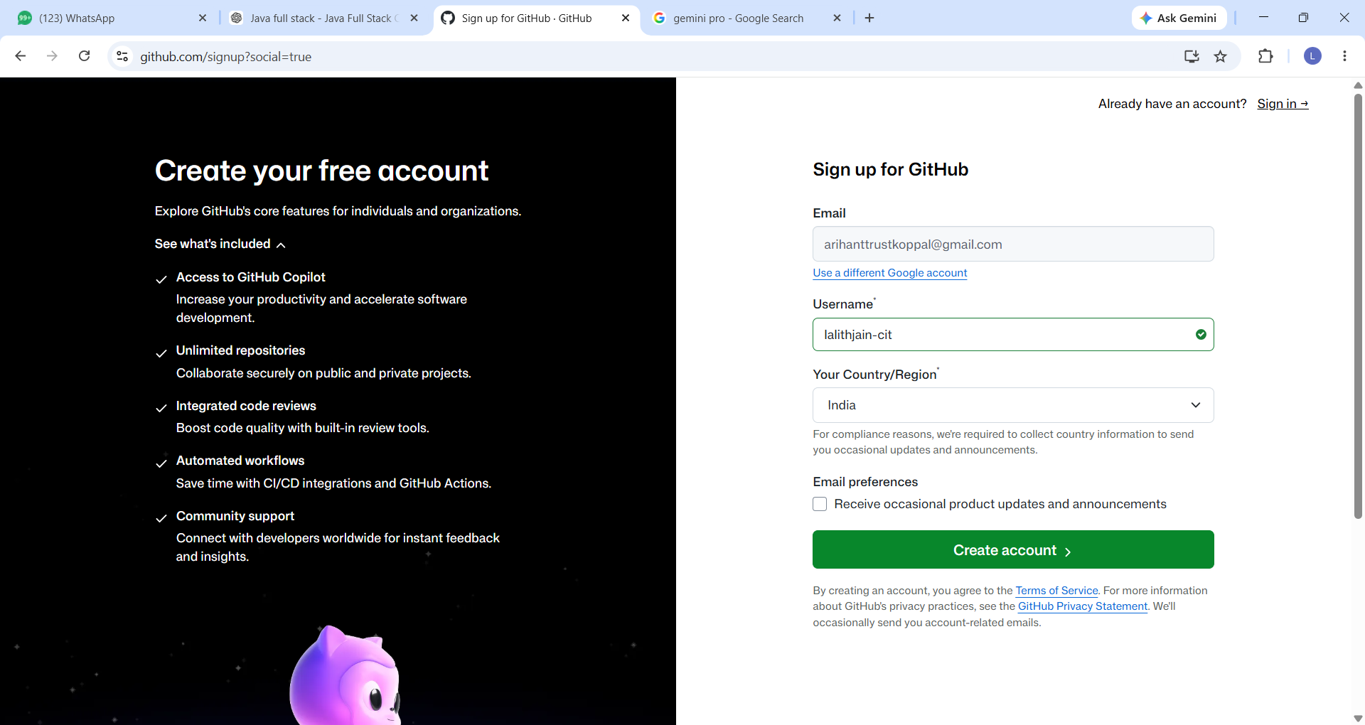

Slide 20
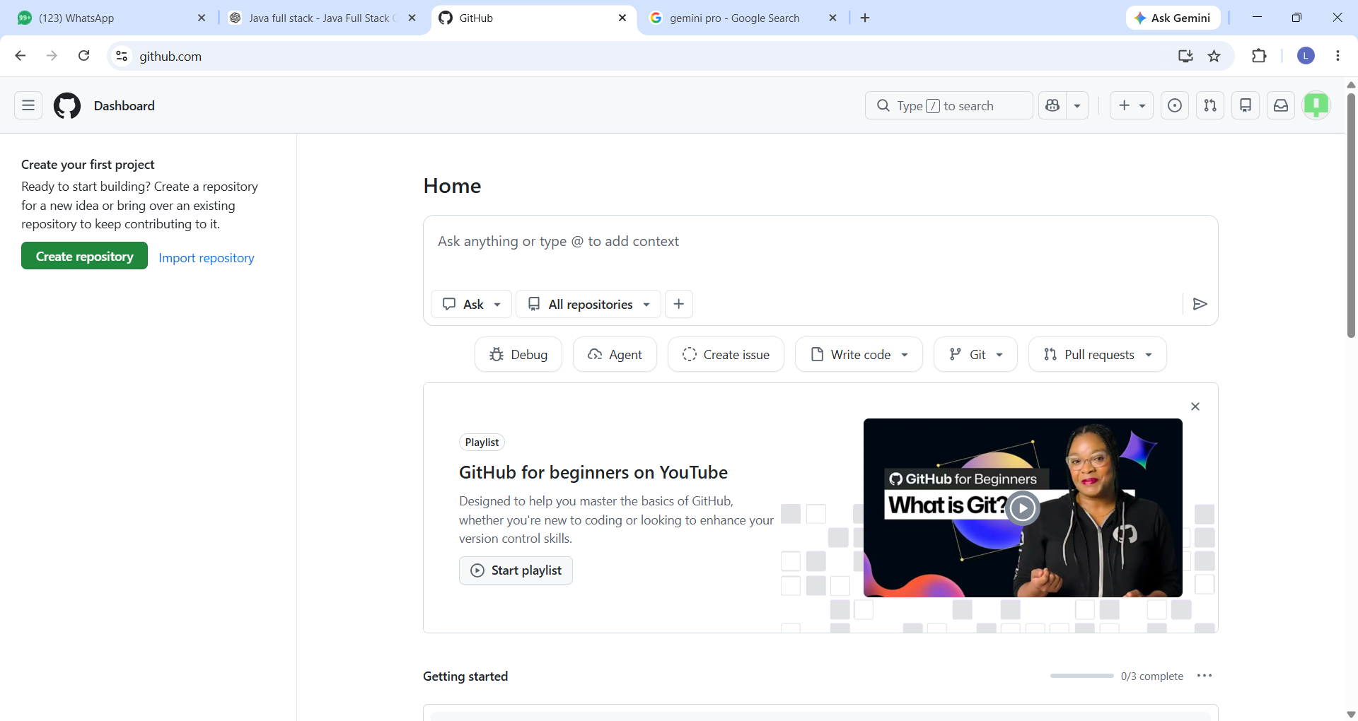

Slide 21
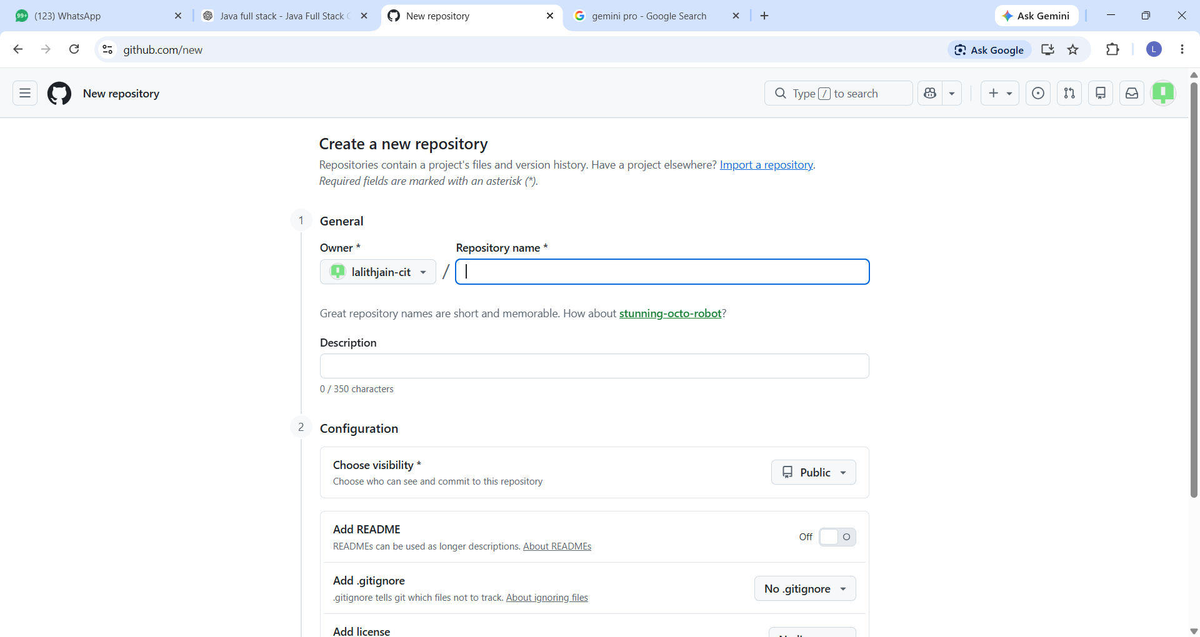

Slide 22
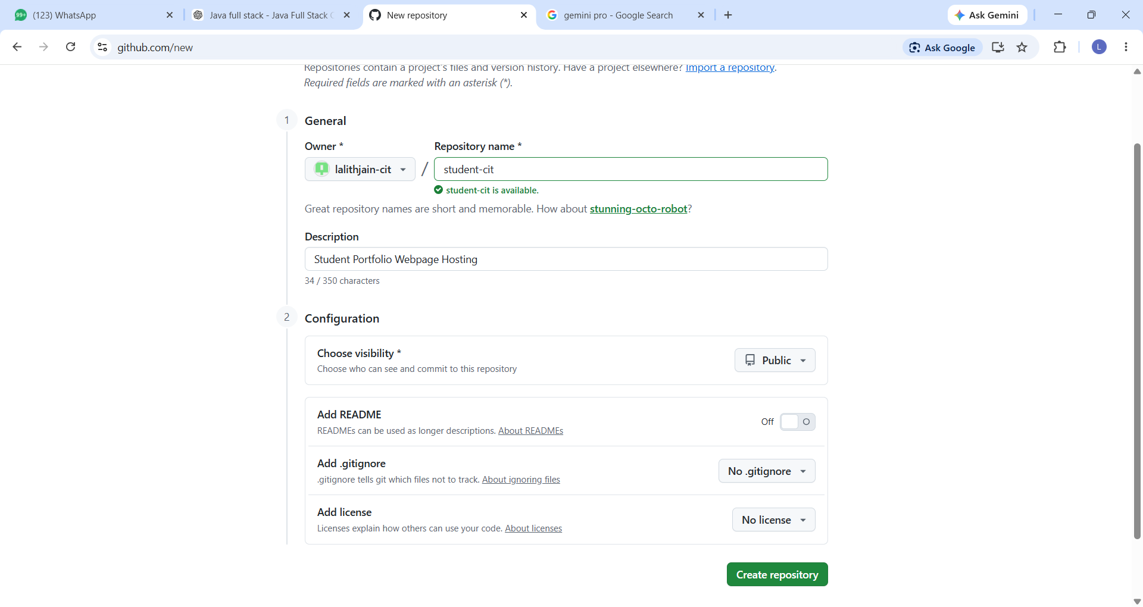

Slide 23
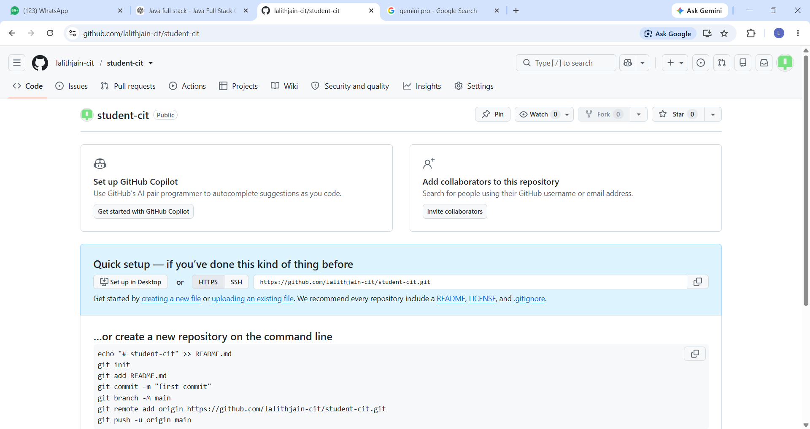

Slide 24
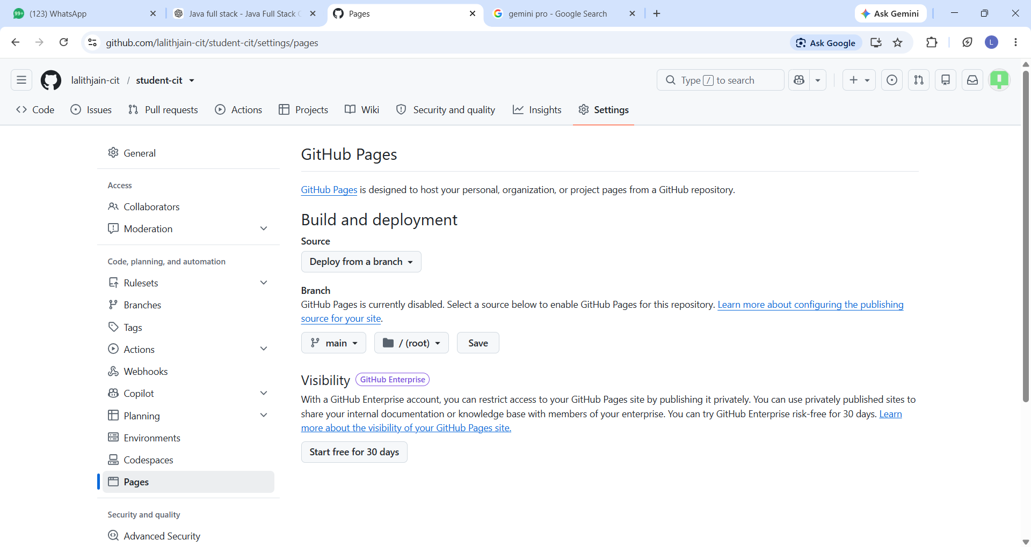

Slide 25
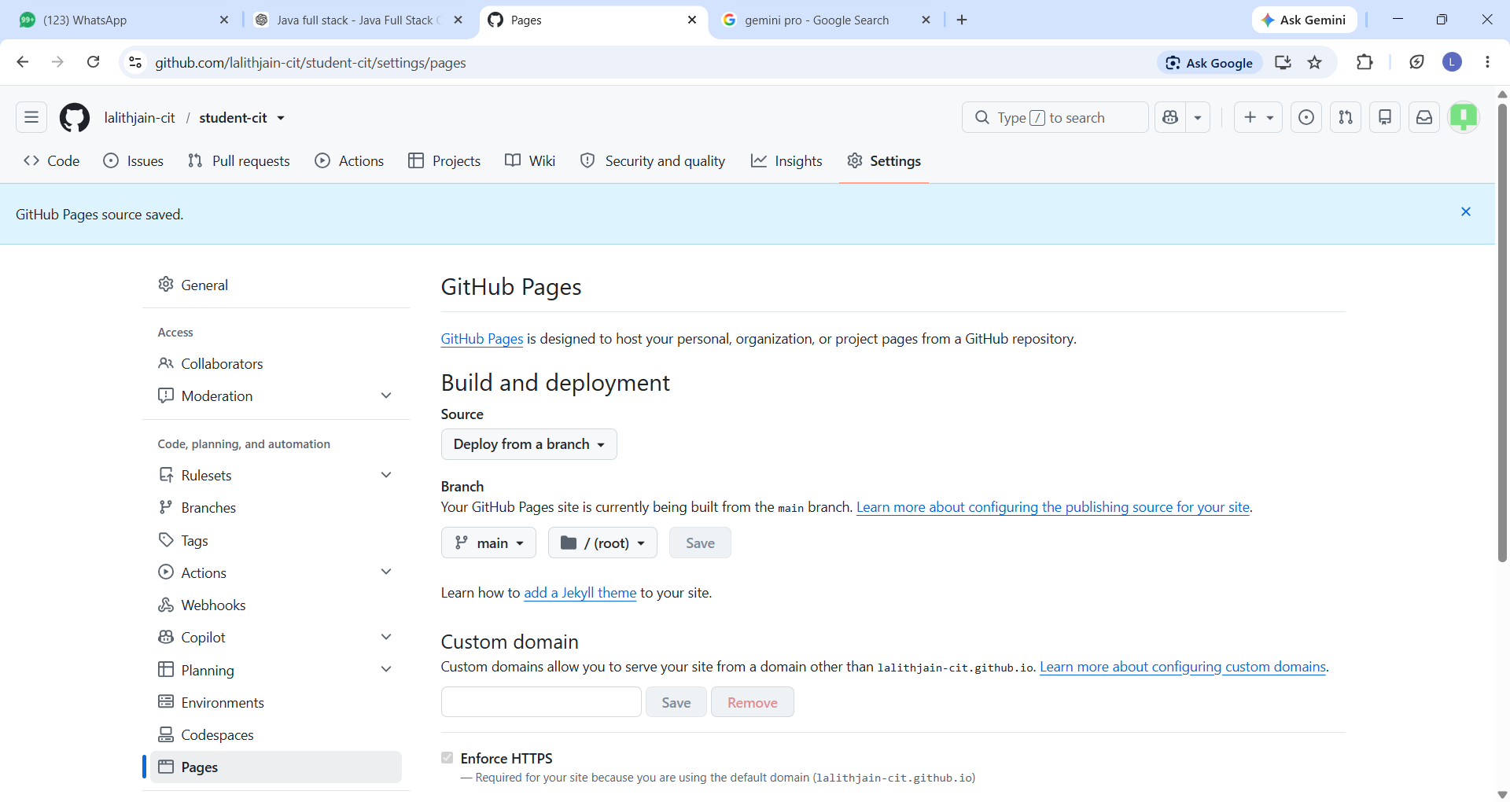

Slide 26
