Slide 1

Presented By :
Gayatri Pendkar (210943025015)
Hirkani Badgujar (210943025007)
Shubham Katkar (210943025022)
Rahul Gitte (210943025016)
Under the guidance of :
Mr. Amey Manjrekar

Slide 2
INTRODUCTION
Determining whether the listed price of a used car is a challenging task, due to the many factors that drive a used vehicle’s price on the market. The focus of this project is developing machine learning models that can accurately predict the price of a used car based on its features.
The dataset consists of 3 lakh records and 16 features. so we are using spark for ETL operations and for storing data we are using mongodb as NoSQL dB for performing prediction we are using regression ml algorithms and to show better visualization we are using Power bi.

Slide 3
OBJECTIVE
To develop a efficient and effective model which predicts the price of a used car according to cars features.
Implement basic model using different regression algorithms.
Compare the different accuracies of different algorithms .

Slide 4
MODULES
Python
Apache-Spark
MongoDB
Machine Learning
Power BI

Slide 5
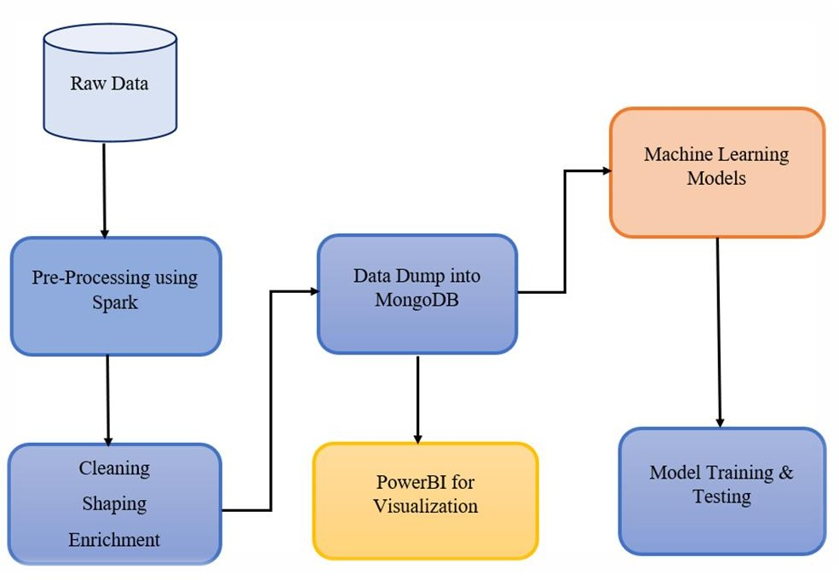
METHODOLOGY
Fig: System Architecture of Used Car Price Prediction.

Slide 6
ALGORITHM
Linear Regression (0.6191)
Ridge Regression (0.6192)
Random Forest Regressor (0.8184)
XGBoost Regressor (0.8079)
AdaBoost Regressor (0.7992)

Slide 7
LINEAR REGRESSION
Linear Regression is a machine learning algorithm based on supervised learning.
Linear Regression algorithm shows a linear relationship between a dependent (y) and one or more independent (x) variables
Regression models a target prediction value based on independent variables.

Slide 8
RIDGE REGRESSION
Ridge regression is a regularization technique, which is used to reduce the complexity of the model. It is also called as L2 regularization.
When the issue of multicollinearity occurs, least-squares are unbiased, and variances are large, this results in predicted values being far away from the actual values.

Slide 9
RANDOM FOREST REGRESSOR
Random forest is a Supervised Machine Learning Algorithm that is used widely in Classification and Regression problems
It builds decision trees on different samples and takes their majority vote for classification and average in case of regression.
Random Forests does not overfit.
The testing performance of Random Forests does not decrease (due to overfitting) as the number of trees increases.

Slide 10
XG BOOST REGRESSOR
XGBoost is an ensemble learning method. XGBoost is an implementation of gradient boosted decision trees designed for speed and performance.
The beauty of this powerful algorithm lies in its scalability, which drives fast learning through parallel and distributed computing and offers efficient memory usage.

Slide 11
ADABOOST
AdaBoost also called Adaptive Boosting is a technique in Machine Learning used as an Ensemble Method.
AdaBoost can be used to boost the performance of any machine learning algorithm. Adaboost helps you combine multiple ‘weak classifiers’ into a single ‘strong classifier’.
The most common algorithm used with AdaBoost is decision trees with one level that means with Decision trees with only 1 split.

Slide 12
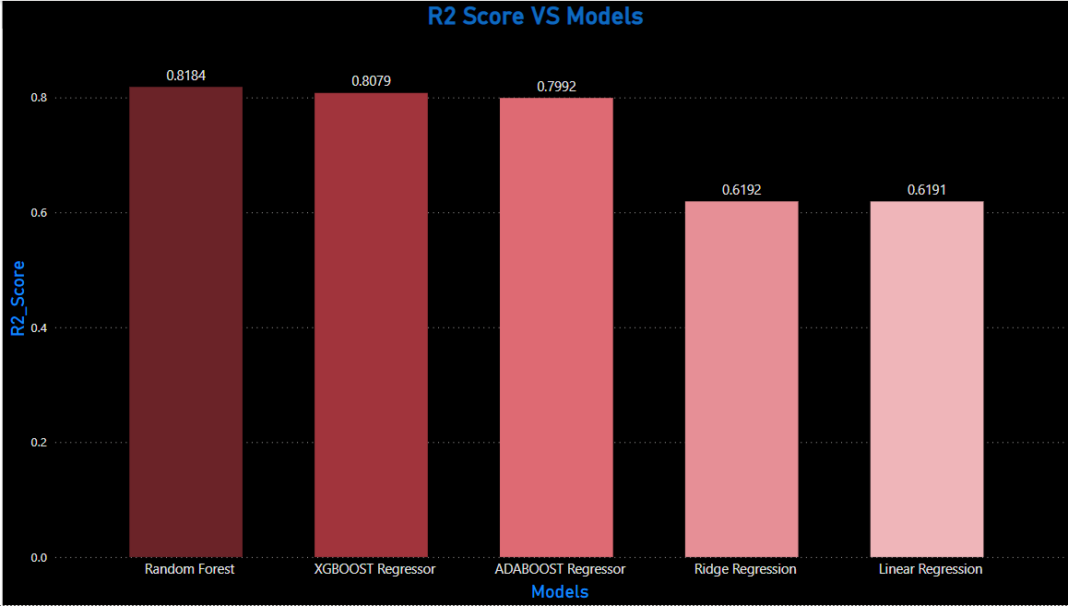
Overall Model Performance

Slide 13
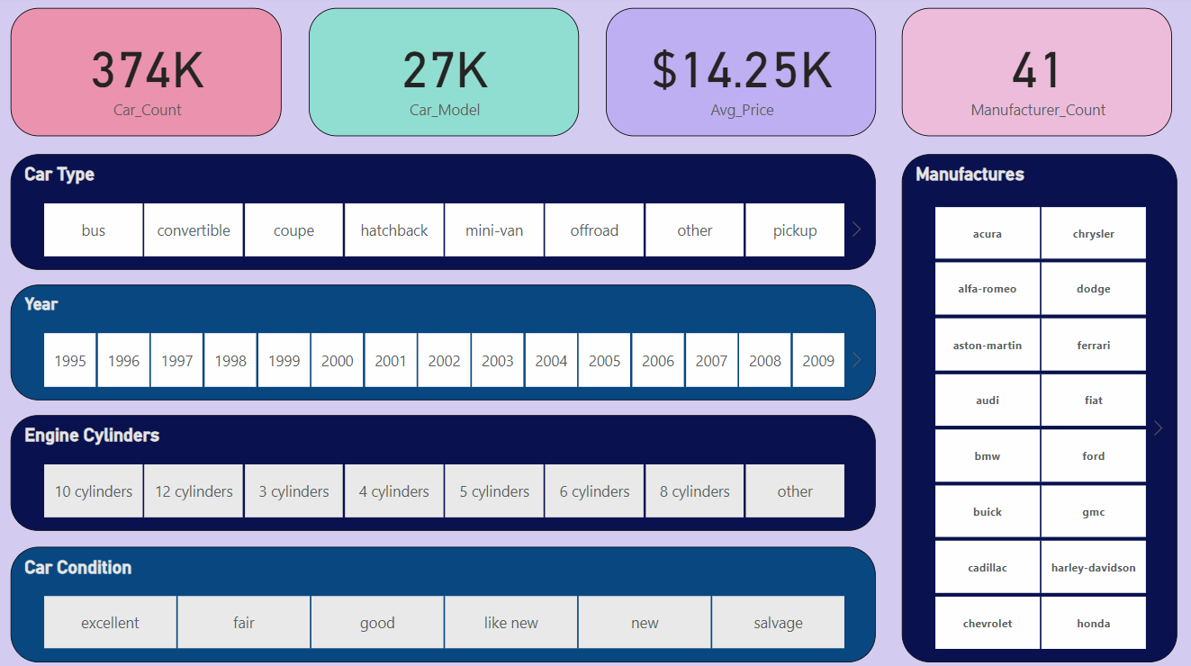
DATA VISUALIZATION

Slide 14
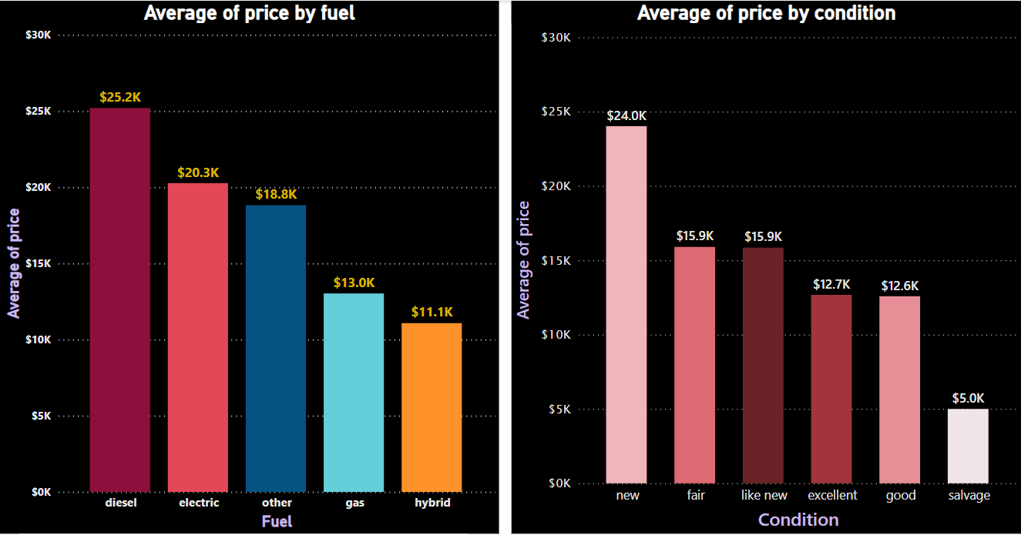
DATA VISUALIZATION

Slide 15
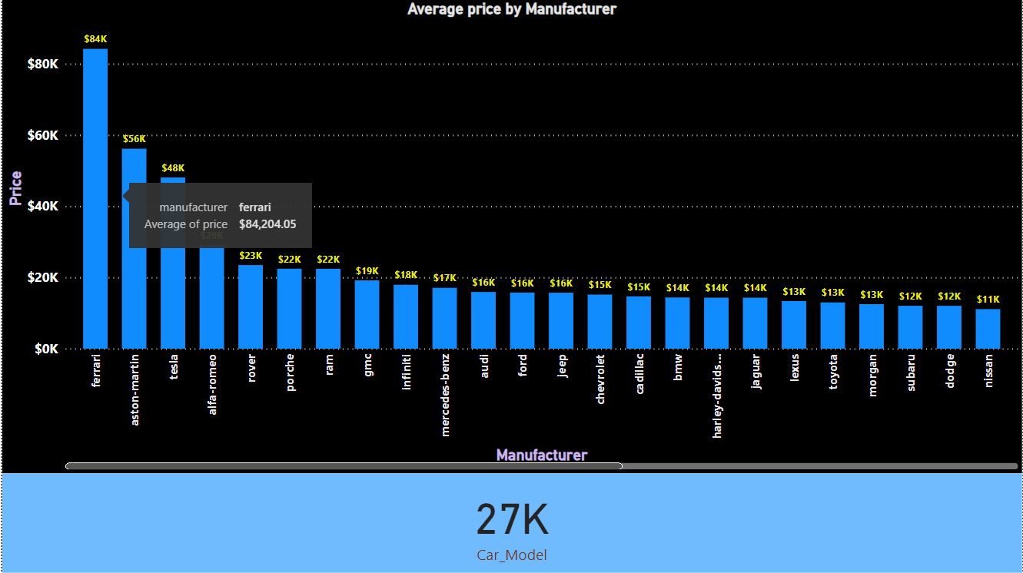
DATA VISUALIZATION

Slide 16
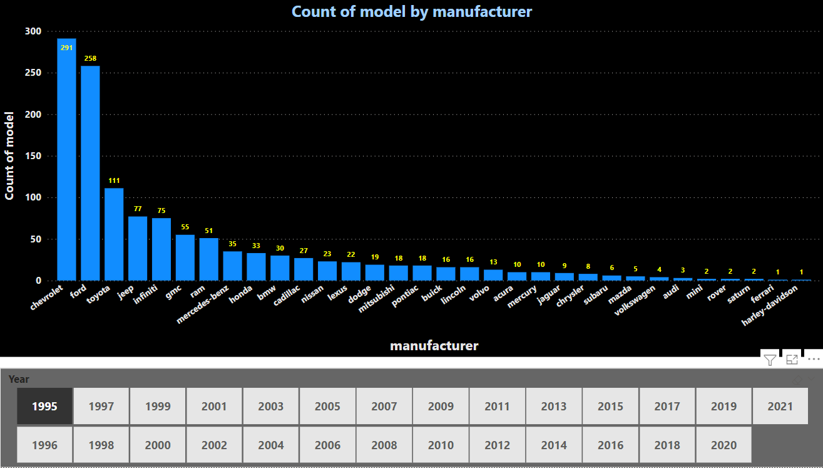
DATA VISUALIZATION

Slide 17
CONCLUSION
Considering what is and what is not accounted for in the models built in this study, their predicting results are fairly accurate.
We used the spark to prepare the data and train different models and compare them in ML and choose the best. We showed how you can use predictive analytics to develop sophisticated models that very accurately detect employees that are at risk of turnover.
The Random Forest Regressor ML algorithm worked well for Regression with accuracy around 0.8185 on data. With the model predictions, we created graphs in PowerBI that would help to predict the car price. Overall, this is a really useful example where we can see how machine learning and data science can do for your business.
For the future studies, researchers can implement other exciting machine learning methods and compare the results.

Slide 18
THANK YOU…

