Slide 1
YES BANK STOCK CLOSING PRICE PREDITCION
SUBMITTED BY:
CH. GAYATRI – 221FA14038
BIOINFORMATICS – 3A

Slide 2
INTRODUCTION
Yes Bank stock closing price prediction by regression involves using historical data to develop a regression model that can forecast future stock prices. Regression analysis is a statistical method that uses a combination of independent variables to predict the value of a dependent variable, in this case, the stock price. Here we are gonna develope different Regression model to predict the Closing stock price. On the basis of different metrics, we are gonna evaluate our model and try to find the best model of it. Also try to gain some insights in feature importance using various methods.

Slide 3
LINEAR REGRESSION
Linear regression is a statistical method used to model the relationship between a dependent variable (also known as the outcome variable) and one or more independent variables (also known as predictors). The goal is to find a linear equation that best fits the data points, allowing us to predict the value of the dependent variable based on the values of the independent variables.
Key components of linear regression:
Dependent variable (Y): The variable we want to predict.
Independent variables (X): The variables used to predict the dependent variable.
Linear equation: A mathematical equation that represents the relationship between the variables.
Coefficients (β): Numerical values that represent the strength and direction of the relationship between the independent variables and the dependent variable.

Slide 4
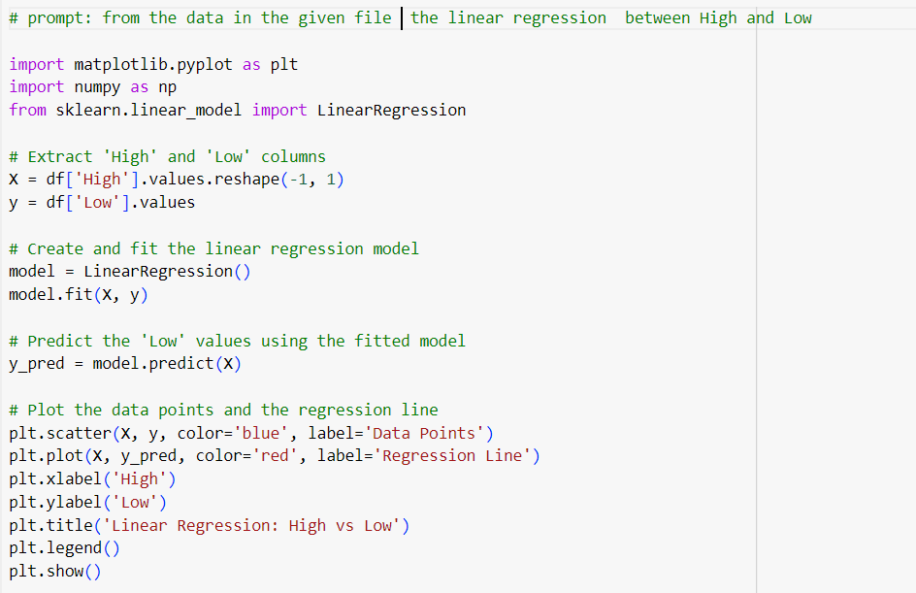
Python script and r script:

Slide 5
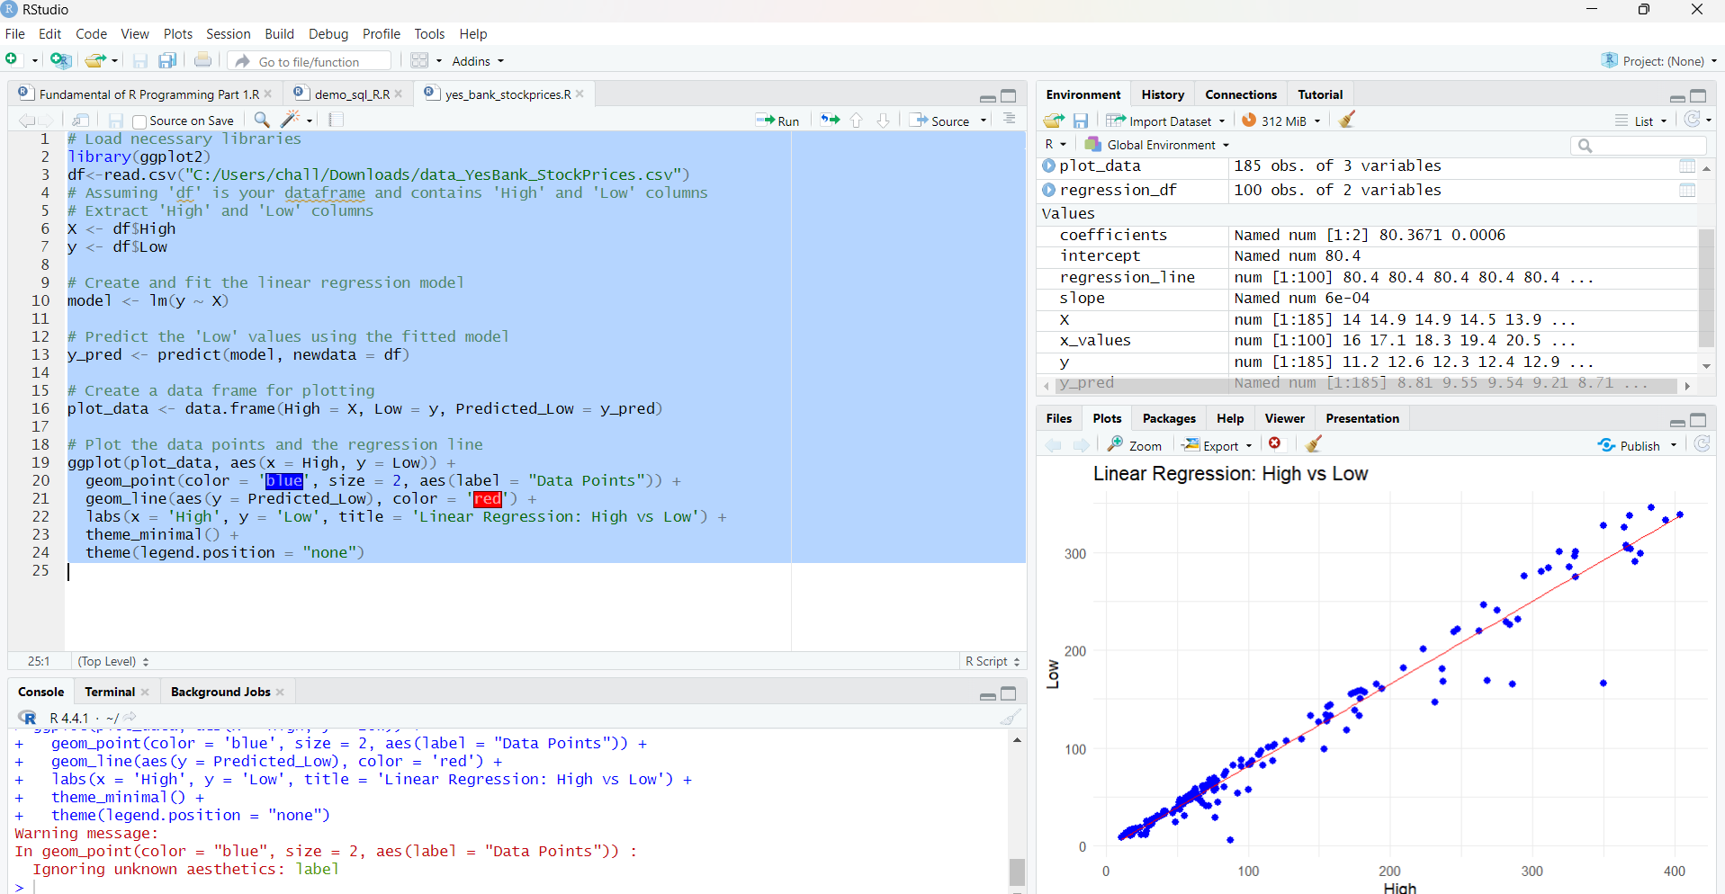

Slide 6
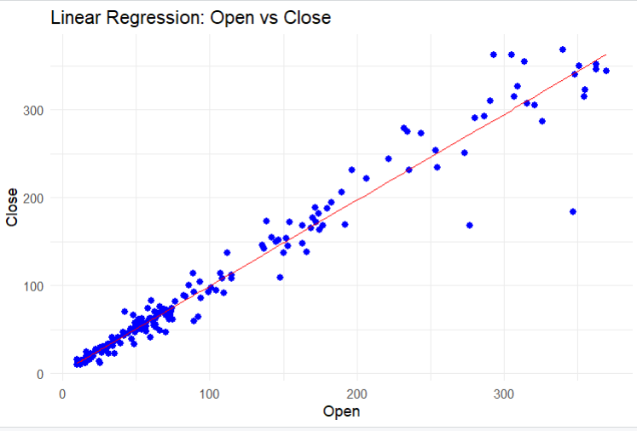
LINEAR REGRESSION:OPEN VS CLOSE
This image shows a simple linear regression plot where the "Open" price (on the x-axis) is plotted against the "Close" price (on the y-axis). Here’s a breakdown of the key elements:
Data Points (Blue dots): These represent individual observations of the open and close prices for a certain period. Each dot corresponds to a pair of values: one for "Open" and one for "Close."
Regression Line (Red line): The red line is the linear regression line, which is a statistical model to predict the value of the "Close" price based on the "Open" price. This line minimizes the distance between itself and all the data points (in terms of squared differences).

Slide 7
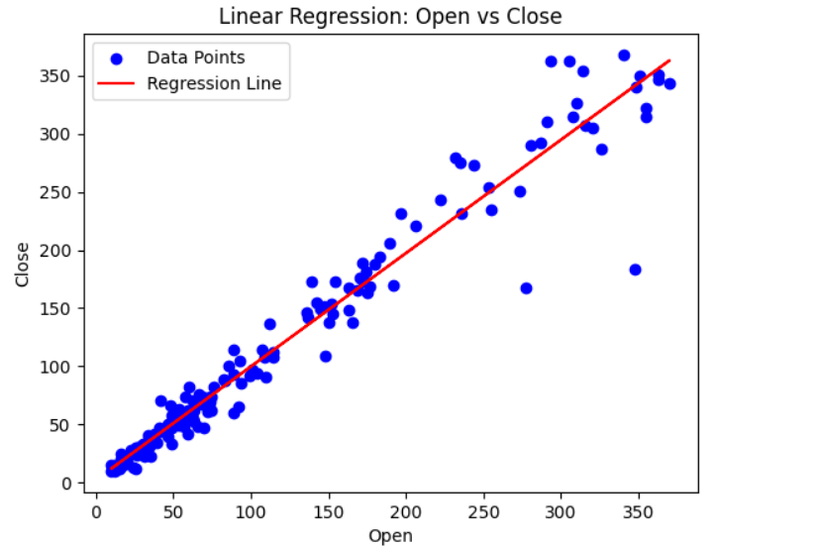
Fit of the Model: Most of the blue dots are clustered closely around the red line, indicating a good fit, meaning the linear regression model is effective at predicting the "Close" price based on the "Open" price.
Number of data points in the dataset: 185
R-squared (Open vs Close): 0.9564272890130099
MSE (Open vs Close): 421.18
RMSE (Open vs Close): 20.52
Mean Squared Error (Open vs Close): 421.17839105792336
Number of data points in the dataset: 185

Slide 8
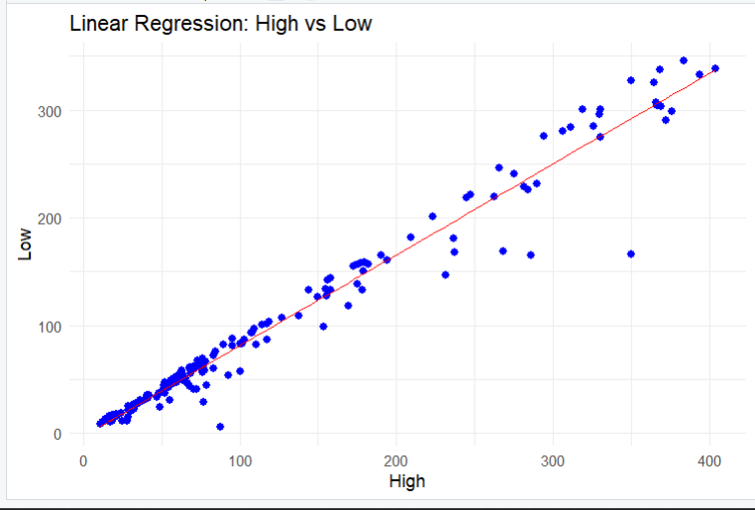
LINEAR REGRESSION:HIGH VS LOW
The provided graph illustrates a linear regression model, which aims to predict the relationship between two variables: "High" and "Low."
Blue dots: These represent the individual data points. Each dot corresponds to a specific pair of "High" and "Low" values.
Red line: This is the regression line. It's a straight line that best fits the data points. The equation of this line represents the linear relationship between "High" and "Low.“

Slide 9
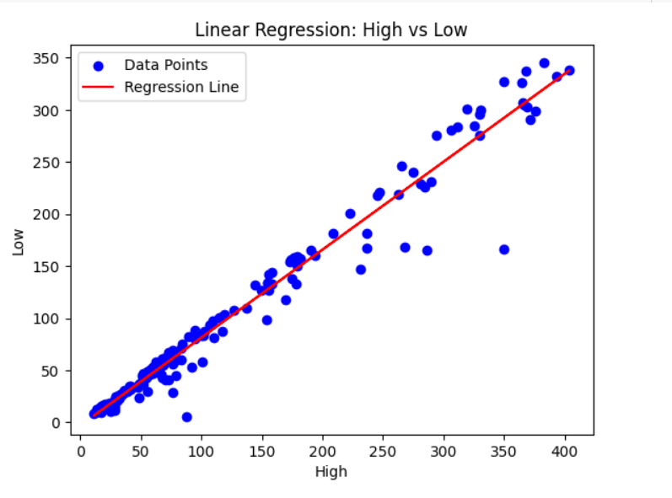
Interpreting the Relationship
Based on the graph, we can observe a positive linear relationship between "High" and "Low." This means that as the values of "High" increase, the values of "Low" tend to increase as well. The upward slope of the regression line confirms this positive correlation.
Number of data points in the dataset: 185
R-squared (High vs Low): 0.9564272890130099
MSE (High vs Low): 421.18
RMSE (High vs Low): 20.52
Mean Squared Error (High vs Low): 421.17839105792336

Slide 10
THANK YOU

