Slide 1
Sentiment Analysis and Topic Modelling
by
Gayatri Annapurna Vadlani
Harsha Preetham Pukkalla
Rakshith Dyavari Shetty
Harshitha Ambilpur

Slide 2
Outline
Problem statement
Technical Details
Model and Implementation
Dataset
Model for Sentiment Analysis
Model for Topic Modellings
Evaluation
Validation
Results
Demo

Slide 3
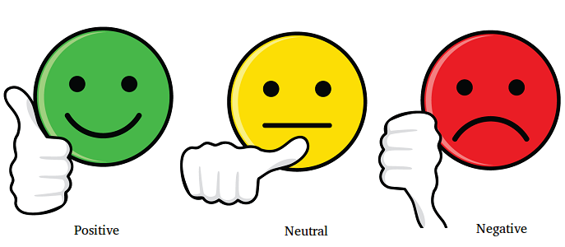
Problem Statement:
Sentiment Analysis is a process of analyzing text for polarity, where a topic is positive, negative or neutral.
Topic modelling helps to identify abstract topics that occur in a collection of documents to determine what the people are talking in a particular discussion.

Slide 4
Models for sentiment Analysis:
Naïve Baye
BOW, TFIDF
Svm
Word Vectors
LSTM
LSTM+CNN

Slide 5
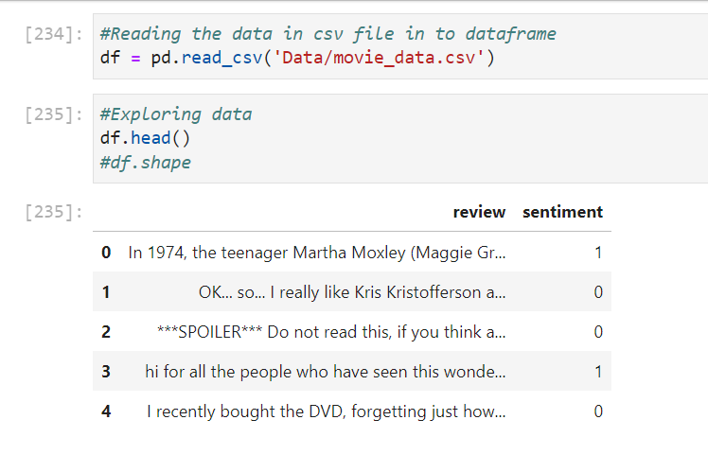
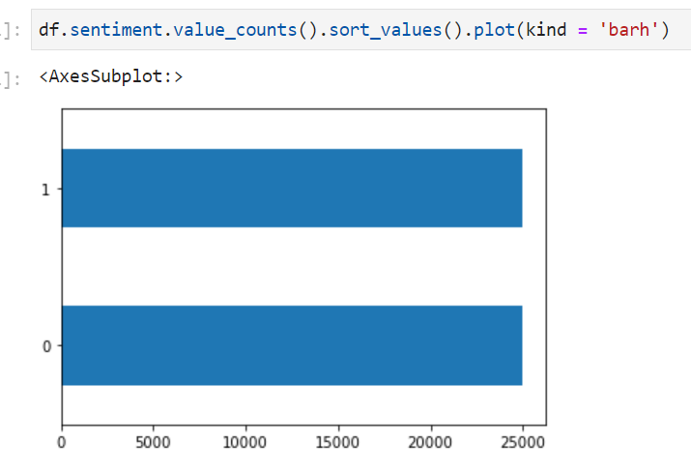
Implementation(Dataset):
Dataset we used is IMDB dataset from Kaggle.
It is in the format of csv file.

Slide 6

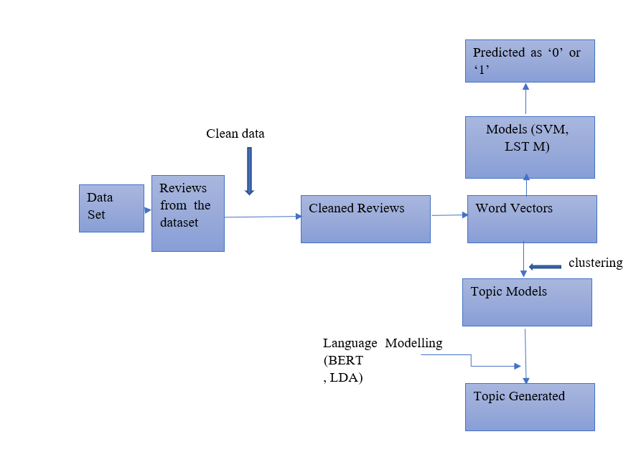



Model and Implementation:

Slide 7
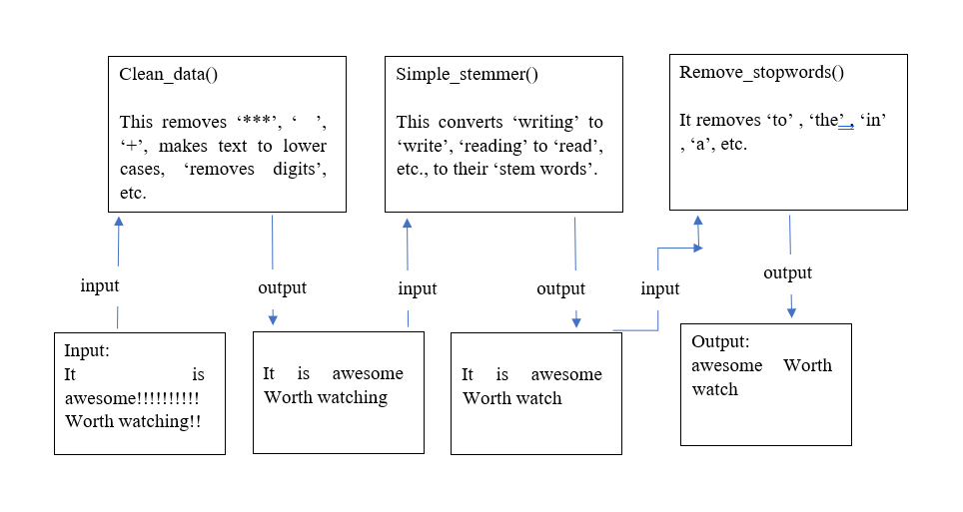
Preprocessing data:
Cleaning of the data
Stemming input
Removing stop words.

Slide 8
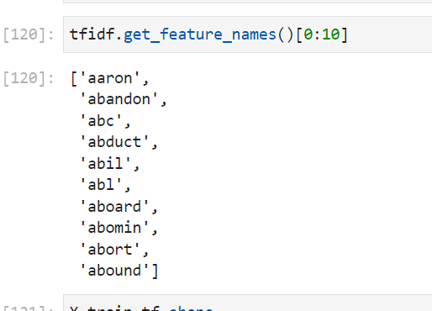
Features:
Bag of words vector representation
Tfidf word vetcors
Tokenizer
Apart from this we used doc2word conversions to generate bag of words in LDA and we used Bert embedding in Bert model.

Slide 9
Algorithms for sentiment Analysis:
Naïve Bayes
Multinomial NB is used
81% accuracy
2. SVM
Linear svc is used
84% accuracy

Slide 10
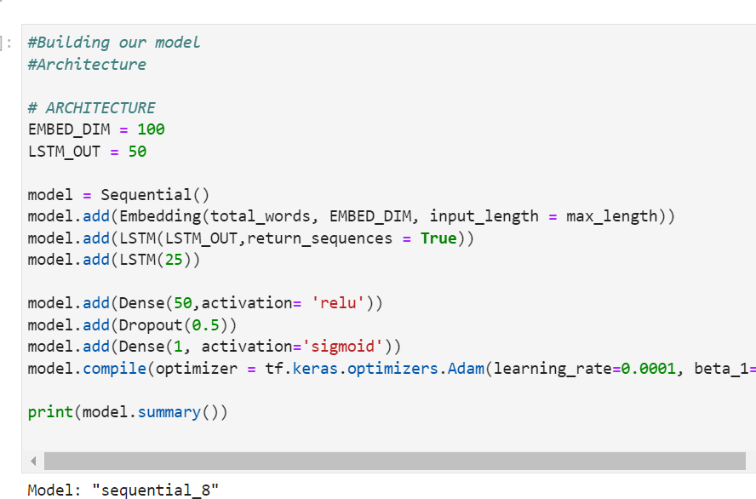
LSTM model:

Slide 11
Algorithms for sentiment Analysis:
LSTM:
LSTM generated accuracy of 86%
So, to further increase accuracy we used LSTM+CNN model/
LSTM+CNN
Input Layer
Convolution layers
Pooling layers
Dense layers
Dropout layers
Output layer

Slide 12
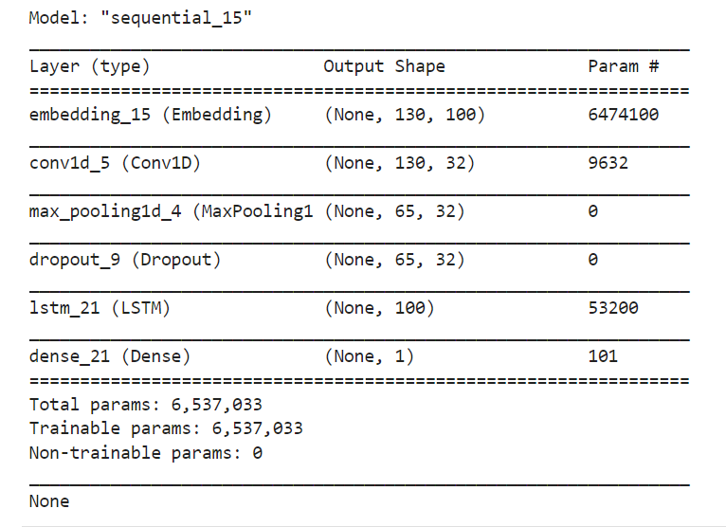
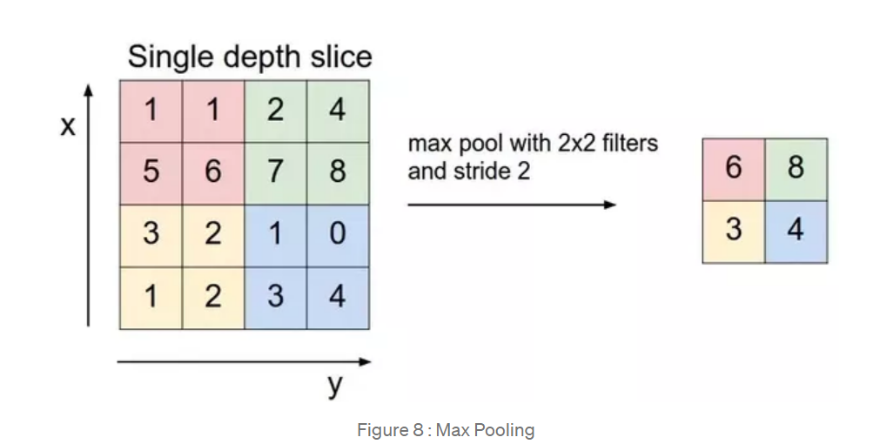
LSTM+CNN model:

Slide 13
Evaluating metrics:
 | Naïve Bayes | SVM | LSTM | CNN+LSTM
Accuracy | 81%(BoW) | 84%(BoW) | 86% (word vectors) | 88% (word vectors)
 | 84%(tfidf) | 88%(tfidf)

Slide 14
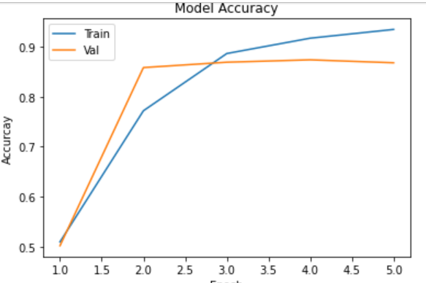
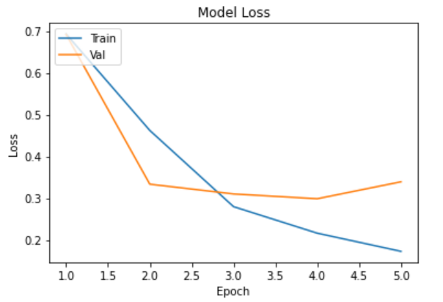
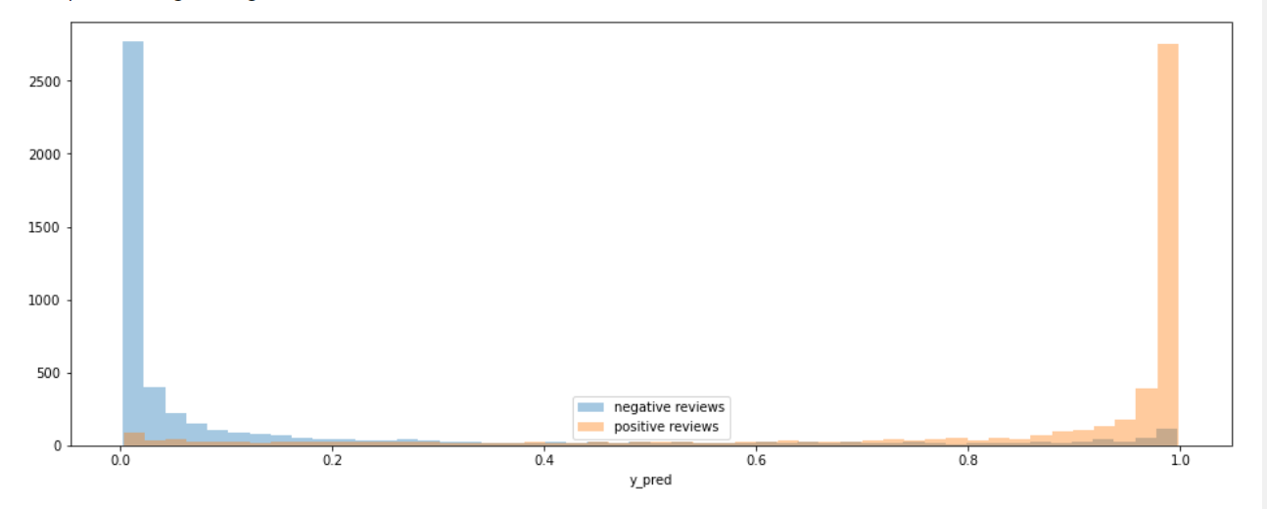
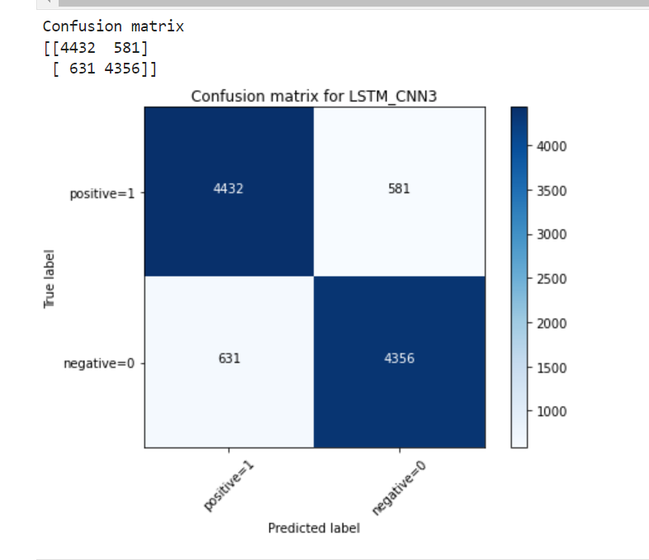
Evaluating metrics:

Slide 15
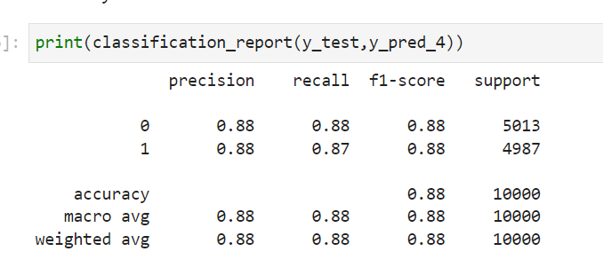
Evaluation Metrics:
Finally, after many experimental hyper tunings we were able to achieve accuracy of 88% which is greater than all the other model's accuracy and nearly equal to SVM tfidf model accuracy.

Slide 16
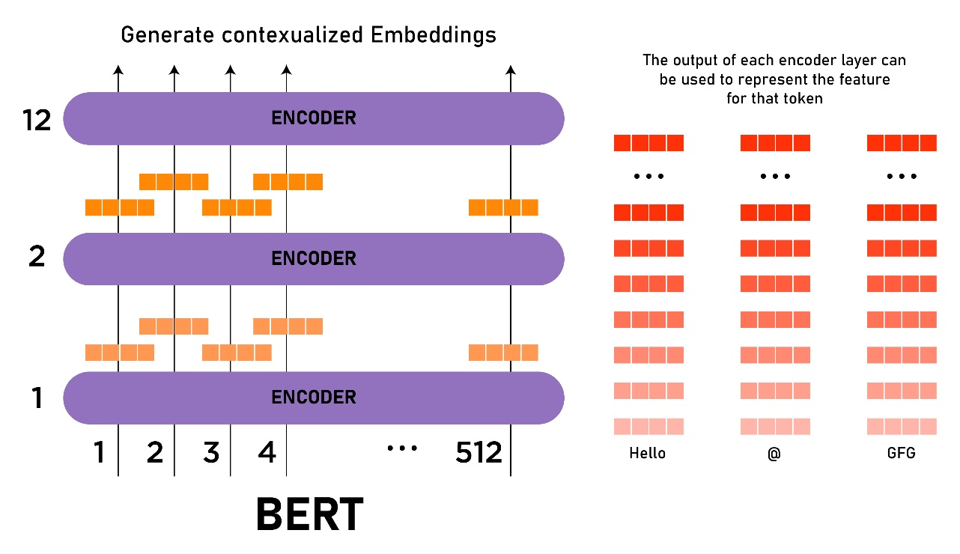
Topic Modeling
BERT
Bert is an encoder stack of transformer architecture.
LDA
It is an unsupervised learning algorithm and a probabilistic model, to assign topics to the clusters

Slide 17
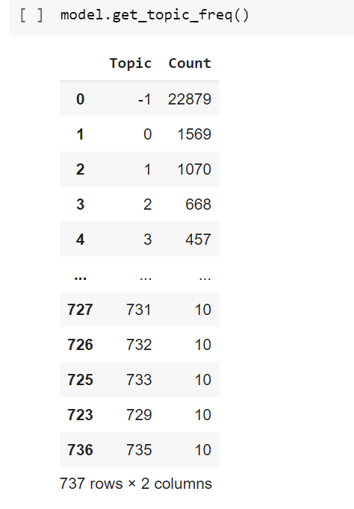
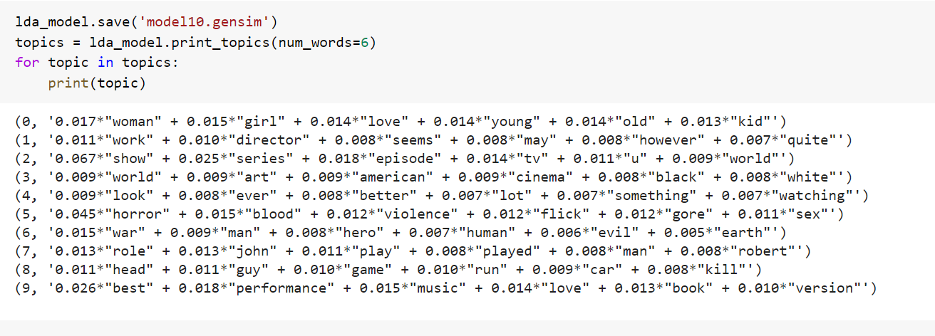
Topics generated by BERT and LDA:

Slide 18
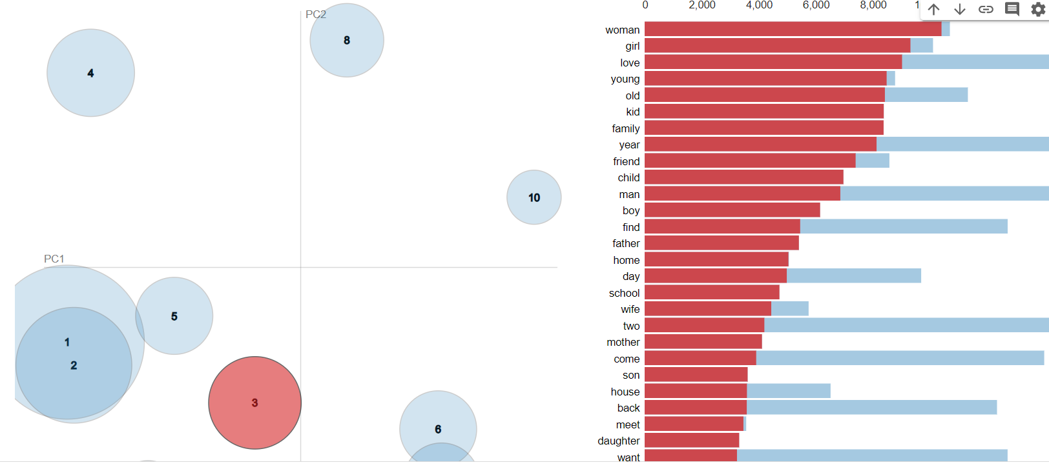
Intertopic distance map of LDA

Slide 19
Validation:
Preprocess data
Convert into vectors
Define the model
Compile the model
Evaluate
Make predictions on test data
Input real-time data
Preprocess the real-time data
Use the trained model for predictions.

Slide 20
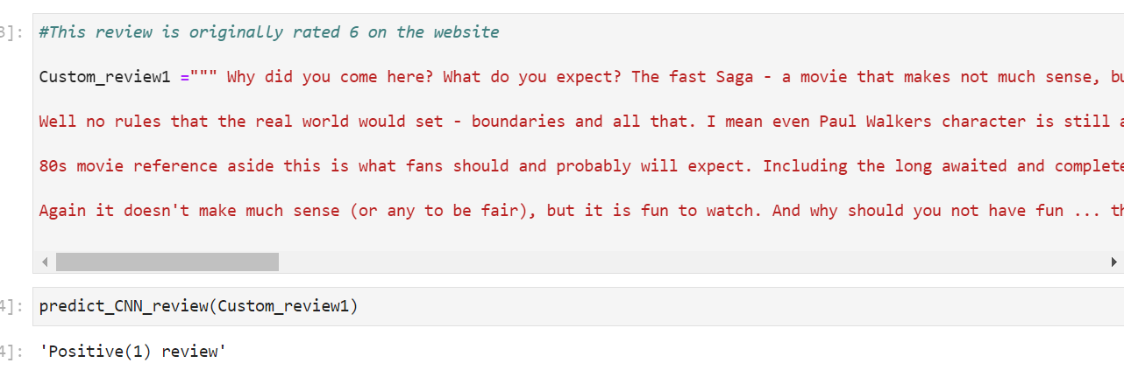
Prediction for sentiment analysis on real-time data:

Slide 21
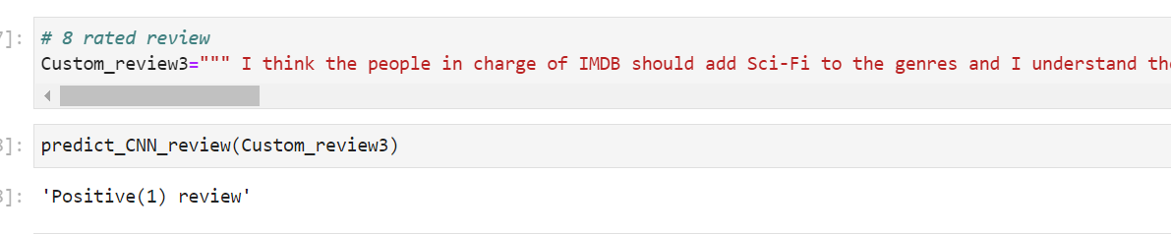
Prediction for sentiment analysis on real-time data:

Slide 22
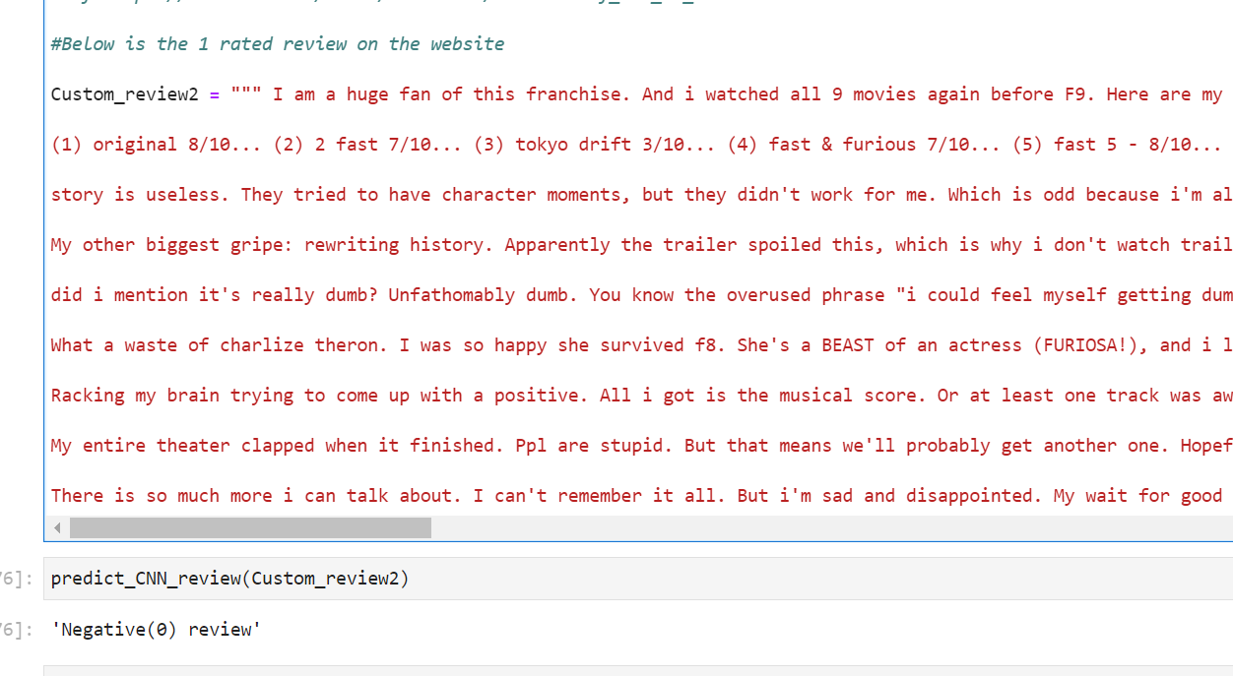
Prediction the real-time data:

Slide 23
Conclusion:
If properly tuned, we can achieve more accuracy with LSTM+CNN model.

Slide 24
References:
https://iopscience.iop.org/article/10.1088/1757-899X/1077/1/012001/pdf
https://link.springer.com/article/10.1007/s40747-021-00436-4
https://web.stanford.edu/class/cs224n/reports/final_reports/report017.pdf
https://www.geeksforgeeks.org/explanation-of-bert-model-nlp/
https://www.kaggle.com/lakshmi25npathi/imdb-dataset-of-50k-movie-reviews
https://www.imdb.com/title/tt5433138/reviews?ref_=tt_sa_3
https://ai.stanford.edu/~amaas/data/sentiment/
https://www.kaggle.com/lakshmi25npathi/imdb-dataset-of-50k-movie-reviews

Slide 25

Thank You

