Slide 1

Project Name:
Sales Order Data Dashboard | POWER BI
BY
GAYATRI BHINGE
Notes:
CREDIT EDA ANALYSIS

Slide 2




Introduction
Dashboard
INDEX

Slide 3
INTRODUCTION
Welcome to the Sales Dashboard project! In this project, I am creating an interactive and insightful Sales Dashboard using Power BI.
We are using two datasets for this project:
Orders
Details
GOALS
We transform raw sales data into a visually appealing and informative dashboard that helps stakeholders make data-driven decisions.

Slide 4

DASHBOARD

Slide 5
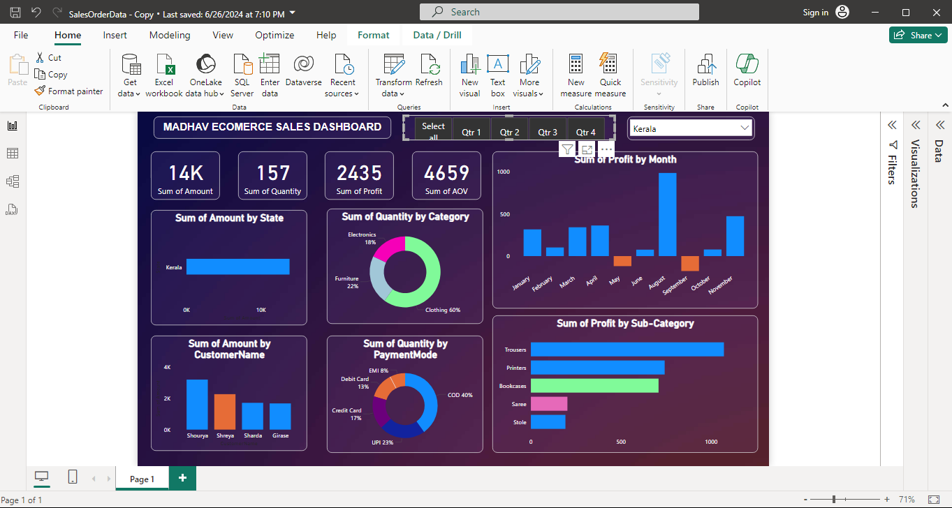

Slide 6
Thank You!!

