Slide 1
FLOWER RECOGNITION SYSTEM
Team Members:
1.Gayatri Chaudhari
2.Sneha Jadhav
3.Ankita Chandavale
4.Amrit Kabir
5.Sneha Chalke

Slide 2
LITERATURE SURVEY
Sr. No. | Title | Author | Name of Journal | Year of Publication | Algorithms | Dataset
1. | A Flower Recognition System Based On Image Processing And Neural Networks | Huthaifa Almogdady, Dr. Saher Manaseer, Dr.Hazem Hiary | INTERNATIONAL JOURNAL OF SCIENTIFIC & TECHNOLOGY RESEARCH VOLUME 7 | NOVEMBER 2018 | (ANN) algorithm . HSV color histogram 7th moments
2. | Flower Identification System by Image Processing | Warisara Pardee1 , Prawaran Yusungnern1 , Peeraya Sripian1 |  | August 2015 | RGB Histogram GrabCut multiple decision trees
3. | To Implement Flower Recognition | Parvathy S N, N Vrinda Rao, Shahistha Bai S, Naeema Nazer, Prof. Anju J | International General Journal of Engineering and Technology | June 2020 | hu’s seven algorithm K nearest algorithm | A subset of Oxford 102 flowers dataset
4. | Flower Recognition System Based on Image Processing | Tanakorn Tiay, Pipimphorn Benyaphaichit, and Panomkhawn Riyamongkol | 2014 Third ICT International Student Project Conference (ICT-ISPC2014) | October 2014 | K-nearest neighbor Hu’s seven moments graph cut Canny edge detection algorithm | A subset of Oxford 102 flowers dataset
5. | A Flower Recognition System based on Image Processing and Neural Network | 1.Huthaifa Almogdady 2.Dr. Saher Manaseer 3.Dr. Hazeem Hiary | International Journal of Science and Technology Research | 2018 | Artificial Neural Networks(ANN) | A subset of Oxford 102 flowers dataset

Slide 3
BLOCK DIAGRAM
Data Acquisition
Pre processing
Feature Extraction
Training using CNN
Test image
Classification
Benefits Module

Slide 4
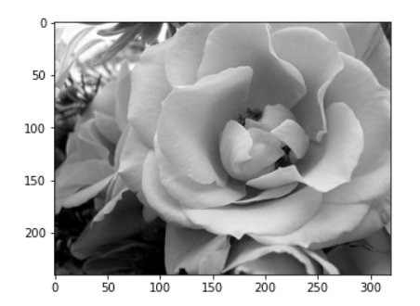
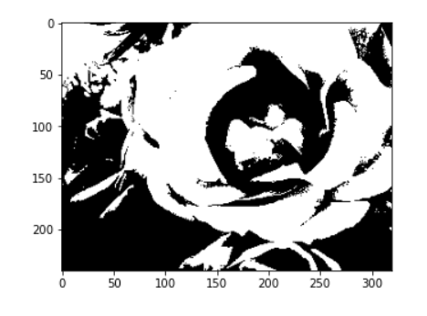
Preprocessing steps on dataset
Convert color images to grayscale to reduce computation complexity: color images contain more information than black and white images, they can add unnecessary complexity and take up more space in memory
Image Thresholding
For instance, if the Threshold (T) value is 125, then all pixels with values greater than 125 would be assigned a value of 1, and all pixels with values lesser than or equal to that would be assigned a value of 0.

Slide 5
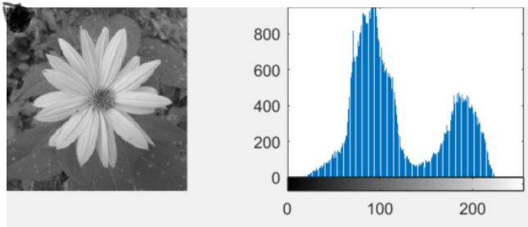
Histogram Equalization:
An image whose pixel values are confined to some specific range of values only. For eg, brighter image will have all pixels confined to high values. But a good image will have pixels from all regions of the image. So you need to stretch this histogram to either endsThis normally improves the contrast of the image.

Slide 6
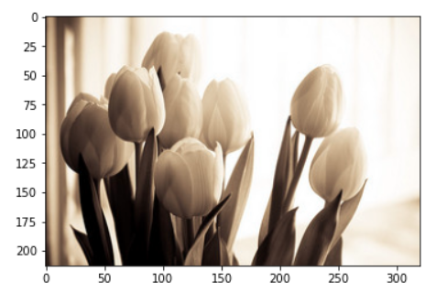
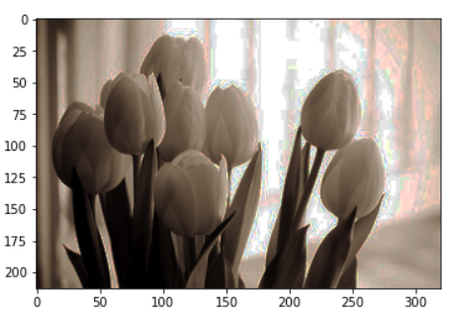
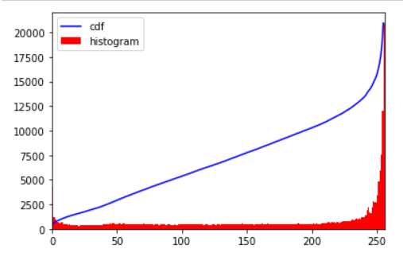
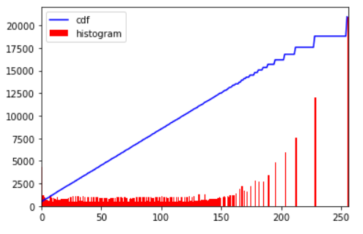

Slide 7
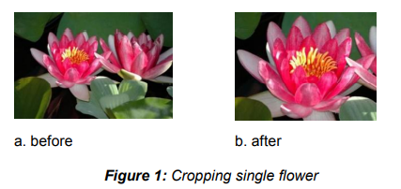
The cropping of images is a step that we introduce to make the flower object in the image clearer and to enhance the segmentation phase by providing the images with less background objects.
The following principles have been made to ensure the stability:
1.Cropping single flower.
This cropping principles works on image that contain flower many separated flowers object but one with an accurate and clear view, the wanted image separated using cropping and became the new image main object and placed on the middle.

Slide 8
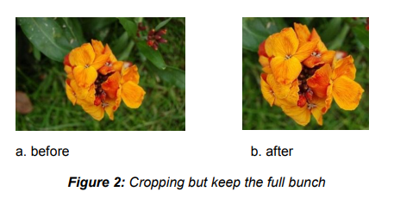
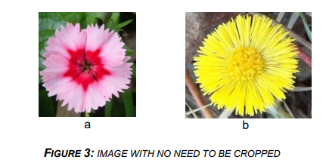
2.Cropping but keep the full bunch:
Cropping but keep the full bunch. Some of flowers species the flower itself come in bunches the small flowers combining together to form the whole big flower that sometimes look like bunch of flower, this principle concerning about taking the whole bunch as a shape constraint not only the best looking ones but the whole bunch together.
3.Keeping the same structure (no cropping):
Some of flowers images already came in the form that we want, no obstacles, the flower object are in the meddle and has only one flower.

Slide 9
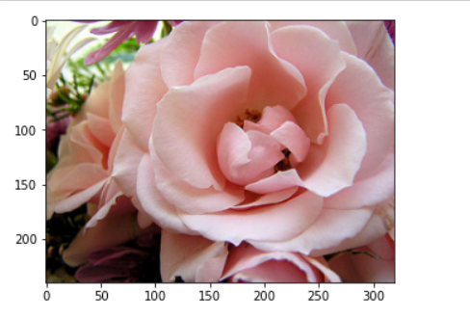
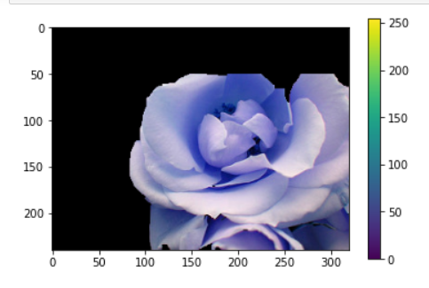
Cropping the image :
We are using the resize function for cropping the image into required shape.
Image Segmentation using grab cut algorithm:

Slide 10
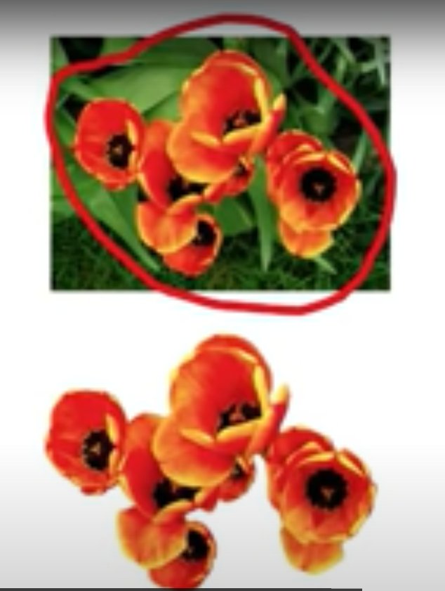
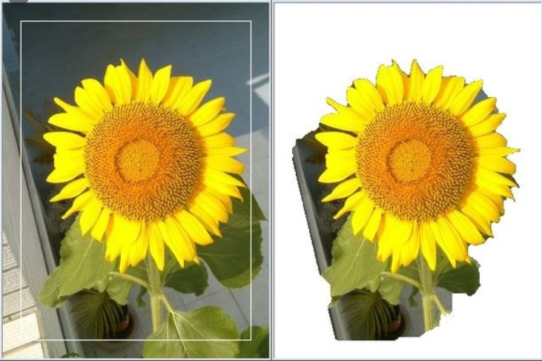
Image Segmentation
GrabCut, a semi-automatic image segmentation algorithm developed based on graph-cut approach was used in the image segmentation stage. User is asked to drag the mouse to form a rectangle shape around the flower region in the image as shown in figure below. The rectangle region is used as an initial rough segmentation. The algorithm took into account color distribution information inside a rectangular and iteratively segment foreground and background without having difficult user interaction. Border matting was used to estimate simultaneously the alphamatte around the object boundary and the colors of foreground pixels.

Slide 11
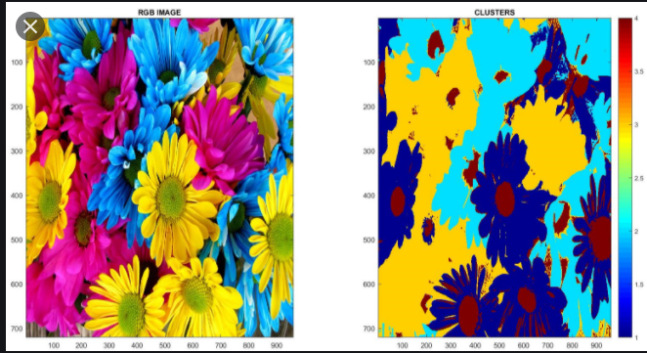
Feature extraction:
Color features: When we see a flower, the first thing that we observe is the color of petals. Color is therefore a primary classifier for flower, for example, red is for rose and white is for jasmine. In our system, we use RGB Histogram, a histogram of red, green and blue luminance, to characterize each flower image. We used 8 bins histogram per color channel, hence 512 dimensional features vector, in our system.

Slide 12
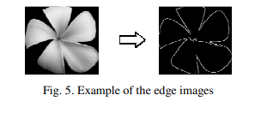
Shape Features:
The Canny edge detection algorithm [9] is applied to the cropped image to receive edge data. The edge data will be the input into Hu’s seven-moment algorithm in the next section. The example of images using canny edge detection algorithm .
After obtaining the edge of the flower Hu’s seven-moment algorithm [10, 11] is applied to obtain seven characteristic of the flower image.
Image moments are useful to describe objects after segmentation. Simple properties of the image which are found via image moments include area (or total intensity), its centroid, and information about its orientation.

Slide 13
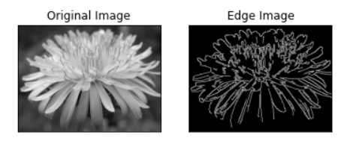
Selection of feature after studying dataset:
Transforming the input data into the set of features is called as feature extraction.For selection of features first we have to find out the dissimilarity between them to distinguish them from each other.
For Flower recognisation we have used two features:
1.Shape of the lower:
For detecting the edge we are using canny edge algorithm. It is a multi-stage algorithm and we will go through each stages.
Noise Reduction:
Finding Intensity Gradient of the Image
Non-maximum Suppression
Hysteresis Thresholding
OpenCV puts all the above in single function, cv2.Canny()
First argument is our input image. Second and third arguments are our minVal and maxVal respectively. Third argument is aperture_size. It is the size of Sobel kernel used for find image gradients. By default it is 3. Last argument is L2gradient which specifies the equation for finding gradient magnitude.
Cv2.Canny(img,minval,maxval)

Slide 14
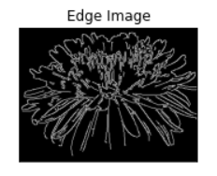
The Canny edge detection algorithm [9] is applied to the cropped image to receive edge data. The edge data will be the input into Hu’s seven-moment algorithm in the next section.
humoments
[[ 0.73204646] [ 2.68716469] [ 2.80214409] [ 3.91006661] [ 7.26617197] [ 5.25364896] [15.13832958]]

Slide 15
IMPLEMENTATION
1. Image Acquisition:
This step involves collecting images that can be used to train the model so that later when it comes across an unknown image, it can identify the flower based on the knowledge acquired during the training phase.
2. Image Pre-processing:
Here the images collected in the previous step were resized and augmented to increase the efficiency of the model. During augmentation, the size of the dataset would be increased by performing operations such as rotation, shear etc. Then the image will be split into 75% training and 25% testing sets.

Slide 16
3.Training Phase:
This is the step where the actual training of the model takes place. In this phase the model extracts features such as color and shape of the flower used for training. Each of the training images will be passed through a stack of layers which includes convolutional layer, Relu layer, pooling layer and fully connected layer.
4. Validation phase:
Once the model completes its training from the training set it tries to improve itself by tuning its weight values. The loss function used is categorical cross entropy and the optimizer used is stochastic gradient descent.
5.Output prediction:
Once the validation phase is over, the model is ready to take an unknown image of a flower and predict its name from the knowledge it gained during training and validation phases. Once the classification is done by the model, it displays the common name as well as the family name of that flower.
6.Benefits Module:
Once the identity of the flower is found out, a previously created CSV file is imported and the benefits of the corresponding flower will be found out and displayed to the user.
7. Web Application:
Finally the developed model was deployed into a web application which further makes the system more user friendly.

Slide 17
CNN
The proposed flower recognition system is implemented by developing a convolutional neural network which is a very efficient model for image classification. CNN models are trained by initially feeding a set of flower images along with their labels. These images are then passed through a stack of layers including convolutional, ReLU, pooling and fully connected layers. These images are taken as batches. In the proposed system, a batch size of 32 was given. The model was trained using 150 epochs. Initially the model extracts small features and as the training process progresses more detailed features will be extracted. Most of the preprocessing is done automatically which is one of the major advantages of CNN. In addition to that input images were resized. Augmentation is also applied which increases the size of the dataset by applying operations such as rotation, shear etc. During the training process, the model discovers features and patterns and learns them. This knowledge is then used to later find the name of a flower when a new flower image is given as input. Categorical cross entropy is used as loss function. Initially the loss values would be very high but as the process advances the loss function is reduced by adjusting the weight values. Once the classification is done, the CSV file is imported and the major uses of that plant would be displayed. To increase the user friendliness of the system, the model was deployed into a web application. Thus the user can take a picture of the flower in their mobile phone or camera. The user can then take the webapp and upload the image and click on the predict button. The model will be loaded and prediction is done. The common name, family name and major uses of that flower will be displayed for the user. Thus the process of knowing more about a beautiful flower that you have just seen is simplified by this system.

Slide 18
Libraries used:
import os
import numpy as np
import pandas as pd
import matplotlib.pyplot as plt
from matplotlib import style
import seaborn as sns
from keras import backend as K
from keras.models import Sequential
from keras.layers import Dense
from keras.optimizers import Adam,SGD,Adagrad,Adadelta,RMSprop
from keras.utils import to_categorical
from keras.layers import Dropout, Flatten,Activation
from keras.utils import to_categorical
from keras.layers import Dropout, Flatten,Activation
from keras.layers import Conv2D, MaxPooling2D, BatchNormalization
import tensorflow as tf
import random as rn
import cv2
from tqdm import tqdm
from random import shuffle
from zipfile import ZipFile
from PIL import Image

Slide 19
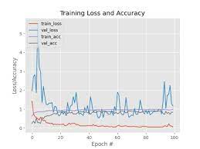
RESULT AND ANALYSIS
The model was trained with batch size 32 and with 150 epochs. The classification report obtained after the training and validation phase is shown in fig 2. The graph plots the training loss, validation loss, training accuracy and the validation accuracy for each epoch. Fig -2: Loss/Accuracy plot Fig -3: Final Result The model attained an overall accuracy of 90%. When the model is fed with a real time image of hibiscus taken on a mobile camera, a correct prediction with 98.46% accuracy was obtained.

Slide 20
CONCLUSION:
Flower being the most attractive part is the best way to identify a plant. Thus identifying the flower can help in knowing more about that plant. The proposed system takes as input, an image of a flower and displays the common name as well as the family name of the flower. Since the model is a convolutional neural network which has proven to be one of the most efficient image classification methods, the proposed system is highly reliable. A CSV file is imported after classification and the corresponding uses of the plant are displayed to the user thus making the system more useful.

Slide 21
Reference:
https://opencv-python-tutroals.readthedocs.io/en/latest/py_tutorials/py_imgproc/py_histograms/py_histogram_equalization/py_histogram_equalization.html#histogram-equalization
https://gogul.dev/software/image-classification-python
https://www.kaggle.com/rajmehra03/flower-recognition-cnn-keras
-We have taken the code from kaggle site for case study

Slide 22
Thank
You

