Slide 1

Sprocket Central Pty Ltd
Data analytics approach
[Division Name] - [Engagement Manager], [Senior Consultant], [Junior Consultant]

Slide 2
Agenda
Introduction
Data Exploration
RFM

Slide 3

Introduction
Sprocket Central Pty Ltd is a long-time client of KPMG and specializes in offering cyclists affordable and high-quality bicycles.
The aim is to help the organization to boost the business by analyzing their existing customer dataset to determine customer trends and behavior.
The 3 data sets used for this purpose are Customer demographic, customer address and transactions.

Slide 4

Data Exploration
The initial phase in data analysis is called data exploration, and it involves looking at and visualizing data to find insights right away or point out regions or patterns that need further investigation.
A dataset can be better understood through exploration, which also makes it simpler to explore and utilize the data in the future.

Slide 5
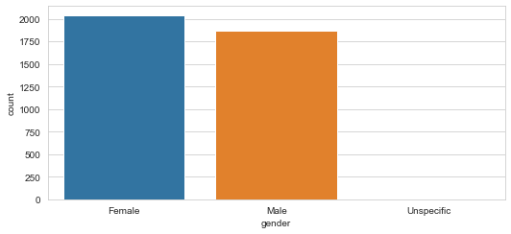

Analysis 01
Gender Distribution
The total number of customers 4000. This variable is categorical and is classified into 3 types:
Female
Male
Unspecified
From the below bar chart we see that most of the customers for this company are females. The actual count of females would be a bit more higher as few customers have not specified their gender. The company should thus focus on female customers more but also should give importance to it male customers too.

Slide 6
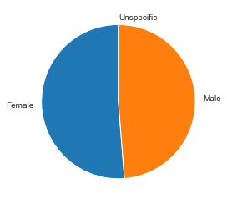
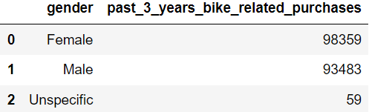
Analysis 02
Bike Related Purchase in the last 3 Years
Over the last 3 years, it is observed that female customers purchases bikes more than the male customers.
The female customers make up majority of the bike sales.

Slide 7
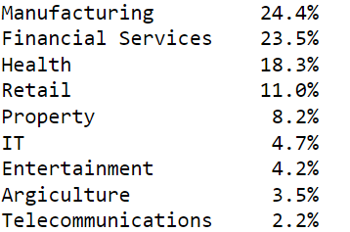
Analysis 03
Job Industry Distribution
From the given dataset, it is observed that there are 9 different job industry. The following are the 9 types:
Manufacturing
Financial Service
Health
Retail
Property
IT
Entertainment
Agriculture
Telecommunications
From the adjacent table, it is clear that manufacturing and Financial services occupy the highest position, meaning most of the customers are belong these job industry. The smallest percentage of customers are from agriculture and telecommunication industry.

Slide 8
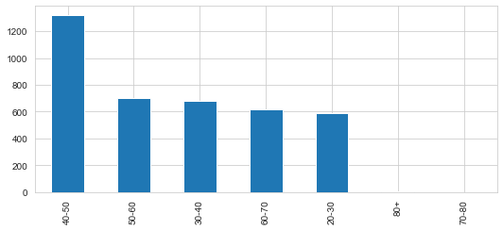

Analysis 05
Age Distribution
The dataset consisted of a variable called DOB. With the help of this variable, we were able to calculate the present age of the customer.
From the adjacent bar plot, we see that the most of the customers belong to the range of 40-50 years old, followed by 50-60 years old. Thus, the company should target these two groups more.
Wealth Segmentation
The wealth segmentation is a categorical variable and is of 3 types – Mass Customer, High Net Worth and Affluent Customer.
From the table we observe that most of the consumers are Mass Customer.

Slide 9
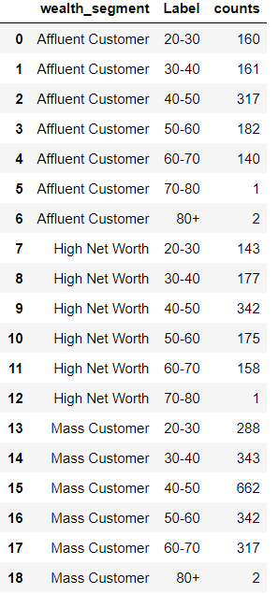
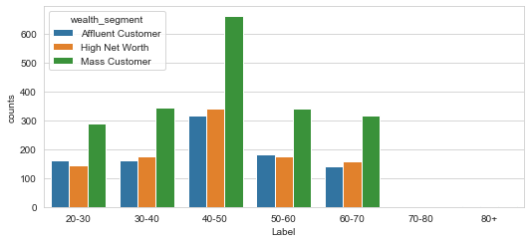
Analysis 06
Wealth Segmentation by Age
The wealth segment is a categorical variable and is of 3 types – Mass Customer, High Net Worth and Affluent Customer. The adjacent table shows the wealth segment type, age group and number of customer of a particular age group belonging to that particular wealth segment.
The below bar chart shows that in all the age categories, the largest number of customers are classified as “Mass Customer”. The Affluent Customers is more in the age group 50-60 but is less that mass customers.

Slide 10


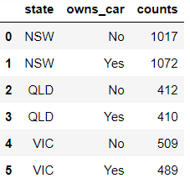
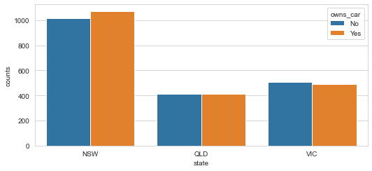
Analysis 07
Car Owner and State
For the purpose, we have merged the two datasets – CustomerDemography and CustomerAddress. Car Owner is of categorised into 2 types – Yes and No. From the below table we see that most of the customers own cars.
Another variable that we will look is State. The dataset consists of 3 states, within Australia. It is observed that most of the customers are from NSW (New South Wales) followed by Victoria.
We wish to analyse the relationship between Car Owner and State. From the bar plot, it is clear that NSW has the largest customers who own cars. QLD splits quite evenly. However numbers are significantly lower compared to NSW. Victoria has more numbers of customers who does not own cars.

Slide 11
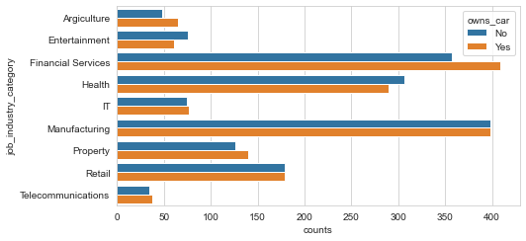
Analysis 08
Car Owner and Industry
As per the data provided, we observe that most of the customer who job category is Financial services, they own cars. Customers in manufacturing sector shares an equal proportion of ownership.

Slide 12
THANK YOU!

