Slide 1
PRE-OWNED CAR
Gayatri Krishna
21BDA16

Slide 2
USED CAR MARKET IN INDIA
In India the used car market is segmented by vehicle type (hatchbacks, sedan, and sports utility vehicles), fuel type (petrol, diesel, electric, CNG, LPG).
The increased sale of used car is mainly found in metro cities and also a rise in online sales platforms, such as CarDekho, Cars24 etc.

Slide 3
INTRODUCTION TO PANDAS
Pandas is a powerful Python data analysis toolkit for :
1. Reading different varieties of data
2. Functions for filtering, selecting and manipulating the data
3. Plotting data for visualization and exploration purposes

Slide 4
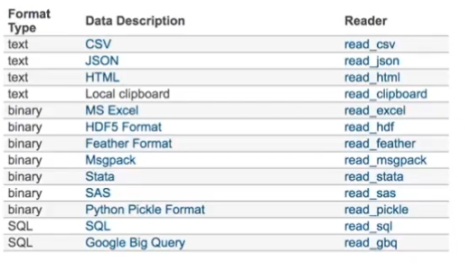
READING A SPREADSHEET FILE
Pandas can help us read data of different types of file.
Here the dataset is csv

Slide 5
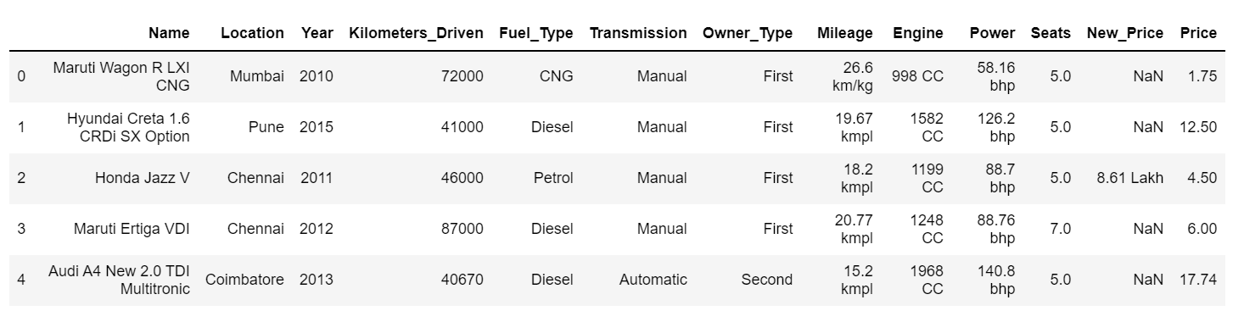
DATASET

Slide 6
ABOUT THE DATASET
The dataset is about the pre-owned cars from 1998 to 2019.
There are 6019 rows and 13 columns in this dataset. The first 5 observations from the dataset is displayed.
The dataset consist of the pre-owned cars in 11 different states in India.

Slide 7
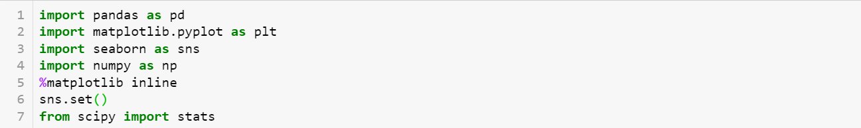
NECESSARY LIBRARIES IN PYTHON

Slide 8
DATA CLEANING
Data cleaning is the process of identifying, deleting, and/or replacing inconsistent or incorrect information from the database.
Scrub for duplicate
Scrub for irrelevant Data
Scrub for Incorrect Data
Handle Missing Values
Check the outliers
Standardise
Normalize

Slide 9
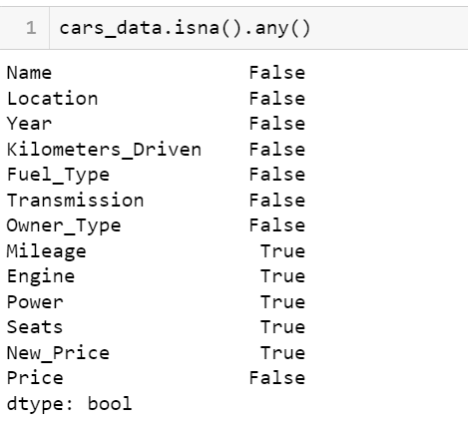
1. Find the out how many variables have missing values
So we see that Mileage, Engine, Power, New_Price and Seats have missing values… (Displayed by the boolean True). All other columns have complete information.

Slide 10
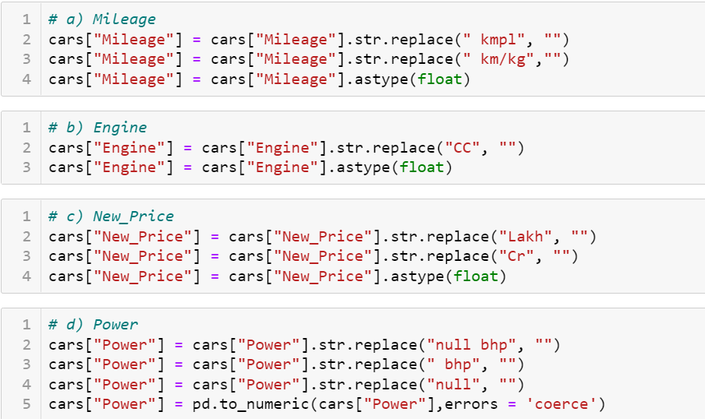
2. Removing the substring
Substrings are prefix or suffix of any string. Here Mileage, Engine and Power have substrings. So we replaced them and also converted the string type to float type to do statistical operations.

Slide 11
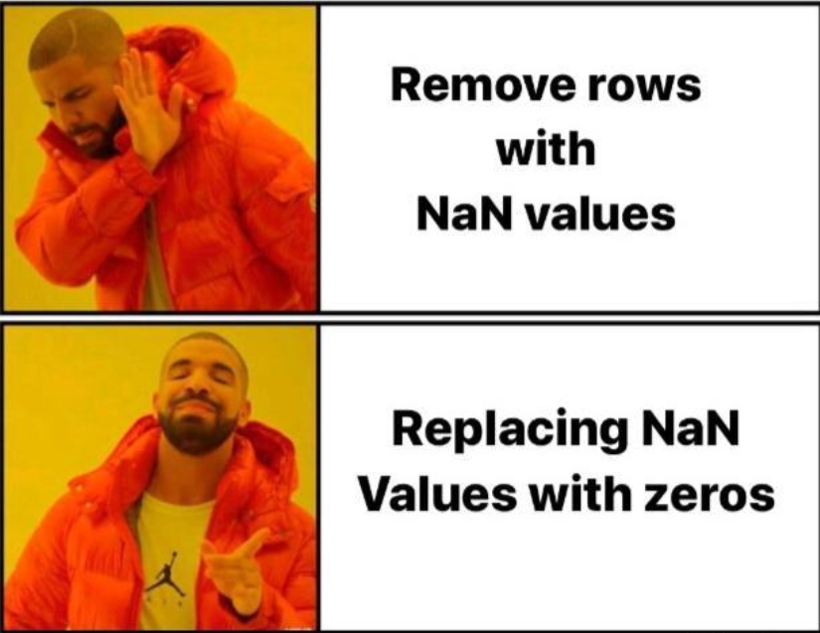
3. Replacing the missing values by 0
Here we use the replace() function to replace the missing values by 0. The inplace is an argument in pandas. The default value of this attribute is False and it returns the copy of the object.
null bhp’ is present in the ‘Power’ column.
‘nan’ is present in some columns of the dataset.
‘0.0 kmpl’ is present in Mileage column.
np.Nan present in all the columns
all are replaced by 0.

Slide 12
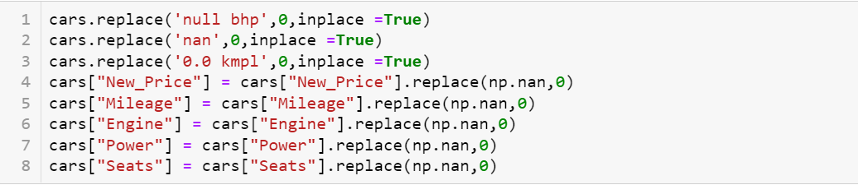
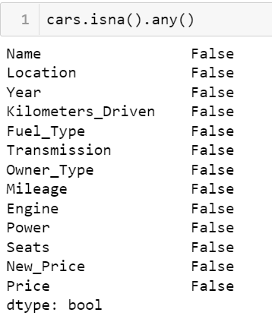

Slide 13
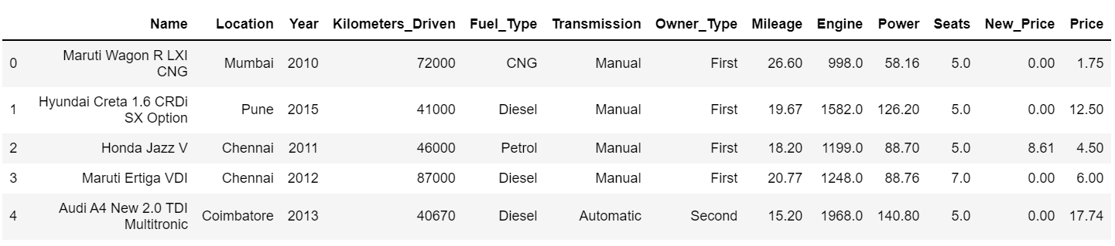

Slide 14
DECRIPTION OF THE DATA
The data is now cleaned and we have replaced all the null values with 0. Also in the data cleaning process the substring were also removed so as to help in further statistical analysis. The number of observations still remains the same (ie) 6019, it is not reduced.
The data is copied to the variable name ‘cleaned_data’.

Slide 15
cleaned_ data
Categorical Data
Numerical Data

Slide 16
NUMERICAL DATA
The data that has numerical values is called numerical data or quantitative data.
In the dataset we have Kilometers_Driven, Mileage, Engine, Power, Price as numerical data.
CATEGORICAL DATA
The data that has no numerical values(ie) has attributes is called categorical data or qualitative data.
In the dataset we have Seats, Locations, Year, Fuel_Type, Transmission, Owner_Type as categorical data.

Slide 17
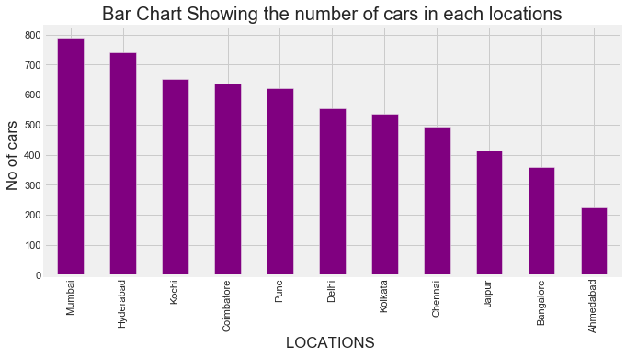
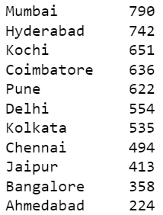
DATA VISUALIZATION
1. Bar Plot showing the sales of cars in each location
The bar plot shows the number of cars in different location, we observe that the sale of cars is more in Mumbai followed by Hyderabad and Kochi. The lowest sales of car is Ahmedabad which is 224 units only.

Slide 18
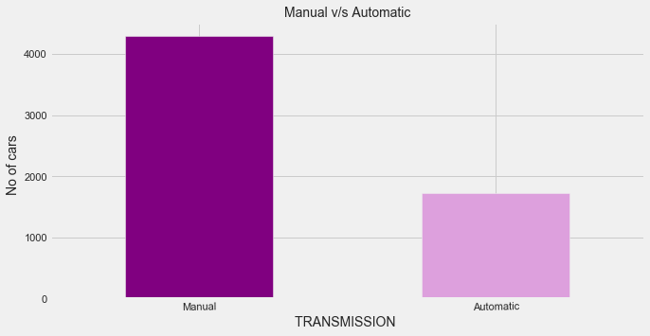

2. Bar plot to show the number of cars in different transmission
As we know that there are two transmissions (ie) automatic and manual. Clearly from the bar plot we see that the manual transmission is more than automatic transmission.
The reason is that automatic cars though it came to India but it wasn't that famous. The automatic cars gained popularity from last 3 years.

Slide 19
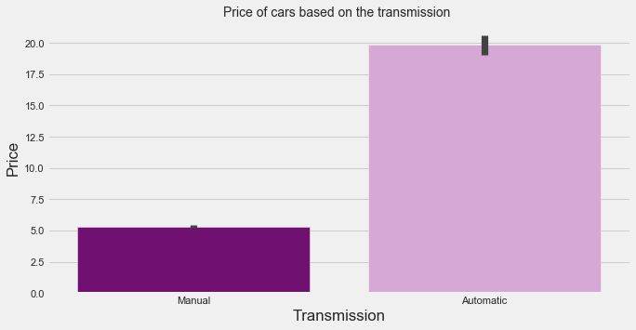
3. Bar Plot of Price vs Transmission
The below bar plot is shows the price of the cars based on the transmission. Clearly manual cars price less compared to automatic cars. So this could be one reason why the manual users were more than automatic users. The automatic cars are more expensive as the AT gearboxes cost carmakers more money as most of them are not made in India unlike the manual versions.

Slide 20
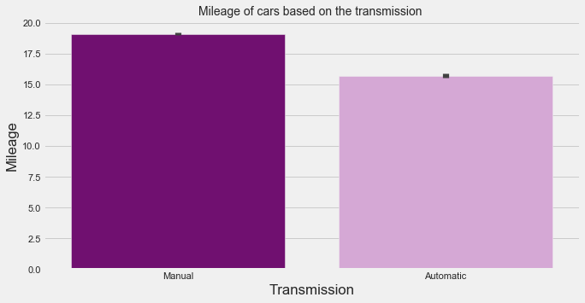
4. Bar Plot of Mileage vs Transmission
The mileage offered by manual cars are more compared to automatic. But now the automatic cars have gained popularity.
The buyers don’t really bother about fuel consumption as we would imagine.
We want to enjoy driving in our congested cities, comfort while driving and no headache of shifting gears. Just keep the gear lever on D (drive) mode and relax, accelerate and brake when needed by using only the right foot, while the left foot rests and you can drive with both hands on the steering wheel, eyes focused on the road.

Slide 21
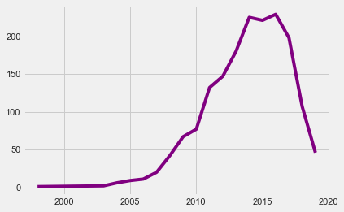
5. Demand Surge for Automatic Cars in India
From the adjacent graph, we see that the automatic cars gained in the year 2015. However we see that there is a decline in the demand. The reasons could be that mileage offered by the automatic cars is very low and also the price of the automatic cars are more than that of manual cars.

Slide 22
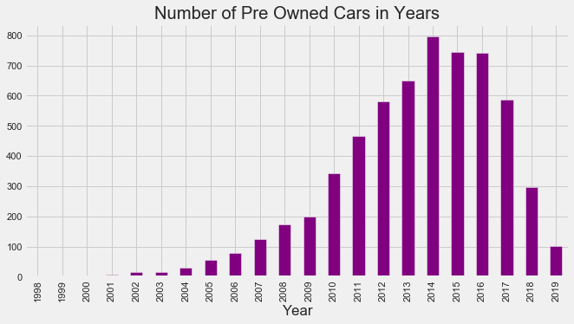
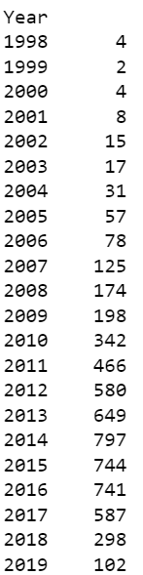
6. Number of Pre Owned Cars in Years
From the above graph we see that most of the cars are in the year 2014 (ie) 797 units. The least is in the year 1999 (ie) 2 units

Slide 23
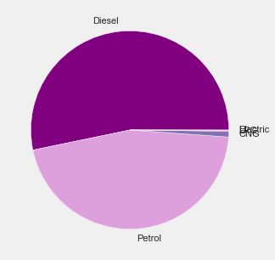
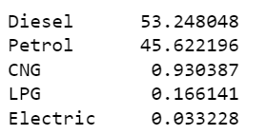
6. Fuel Type pie chart
It is seen that the consumer preference is for diesel driven fuel cars which is a bit surprising in the current context ; the price difference between petrol and diesel is marginal.
EV cars are slowly picking up, however availability of charging points is a challenge across cities.

Slide 24
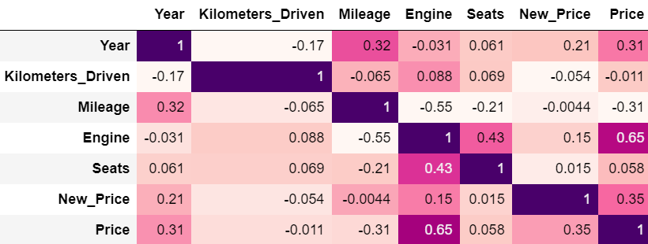
CORRELATION
From the above corrplot we see that there is strong positive correlation between Engine and Price.

Slide 25
THANK YOU

