Slide 1
AXIS BASED VIRTUAL COORDINATE ASSIGNMENT TECHNIQUE
Gayatri Pendharkar
ECE 658 Internet Engineering Project Presentation
Spring 2016

Slide 2
Wireless Sensor Networks (WSNs):
WSNs are spatially distributed autonomous devices using sensors to monitor the physical or environmental conditions.
Routing is an important issue affecting the wireless sensor networks performances.
Routing in WSNs is a challenging task due to:
Variable network topology.
Limited number of available resources
Main types of address based routing protocols:
Geographic Routing Protocol : Relying on exact position information using GPS.
Virtual Coordinate System (VCS) : Relying on use of Virtual Coordinates and VCR routing techniques.
Axis Based Virtual Co-ordinate Assignment Technique for Delivery Guaranteed Routing in Wireless Sensor Networks (type of VCS technique independent of GPS assistance)
Assigns a 5 tuple Virtual Coordinate to all the nodes VCs = (node.lo, node.la, node.ripple, node.up, node.down)

Slide 3
ABVCAP IMPLEMENTATION ->
Assumed that all the nodes in WSN have a same transmission range of R=1.5
The ABVCAP follows a 4 phase algorithm for assignment of virtual coordinates:
PHASE 1: ANCHOR ELECTION W = sink node X = max hop distance from W Y = max hop distance from X Z = max hop distance from W from the set of nodes following the condition X=Y+1 or X=Y-1 Z’ is chosen as node with max hop distance from Z and with same condition as above.
(In case of parity node, higher node ID is considered)

Slide 4
ABVCAP IMPLEMENTATION ->
PHASE 2: ESTABLISHMENT OF AXES Parallel of latitude - -Anchor Y generates Parallel SET message and is forwarded node to node whose x coordinate is smaller by 1 until anchor X is reached. -Each node that receives the Parallel SET message is located in the parallel of latitude Meridians- Each node in the parallel of latitude generates Meridian i+ SET message containing its z coordinate, and a Meridian i- SET message containing its z’ coordinate. The Meridian i+ SET (or Meridian i- SET) message is forwarded by a node to another node whose z (or z’ ) coordinate is smaller by 1 until anchor Z (or Z’) is reached. When more than one node is eligible to be forwarded, node having the minimum distance to the node that generates the message is selected.

Slide 5
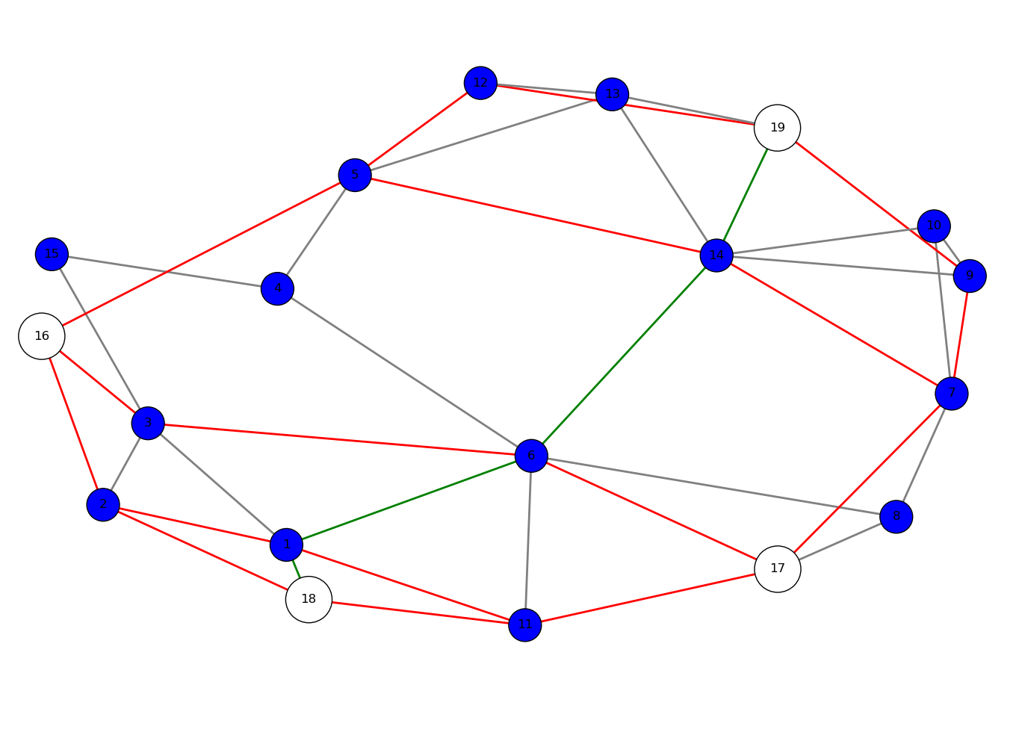
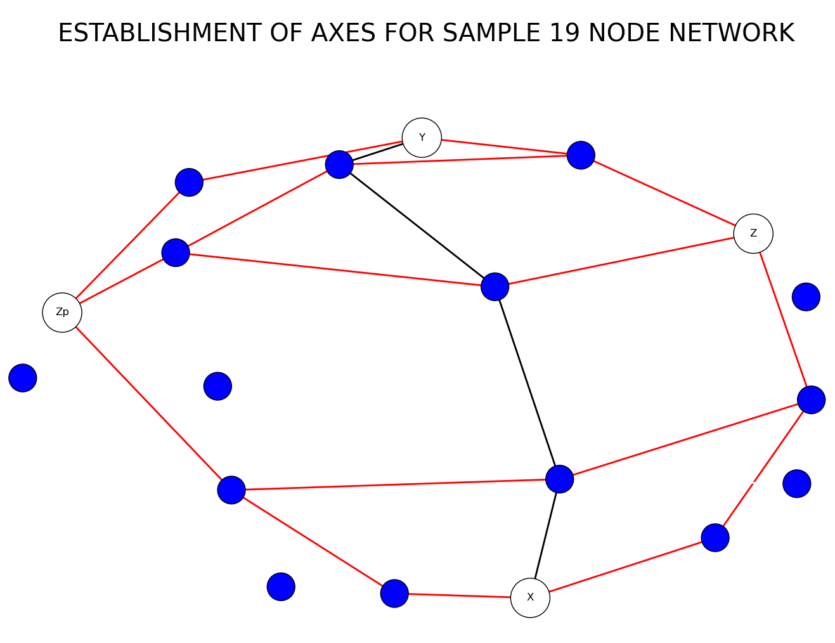
ABVCAP IMPLEMENTATION ->
The following figure shows the anchor election, where nodes 16, 17, 18, 19 are anchors and second figure shows establishment of axes for the same network

Slide 6
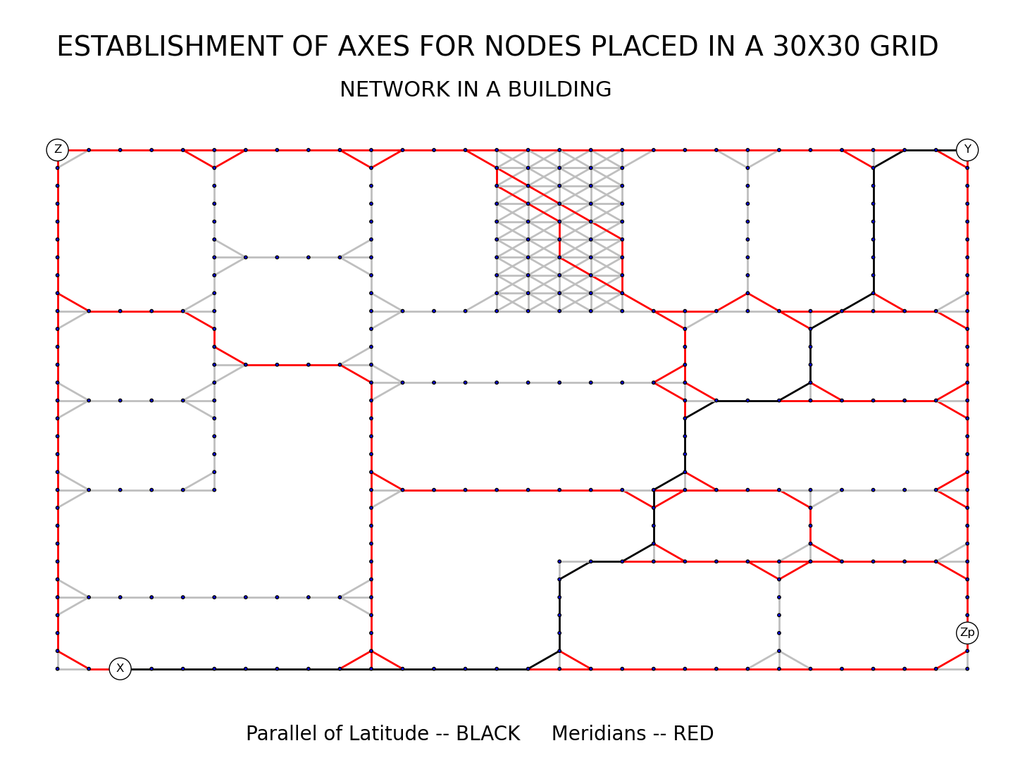
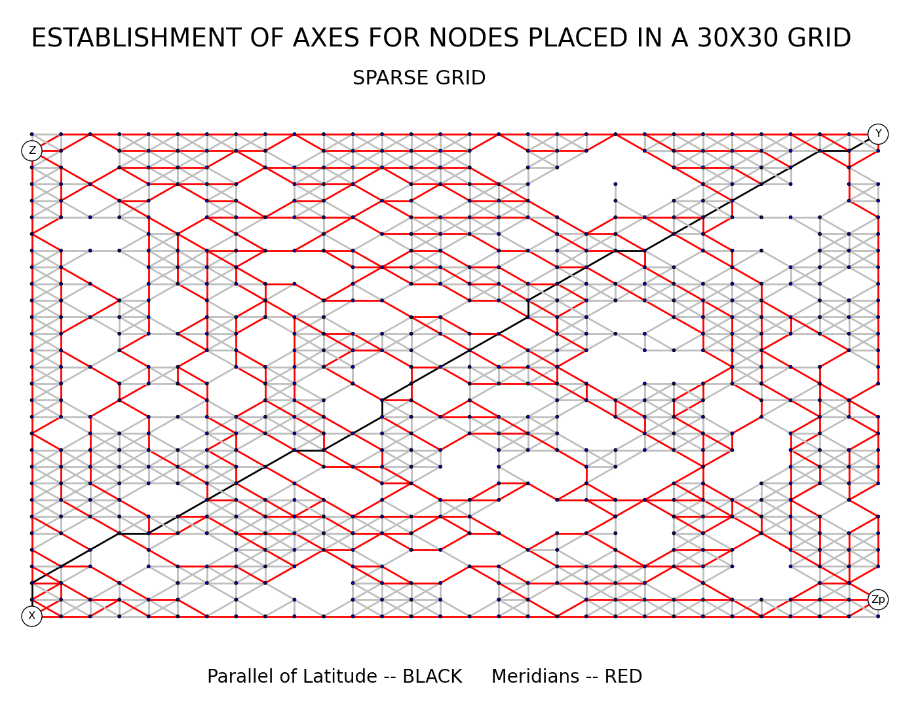
ABVCAP IMPLEMENTATION ->

Slide 7
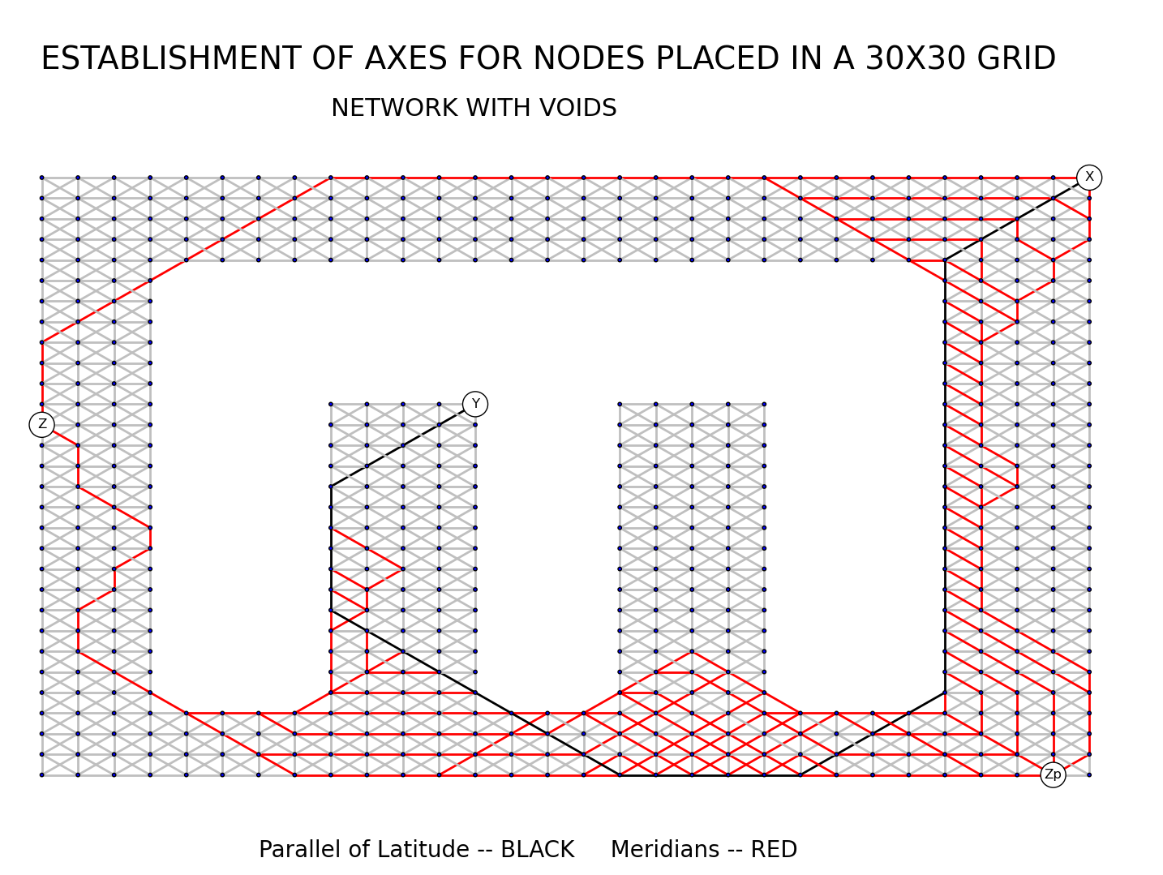
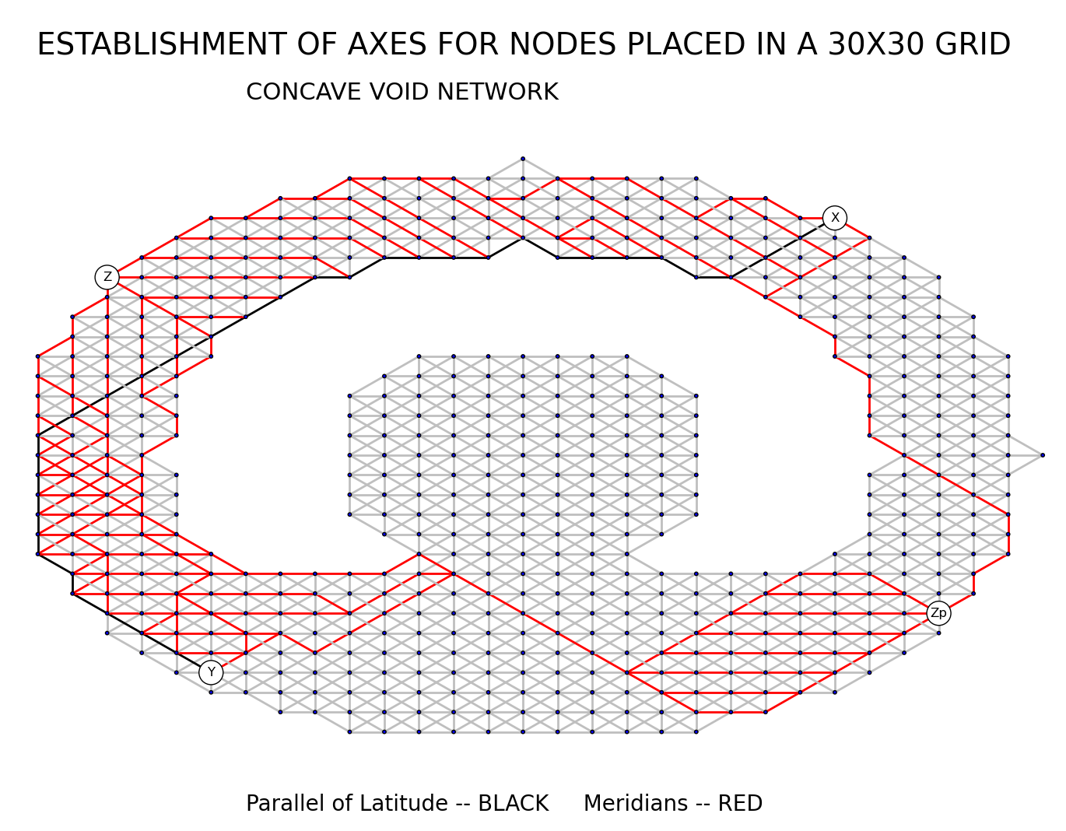
ABVCAP IMPLEMENTATION ->

Slide 8
ABVCAP IMPLEMENTATION ->
PHASE 3: Assignment of Longitude, Latitude and Ripple Coordinates: The nodes lying on the parallel of latitude are assigned virtual coordinates first, followed by the meridian nodes after which coordinates are assigned to the non-axial nodes. PARALLEL OF LATITUDE NODES: Lo, La, ripple = (x,0,0) x- x coordinate of the node MERIDIAN NODES: If Meridian i+ SET message received - (i, Zs - Zn, 0) i = meridian number, Zs-Zn = z coordinate of the node that generates the Meridian i+ SET message minus its own z coordinate, ripple coordinate = 0 If Meridian i- SET message received - (i, Zs’ – Zn’, 0) i = meridian number, Zs’-Zn’ = z’ coordinate of the node that generates the Meridian i- SET message minus its own z’ coordinate, ripple coordinate = 0 NONAXIAL NODES: Each axis node generates 3COOR_SET message - longitude and latitude coordinates plus a hop counter initially set to 1. non-axial node locally broadcasts the message, whilst assigning the longitude and latitude coordinates to the longitude and latitude coordinates of the node that generates the message and the ripple coordinate to the hop counter. If more than one message is received from different nodes, the non-axis node broadcasts the message with the lowest hop count and assigns its lo, la and ripple virtual coordinates accordingly.

Slide 9
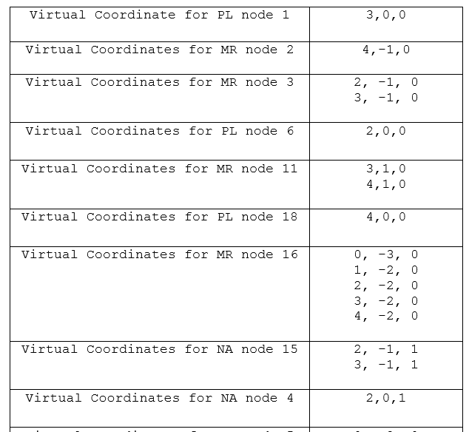
ABVCAP IMPLEMENTATION (la, lo, ripple)->

Slide 10
FUTURE WORK & CONCLUSION ->
Find the UP/DOWN coordinates of the 5-tuple virtual coordinates based on the longitude, latitude and ripple coordinates.
Once all the coordinates are acquired, each node will have at least one 5 tuple coordinate (u.lo, u.la, u.rp, u.up, u.dn).
If a node consists of more than one 5 tuple virtual coordinate, it is perceived as multiple virtual nodes located in the same location with each virtual node having exactly one 5- tuple virtual coordinate.
Based on this coordinates, routing will be performed to test the efficiency of this virtual coordinate placement technique and compare it with existing directional VCs techniques like DVCS for performance evaluation.
One of the most efficient Virtual Coordinate Assignment technique.
Assignment of a unique 5 coordinate tuple to each of the sensor node in the Wireless Sensor Network. No issue of clashing.
Location free coordinate assignment hence reducing cost per node required to install GPS systems.

Slide 11
REFERENCES ->
[1] M. J. Tsai, H. Y. Yang, and W. Q. Huang, “Axis based virtual coordinate assignment protocol and delivery guaranteed routing protocol in wireless sensor networks,” in Proc. IEEE Int. Conf. Comput. Commun. (INFOCOM), 2007, pp. 2234–2242.
[2] Qing Cao, Tarek Abdelzaher, “Scalable logical coordinates framework for routing in wireless sensor networks, ACM Transactions on Sensor Networks” (TOSN), v.2 n.4, p.557-593, November 2006 [doi>10.1145/1218556.1218561]
[3] [4] A. Caruso, S. Chessa, S. De, and A. Urpi, "GPS free coordinate assignment and routing in wireless sensor networks," in IEEE INFOCOM, 2005, pp. 150-160
[4] AKSA Karima , Benmohammed Mohammed, BILAMI Azeddine, “New Virtual Coordinate System for Improved Routing Efficiency in Sensor Network”, IJCSI International Journal of Computer Science Issues, Vol. 9, Issue 3, No 3, May 2012

Slide 12
Questions?

