Slide 1
Hiding a Text Inside an Image Using Steganography - LSB Algorithm
CAPSTONE PROJECT
Presented By:
BADANA GAYATRI PRIYA
Gayatri Vidya Parishad College of Engineering for Women
CSE (AI & ML)

Slide 2
OUTLINE
Problem Statement (Should not include solution)
System Development Approach (Technology Used)
Algorithm & Deployment (Step by Step Procedure)
Result
Conclusion
Future Scope(Optional)
References

Slide 3
Problem Statement
This project enables secure data hiding using steganography, allowing users to embed either encrypted text or a secret image inside a cover image. With growing concerns around data security and privacy, this dual-mode approach increases flexibility and protection during communication. Users interact via a Streamlit-based interface to select the mode, upload media, and retrieve results with simplicity and security. The system applies Least Significant Bit (LSB) and bit-level masking techniques. This creates a balance between usability and data secrecy for secure media exchange.

Slide 4
System Approach
Python 3.8+
Streamlit – for building the interactive web app interface
OpenCV (cv2)– for reading and processing images
NumPy – for pixel-level operations and array handling
Pillow (PIL) – for image loading and saving in image-in-image mode
Cryptography(FERNET) – to securely encrypt and decrypt text messages

Slide 5
Algorithm & Deployment
1. User uploads a cover image and enters the secret text. 2. Text is encrypted using Fernet encryption. 3. Encrypted text is converted to binary. 4. Each bit is embedded into the Least Significant Bit (LSB) of the image’s RGB pixels. 5. Resulting image is saved and downloaded as the stego image.

Slide 6
Algorithm & Deployment (Contd.)
6. For extraction, the stego image is uploaded.
7. LSBs from RGB channels are read and combined into a binary string.
8. Binary is grouped into bytes and decrypted using the Fernet key.
9. The original message is displayed if key and size are correct.
10. Error handling is included to show if the decryption fails.

Slide 7
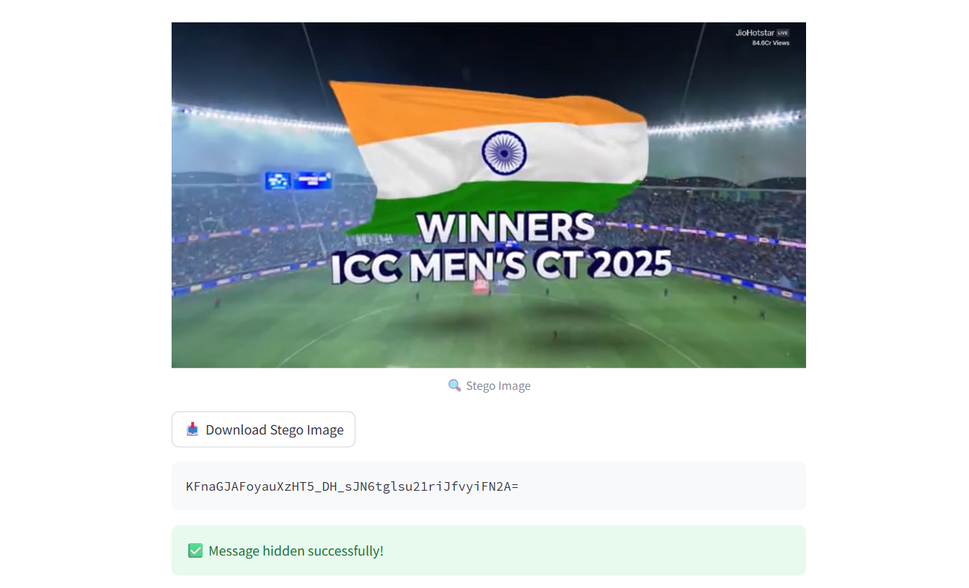
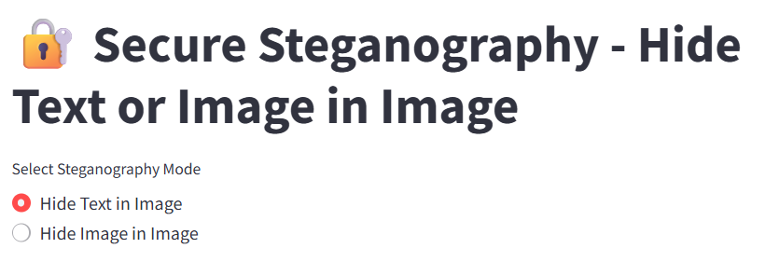
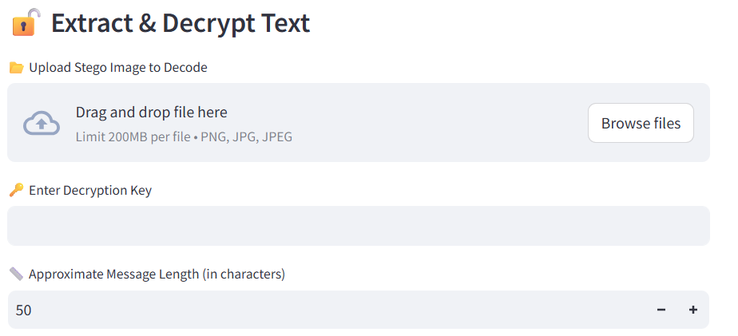
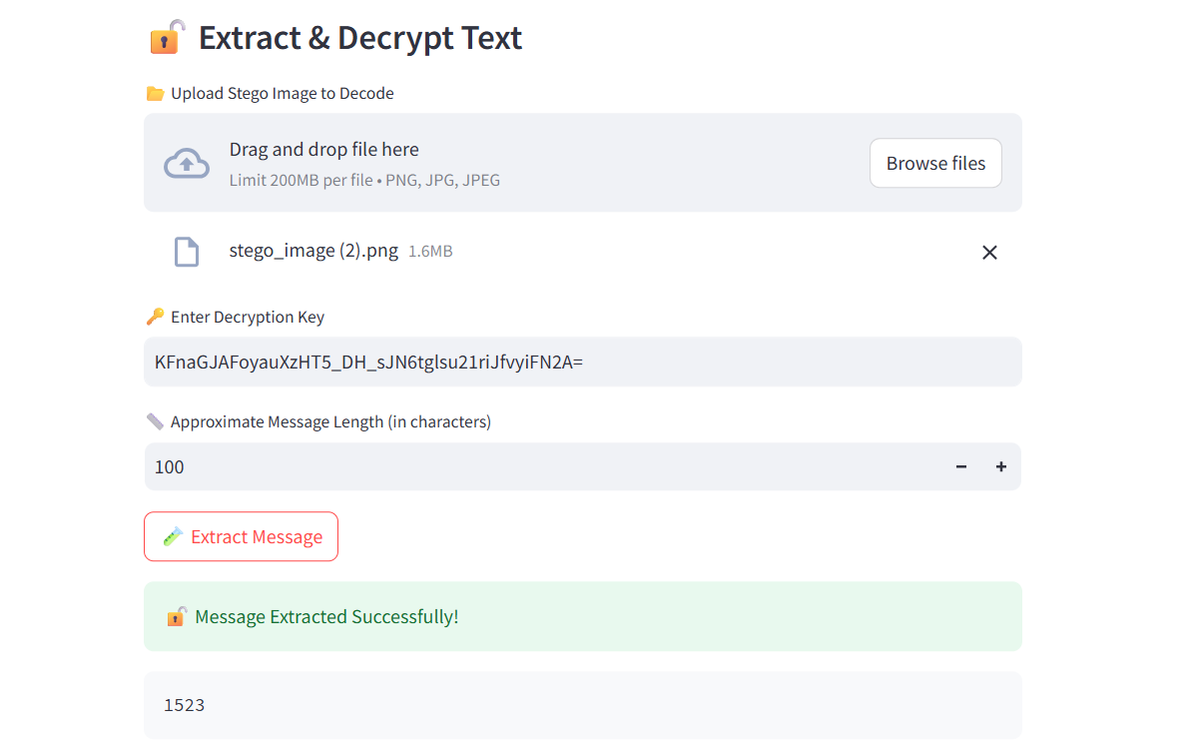
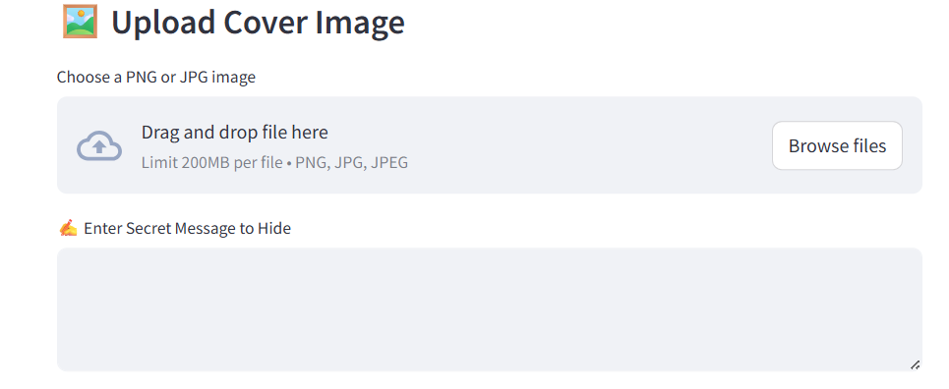
Result

Slide 8
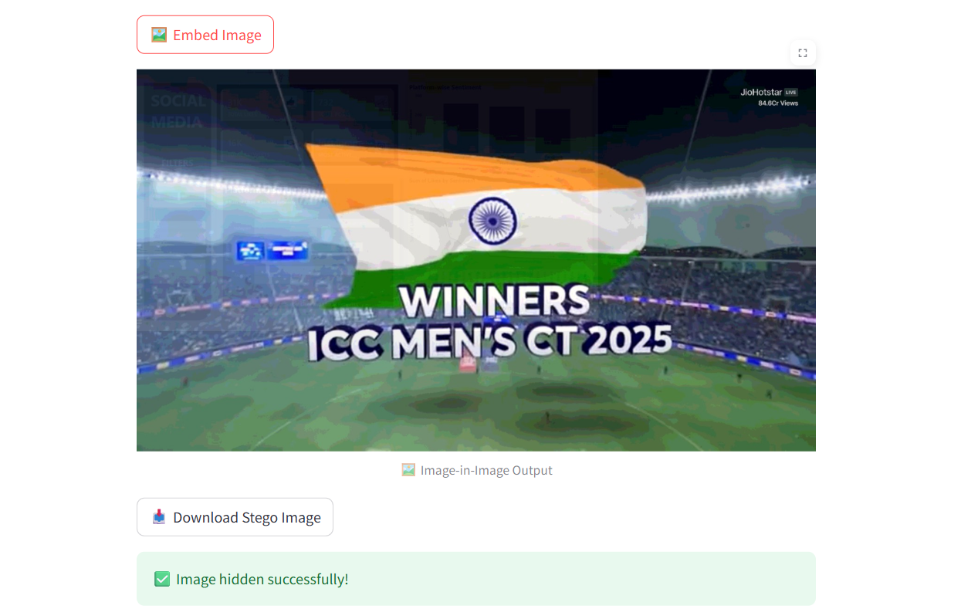
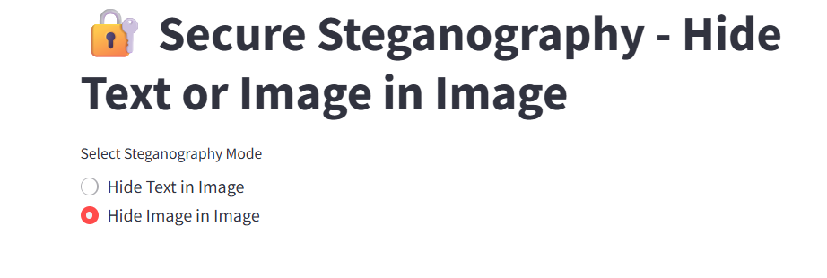
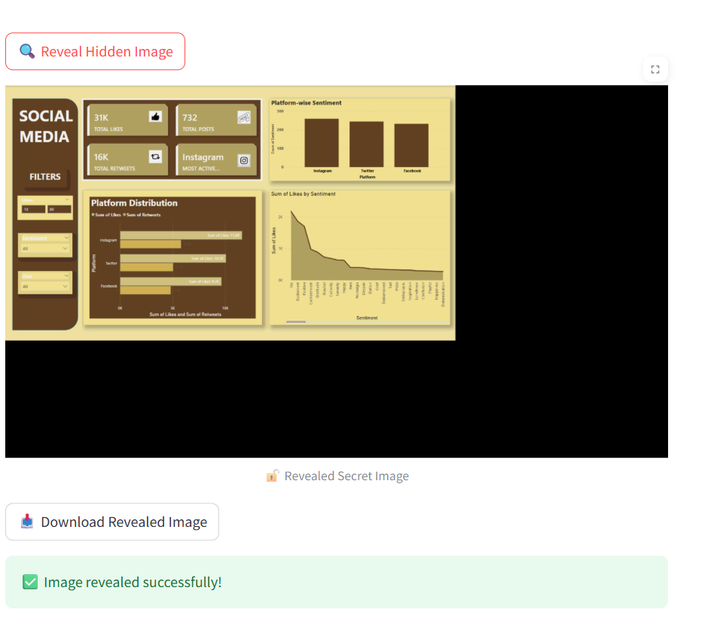
GITHUB LINK:
https://github.com/Gayatripriya369/Steganography.git

Slide 9
Conclusion
This project successfully demonstrates a dual-mode steganography system with encryption and image concealment features. It is implemented with an intuitive user interface using Streamlit, offering a real-world friendly experience. Challenges included handling bit overflow, image resizing, and ensuring proper extraction logic.
We used LSB because our goal was steganography, not just encryption. ASCII XOR is useful but doesn’t help with hiding — it just disguises. That’s why we chose LSB + strong encryption (Fernet) to give both invisibility + protection.

Slide 10
Future scope(Optional)
- Support for audio or video steganography - Password-based decryption for added security

Slide 11
References
1. OpenCV Documentation – https://docs.opencv.org/
2. Streamlit Official Documentation – https://docs.streamlit.io/
3. Python Cryptography Library (Fernet) – https://cryptography.io/en/latest/
4. GitHub Repo – https://github.com/Gayatripriya369/Steganography.git

Slide 12
THANK YOU

