Slide 1
Environmental management system
Presenting by
1)Surisetty gayathri
2)varshitha

Slide 2

An Environmental Management System (EMS) is a set of processes and practices that enable an organization to reduce its environmental impacts and increase its operating efficiency. This site provides information and resources related to establishing an EMS for small businesses and private industry, as well as local, state and federal agencies. The EPA continues with its progress in developing and maintaining an environmental management system at each of its offices, laboratories, and other facility operations, focusing on the reduction of the agency's environmental footprint.

Slide 3
ABSTRACT:-
on a survey to analyze the current Environmental Management System (EMS), or Green Manufacturing (GM), praThis paper is based ctices in Hong Kong. The survey focuses, in particular, on the investigation of:
the critical factors that most companies have considered in implementing the GM or EMS;
the benefits that the companies have targeted in implementing the GM/EMS;
the business activities that the companies have carried out in striving for the targeted benefits;
the business benefits attainable in the implementation of the GM/EMS.
The study results show that most of the companies used in the survey have a positive attitude towards the implementation of the GM/EMS.
The majority of them also consider that GM/EMS can effectively strengthen their competitiveness in business.

Slide 4
An environmental management system (EMS) is "a system and database which integrates procedures and processes for training of personnel, monitoring, summarizing, and reporting of specialized environmental performance information to internal and external stakeholders of a firm".
The most widely used standard on which an EMS is based is International Organization for Standardization (ISO) 14001.[2] Alternatives include the EMAS.
An environmental management information system (EMIS) or Environmental Data Management System (EDMS) is an information technology solution for tracking environmental data for a company as part of their overall environmental management system.

Slide 5
INTRODUCTION
The increasing environmental consciousness of the public, the statutory requirements due to government policies and regulations, and pressures from organized groups are traditionally considered to be the factors that sway companies to adopt a Green Manufacturing (GM) or an Environmental Management System (EMS) policy
[1]. The needs for environmental protection (such as waste minimization, pollution prevention, energy conservation and otheINTRODUTION:-
r health and safety issues) have been widely publicized. An increasing number of firms recognize that adopting a GM/EMS is an integral part of the business strategy. Adoption of a GM helped to decrease waste and pollution generation
[2], whereas implementing the EMS provided an effective guidance for companies to simultaneously establish, develop and review their business practices towards both corporate and environmental goals
[3].There are several GM practices and EMS standards currently adopted by different regions and countries throughout the world
[4]. The Eco-Management and Audit Systems, CSA-Z750-94, BS 7750 and ISO 14000 series are typical examples .

Slide 6
5] These standards are designed to help organizations, regardless of their size and business type, to develop a formalized management process with the objective of evaluating and improving their environmental and safety performance
[6].The GM/EMS program in Hong Kong is relatively new; not much information about its implementation results is available.
[7] The investigation reported in this paper was based on the eleven companies that had participated in the ISO 14000 EMS Pilot Program organized by the Hong Kong Productivity Council in 1995.
[8] One of the objectives of this investigation is to identify the critical factors/sub-factors, benefits and business activities that a company may have considered or targeted in the implementation of the GM/EMS program.
Another objective is to discover what activities contributed to a successful GM/EMS program.
The benefits that are recognized by these companies for the implementation of the program are also to be determined

Slide 7
Objectives:-
The main objectives of the environmental management system are to prevent pollution, meet compliance obligations and enhance conditions of the environment.
A systematic approach to environmental management can provide the organization with information to build success over the long term and create options for contributing to sustainable development by:
protecting the environment by preventing or mitigating adverse environmental impacts;
- mitigating the potential adverse effect of environmental conditions on the organization;
- assisting the organization in the fulfilment of compliance obligations;- enhancing environmental performance;
- controlling or influencing the way the organization’s products and services are designed,manufactured, distributed, consumed and disposed by using a life cycle perspective that canprevent environmental impacts from being unintentionally shifted elsewhere within the life cycle;

Slide 8
LITERATURE SURVEY
Name:-mohammad B.Memon
Published: September 25, 2022 (see history)DOI: 10.7759/cureus.29558Cite this article as: Memon M B, Chadda N, Dahhan A, et al. (September 25, 2022) Refractory Hypotension: A Detailed Case Discussion and Current Literature Review. Cureus 14(9): e29558. doi:10.7759/cureus.29558
Name:-Naseem S.Miller
On Sept. 28, the White House is hosting a conference on hunger, nutrition and health
the second conference of its kind in five decades.
introducing a 40-page national strategy as a roadmap toward the goal of ending hunger and increasing healthy eating by 2030.
Name:-Dr.nagham Mahmood aljamali
Dr. Aseel Mahmood Jawad2 , Anaam Jawad Alabbasy3, Dr. Layla Ali Mohammed Salih4 1,4Department of Chemistry, College of Education for girls, kufa university, Iraq. 2College of Medicine, General Surgery Department, Iraq. 3Department of Biology, College of Education for girls, kufa university, Iraq.

Slide 9
Bardwell, Lisa V.
1991-09-01
The specter of environmental calamity calls for the best efforts of an involved public. Ironically, the way people understand the issues all too often serves to discourage and frustrate rather than motivate them to action. This article draws from problem-solving perspectives offered by cognitive psychology and conflict management to examine a framework for thinking about environmental problems that promises to help rather than hinder efforts to address them. Problem-framing emphasizes focusing on the problem definition. Since how one defines a problem determines one's understanding of and approach to that problem, being able to redefine or reframe a problem and to explore the â€œproblem spaceâ€ can help broaden the range of alternatives and solutions examined. Problem-framing incorporates a cognitive perspective on how people respond to information. It explains why an emphasis on problem definition is not part of people's typical approach to problems. It recognizes the importance of structure and of having ways to organize that information on one's problem-solving effort. Finally, problem-framing draws on both cognitive psychology and conflict management for strategies to manage information and to create a problem-solving environment that not only encourages participation but can yield better approaches to our environmental

Slide 10
Bowonder, B.
1986-09-01
Environmental problems are becoming serious in India because of the interacting effects of increasing population density, industrialization and urbanization, and poor environmental management practices. Unless stringent regulatory measures are taken, environmental systems will be irreversibly degraded. Lack of political commitment, lack of a comprehensive environmental policy, poor environmental awareness, functional fragmentation of the public administration system, poor mass media concern, and prevalence of poverty are some of the major factors responsible for increasing the severity of the problems. Environmental problems in India are highly complex, and management procedures have to be developed to achieve coordination between various functional departments, and for this, political leaders have to be convinced of the need to initiate environmental protection measures.

Slide 11
Miller, A.
19-05-1997
Human influences create both environmental problems and barriers to effective policy aimed at addressing those problems. In effect, environmental managers manage people as much as they manage the environment. Therefore, they must gain an understanding of the psychological and sociopolitical dimensions of environmental problems that they are attempting to resolve. The author reappraises conventional analyses of environmental problems using lessons from the psychosocial disciplines. The author combines the disciplines of ecology, political sociology and psychology to produce a more adaptive approach to problem-solving that is specifically geared toward the environmental field. Numerous case studies demonstrate the practical application of theorymoreÂ Â» in a way that is useful to technical and scientific professionals as well as to policymakers and planners.Â«Â less

Slide 12
Conclusion:-
The use of environmental management tools allows institutions to anticipate and to avoid problems in a proactive rather than reactive way. They assist with analysis and reporting of performance and with day-to-day management, which requires timely feedback to make appropriate adjustments.
This free course began by approaching environmental management as a way of thinking about and managing changing human–environment relationships in their many different arenas and contexts, and
drawing on systems ideas to explore how those relationships are understood and managed over time.It firstly challenged the ways that you may think about environment and management and then explored different ways of thinking about organisations including as a system,
why a focus on organisations is key to environmental management and some of the historical aspects of environmental management in relation to organisations.
You have also had an opportunity to think about the links between an organisation and its environment, and some aspects of voluntary and compulsory approaches to environmental management.

Slide 13
identify environmental problems
Environmental management problems are often complex and uncertain. A formal process with proper guidance is needed to understand the issues, identify sources of disagreement, and analyze the major uncertainties in environmental problems. This course will present a process that fo...
Identifies the more representative problem-solving models in environmental education. Suggests the addition of a strategy for defining a problem situation using Soft Systems Methodology to environmental education activities explicitly designed for the development of critical thinking. Contains 45 references. (JRH
Environmental problem is a real problem that occur in studentâ€™s daily life. Junior high school studentsâ€™ perception about environmental problem is interesting to be investigated. The major aim of this study is to explore junior high school studentsâ€™ perception about environmental problems around them and ways to solve the problem.

Slide 14
A literature review Water Pollution :
The following review attempts to understand water pollution from a chronological perspective, representing the shift in sources of pollutants, namely from purely examining sewage to the contemporary issues of microplastics before recognising the research of naturally occurring factors affecting the overall water quality. Lastly, we review the change of focus surrounding the impacts of bad water pollution on health with specific regards to disease transmission.
Pollution Water resources are considered to be polluted when the physical, chemical and or biologicalcharacteristics of water are altered to such an extent that the utility for any reasonable purpose becomes dysfunctional or its environmental value is demonstrably depreciated.

Slide 15
Components of polluted water:
Temperature :
Disturbances of temperature, largely due to the disposal of hot water into adjoining water supplies can disrupt the local aquatic ecosystems. Typically, such action is derived from nuclear power and other power generation processes as they require intensive water coolantsystems. Little is discussed of thermal pollution before the 1900’s, though since world war 2, electric utility requirements have raised considerably in demand and nuclear power stations had started to become viable sources drawing more attention to such issues
PH :
negative log of H+ concentration contained within a sample. It can regulate the effectiveness of enzymatic reactions. A surge of new papers, gravitate around the effects of anthropogenic co2 loading on ocean acidification. (Orr et al., 2005) attempts to identify the changes of aragonite in response to increased carbon dioxide loading and the effects this may have on corals (who maintain external calcium carbonate skeletons)

Slide 16
Soil pollution :-
HEAVY MEATLS :-
The presence of heavy metals in soils can cause it to become highly toxic to human beings. Some metals that can be classified as soil pollutants such as arsenic (As), mercury(Hg), lead(Pb), antimony (Sb), zinc (Zn), nickel (Ni), cadmium (Cd), selenium (Se), beryllium (Be), thallium (Tl), chromium (Cr) and copper (Cu).
ACID RAINS :-
Acid rain has high levels of hydrogen ions, making it acidic. When this rain seeps into the soil, it can adversely change the soil chemistry. This means the acid rain may negatively affect plants and important microbes that live in the soil; thereby affecting the food chain (e.g., Chen et al., 2012).
MINING :-
Mining activities can affect the soil by causing soil erosion, the formation of sinkholes, or leaching chemicals of the mining process into the soil.

Slide 17
Air pollution :-
INDORE AIR QUALITY :-
A lack of ventilation indoors concentrates air pollution where people often spend the majority of their time. Radon gas, a carcinogen, is exuded from the Earth in certain locations and trapped inside houses. Building materials including carpeting and plywood emit formaldehyde (H2CO) gas.
Emission Factors :-
Air pollutant emission factors are reported representative values that attempt to relate the quantity of a pollutant released to the ambient air with an activity associated with the release of that pollutant. These factors are usually expressed as the weight of pollutant divided by a unit weight, volume, distance, or duration of the activity emitting the pollutant (e.g., kilograms of particulate emitted per tonne of coal burned). Such factors facilitate estimation of emissions from various sources of air pollution.

Slide 18
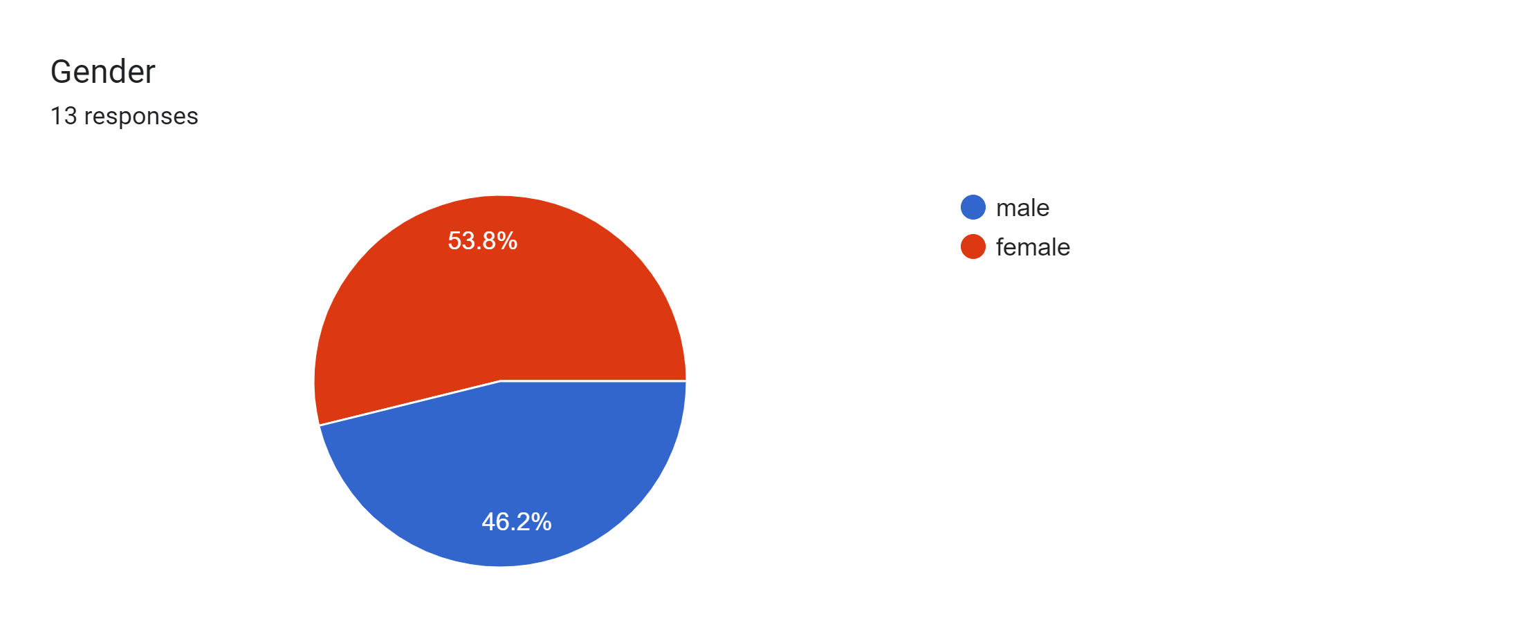
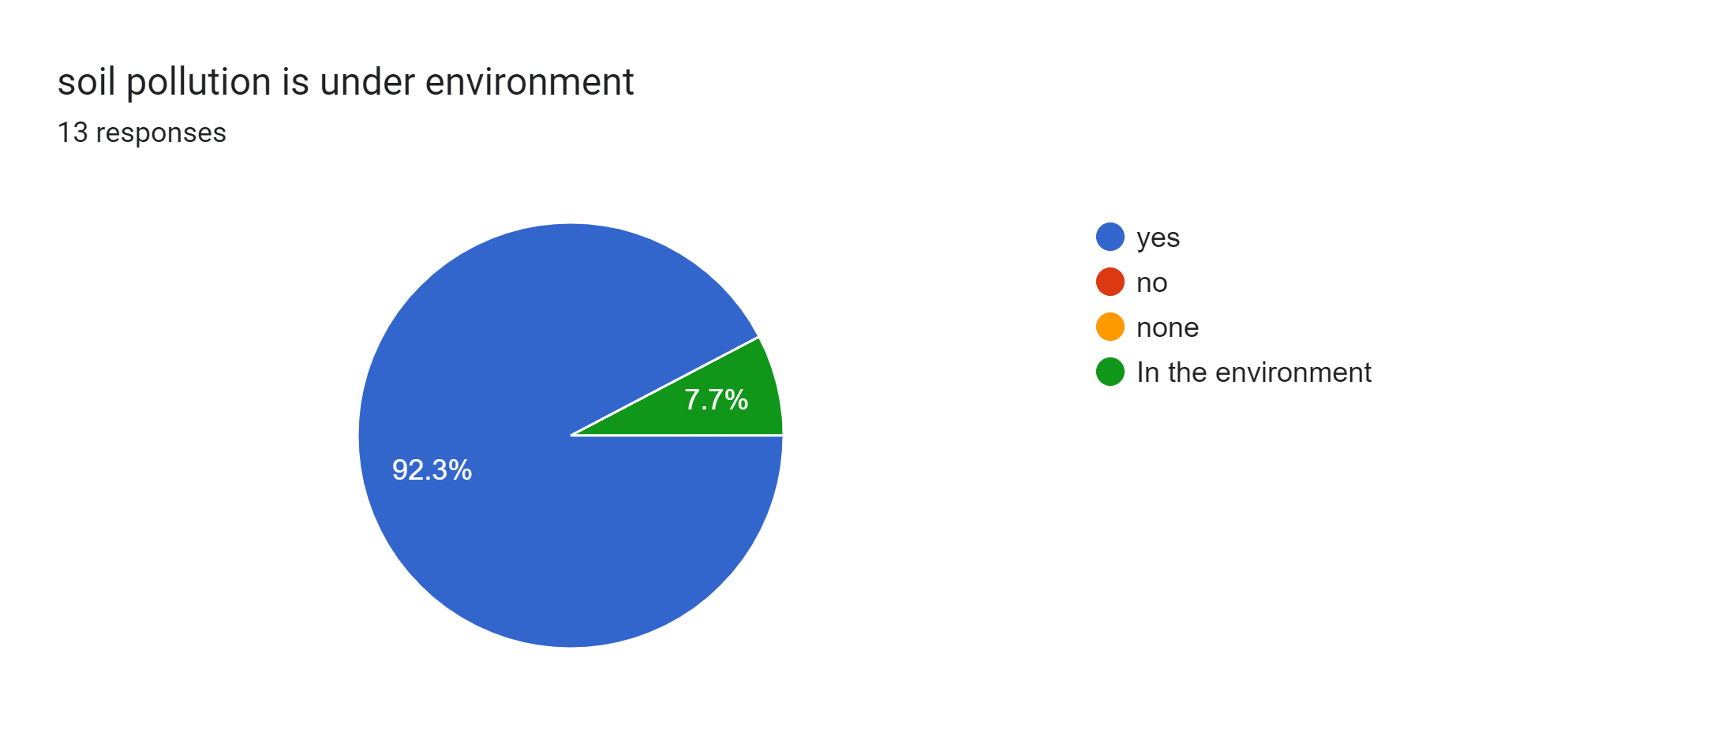
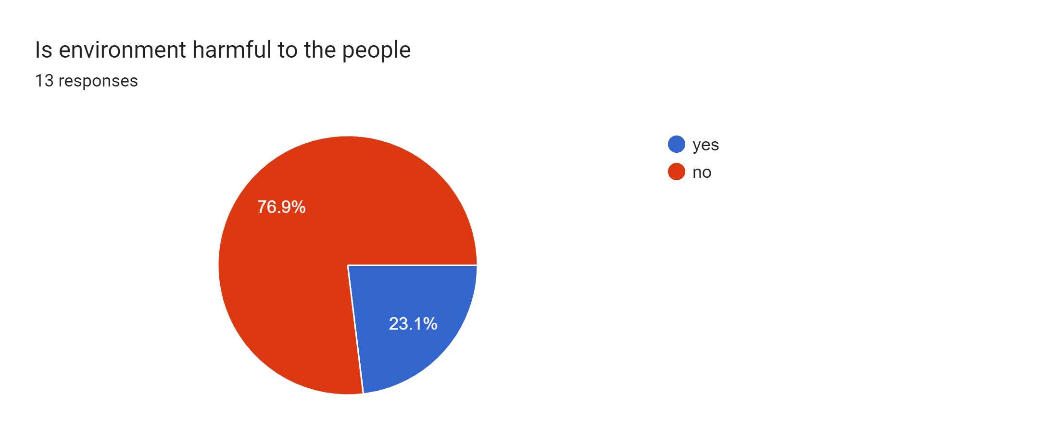
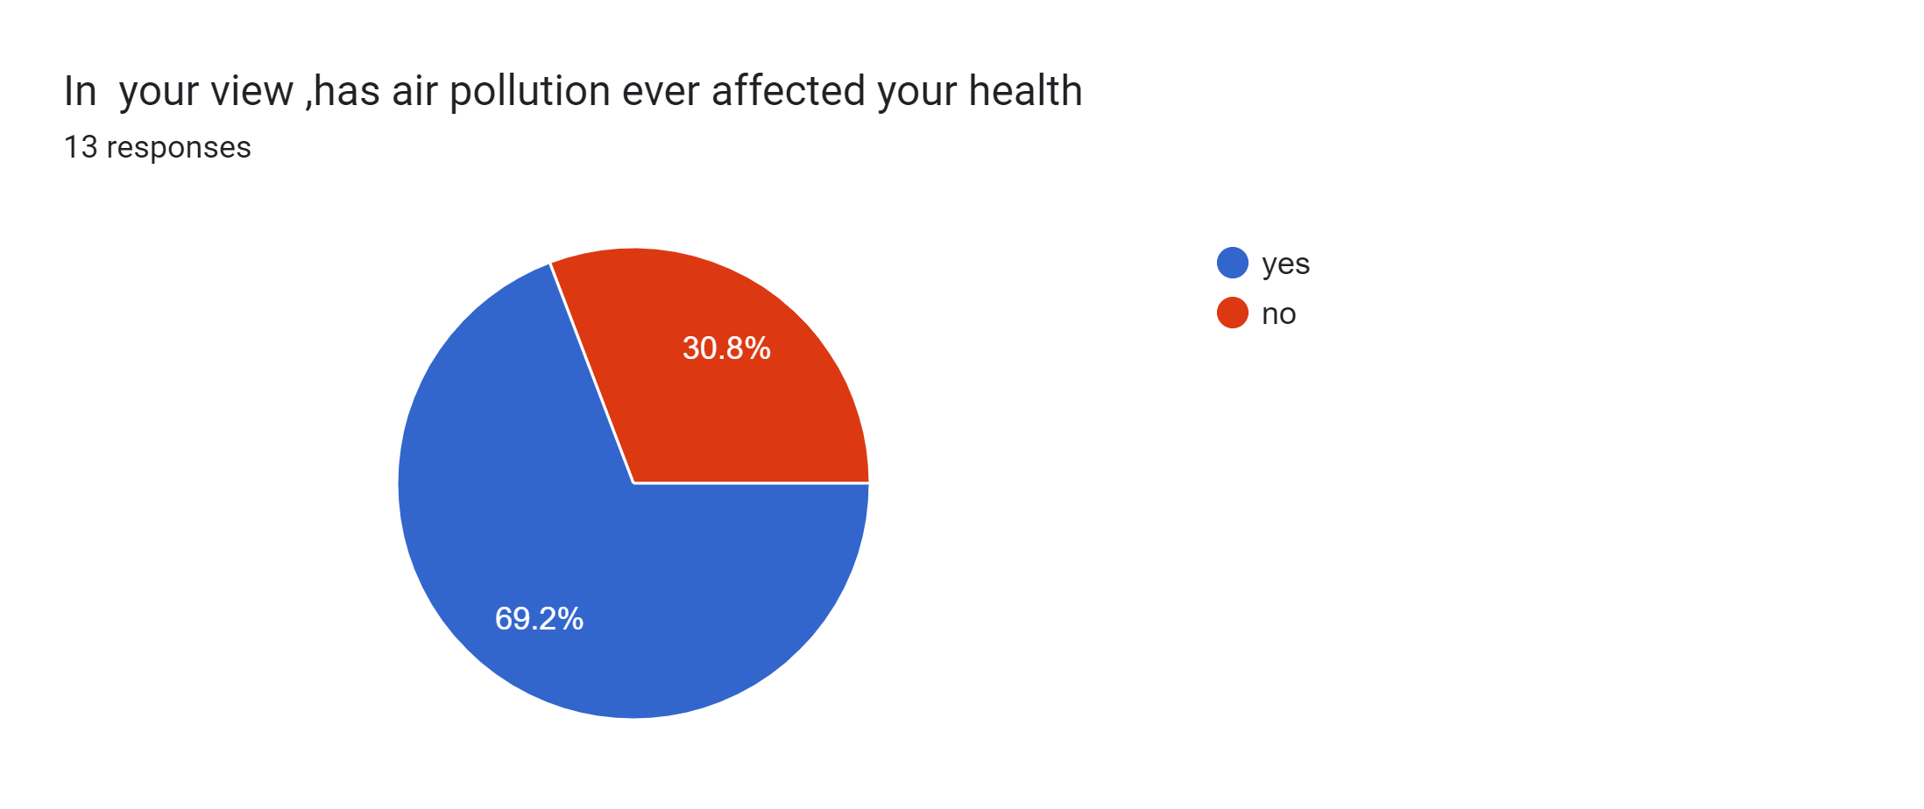

Slide 19
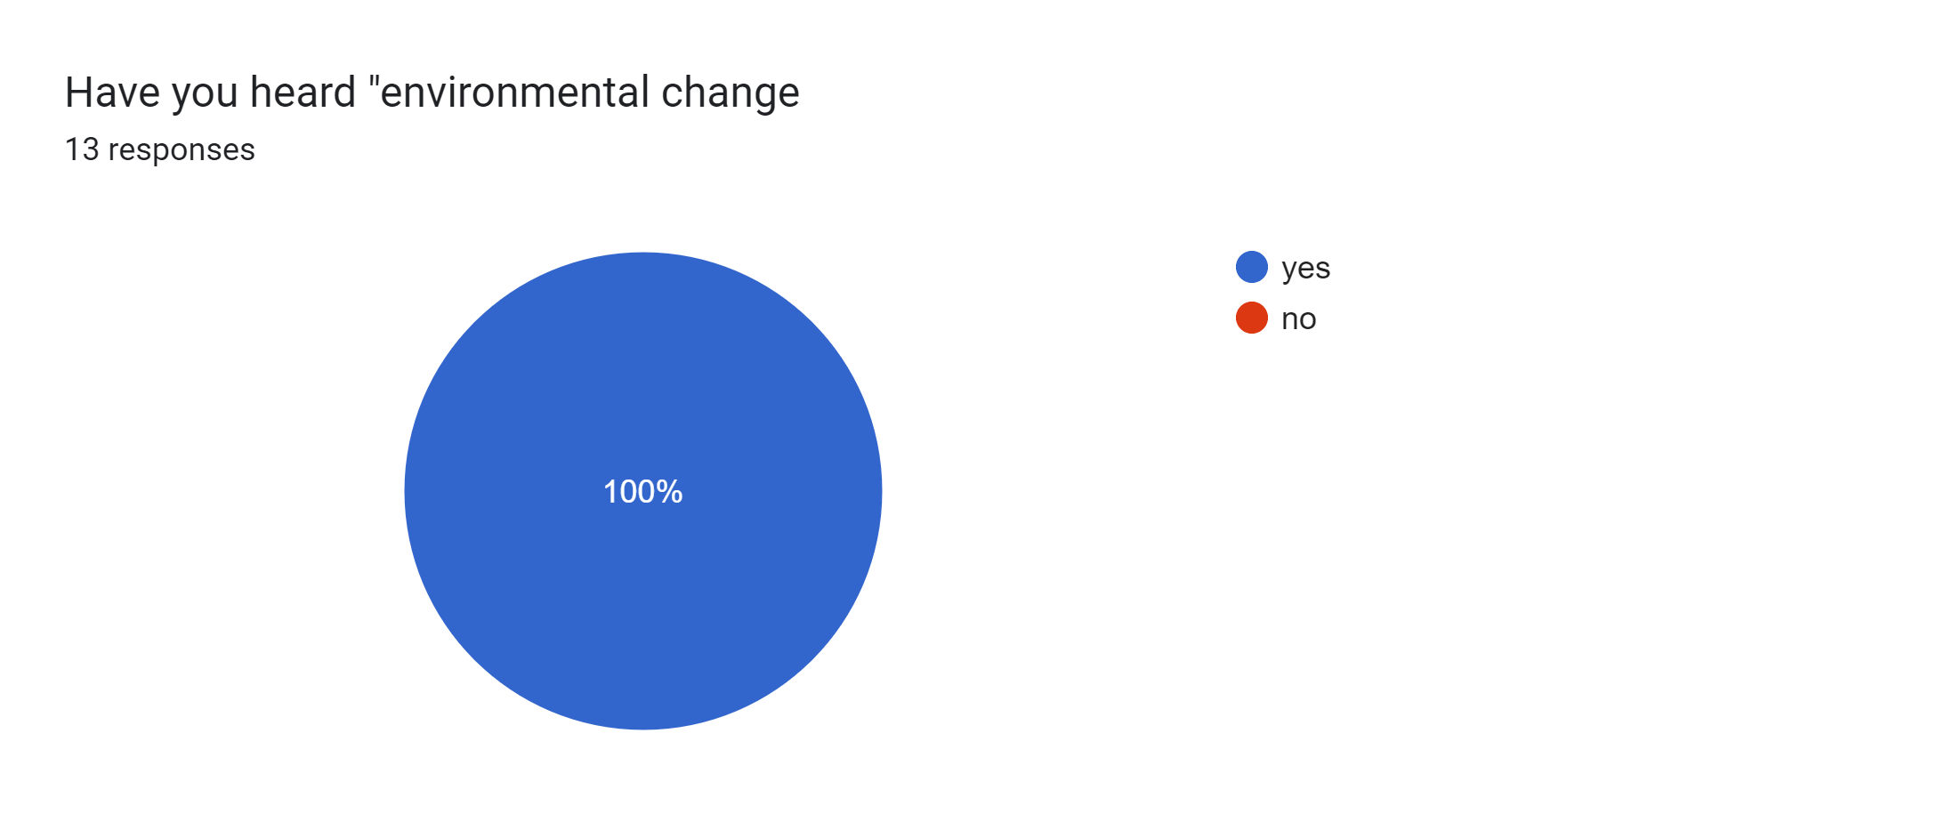
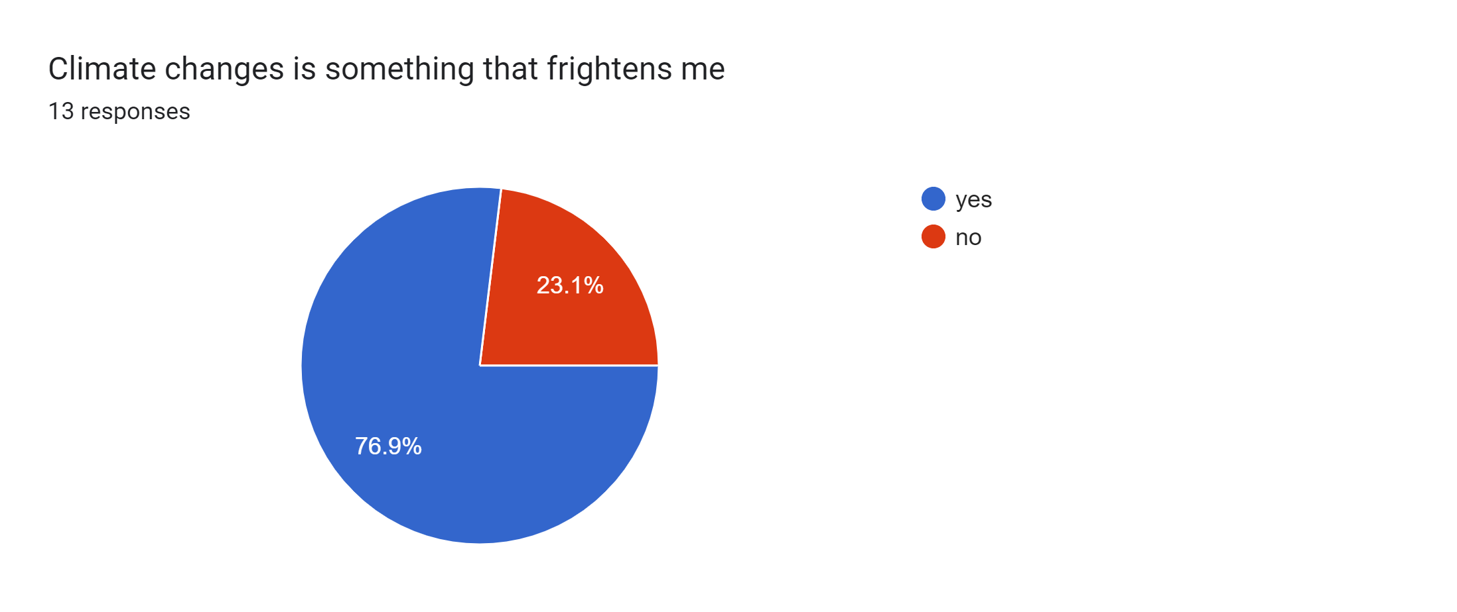



Slide 20
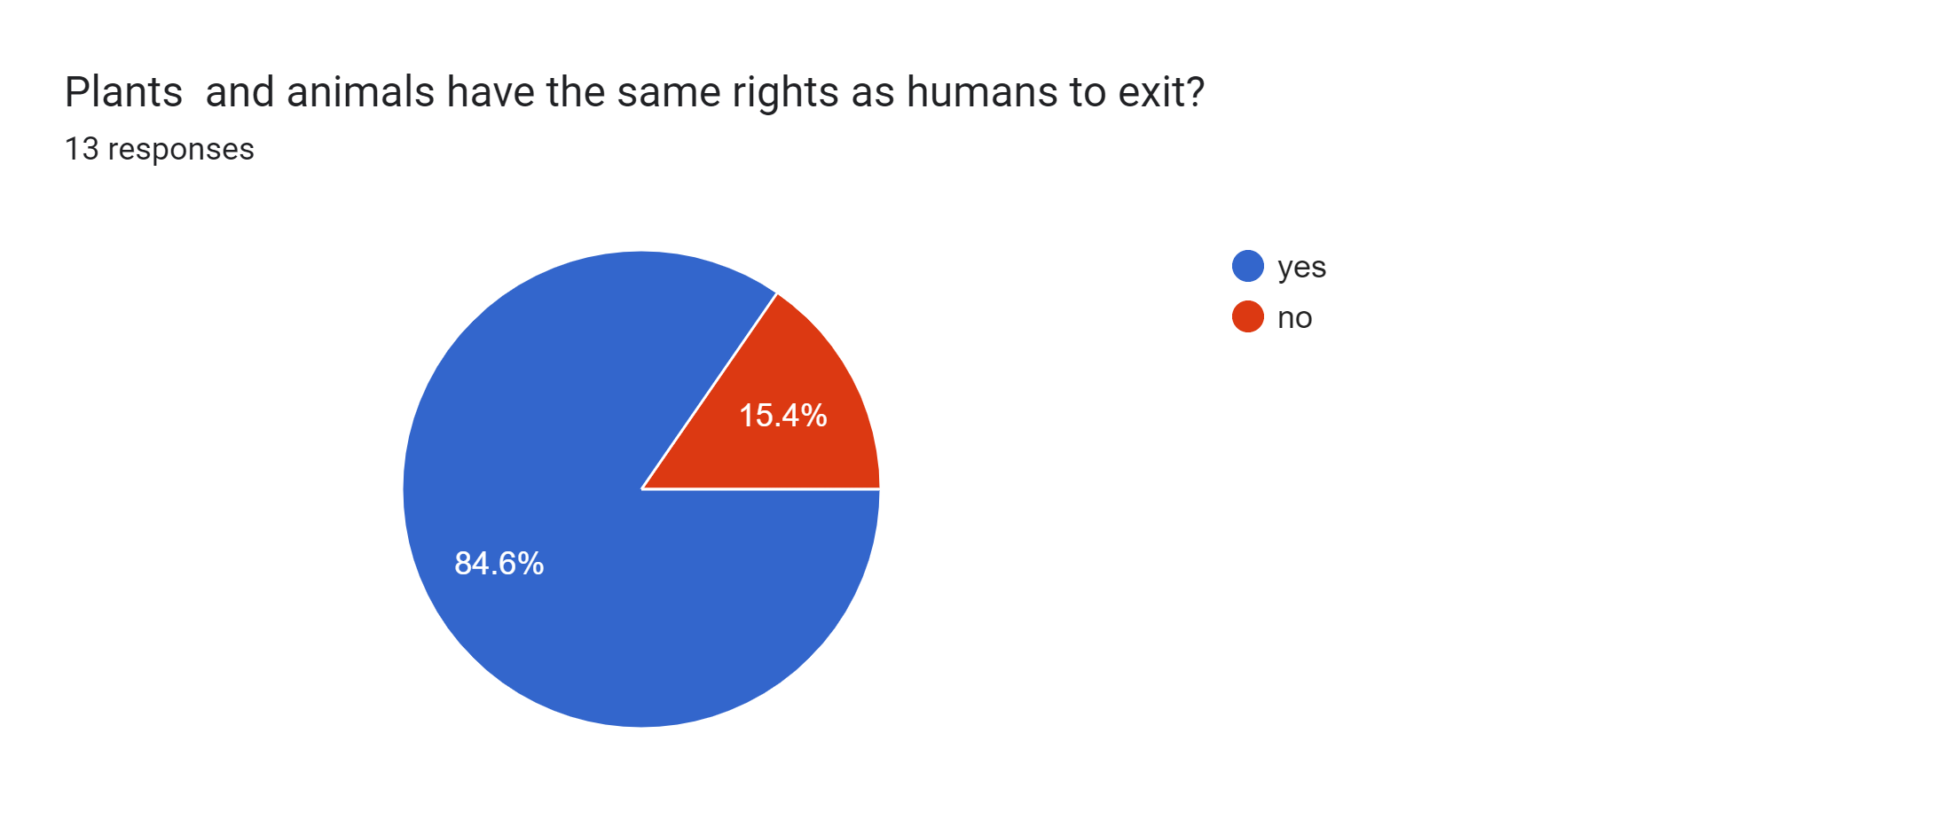

Slide 21
ACKNOWLEDGEMENT :-
Buyer acknowledges that the Properties have been used for exploration, development, production, handling, transporting and/or processing of oil and gas and that there may be petroleum, produced water, drilling fluids and chemicals, or other Hazardous Materials located on or under the Properties or associated with the premises in quantities typical for oilfield or gas operations in the areas in which the Properties are located. Some equipment and sites included in the Properties may contain naturally occurring radioactive material (“NORM”), asbestos, or other Hazardous Materials. NORM may affix or attach itself to the inside of wells, materials, and equipment as scale, or in other forms; the wells, materials, and equipment located on the Properties or included in the Properties may contain NORM, asbestos, or other Hazardous Materials

Slide 22
REFERENCE :-
Berger, M., Warsen, J., Krinke, S., Bach, V. and Finkbeiner, M. (2012) ‘Water footprint of European cars: potential impacts of water consumption along automobile life cycles’, Environmental Science & Technology, vol. 46, no. 7, pp. 4091–99.
Brown, M. (2012) ‘Water stress hurting more than 50% of global companies, CDP says’, Bloomberg, 23 October [Online]. Available at http://www.bloomberg.com/ news/ 2012-10-23/ water-stress-hurting-more-than-50-of-global-companies-cdp-says.html (Accessed 5 June 2013).
Chernobyl Forum (2006) Chernobyl’s legacy: health, environmental and socio-economic impacts [Online], Vienna, Austria, International Atomic Energy Agency. Available at http://www.iaea.org/ Publications/ Booklets/ Chernobyl/ chernobyl.pdf (Accessed 7 June 2013).
https://www.open.edu/openlearn/nature-environment/environmental-management-and-organisations/content-section

