Slide 1
Techniques for migrating monolithic systems to microservices
Shihao Hu
THESIS - CS 4490Z
Department of Computer Science
Western University
Prof. Konstantinos Kontogiannis
Prof. Nazim Madhavji
Notes:
Hello everyone, my name is Shihao. I am a undergraduate student from the computer science department. Today I want to introduce my cs4490 research project and my topic is techniques for migrating monolithic systems to microservices. My supervisor is professor Konstantinos Kontogiannis and my course instructor is professor Nazim Madhavji. 25s

Slide 2
INTRODUCTION
General Context: In the era of digital transformation of enterprises, making
changes without some formal procedures and strategies to a complex monolithic
system is very expensive in terms of time and cost, which is often an obstacle for
small and medium sized enterprises. Hence, this research aims will explore and
provide an effective approach in transforming monolithic systems to microservices.
Current situation and problems: The demand for microservices is growing in
enterprises today, but some SMBs still have difficulties in migrating from
monolithic applications to microservices because they lack a standard foundation
to guide them. We are trying to guide them through· the modern technique and
procedure of migrating monolithic systems to microservices.
Notes:
Now I want to introduce some context for this project.
Making changes to a large monolithic system without some formal procedures and plans is very time consuming and expensive in the era of digital transformation, which is typically an impediment for small and medium-sized businesses. As a result, the goal of this research is to investigate and give an effective method for converting monolithic systems to microservices.
Microservices are becoming more popular in businesses today, but some small businesses are still having trouble moving from monolithic apps to microservices due to a lack of a common foundation to guide them. We're attempting to lead them through the process of transitioning monolithic systems to microservices using modern techniques and procedures.
57s

Slide 3
Research Gap addressed: We found that many research papers only focus on
either the clustering techniques or the use of existing techniques on a
monolithic system, and there is lack of systematic review of whole migration
process from the comparing and analyzing different clustering strategies to
the construction of a microservice system by using modern microservice tech stack.
Results attained: The anticipated outcome of this research would be
successfully obtaining the clustering results with compare and analysis of
different clustering strategies or algorithms and building the microservice
modules based on the clustering results.
Notes:
Many research papers only focus on clustering techniques or the application of existing techniques to a monolithic system, and there is a lack of systematic review of the entire migration process, from comparing and analysing different clustering strategies to building a microservice system using modern microservice tech stack.
The expected aim of this study is the successful acquisition of clustering results through comparison and analysis of various clustering techniques or algorithms, as well as the development of microservice modules based on the clustering results.
38s

Slide 4
Novelty/Progress made: This research work has explored and find a
good migration approach for constructing some highly decoupled and
well-functioned microservices from a monolithic system.
Impact of Results on Theory & Practice: The results from the research work
will not only make some of the theories in academia more reliable, but also
provide some practical strategies for helping the industry enterprises transform
their monolithic systems to microservices.
Notes:
This research study looked into and discovered a solid migration method for creating highly decoupled and well-functioning microservices from a monolithic system.
The research findings will not only strengthen some academic theories, but will also provide some practical solutions for assisting industry companies in converting monolithic systems to microservices.
26s

Slide 5
Table of Contents
Background & Related Work
Research Methodology
Results
Novelty
Critical analysis of the Results
Impact on Theory & Practice
Conclusions
Future Work & Lessons Learnt

Slide 6
BACKGROUND & RELATED WORK
We have selected several papers to build up the theoretical background and enhance our understanding for this research:
Three of these papers, respectively by Kamimura & Yano & Hatano & Matsuo, Mazlami & Cito & Leitner, Ivanov & Tasheva, introduced the technique of identifying and extracting the microservices. The common problem in these efforts is to identify from monolithic systems the candidates of microservices which includes the program files and class files or data (such as database tables, files, and data objects) that can be turned into cohesive, standalone services. [Kamimura & Yano & Hatano & Matsuo, 2018].
Notes:
We've chosen a few papers to help us create a theoretical foundation and improve our comprehension for this study:
The technique of identifying and extracting microservices was introduced in three of these articles, by Kamimura, Mazlami, and Ivanov, respectively.
The fundamental difficulty in these initiatives is identifying candidates for microservices from monolithic systems, which includes programme and class files as well as data (such as database tables, files, and data objects) that can be transformed into cohesive, standalone services.
40s

Slide 7
Other two papers, respectively by Li & Ma & Lu and Yugopuspito & Panduwinata & Sutrisno, implemented the migration process from monolithic systems to microservices on two different systems, which also demonstrating the working POC for our view.
To obtain some industrial background knowledge in the field of microservices migrating, we have reviewed three papers in total:
The first paper presented by Furda & Fidge & Zimmermann & Kelly & Barros elaborates three challenges of microservice migration where focus on multitenancy, statefulness, and data consistency. And it provides a hint of best-practice solution to develop a microservice iteratively, focusing on eliminating statefulness from the extracted legacy code, implementing multitenancy functionalities, and solving potential new introduced data consistency challenges [. Furda & Fidge.., 2018 ].
Notes:
Other two articles, by Li and Yugopuspito, respectively, implemented the migration process from monolithic systems to microservices on two separate systems, proving a workable POC for our point of view.
We also studied three articles in order to gain some industry background knowledge in the topic of microservices migration:
Furda present their first work, which focuses on three issues of microservice migration: multitenancy, statefulness, and data consistency.
It also gives a hint of a best-practice strategy for iteratively developing a microservice, with a focus on removing statefulness from extracted legacy code, providing multitenancy functionalities, and resolving any new data consistency issues that may arise.

Slide 8
The second paper presented by Kazanavičius & Mažeika includes six migration process methods, which introduces and analyzed the benefits and drawbacks for each of them. It indicates that each legacy monolithic application is special and there is no best way to migrate monolith to microservices, which results in a lack of general guidelines for migrating monoliths towards microservices [Kazanavičius & Mažeika, 2019].
The third paper presented by IBM researchers Kalia & Krishna & Vukovic & Banerjee developed a tool called Mono2Micro for solving the daunting task of migrating monolithic systems to microservices. In this paper, they talked about the mechanism of how Mono2Micro performs the migration tasks and compare Mono2Micro against other clustering techniques on a set of open-source and proprietary Java applications and using different metrics to assess the quality of decomposition and tool’s efficiency [Kalia & Xiao.., 2021 ].
,
Notes:
The second paper presented by Kazanavičius includes six migration process methods, which introduces and analyzed the benefits and drawbacks for each of them.
It implies that each legacy monolithic programme is unique, and there is no one-size-fits-all approach to moving monoliths to microservices, which results in a lack of broad principles for doing so.
IBM researchers Kalia presented the third article, which developed a tool called Mono2Micro to help with the difficult work of transitioning monolithic systems to microservices.
They discussed the process of how Mono2Micro conducts migration tasks and compared Mono2Micro to other clustering algorithms on a set of open-source and proprietary Java programmes, using various metrics to gauge decomposition quality and tool efficiency.

Slide 9
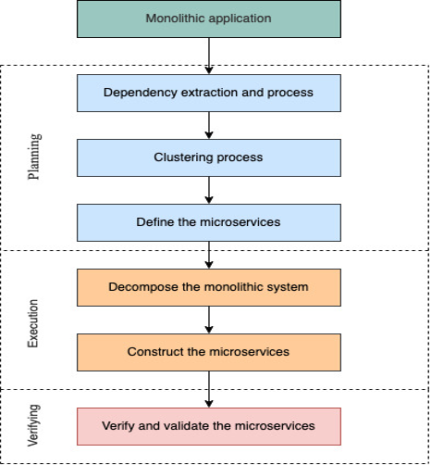
RESEARCH METHODOLOGY
Implementation strategy:
For this research, we have adopted build
methodology to validate our microservice
migration approach. After we did some
literature review, we defined our model of
migrating monolithic systems to microservices.
This migration model is what we used for
getting the later results. The migration process
is shown on right:
Notes:
Now I want to talk about the methodology or implementation strategy we used in this project
We used build methodology to validate our microservice migration approach for this study.
We defined our model for transitioning monolithic systems to microservices after doing some literature review. We used this migration model to obtain the later results.
On the right, you can see the migration process, which is also composed of our five research objectives:
Extract and analyze the dependencies of monolithic systems
Understand the mechanism of different clustering algorithms and group the highly coupled dependencies into several clusters
Decompose the monolithic systems into several independent modules based on the clustering results
Construct decomposed modules as independent microservices, which will be deployed by using container techniques such as Docker
Testing the microservice systems with the comparison of the monolithic one

Slide 10
Technical details:
We first used a tool called sourceNavigator with some additional process and modification for the system dependencies extraction.
We then used some clustering tools such as Bunch or ACDC for the clustering process with the comparison and analysis of different algorithms.
The main language we used for constructing the microservices is Java 8, and we have adopted some Spring Framework such as Spring Boot and Spring Cloud Alibaba for helping us to develop microservice applications faster and easier.
We have used API testing which is part of integration testing to test all the REST APIs we defined in each microservice.
Notes:
For the system dependencies extraction, we first used a tool intergrates sourceNavigator with some additional processes and modifications.
We then used clustering programmes like Bunch or ACDC to compare and analyse different techniques during the clustering process.
We used Java 8 as the main language for building the microservices, and we used Spring Frameworks like Spring Boot and Spring Cloud Alibaba to help us develop microservice applications more quickly and easily.
To test all of the REST APIs we defined in each microservice, we used API testing, which is a subset of integration testing.

Slide 11
RESULTS
Three key results:
Understand the mechanism of different clustering algorithms and group the highly coupled dependencies into several clusters
Reconstruct the monolithic systems into several independent microservices based on the clustering results
Testing the microservice system and compare it with the monolithic one
Notes:
Understand how clustering techniques work and how to organise strongly entangled relationships into multiple clusters.
Based on the clustering results, split the monolithic systems into several independent microservices.
Putting the microservice system to the test and comparing it to the monolithic system

Slide 12
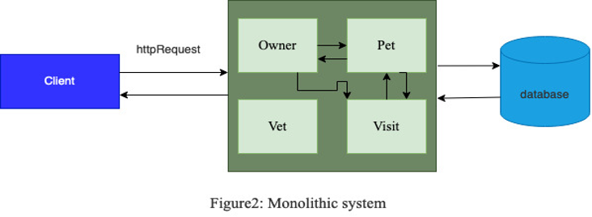
A monolithic system - petclinic
Limitations:
Inconvenient
Causing waste
Not for larger projects
Notes:
Here is the architecture of an open-source monolithic system that we implemented our migration approach on .
1) The so-called monolithic applications, is our traditional sense, a single application application. 2) This application is generally used in a layered, sub-package approach to achieve decoupling and management of code. 3) This application is generally divided into MVC three-tier architecture. (4) Generally in the traditional application, springMVC (or sturts, servlet) as the control layer, mybaties (or hibernate, JDBC) as the persistence layer.
Limitations of traditional monolithic applications.
A, when the project is getting bigger and bigger, the amount of code is getting large, which could cause compilation and packaging to be time-consuming and increasingly affecting efficiency.
B, when the business is getting more and more, different business will rebuild new projects, and the functional modules of different projects may be built repeatedly, causing waste.
C, not suitable for the construction of large-scale projects.

Slide 13
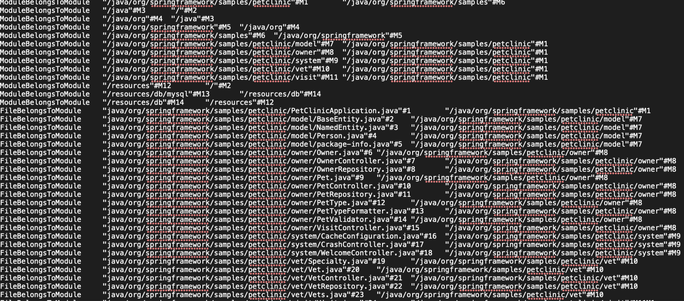
Dependency extraction and Analysis:
The diagram on the right is
the system analysis we did
on a open-source monolithic
System. And the result is
process to MDG for later
clustering process.
Notes:
The diagram on the right is
the system analysis we did
on a open-source monolithic
system. For each line, the first element shows the relationship, the second and third element could be a module or a .java class
And the result will be used to
process to MDG for later
clustering process.

Slide 14
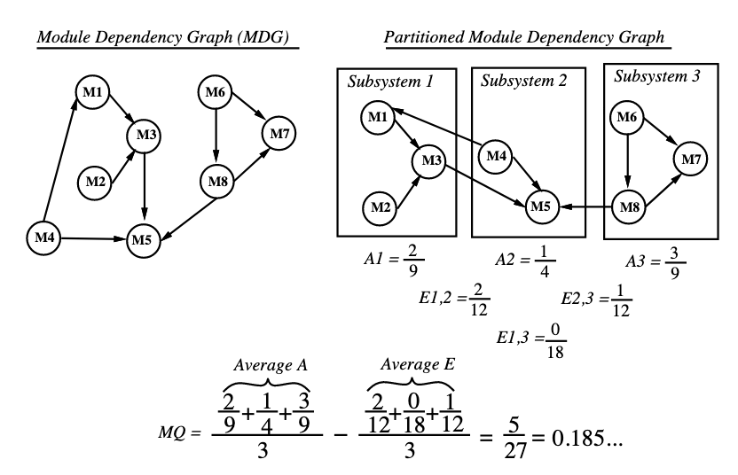
Clustering mechanism:
Here we introduced the clustering mechanism from the Bunch tool:
Notes:
Finding a good graph partition involves systemati- cally navigating through a very large search space of all possible partitions for that graph. Bunch treats graph partitioning (clustering) as an optimization problem. The goal of the optimization is to maximize the value of an objective function, called Modularization Quality
What does MQ do ?
MQ determines the \quality" of an MDG partition quantitatively as the trade-o between inter-connectivity (i.e., dependencies between the modules of two distinct subsystems) and intra-connectivity (i.e.,dependencies between the modules of the same subsys-tem).

Slide 15
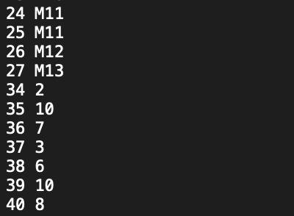
Input MDG:
Here is the model dependency graph we
obtained based on the output of system
information analysis, each line indicates
a relationship exist between two elements.
Eg. Module 11 has relationships with
system parts 24 and 25.
Notes:
For example, the number 24 indicates it is a .java class. 24 M11 means the # 24 class has a relationship with module 11

Slide 16
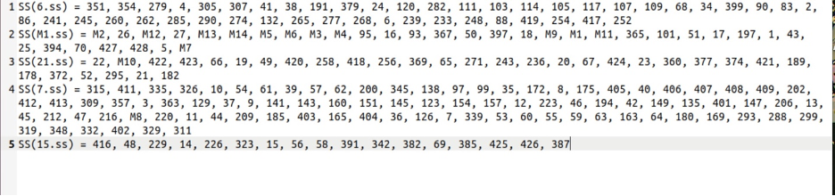
Clustering results:
The following result corresponds to the clustering process as we defined in our
implementation strategy:
Notes:
Each SS is a clustered node, which has the potential to be constructed as microservice.

Slide 17
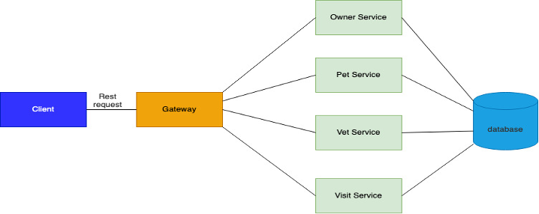
Reconstructed microservices:
Here the figure shows the
microservices we built based
on the clustering results we
obtained before:
Notes:
Definition 1: The API gateway is a service built between the client and the microservice. With it, the client sends the request to the API gateway first, and then the API gateway forwards the request to the microservice instance based on the request's identification information.
Definition2: A REST API is an API that follows the design principle of the REST, which enables an application or service to access a resource within another application or service.
The monolithic application that we just saw is a single large application which contains several modules such as Owner, pet, vet and visit. Compared with the monolithic version, we do not have a single application, instead each service would be an independent application. In reality, each service could their own database distributively.
The advantages of microservices are ：
(1) Splitting complex services into single-function services facilitates the division of labor and locates problems easily.
(2) Microservice system is a distributed system, and the business is completely decoupled from the business.
(3) Services are completely independent from each other. Each service can choose the appropriate programming language and database according to the business scenario.
(4) The services are deployed independently, and the modification and deployment of each service has no impact on other services

Slide 18
NOVELTY & ANALYSIS
We have compared our results with the results presented by Kamimura & Yano & Hatano & Matsuo: They first proposed a method which produces the candidates of microservices as the list of programs and data from the source code of monolithic applications. They use SArF software clustering algorithm with data access and the relationship between “program groups” and “data” as the input. Then they implement their approach on an open-source monolithic system, which is the same one as ours. The result they get is they reconstructed three microservices: the first service contains all java classes related to Owner and Pet modules, the second service contains all java classes related to the Visit module and the third service contains all java classes related to the Vet module. Instead, our technique presents a more granular feature, which the clustering result contains 4 clusters, which could be considered to build microservices.
Notes:
We have compared our results with the results presented by Kamimura.
They use the SArF software clustering algorithm as the input, which uses data access and the relationship between "programme groups" and "data."
Then they put their strategy into action on a monolithic open-source system that is identical to ours.
They end up with three microservices: the first contains all java classes related to the Owner and Pet modules, the second contains all java classes related to the Visit module, and the third contains all java classes related to the Vet module.
Instead, our technique presents a more granular feature, which the clustering result contains 4 clusters, which could be considered to build microservices. More accurate MDG will result in better clustering result.

Slide 19
LIMITATIONS of RESULTS
First, our migration approach has only implemented under a small open-source application, which is less complex than a real-world industrial application.
Also, our approach needs an accurate or good representation of MDG as the input for the clustering algorithm.
Our integrated clustering approach may not perform well on larger number of modules.
The reconstructed microservices may not handle well on data consistency issue since we just applied simple locks.
Notes:
First, our migration strategy has only been tested on a small open-source programme that is less sophisticated than a real-world industrial application.
In addition, as the input for the clustering process, our approach requires an exact or good representation of MDG.
On a larger number of modules, our integrated clustering solution may not function effectively.
Because we only applied simple locks to the reconstructed microservices, they may not be able to manage data consistency issues well.

Slide 20
IMPACT on theory and practice
Since system migration has been a prominent problem these decades, the systematic analysis of monolithic systems and implementation of different clustering strategies will have some great impacts on the result of deploying the clusters as independent microservices, which will contribute some foundational research knowledge into the academia of system migrating and microservices. This thesis work will build up some research foundations and methodologies for advanced topics related to the novelty of clustering algorithms and microservice migration.
It will help the organizations and enterprises to have an optimized and efficient approach of migrating their monolithic applications to microservices. Some benefits this research bring to enterprises will result in costs saving and less time consumption for system migration process.
Notes:
Since system migration has been a popular issue in academia for decades, a systematic analysis of monolithic systems and the implementation of various clustering strategies will have a significant impact on the outcome of deploying clusters as independent microservices, contributing some foundational research knowledge to the field of system migration and microservices.
This thesis will lay the groundwork for advanced subjects such as clustering algorithms and microservice migration by establishing certain research foundations and approaches.
It will assist organisations and businesses in moving monolithic programmes to microservices in a more optimised and efficient manner.
Some of the advantages that this study provides to businesses include cost savings and reduced time spent on the system migration process.

Slide 21
Microservices cases examples:
Typical scenarios of microservices Microservices architecture cases:
E-commerce
WeChat
Payment
Live streaming
Games
Notes:
These are some examples of microservice architecture applications. I think the biggest benefit of microservice architecture for these application scenarios is that when a service goes down or stops working, it does not affect the operation of other services. For example, for live streaming, if it is a single application, if there is a problem with a function of the application or the server where it is located, then the live streaming will be shut down. But if it is a microservice architecture, as long as the service with live streaming function is not down, then the live streaming can continue to line.

Slide 22
VALIDATION
For validating the whole system, we first package each microservice module as a jar file, then we deploy every jar file on localhost to see if they can function together well. Instead of using integration testing for each microservice module separately as we described before, we will have a client-side application for validating the wellness of whole system. Then we will try to dockerize each jar file (each service) and database for simulating the isolated environment.
Notes:
To validate the entire system, we package each microservice module as a jar file and then deploy each jar file on localhost to test if they work properly together.
Instead of performing integration testing for each microservice module individually, we will use a client-side application to validate the overall system's health.
Then, to simulate the isolated environment, we'll try to dockerize each jar file (each service) and database.

Slide 23
CONCLUSIONS
For this research, we have answered the problem of what is whole process of migrating monolithic systems to microservices with the compare and analysis of different clustering strategies. The research that were defined earlier have been successfully completed. The significant contribution in this research is the compare and analysis of different clustering strategies [O2], the decomposition of extracted dependencies into clusters [O3] and the construction of microservices with modern industrial tech stack [O4].
The key results achieved are:
(I) Constructing the migration approach
(II) Building the Proof of Concept
(III) Implementing our migration theory on an open-source monolithic system

Slide 24
FUTURE WORK & LESSONS LEARNT
First, we would narrow down the research area and only explore one specific area instead of the techniques for whole microservice migration process.
Second, we would focus on more about clustering techniques and create new
clustering algorithms or software.
Third, we would develop a systematic method for solving the data consistency issues.
Finally, we would implement our migration approach on a more complex
real-world system instead of a small system for acquiring more reliable and
persuasive result.
Notes:
First, rather than exploring techniques for the entire microservice migration process, we would limit down the research field and focus on one single issue.
Second, we'd spend more time focusing on clustering approaches and developing new clustering algorithms or software.
Third, we would develop a systematic method for solving the data consistency issues.
Finally, rather than a small system, we would apply our migration strategy to a more complicated real-world system in order to obtain more dependable and persuasive results.

Slide 25
Through this research experience, the lesson I learnt is you should learn to be an independent researcher instead of heavily relying on the supervisor.
Sometimes your questions may not be that hard if you would like to spend
some time on it.
For the area you have no previous knowledge, just do enough research by yourself first, then head to your supervisor and have a talk with him. Do not rush to decide what your topic is until you find out your interest and do not be ashamed to ask the same question multiple times until you figured out what your professor means.

Slide 26
REFERENCES
[1] Auer, F., Lenarduzzi, V., Felderer, M., & Taibi, D. (2021). From Monolithic Systems to microservices: An assessment framework. Information and Software Technology, 137, 106600. https://doi.org/10.1016/j.infsof.2021.106600
[2] A. Furda, C. Fidge, O. Zimmermann, W. Kelly and A. Barros, "Migrating Enterprise Legacy Source Code to Microservices: On Multitenancy, Statefulness, and Data Consistency," in IEEE Software, vol. 35, no. 3, pp. 63-72, May/June 2018, doi: 10.1109/MS.2017.440134612.
[3] N. Ivanov and A. Tasheva, "A Hot Decomposition Procedure: Operational Monolith System to Microservices," 2021 International Conference Automatics and Informatics (ICAI), 2021, pp. 182-187, doi: 10.1109/ICAI52893.2021.9639494.
[4] A. Kalia, J. Xiao, R. Krishna, S. Sinha, M. Vukovic, and D. Banerjee, “Mono2micro: A practical and effective tool for decomposing monolithic Java applications to microservices,” arXiv.org, 14-Sep-2021. [Online]. Available: https://arxiv.org/abs/2107.09698. [Accessed: 25-Mar-2022].
[5] M. Kamimura, K. Yano, T. Hatano and A. Matsuo, "Extracting Candidates of Microservices from Monolithic Application Code," 2018 25th Asia-Pacific Software Engineering Conference (APSEC), 2018, pp. 571-580, doi: 10.1109/APSEC.2018.00072.

Slide 27
[6] J. Kazanavičius and D. Mažeika, "Migrating Legacy Software to Microservices Architecture," 2019 Open Conference of Electrical, Electronic and Information Sciences (eStream), 2019, pp. 1-5, doi: 10.1109/eStream.2019.8732170.
[7] C. -Y. Li, S. -P. Ma and T. -W. Lu, "Microservice Migration Using Strangler Fig Pattern: A Case Study on the Green Button System," 2020 International Computer Symposium (ICS), 2020, pp. 519-524, doi: 10.1109/ICS51289.2020.00107.
[8] S. Mancoridis, B. S. Mitchell, Y. Chen and E. R. Gansner, "Bunch: a clustering tool for the recovery and maintenance of software system structures," Proceedings IEEE International Conference on Software Maintenance - 1999 (ICSM'99). 'Software Maintenance for Business Change' (Cat. No.99CB36360), 1999, pp. 50-59, doi: 10.1109/ICSM.1999.792498.
[9] G. Mazlami, J. Cito and P. Leitner, "Extraction of Microservices from Monolithic Software Architectures," 2017 IEEE International Conference on Web Services (ICWS), 2017, pp. 524-531, doi: 10.1109/ICWS.2017.61.
[10] J. Zhao, J. Zhou, H. Yang and G. Liu, "An orthogonal approach to reusable component n discovery in cloud migration," in China Communications, vol. 12, no. 5, pp. 134-151, May 2015, doi: 10.1109/CC.2015.7112036.

Slide 28
[11] P. Yugopuspito, F. Panduwinata and S. Sutrisno, "Microservices architecture: Case on the migration of reservation-based parking system," 2017 IEEE 17th International Conference on Communication Technology (ICCT), 2017, pp. 1827-1831, doi: 10.1109/ICCT.2017.8359946.
[12] S. Sarkar, G. Vashi and P. P. Abdulla, "Towards Transforming an Industrial Automation System from Monolithic to Microservices," 2018 IEEE 23rd International Conference on Emerging Technologies and Factory Automation (ETFA), 2018, pp. 1256-1259, doi: 10.1109/ETFA.2018.8502567.

