Slide 1
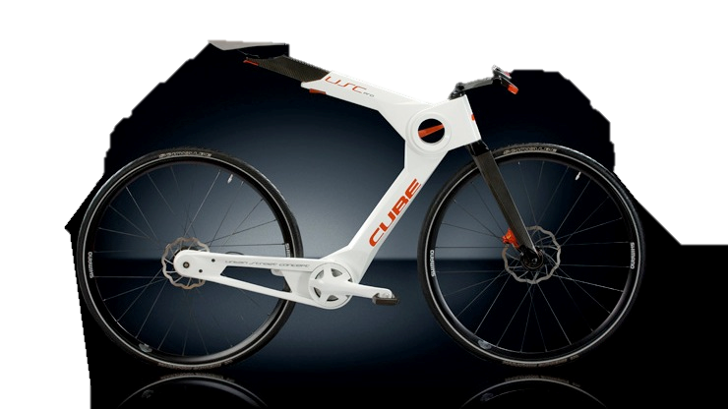
Analysis of Bike Purchasing Trends
Presented by: Lawoe Gayheart
Last Update: Jan, 2023

Slide 2
content
INTRODUCTION
OBJECTIVE
FINDINGS
RECOMMENDATIONS
CONCLUSION
CALL TO ACTION
REFERENCE

Slide 3
introduction
Roses are red, violets are blue, we've got data insights for bike selling, and can't wait to share them with you!
This presentation will cover insights into the demographics of bike purchasers and potential customer traits, followed by recommendations for the company.
Exploration of demographics of company and exploration and exploitation of insights on customer traits

Slide 4
objective
By the end of this presentation, we will have a deeper understanding of the demographics of bike purchasers and potential customer traits, as well as recommendations on how the company can better serve its target market and increase its sales

Slide 5
Age Distribution
Millennials and Gen X are the top customers. Further analysis is needed to determine if these groups use the bikes for daily movement or exercise.

Slide 6
Gender Proportion
Almost equal male to female ratio. Targeted designs for each gender should be considered

Slide 7
Distribution by Region
North America has the largest market, mostly made up of Gen X and Millennials. Europe has a larger Gen X population than North America. Further analysis is needed to identify potential marketing opportunities.

Slide 8
EFFECT OF Commute Distance ON Purchases
Purchases decrease with distance. Features to attract longer distance commuters such as rechargeable battery and fast motor would be desirable.

Slide 9
RELATIONSHIP BETWEEN INCOME AND EDUCATION
Well-educated customers have higher income and disposable income for recreational activities.

Slide 10
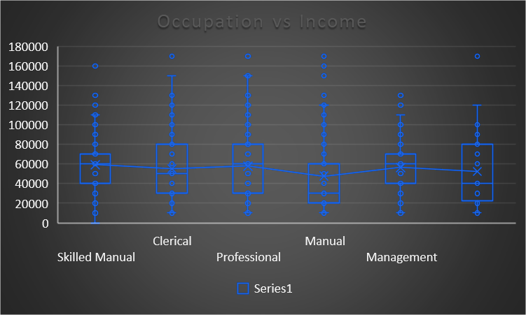
occupation and Income of Bike Purchasers
Professionals have a higher income and should be targeted with higher-end bikes

Slide 11
Recommendations
Develop and market bikes with features suitable for longer distance commuters.
Design unisex bikes or make similar effort in targeted designs for each gender.
Explore potential marketing opportunities in Europe, especially among the Gen X population.
Develop higher-end bikes for professionals with higher income.

Slide 12
Call to Action
Analysis of the data has provided valuable insights into the bike purchasing trends.
The demographics of the top customers and their potential usage patterns should be studied further.
Based on the analysis, recommendations have been made to improve marketing strategies and product development.
The bike selling company should take action on these recommendations to stay competitive in the market.

Slide 13
Reference
Data source: https://raw.githubusercontent.com/AlexTheAnalyst/Excel-Tutorial/main/Excel%20Project%20Dataset.xlsx

Slide 14

THANK
YOU!

