Slide 1
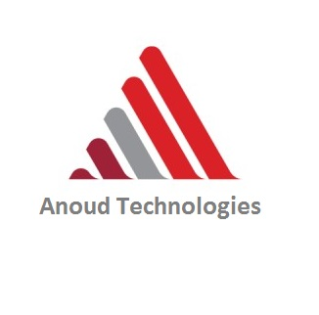
About Anoud- Anoud Technologies LLC MENA-headquartered InsurTech / insurance core systems and digital solutions , around 2020 via QIC–Swiss Re collaboration.
About my Role- I work closely with business requirements to ensure the system aligns with real-world insurance workflows.
About Anoud+ Product- Anoud is an end-to-end digital insurance platform that streamlines operations, offering high-speed performance and platform independence across both Android and iOS.
Anoud+ consists of Core Solutions for insurance operations and Digital Solutions for analytics and business support.
Clients of Anoud: Anoud Technologies provides solutions to insurance companies globally, especially in the MENA region, Europe, and the Caribbean, enabling them to efficiently manage their business through the Anoud+ platform.
About QIC : In the Qatar Insurance Company (QIC) application, different user roles such as admin, user, and employee access modules like underwriting, reports, and claims to manage policies and process customer claims efficiently.
About Policies : Anoud+ supports multiple insurance policies such as motor insurance (including comprehensive and third-party), medical, life, travel, corporate, property, and liability insurance. These policies are configurable based on client requirements.

