Slide 1
Beer Reviews Analysis
A detailed insight on the Beer data for the period of 1998 to 2021

Slide 2
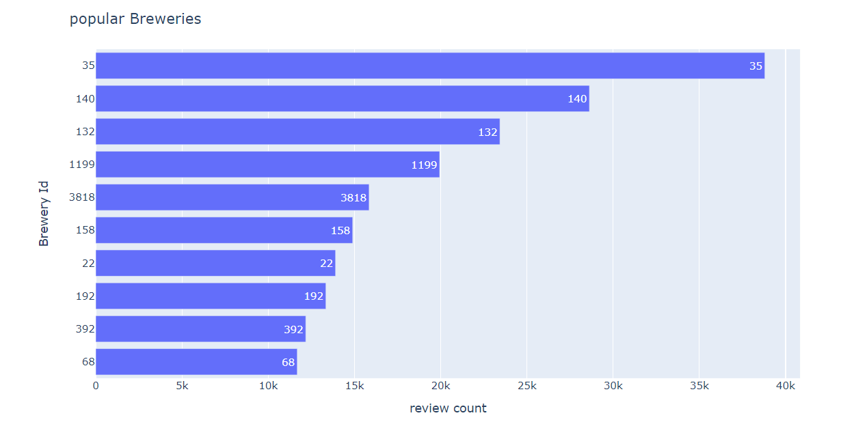
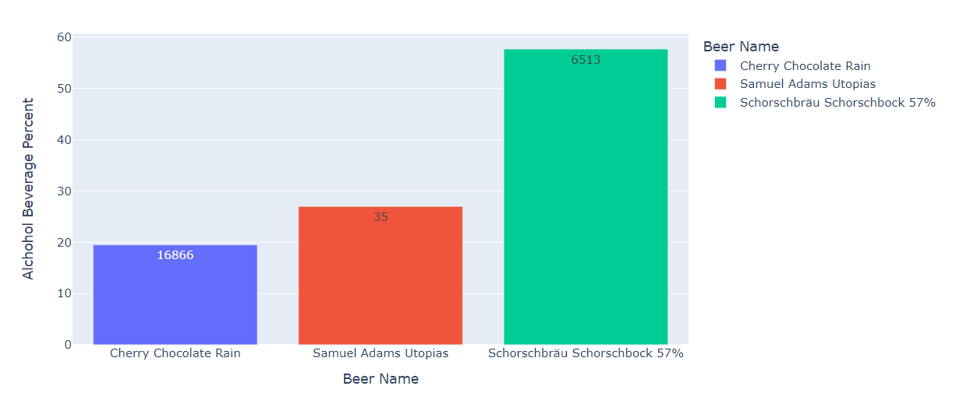
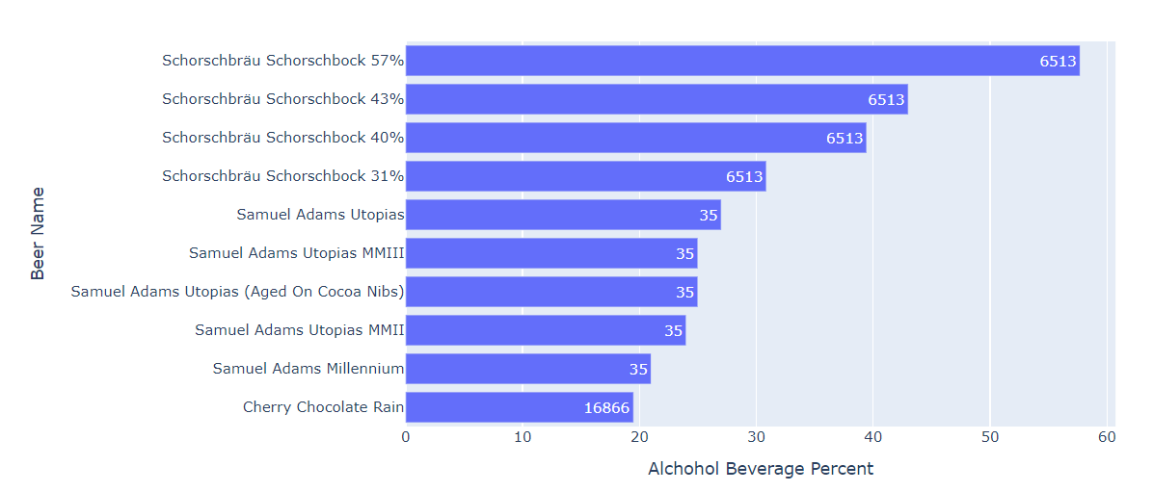
Top Breweries
Based on most review count the brewery ‘s are 35,140,132 are the top breweries .
Out of which, top breweries 6513 is highest in all category..
By simply finding strongest beers by alcohol beverage percent the brewery ‘s are 6513,35,16866 are the top breweries .
Out of which, top breweries 6513 is highest in all category..

Slide 3
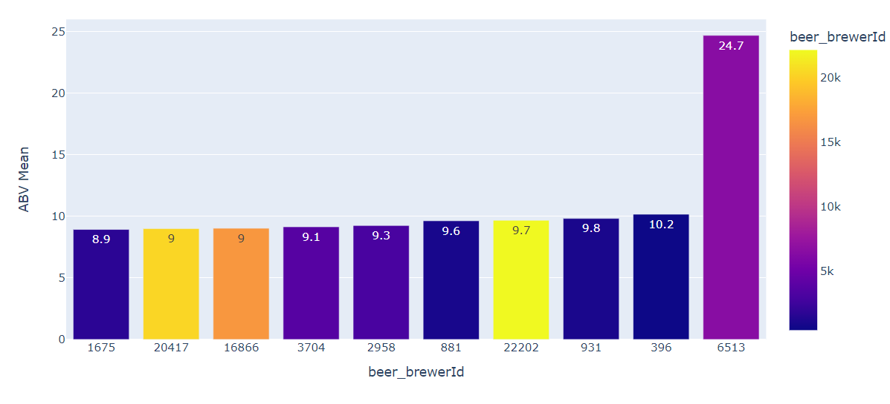
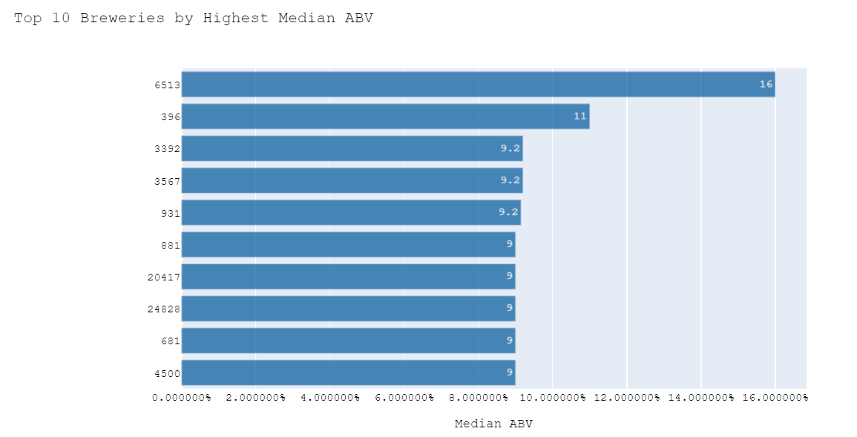
Top Breweries (Mean, Median)
The simple statistical techniques used to find out top breweries by Mean, Median And Average.
Using mean ABV the top breweries are
6513,396,396 are the top breweries .
Out of which, top breweries 6513 is highest in all category..

Slide 4
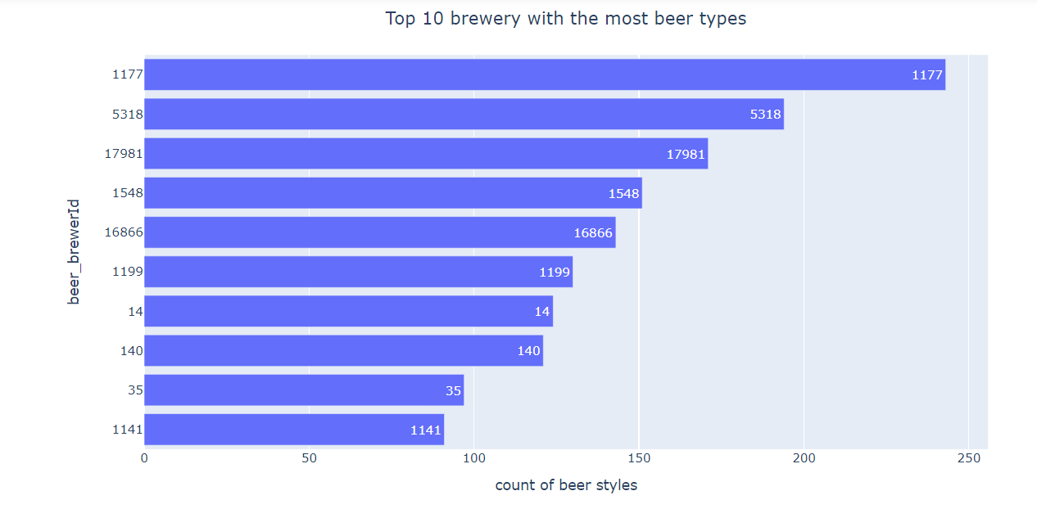
Top Breweries By most beer types
The maximum count of beer styles is also another factor used to define top breweries..
Higher the number of times the beer type mentioned with beer name then the most review count is famous breweries.

Slide 5
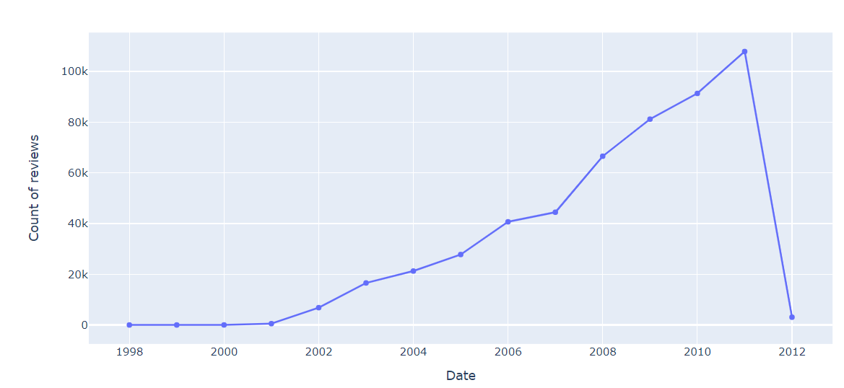
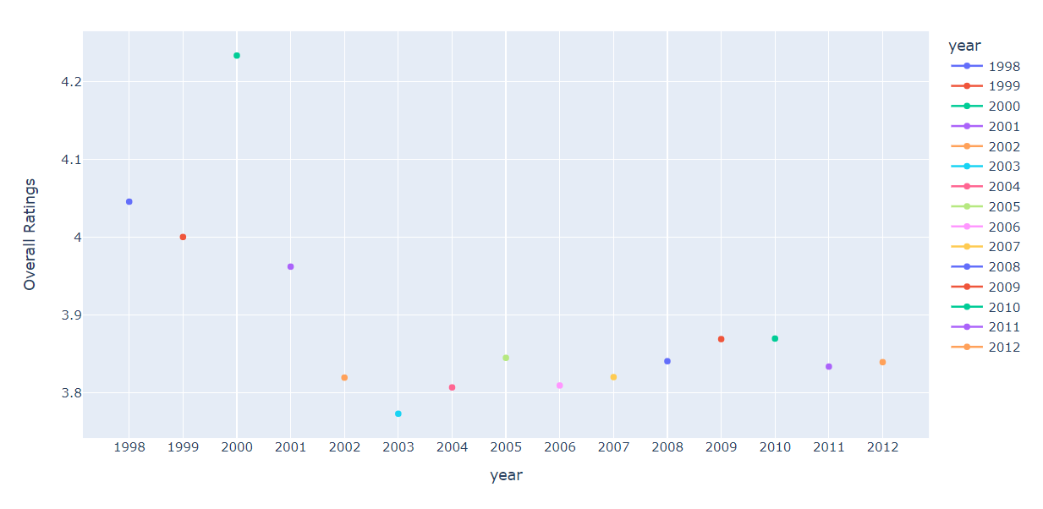
Yearly Beer Analysis
The pattern of emotion flow during the Beer Reviews is seen in this time-series graph from 23/6/1998 to 1/11/2012. The beer review data was first generated in 1998, but the number of daily beer reviews only began to increase in 2001, and reached a peak in early 2011, about 100k(1 Lakh) reviews per day. During year 2000 the beer average rating rating crossed 4 which is highest among all years. After that there is drop down in ratings. Year 2002 enjoy the highest beer rating 5 calculating by mean of all review ratings.

Slide 6
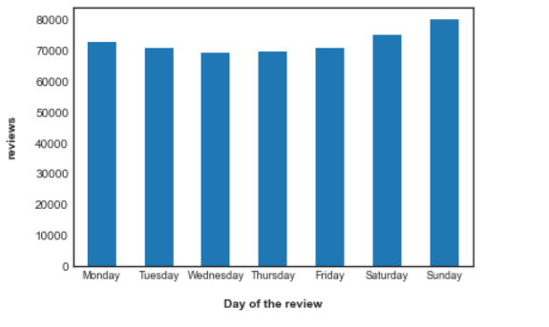
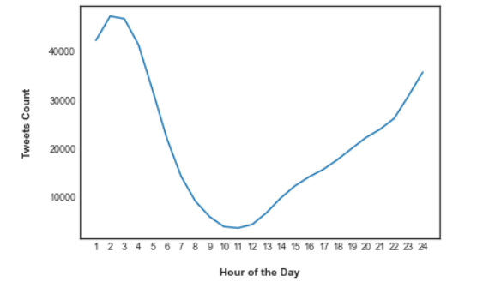
Analysis by Day of the Week and Hour of the Day
This visual indicates the count of Reviews by day of the week. It is observable that the volume of Reviews is more at the inception of weekends compared to weekdays.
The duration was of two weeks, starting from Sunday.
Observing the figures, it is hardly to say that there is slightly more increment in reviews at weekends.
The different hours of the day have been fetched from Twitter as per Coordinated Universal Time or UTC. It is the primary time standard by which the world regulates clocks and time. It is within about 1 second of mean solar time at 0° longitude such as UT1 and is not adjusted for daylight saving time. It is effectively a successor to Greenwich Mean Time. This visual is in 24-hour format.
Upon evaluation, we find that reviews counts for beer started rising exponentially after 12 noon. The number of worldwide reviews surged between 1 PM and 6 PM UTC. The volume started to drop after 3:00 hours. Compared to early morning, the number of reviews is higher from afternoon until midnight. This also reveals that users are more active in the latter part of the day as per UTC timing.

Slide 7
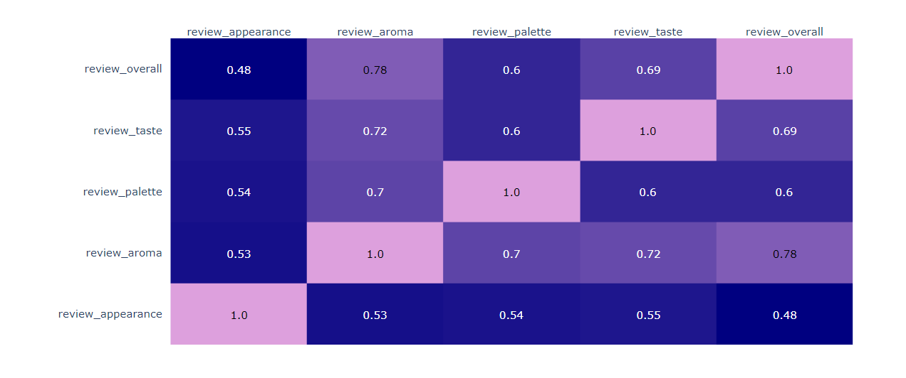
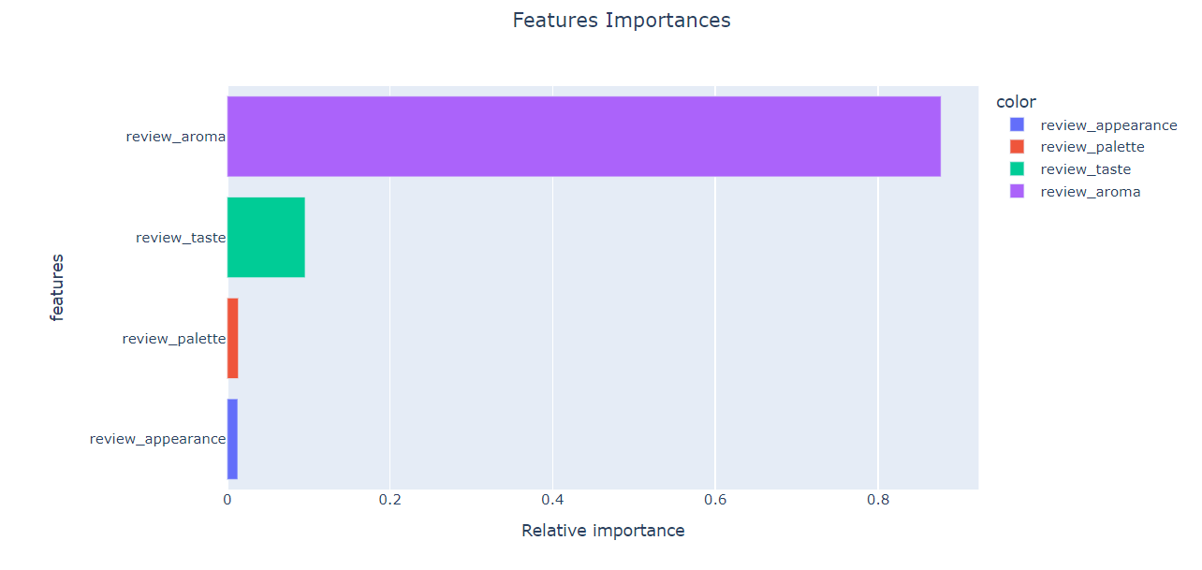
Analysis by Correlation Matrix And Shap
The lighter the color, the higher the correlation between the two features. review aroma has the highest correlation with review overall, at 0.78, followed by review taste at 0.69.
Using XGBoost model checked the feature importance having higher feature importance weightage with model importance with 0.8 maximum for review aroma and less significant is review appearance .

Slide 8
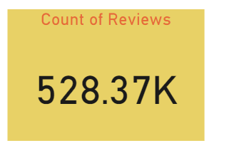
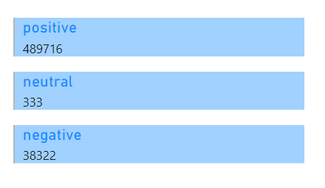
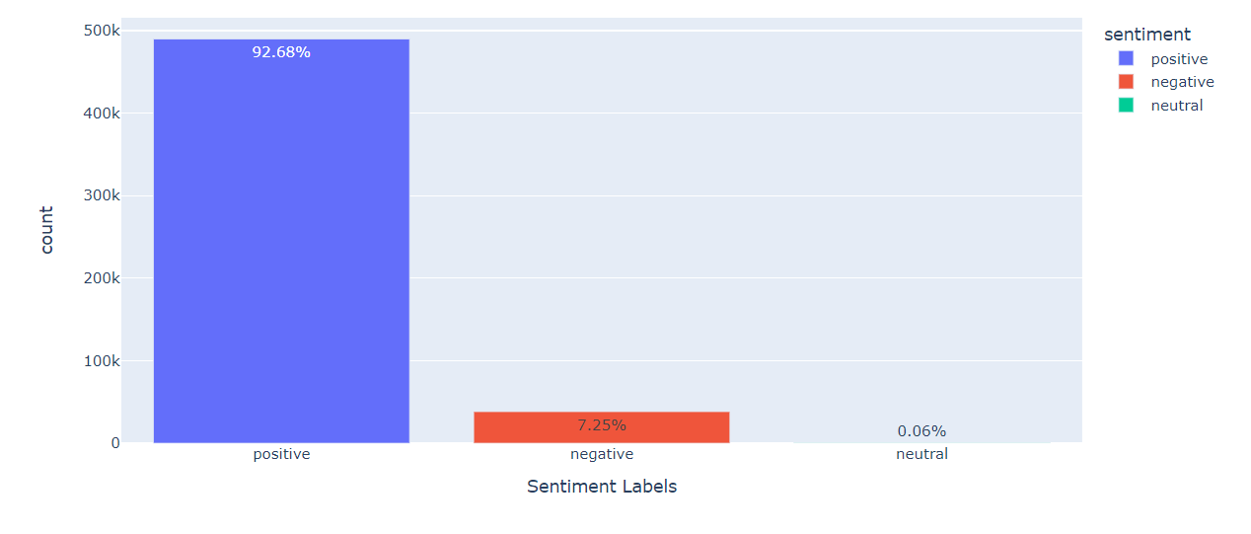
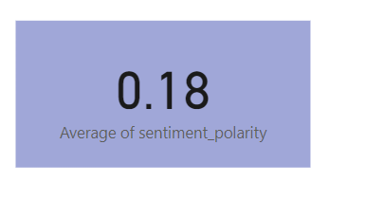
Sentiment Analysis
The pattern of emotion flow during the Beer Reviews is seen from 23/6/1998 to 1/11/2012 roughly 508358.
Before sentiment Analysis data is cleaned.
Out of which, 92.68 % of data holds positive sentiments, around the 0.06% are neutral can be ignored. While 7.25% of data express negative sentiments.
The average of 0.18 in this graph indicates that more reviews are packed with opinions on Beer type than facts. It also demonstrates that positive emotion has outnumbered negative emotion.

Slide 9
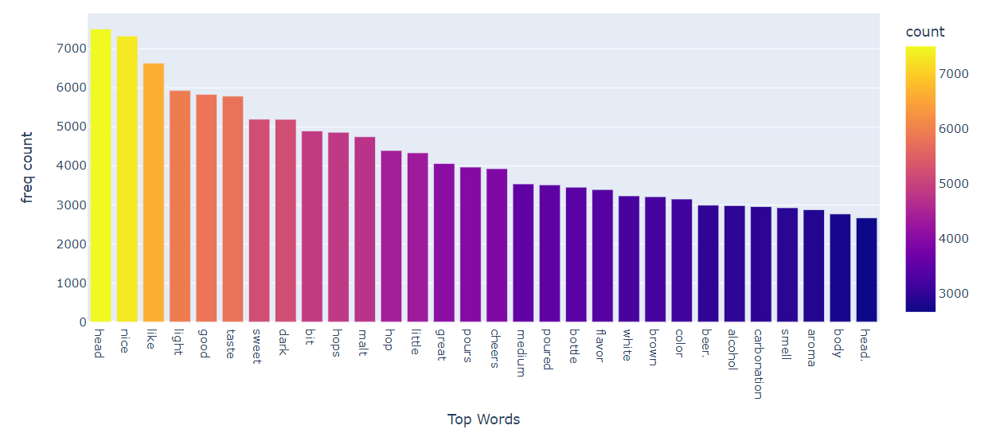
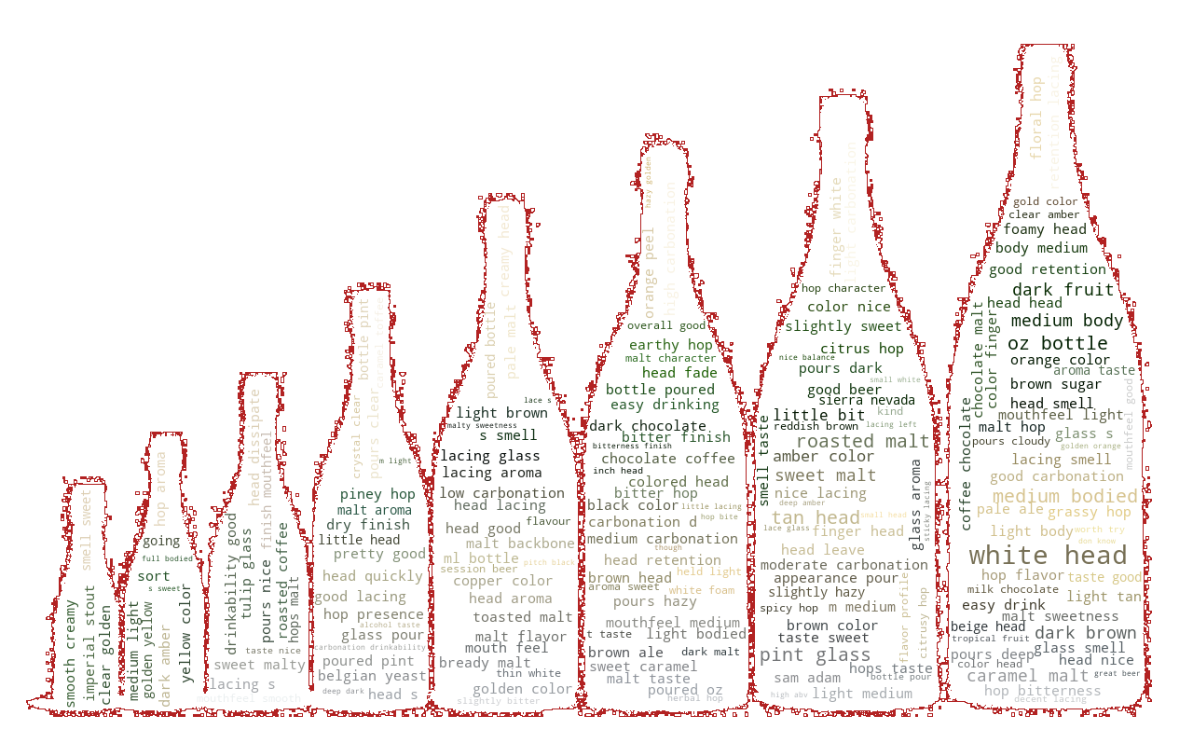
FREQUENCY OF WORDS
The top 20 most used terms in people’s reviews are shown in this graph.
The term “nice, taste, New head, great” implies that the people have mentioned alcohol colors, taste. The word “nice, great," signifies that the reviews are public-oriented in the interest of beer taste.
Word Cloud is a data visualization technique used for representing text data in which the size of each word indicates its frequency or importance. The words “white head", "yellow”, “dark fruit", "medium body” are the most frequent words in the text.

Slide 10
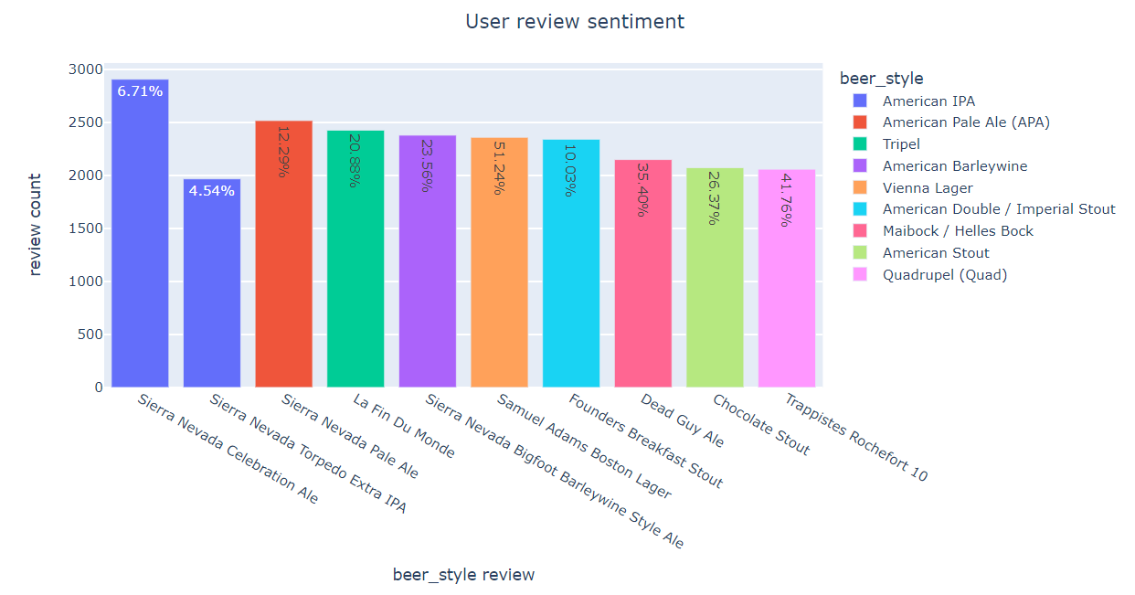
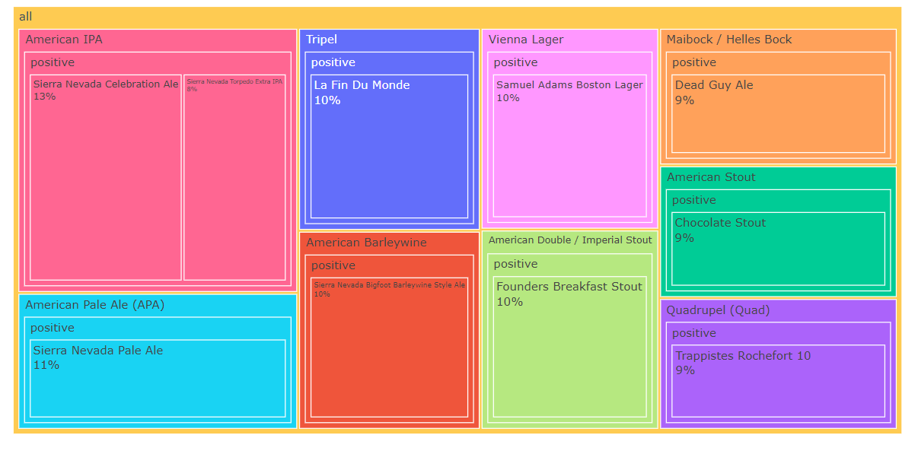
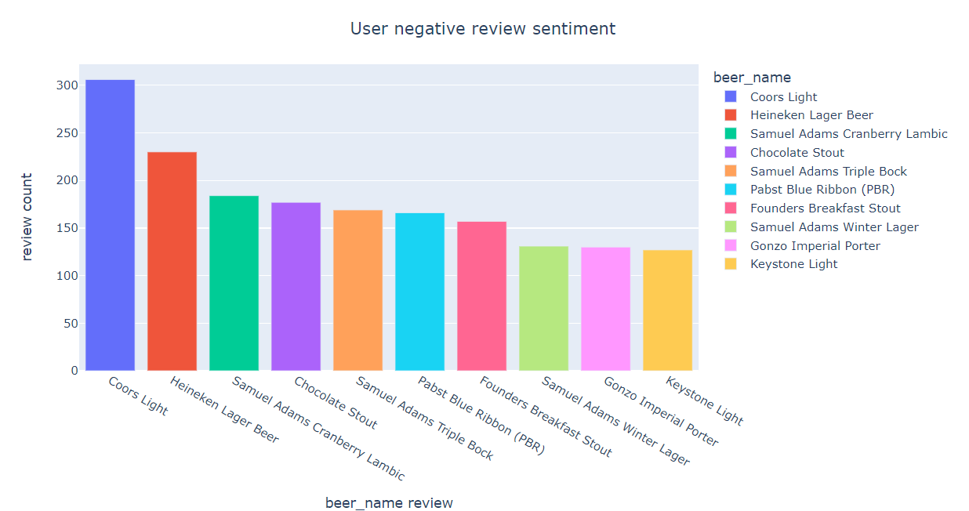
Beer Style By SENTIMENT
To better evaluate datasets, this another novel graph on sentiment analysis distinguishes between beer style and sentiment. The topmost review count with respect to beer style is American IPA having 95% positive reviews counts(more then 40k reviews).Whereas each beer style has one- one negative reviews.

Slide 11
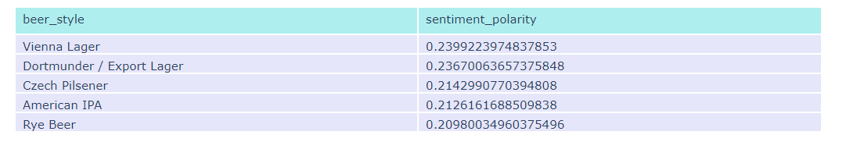
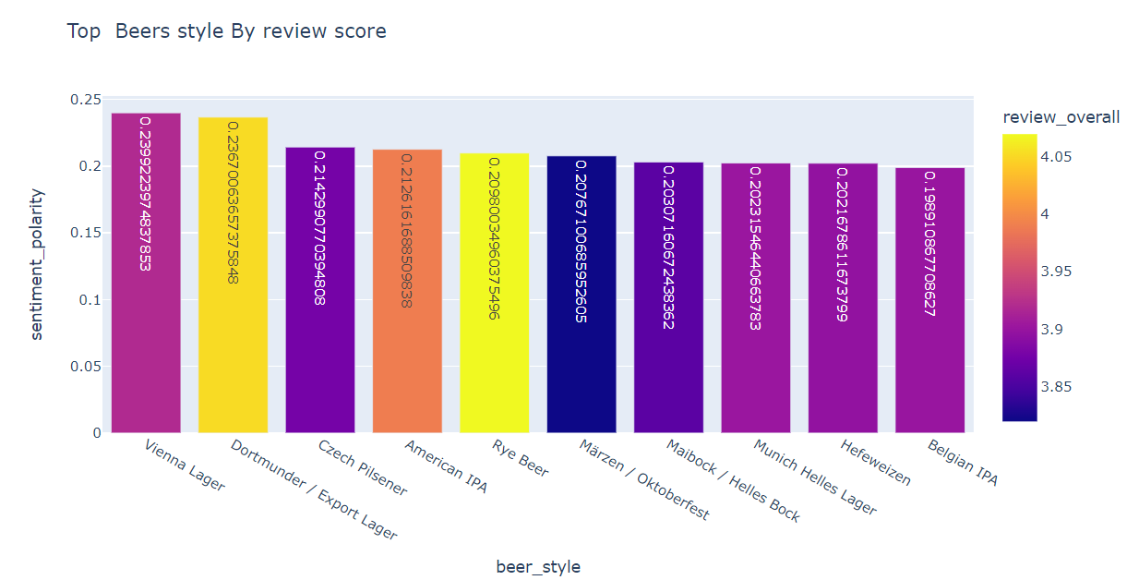
Beer Style By SENTIMENT Polarity
Using Text blob, the topmost beer style having highest polarity is Vienna Larger.
User written review text is collaborating in calculating the overall review score.

Slide 12
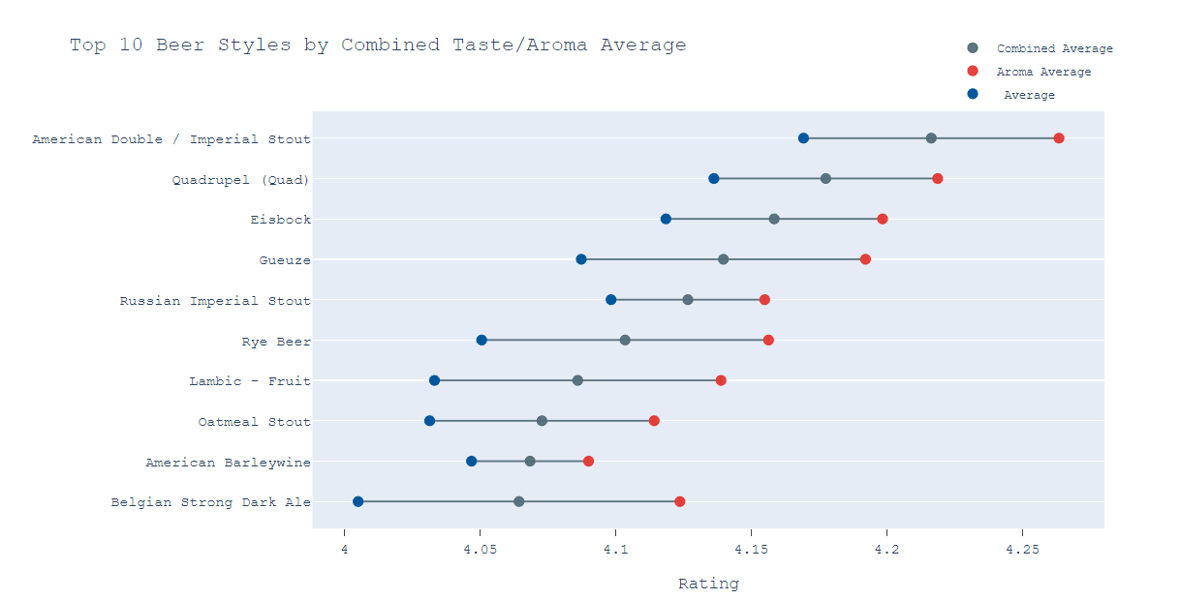
Beer Style By Combining 2 features
There is another approach as combined most important features are aroma and taste rating their average and combination of features average rating provides highly rated beer styles.

Slide 13
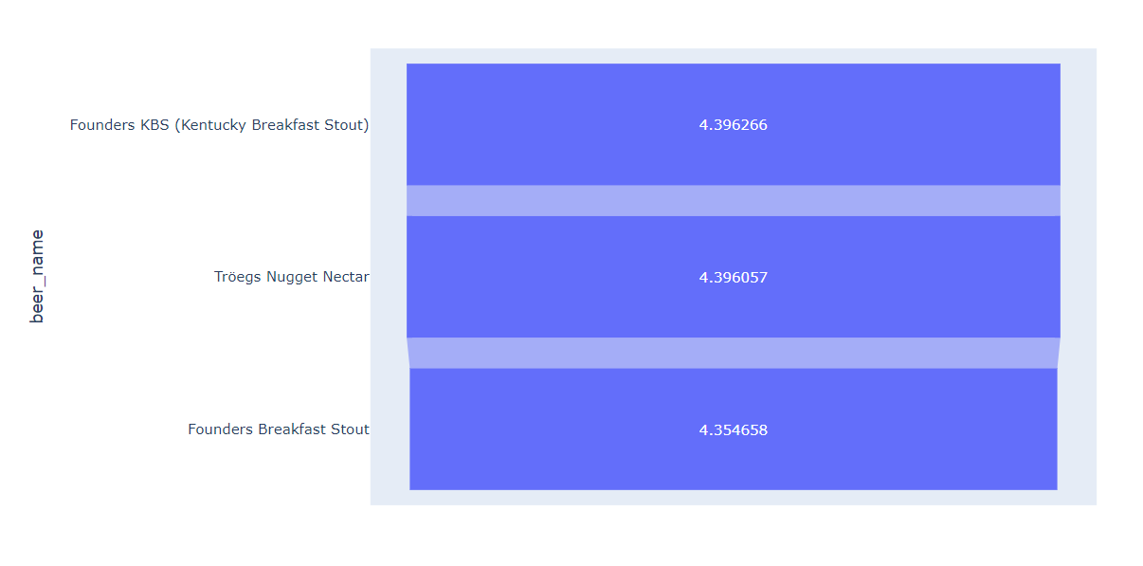
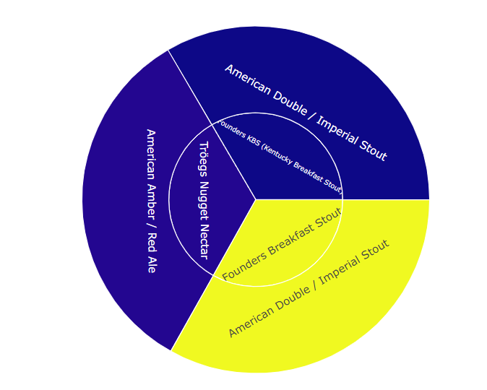
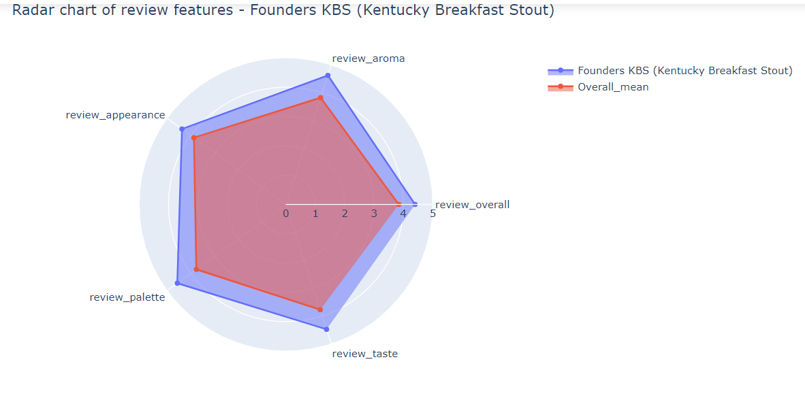
Top beers Recommended based on reviews
Simple recommendation based on the highest overall average rating with reviews more than 1000.
It is observed that by averaging review aroma and review taste gives slightly different beer .But the top beer is same as Founder KBS.

Slide 14
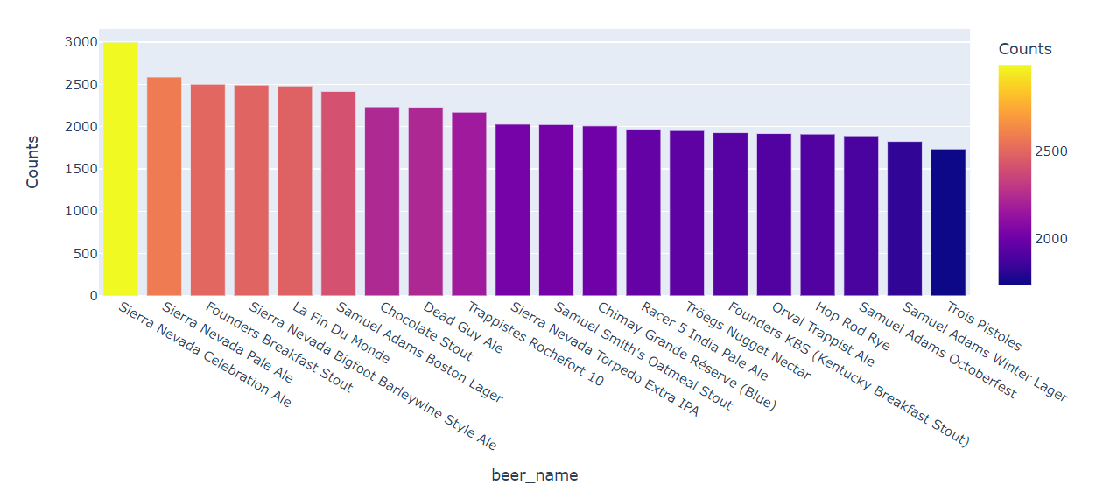
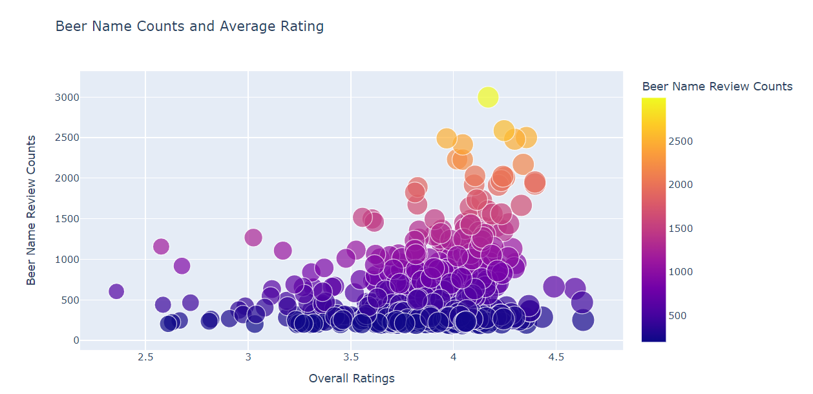
Top beers Recommended based on reviews
From the review count it is concluded that the topmost beer name having rating between 4 to 4.5. There is a large amount of beers review lies between 3 to 4.5 with is average beers.
So, we can say that high rated beers having review counts in the range of 2.5 k. Whereas the top beer names are Sierrea Naveda celebreation,Pale,Founders.

Slide 15


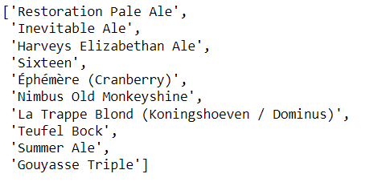
Rrecommendation based on Collaborative filtering
Collaborative Filtering (CF), CF utilizes past transactions or user behavior to find connections or similarities between users and products. Trying to find beer that are similar to one another based on how collective user base have rated these beers or find users who are similar based on the beers that they have mutually rated similarly.
To improve results of the recommender, the beers in the bottom 10 percent in terms of average rating and review counts were removed. This removed about 20% of the beers, bringing the unique beer count from 4964 to 3959. Surprise Library is used for building recommender systems. In this case, the KNN with means (cross validation)prediction algorithm was used.
The sim_options allows you to specific the type of similarity measure to use, for example, Pearson vs. cosine distance vs. mean squared distance. ‘User based = False’ indicates that this is item-item similarity and not user-user similarity.
Running the evaluate method will return a 5-fold cross validation with the specified metric(s). This measures how well the algorithm predicts a missing rating against the actual rating. For this beer recommender, the RMSE (root mean square error) was 3.

Slide 16


Similar beer drinkers
Recommended users which are similar in terms of (taste, review)
Using KNN find similar neighbors.
The sim_options allows you to specific the type of similarity measure to use, cosine. ‘User based = True’ indicates that this is user-user similarity.

Slide 17
References
https://scikit-learn.org/stable/modules/generated/sklearn.decomposition.TruncatedSVD.html
https://surprise.readthedocs.io/en/stable/index.html
https://www.nltk.org/install.html
https://towardsdatascience.com/my-absolute-go-to-for-sentiment-analysis-textblob-3ac3a11d524
https://plotly.com/
https://joss.theoj.org/papers/10.21105/joss.02174.pdf
https://dl.acm.org/doi/abs/10.1145/3018661.3018665
https://esource.dbs.ie/bitstream/handle/10788/3997/hdip_ward_f_2020.pdf?sequence=1

