Slide 1
3-Months Training in (ANDROID) A POWER POINT PRESENTATION ON CRONY(Personal Assistant)
GAZALPREET KAUR
ECE-4A
1308574

Slide 2
Company Profile
Situated at the center of one of the most beautiful and developed cities of India, Develop Tech IT Solutions Pvt. Ltd. was established by a group of young, energetic, determined and talented pros in 2013. Develop Tech IT Solutions Pvt. Ltd., right from its origin in 2013 has always focused on what is called stability in the market and customer satisfaction to the full extent. It is not always about the numbers, but the quality of service they provide to customers that gives the inspiration and spirited driving force. Got nurtured under the guidance of think-tanks Mr. Rohit Sharma (Director) and Mr.Vishal Kedia (Managing Director), who have established as one of the best companies in this sector.
Develop Tech IT Solutions Pvt. Ltd., an emerging IT company is exploiting its each and every bit to get on par with the definition of IT given by intellectuals. Develop Tech IT Solutions Pvt. Ltd. is run by a group of young, innovative and energetic professionals capable of accepting any challenge and fulfilling it to the fullest.

Slide 3
Develop Tech IT Solutions Pvt. Ltd. is a strategic solutions and professional services provider to advise, transform and optimize business and technology processes while minimizing risk. It is offering a large number of services across various sectors with a large number of solutions to each and every problem. Its core services include Console Applications, System Applications, and Web Applications & Mobile Applications.
The rich experience and quality business processes has enabled to fulfill their clients' all requirements. The quality and diversified solutions provided by it to clients has helped to develop and maintain good relations in the market even with competitors. From minute changes to innovative solutions, it helps customers to achieve a profitable growth, leadership in market, customer satisfaction and sustainability.
It has been providing services to both the public as well as private sectors achieving great success and credibility. Proficiency in each and every sector concerned with IT is motto so that it can give its best each and every time to clients. DevelopTech IT Solutions Pvt. Ltd. is providing its services all across the globe including its major clients in the US and Australia.

Slide 4
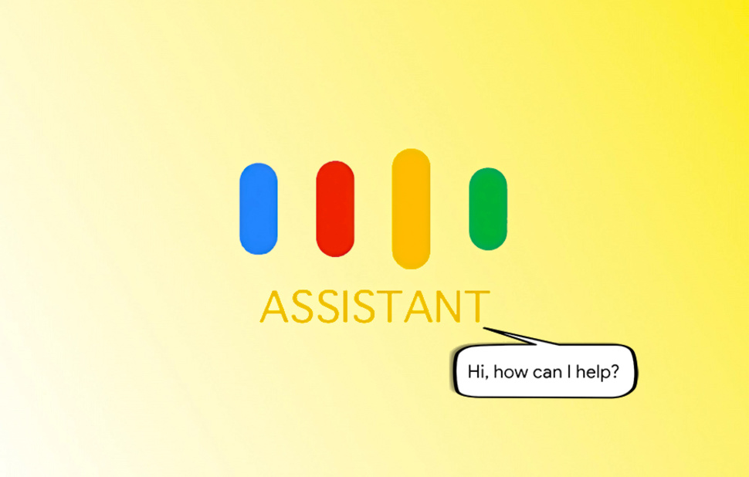
CRONY

Slide 5
INTRODUCTION
An intelligent personal assistant (CRONY) is a software agent that can perform tasks or services for an individual. These tasks or services are based on user input, Birthday reminders, meeting reminders, and the ability to access information from a variety of online sources ( news, user schedules, Note making, Birthday reminder setting ,Alarm, Medicine Reminder etc.). Examples of such an agent are Microsoft's office assistant and later Crotona, Apple 's Siri, Google 's Google now(earlier Android versions had voice search via Google Search).
Intelligent personal assistant technology(CRONY) are enabled by the combination of mobile devices, application programming interfaces (APIs), and the proliferation of mobile devices, application programming interfaces. However, intelligent automated assistants are designed to perform specific, one-time tasks specified by user voice instructions, while smart personal agents perform ongoing tasks (e.g., schedule management) autonomously

Slide 6
Objective
An application that prevents human dependency for performing tasks like wake up call, reminders for appointments, events and meetings , note making, shopping list, fetching news, horoscope and information with just a few taps . Person now a days is so busy that he is unable to remember his important meetings, medicines and even his important dates so to overcome that problem we have developed the application for that which works as a cheap personal assistant for every person. Person can place this application in his phone and can be free from his most of reminders.

Slide 7
Things crony can do…….
Set alarm and Reminders
Get RSS Feeds.
Open Whatsapp,Facebook,Gmail login,Instagram,Snapchat etc.
Call someone
Note-Making and saving Notes like Important appointments ,data and Homework For Students
Horoscope

Slide 8
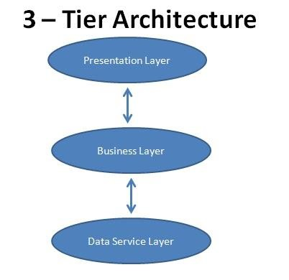
3- Tier Architecture

Slide 9
The three tiers in a three-tier architecture are:
1. PRESENTATION LAYER: Occupies the top level and displays information related to services available on a website. This tier communicates with other tiers by sending results to the browser and other tiers in the network.
2. BUSINESS LOGIC LAYER: Also called the middle tier or logic tier, this tier is pulled from the presentation tier. It controls application functionality by performing detailed processing.
3. DATA TIER: Houses database servers where information is stored and retrieved. Data in this tier is kept independent of application servers or business logic.

Slide 10
ADVANTAGES OF 3-TIER ARCHITECTURE
Flexibility: By separating the business logic of an application from its presentation logic, a 3-Tier architecture makes the application much more flexible to changes.
Maintainability: Changes to the components in one layer should have no effect on any others layers. Also, if different layers require different skills (such as HTML/CSS is the presentation layer, PHP/Java in the business layer, SQL in the data access layer) then these can be managed by independent teams with skills in those specific areas.
Reusability: Separating the application into multiple layers makes it easier to implement reusable components. A single component in the business layer, for example, may be accessed by multiple components in the presentation layer, or even by several different presentation layers (such as desktop and the web) at the same time.

Slide 11
Scalability: A 3-Tier architecture allows distribution of application components across multiple servers thus making the system much more scalable.
Reliability: A 3-Tier architecture, if deployed on multiple servers, makes it easier to increase reliability of a system by implementing multiple levels of redundancy.

Slide 12
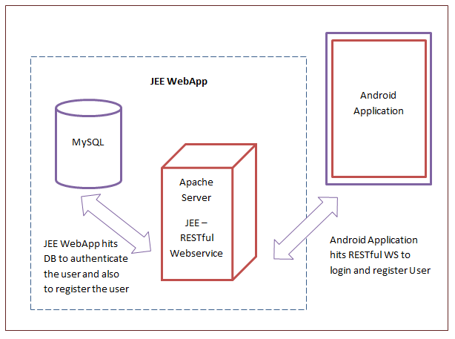
Web Service

Slide 13
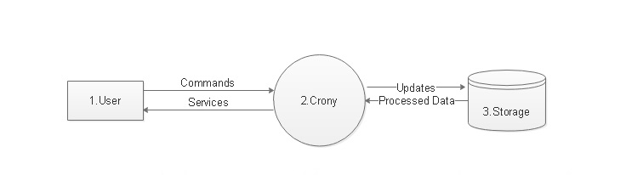
Data Flow Diagrams

Slide 14
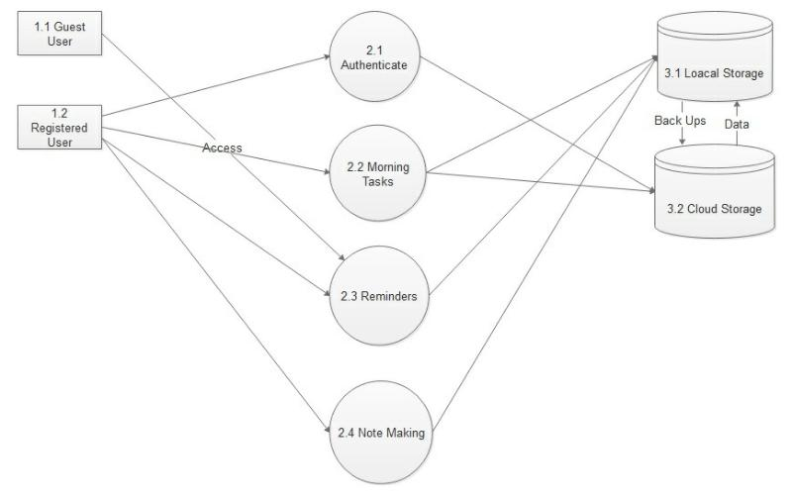

Slide 15
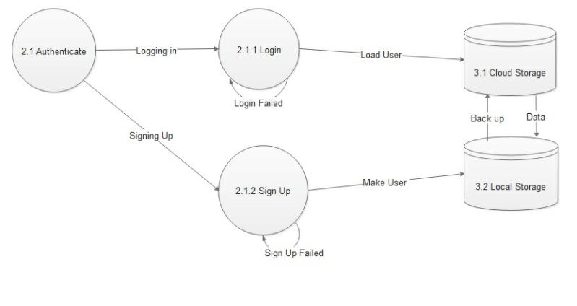

Slide 16
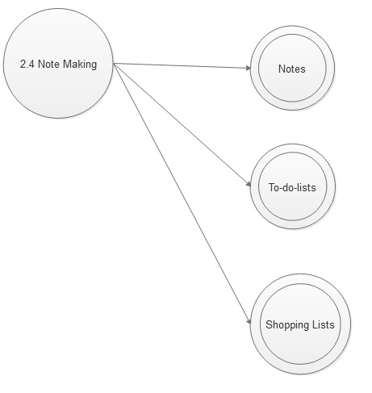
Note Making

Slide 17
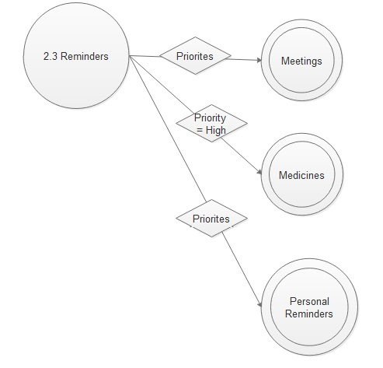
Reminders

Slide 18
Software Requirements
Android Studio
Netbeans IDE 8.1
Database –MySQLite
Web Services
Operating System-Windows and Linux
JDK(Java Development Kit)
SDK(Software Development Kit)
Mobile

Slide 19
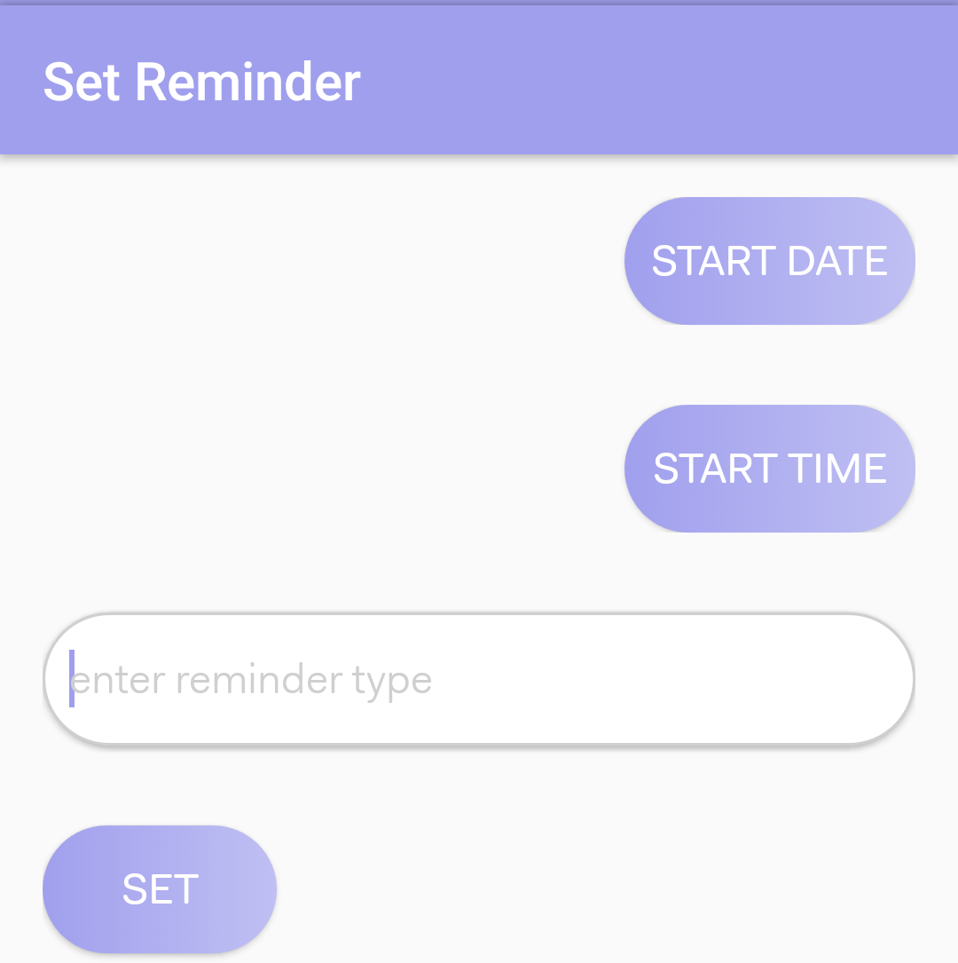
Never Miss Your Important Tasks

Slide 20
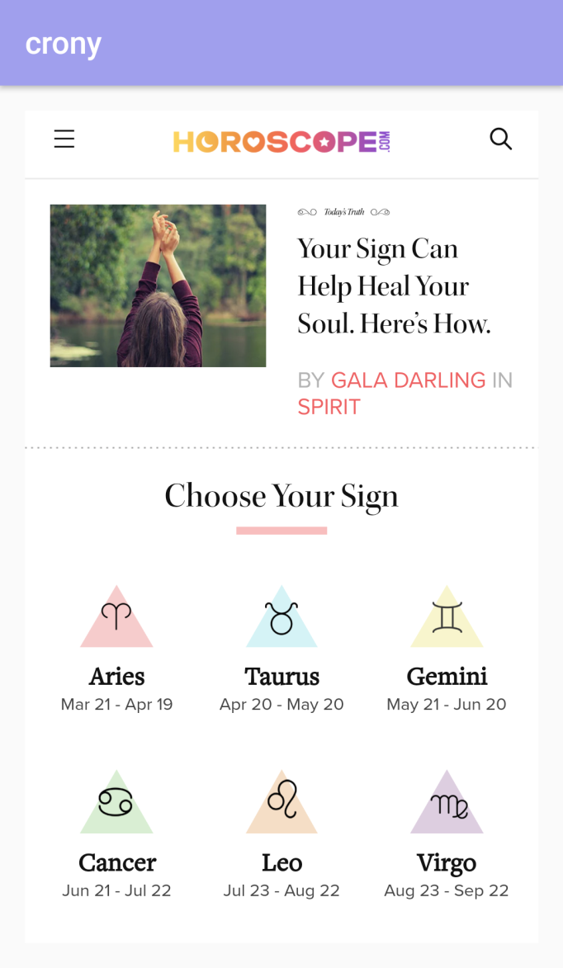
Your Sign Can Help Heal Your Soul

Slide 21
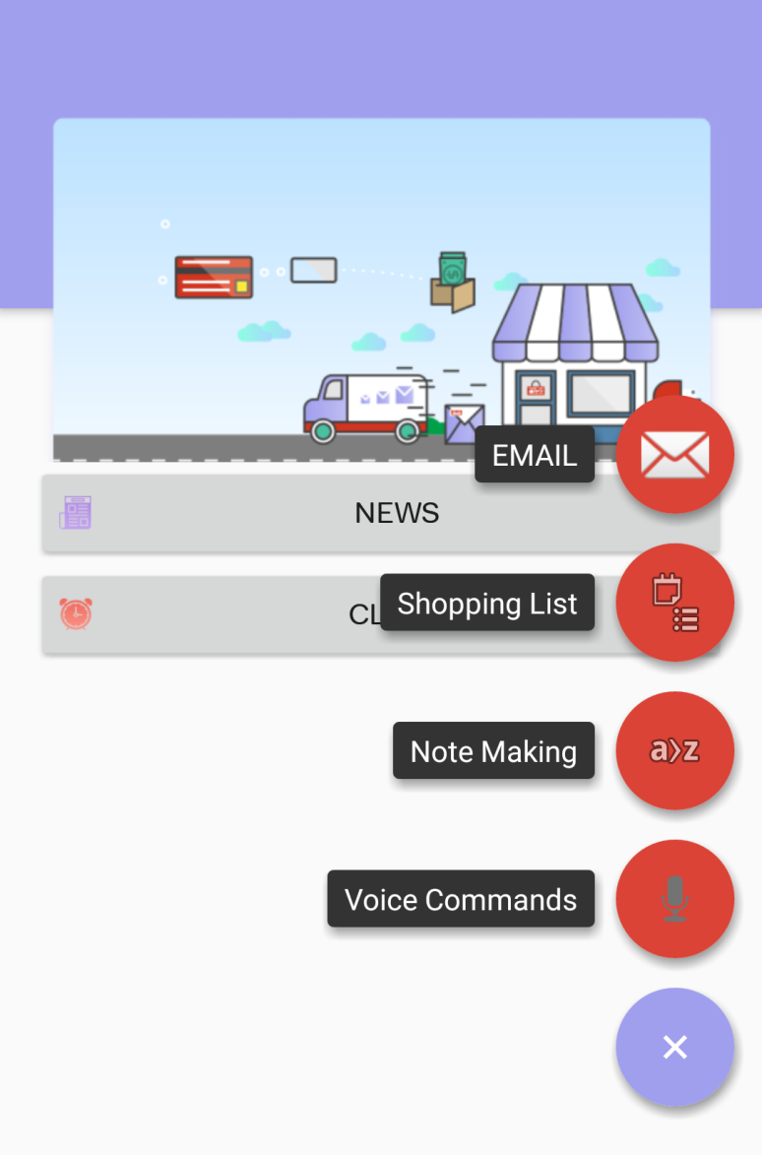
Make Your Shopping List Ready

Slide 22
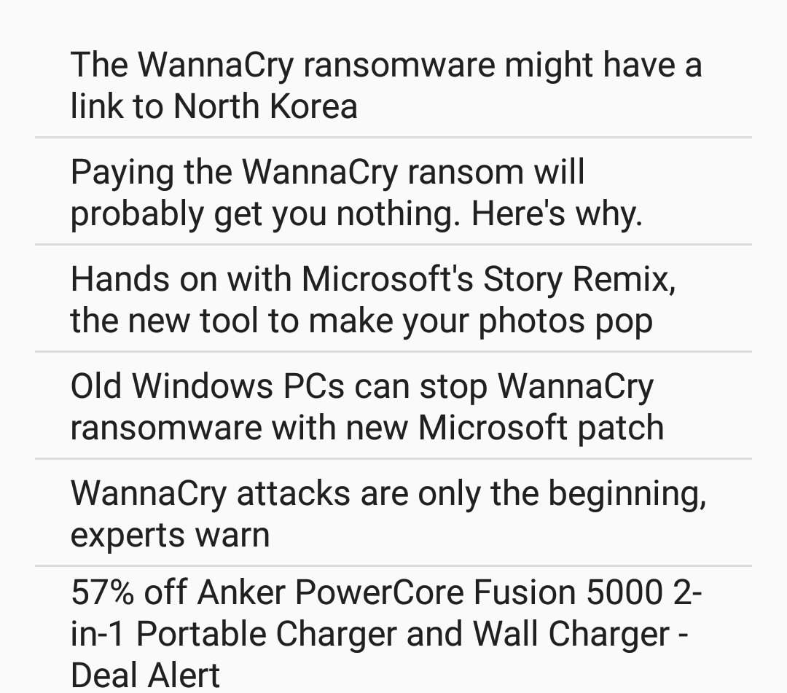
DAILY RSS FEEDS

Slide 23
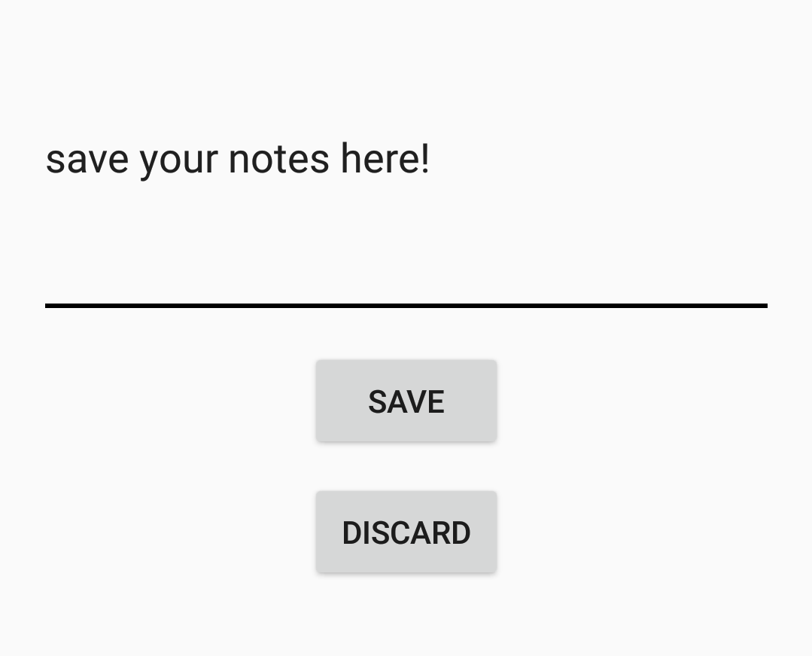
Note Making

Slide 24
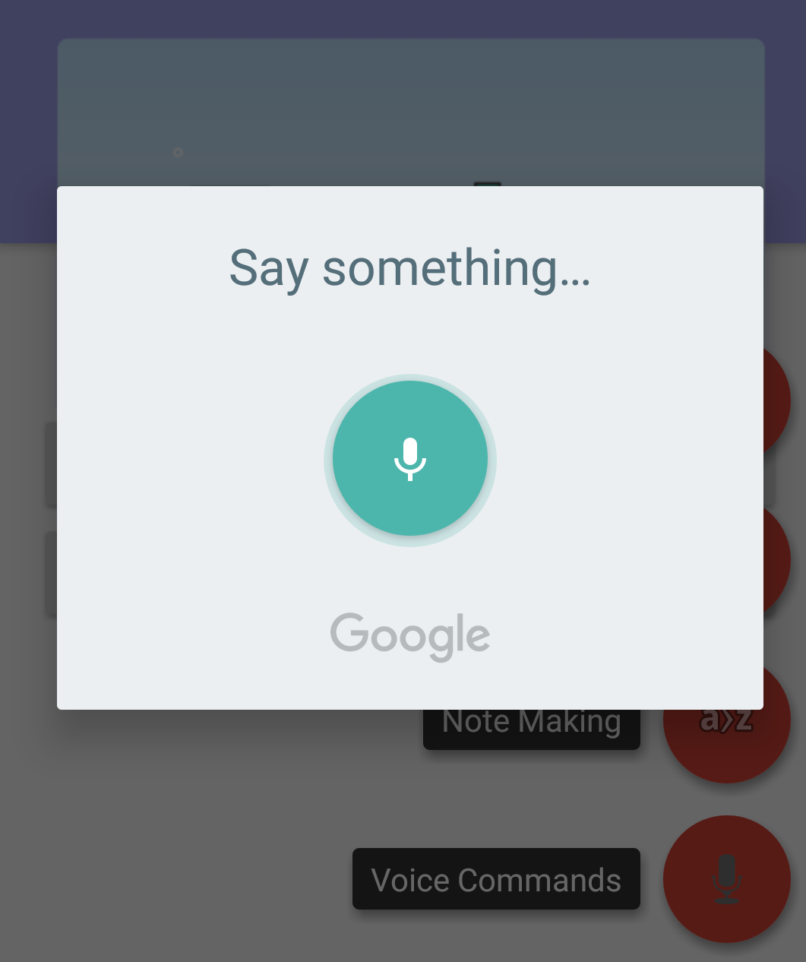
Voice Commands

Slide 25
Thank you

