Slide 1
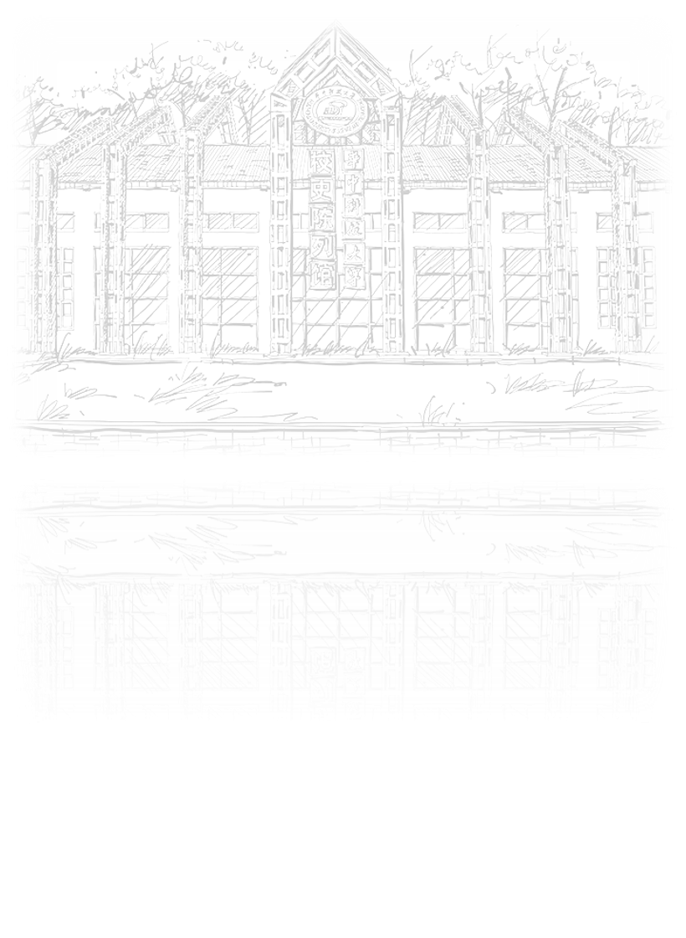
Supporting text here
REPORT
Supporting text here.Supporting text here.
Supporting text here.

Slide 2
CONTENTS
01
02
03
04
Text here
Text here
Text here
Text here
Supporting text here.
Supporting text here.
Supporting text here.
Supporting text here.

Slide 3

01
Text here
Text here
Text here

Slide 4
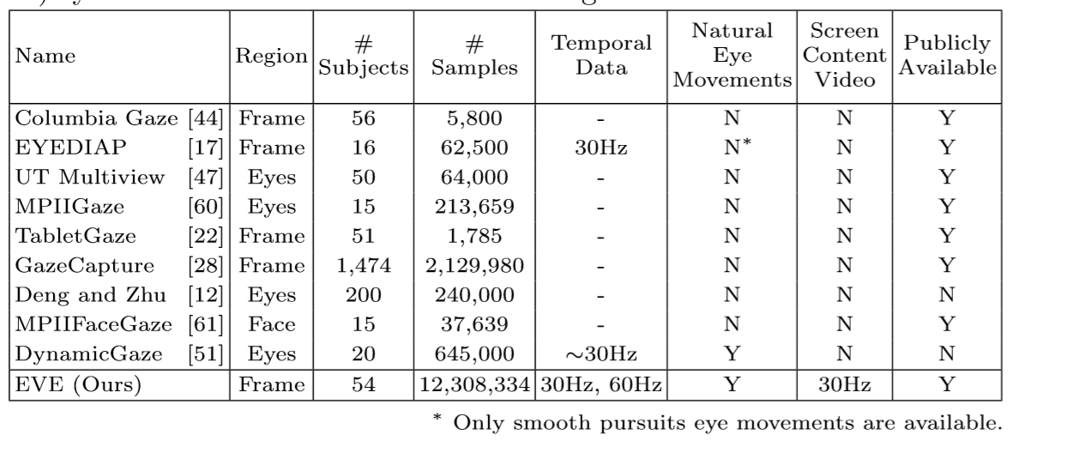
Gaze estimation
dataset

Slide 5
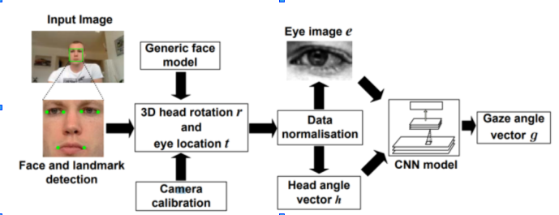
Xucong Zhang
2015 Appearance-Based Gaze Estimation in the Wild

Slide 6
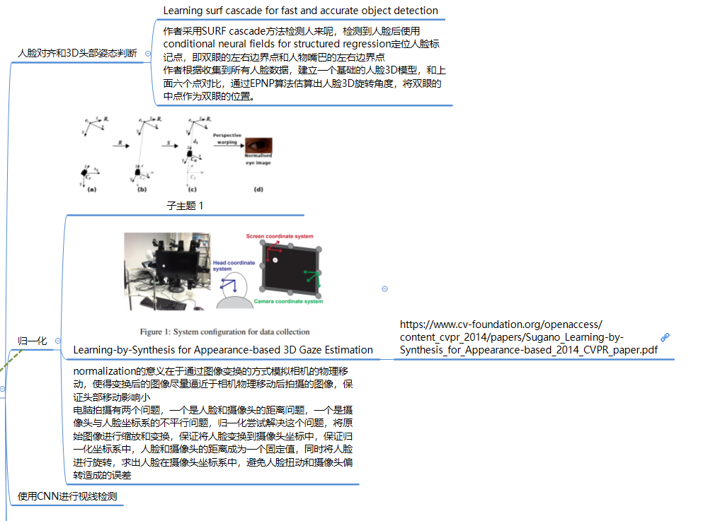
Xucong Zhang
2015 Appearance-Based Gaze Estimation in the Wild

Slide 7
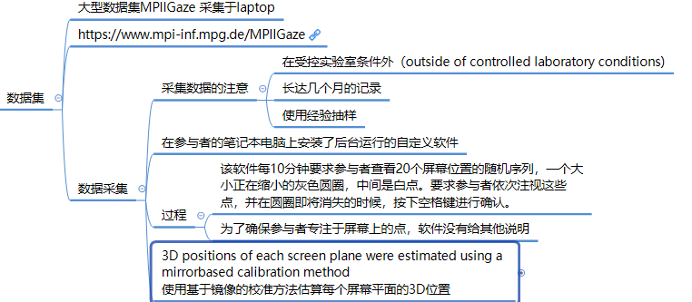
Xucong Zhang
2015 Appearance-Based Gaze Estimation in the Wild

Slide 8
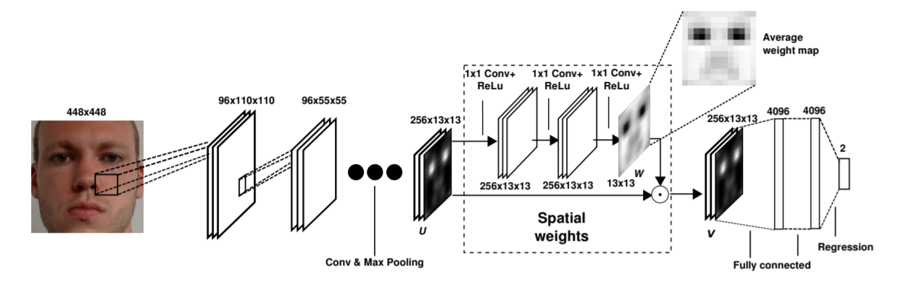
Xucong Zhang
2017 It's written all over your face: Full-face appearance-based gaze estimation
创新：Attention计算权重

Slide 9
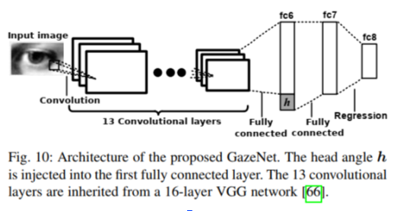
Xucong Zhang
2017 MPIIGaze: Real-World Dataset and Deep Appearance-Based Gaze Estimation
问题：泛化不行，跨数据集性能下降很多

Slide 10
Xucong Zhang
2020 Towards End-to-end Video-based Eye-Tracking
问题：泛化不行，跨数据集性能下降很多

Slide 11
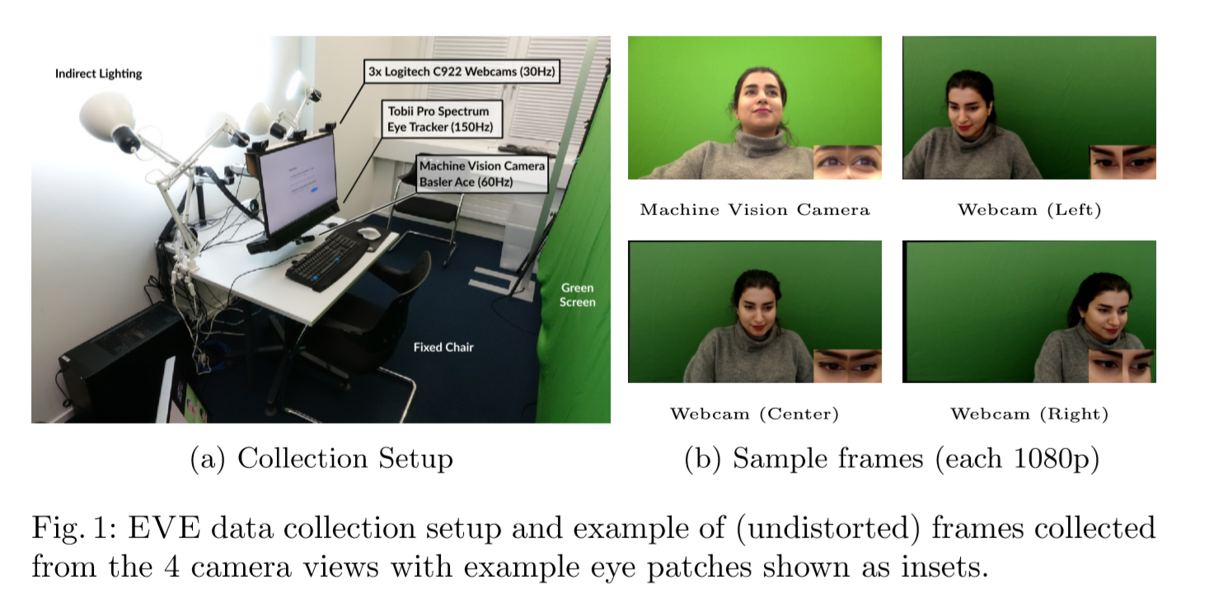
Xucong Zhang
2020 Towards End-to-end Video-based Eye-Tracking

Slide 12
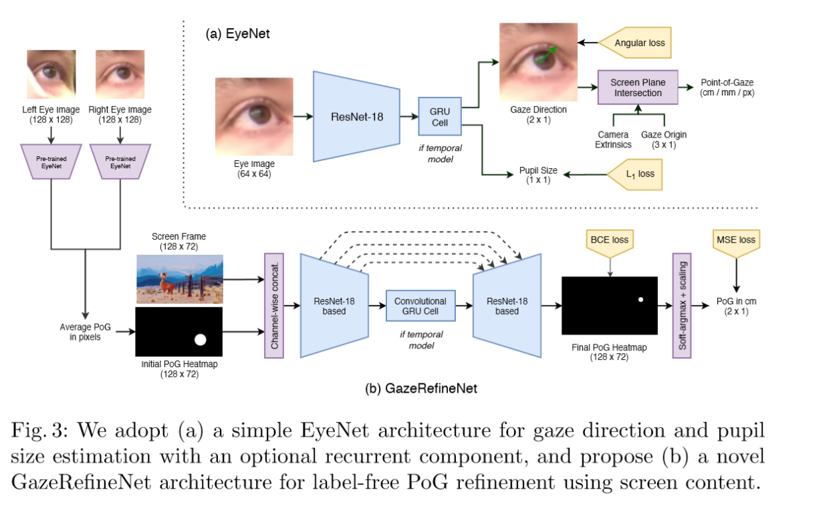
Xucong Zhang
2020 Towards End-to-end Video-based Eye-Tracking
Code和dataset coming soon

Slide 13
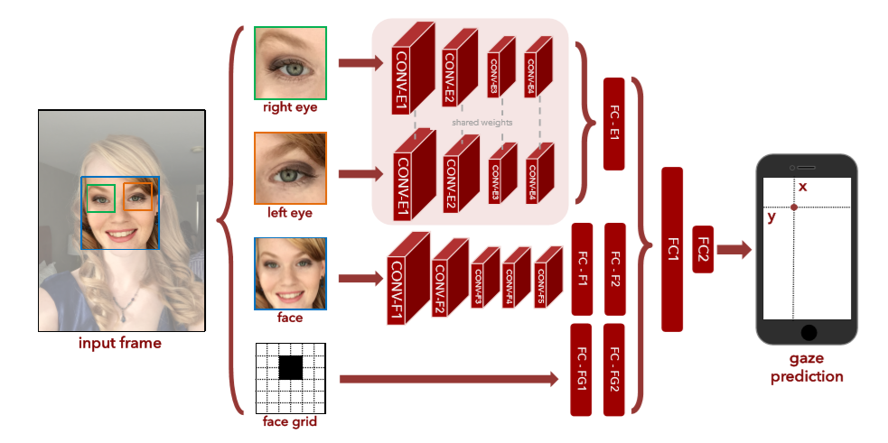
手机端

Slide 14
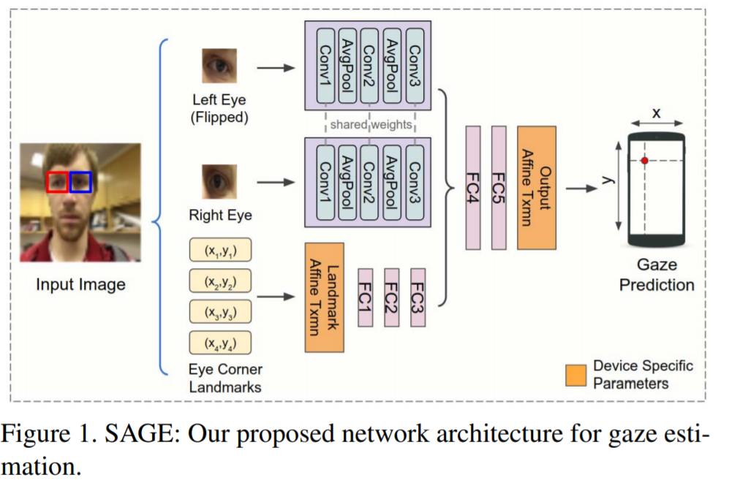
手机端
Google对上述模型做了进一步压缩，即将人脸和人脸位置这两个输入替换为四个眼角的位置坐标

Slide 15
Xucong Zhang
1.数据集收集困难
2.数据集的标注本身有问题，影响了正确率的提升

Slide 16
Xucong Zhang
数据集收集困难
使用GAN合成眼部数据。微软剑桥研究院的Erroll Wood博士在读博期间曾尝试使用计算机图形学的方法来合成眼睛样本[1]，并公开了相关数据集。其中UnityEyes数据集因其真实性及丰富的标签信息（关键点位置）已经是gaze领域十分重要的数据集。
[1] Wood, E., Baltrušaitis, T., Morency, L.-P., Robinson, P., and Bulling, A. (2016b). Learning an appearance-based gaze estimator from one million synthesised images. In Proceedings of the Ninth Biennial ACM Symposium on Eye Tracking Research & Applications (ETRA), pages 131–138.

Slide 17
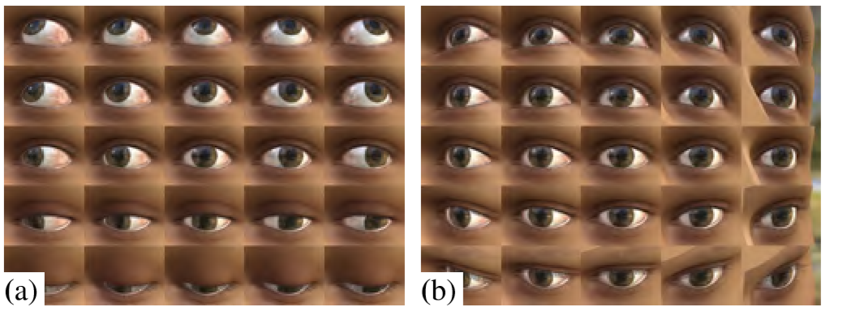
Xucong Zhang
UnityEyes

Slide 18
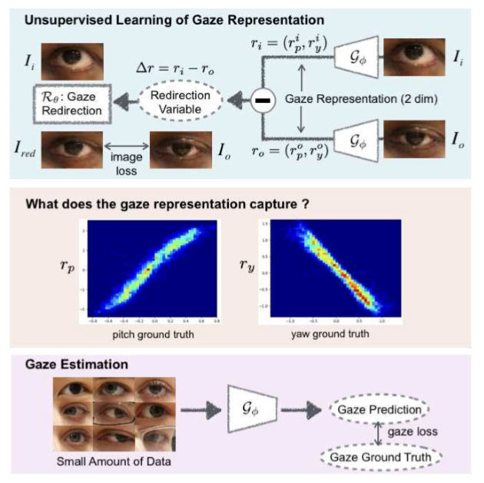
Idiap
2020 Unsupervised Representation Learning for Gaze Estimation

