Slide 1
Gaze Profile Changes in Search Behaviour
Supervised By:
Johannes Schwerdt
Presented by:
Rahul Chakli Nagaraja (rahul.chakli@st.ovgu.de)
Devesh Singh (devesh.singh@st.ovgu.de)
Madhu (madhu1@st.ovgu.de)
Zain Ul Abdeen (zain.ul@st.ovgu.de)
Olatunji Ojuko (saheed.ojuko@st.ovgu.de)

Slide 2
Introduction

Slide 3
Related works

Slide 4
Classification of Reading patterns

Slide 5
DataSet

Slide 6
Types of Models
The Pupil Data follows Multimodal Gaussian Distribution .

Slide 7
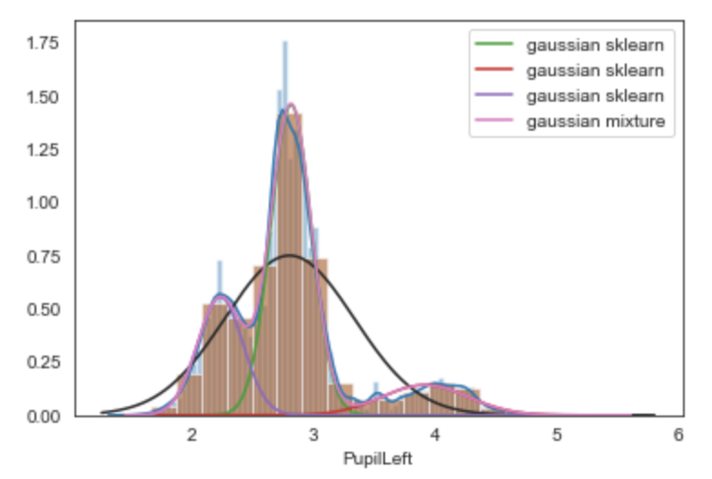
Pupil Data
Multiple peaks in pupil data distribution could represent people of different age, gender or having different level of concentration while reading.
We use Expectation Maximisation to find parameters of various peaks in the Multimodal Gaussian Distribution for various reading types.

Slide 8
Expectation Maximization for Gaussian Mixture Model:
Initialize mean, standard deviation and weights then calculate the log-likelihood with these values.
E-Step: Given current values of parameters find out probability of each point coming from each of the gaussian.
M-Step: Re-estimate the values of mean, standard deviation and weights to better fit the data points.
Calculate the log-likelihood again and if the change in log-likelihood is below some threshold level then stop, else repeat E and M step.

Slide 9
Feature Selection

Slide 10
Experiments

Slide 11
Results and conclusion

Slide 12
Summary and Future Works

Slide 13
References

Slide 14
Thank You
Questions?

