Slide 1
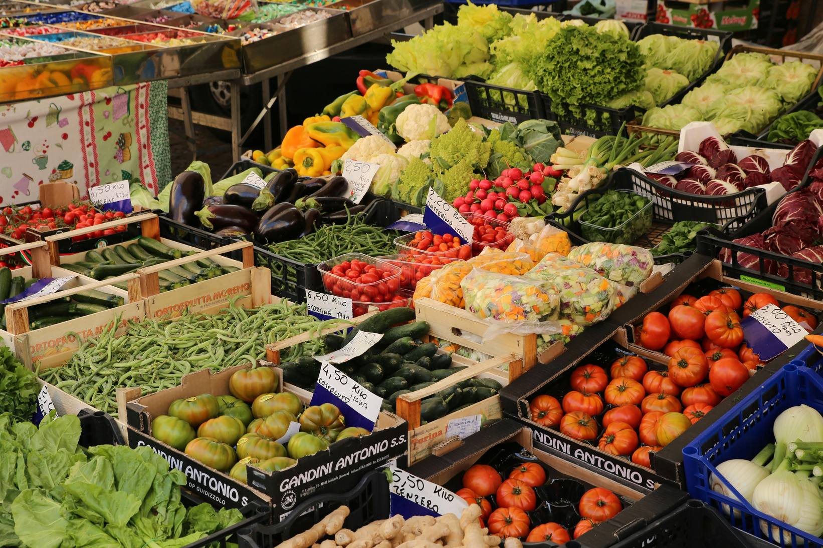
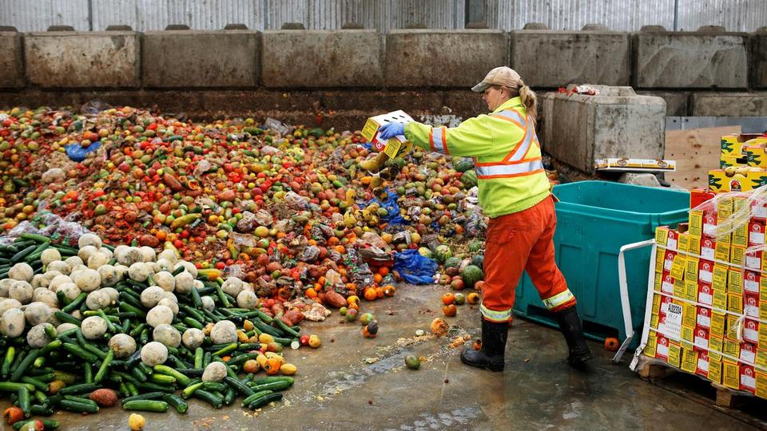
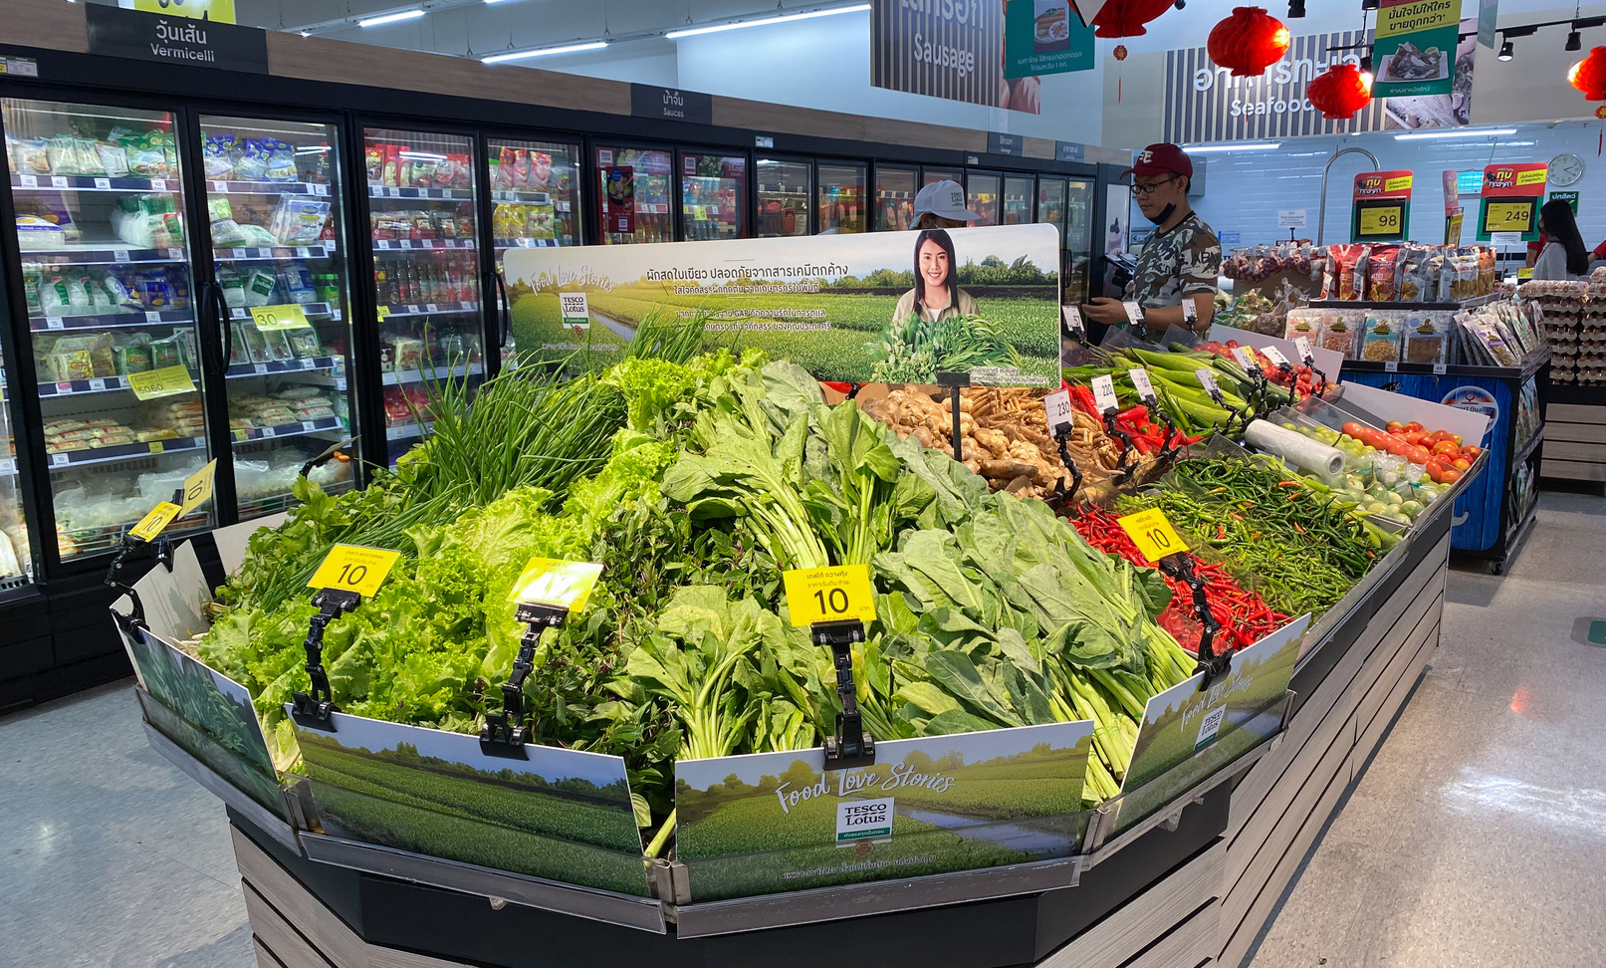
BLESSING OHAUKWU
FreshTrack
Turning Food Waste Into Smart Decisions

Slide 2
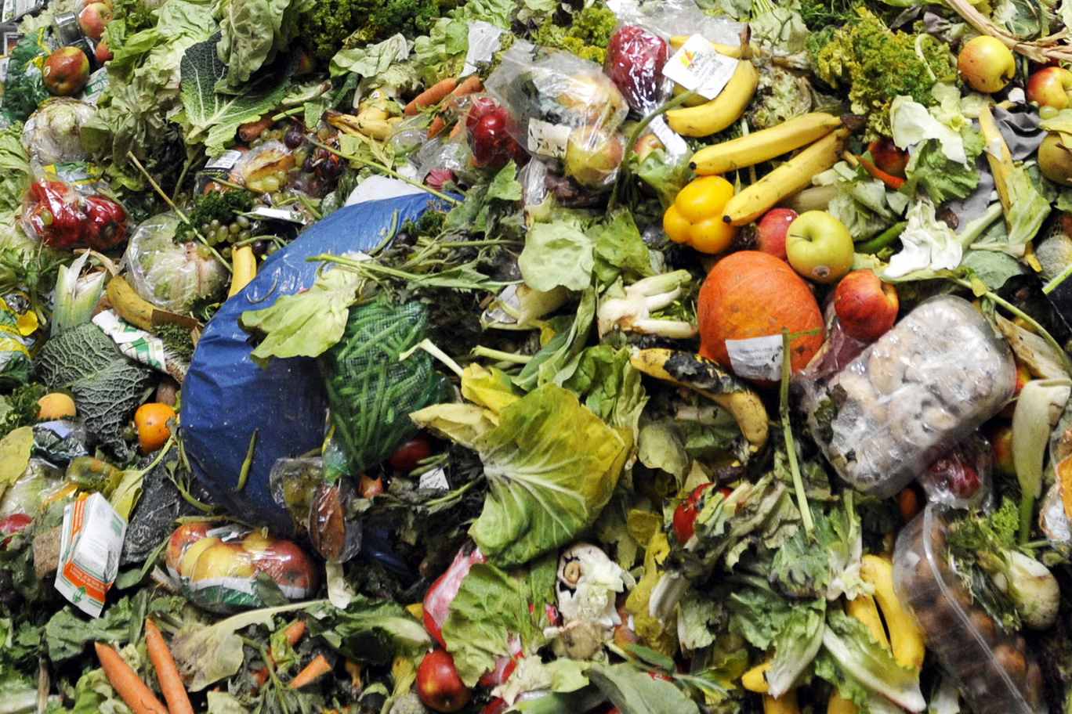
What if food waste could be predicted ?
  Millions of food items are produced, transported, and stocked.
  Some are never sold before they expire.
  Could data help us prevent this?

Slide 3
Food waste is often a supply and demand mismatch
  Overstocking
  Unpredictable demand
  Products reaching expiration
  Data stored in separate systems

Slide 4
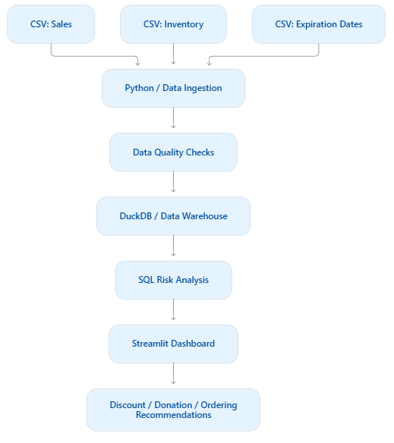
FreshTrack connects the data
FreshTrack Architecture
  Python: collects and cleans the data.
  SQL / DuckDB: combines sales, inventory, and expiry information.
  Airflow: schedules the pipeline to run daily.
  Dashboard: shows products at risk and recommended actions.

Slide 5
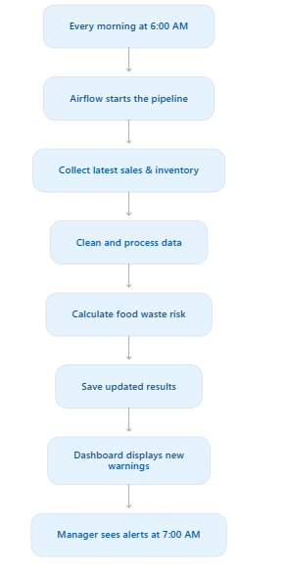
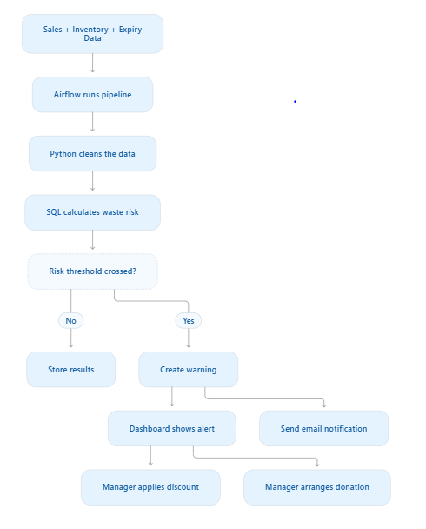
FreshTrack connects the data
Daily Arflow Schedule

Slide 6
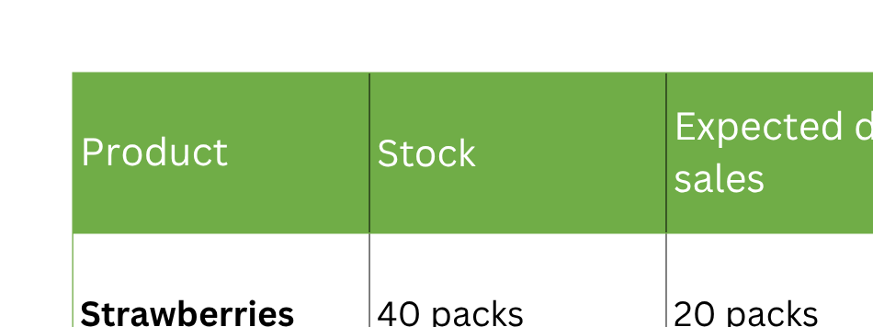
From raw data to an early warning
“If the supermarket has 40 packs but expects to sell only 20 before the expiration date, the system flags the extra stock as at risk.”

Slide 7
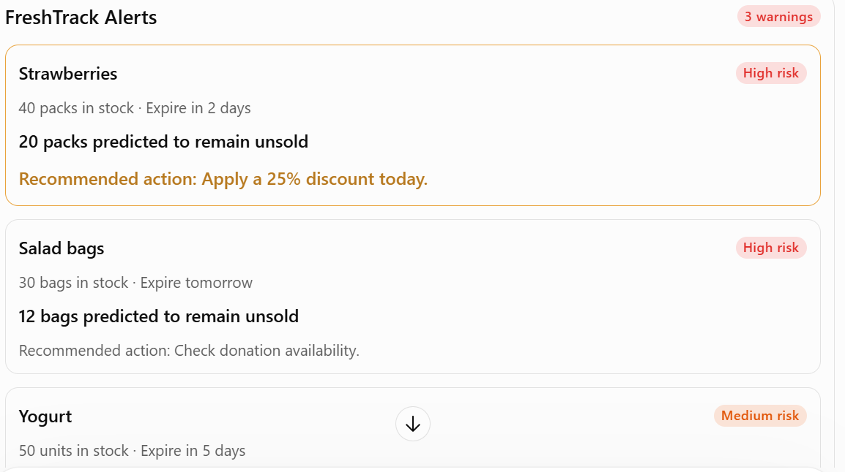
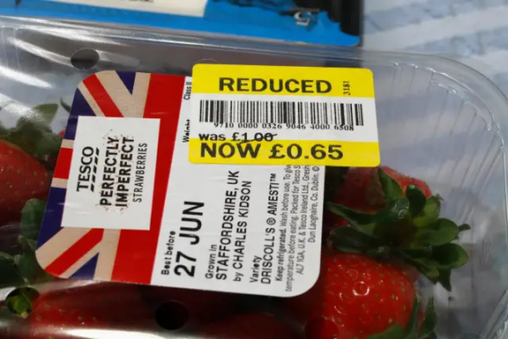
The system doesn't just report waste—it helps prevent it
  Dashboard Warnings
  Emails Notifications
  Mobile App Notifications

Slide 8
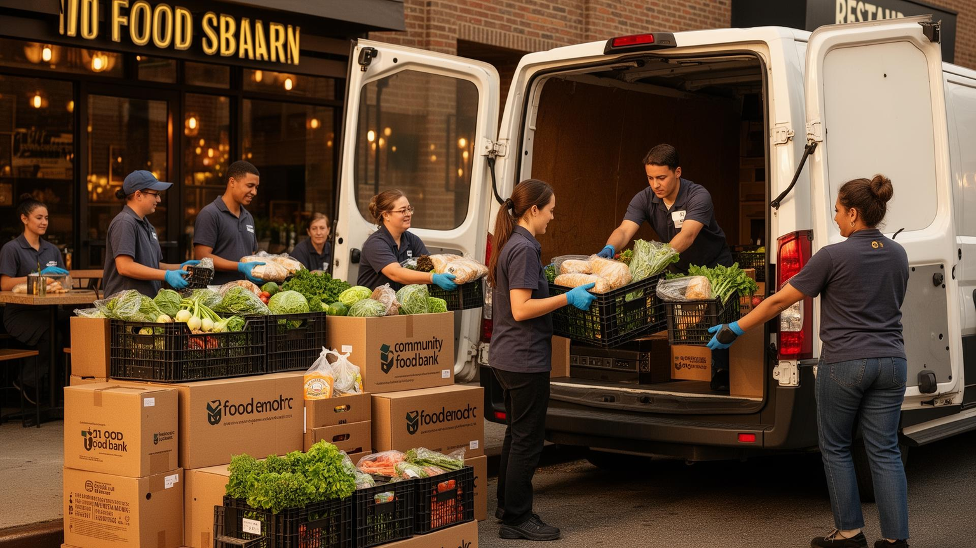
Better data. Less waste. More value.
  Less food discarded
  Lower costs for supermarkets
  More food available for donation
  Better decisions based on data

Slide 9
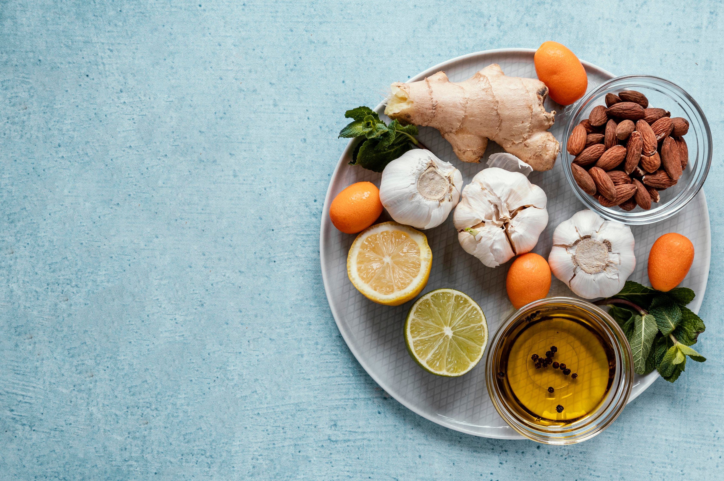
THANK YOU

